Slide 1
Navigating Distance Education
California Community Colleges Chancellor’s Office

Slide 2
Webinar Agenda
Introductions & Webinar Overview
Preparing for Distance Education
Distance Education Addendums
Examples from Columbia College
Resources & Support
Questions

Slide 3
Welcome & Introductions
Marty J. Alvarado, Executive Vice Chancellor of Educational Services & Support
Cheryl Aschenbach, ASCCC Curriculum Committee Chair
Lisa Beach, Director of Distance Education & DECO President
Pam Guerra-Schmidt, Academic Senate President
Aisha Lowe, Vice Chancellor Educational Services & Support
Joanna Miller, Dean of Distance Education
Brian Sanders, Vice President of Instruction & DEETAC Chair

Slide 4
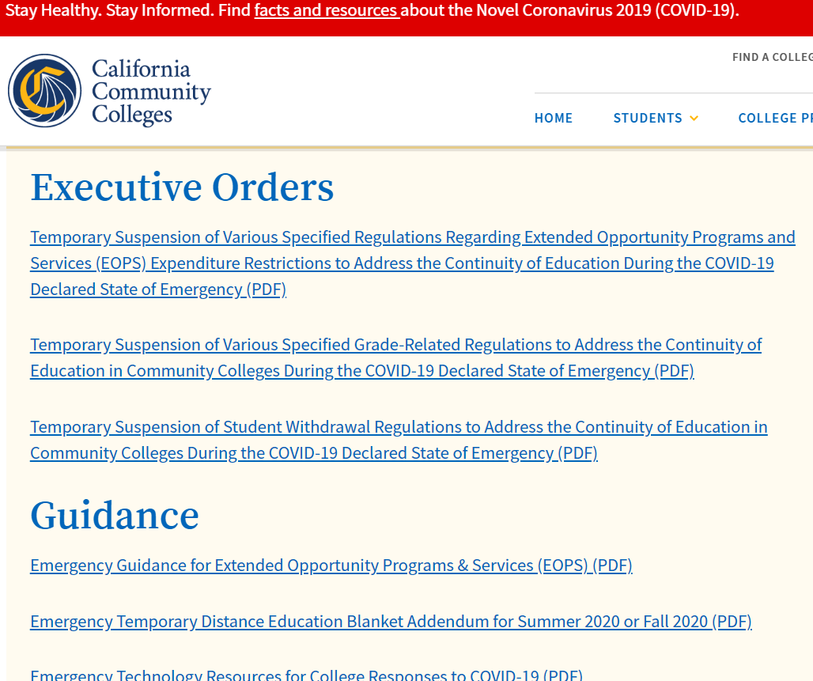
Preparing for Distance Education
Review local policies and adapt as needed
Review resource allocations for DE supports and infrastructure
Identify new interactions or roles that have helped in the transition for continuity
Name the impact or change desired as a result of professional development support
Name and make explicit the values that are central to your campus efforts
Notes:
● A change in power: There are designated positions—people with formal authority—responsible for the new activity (not just committed or skillful individuals who happen to care about it). ● A change in money: Routine funding is earmarked for the new activity in a new way—or, failing that, there is a pattern of recurring special funding on which most actors in the system can rely. ● A change in habits: Participants in a system interact with each other to carry out the new activity as part of their normal routine—not just in response to a special initiative, demonstration, or project. If top-level authorities have to “command” such interactions to take place, then the system has not absorbed them, and thus has not yet changed. ● A change in technology or skills: There is a growing cadre of skilled practitioners at most or all levels in the delivery chain, practicing methods that were not previously common or considered desirable. These practitioners are now expert in the skills that the new system demands and have set a standard for effective delivery of the new system’s intended results. ● A change in ideas or values: There is a new definition of performance or success, and often a new understanding of the people to be served and the problem to be solved. The new definition and understanding are common

Slide 5
DE Addendum
Memorandum ES 20-12 Emergency Temporary Distance Education Blanket Addendum for Summer 2020 or Fall 2020
Submit separate requests for DE Blanket Addendum for Summer 2020 and Fall 2020.
Submission requires contact information and reason for the request.
Submission also requires four file uploads:
List of all courses covered by the addendum + all courses remaining F2F *
Plan for obtaining local approval of all courses in the addendum by December 30, 2020.
List of all programs that transition to more than 50% online. *
Plan for ongoing professional development
* Memo contains links to Excel forms with required course or program information fields

Slide 6
DE Addendum
Honor local processes and faculty input while contingency planning
If not COVID-19, it could be fire, snow, wind, power outages…
It’s okay to have DE Addendum for courses that are noted as applicable only in emergency situations (as temporary remote instruction), not regular offering via distance education.

Slide 7
ASCCC Resources
ASCCC currently is offering a variety of webinars, including small-group discipline-specific discussions and larger webinars on governance, remote teaching, and discipline-specific information
Visit www.asccc.org for a full list of webinars
Professional Development Series 3 & 4 is effective April 13-April 24
Additional webinars are being planned for April 24 and beyond
Visit the event page for recorded webinars and Powerpoints

Slide 8
Examples from the Field
How the Blanket DE Addendum is playing out at Columbia College

Slide 9
Leveraging Opportunities at Columbia College
OEI Consortium Member – Early adopters. OL increased significantly.
Guided Pathways Preparation – Simplified menu of courses and programs
15% reduction in course count (670 → 566)
19% reduction in programs (134 → 108)
Installing new curriculum system this year, finalizing this summer
Uploading all course information
Validating data course by course
Fall Curriculum Committee discussion
Frustration with adding DE approvals at last minute – always a rush
World of online instruction changed – DE now seems possible for most classes.
“Let’s get ahead and consider DE approvals for every course at 5-yr cyclical review.”

Slide 10
COVID-19 Crisis as Impetus for Improvement
Spring 2020 – “Git ‘er dun” approach
TRUST in faculty to achieve course learning goals
GROWTH MINDSET that students & faculty have capacity to succeed
Compared to OEI rubric – low level
Summer 2020 & Possibly Fall 2020 – VPI to the Faculty…
“Let’s take it up to medium level for summer.”
What does medium mean?
CCCCO and ACCJC now collaborating to ensure high quality and effectiveness
Use corequisite remediation for ongoing faculty training to take it up another notch in fall if restrictions continue.
Reminders
We are GOOD at online instruction!
We’ve been doing this a LONG time!

Slide 11
Columbia College DE Challenge
Academic & Professional Matters
Establish what “medium” looks like for summer.
Establish a plan for intensive DE Approval over summer.
Fund Curriculum Chair and DE Coordinator for prep work
Provide faculty stipends for a “DE Work Party” for 1-2 days
Double-check data on all courses
Approve all applicable DE modalities for all courses possible
Finalize “the tough ones” in the early fall
By end of September, 90%+ of courses fully approved for DE

Slide 12
Academic Senate – Taking up the Challenge
Important note: The Academic Senate is still discussing these processes.
What does “medium” mean?
Convened DE Committee
Establish consistency for students
Use Canvas as at least a launching point
Use Canvas to capture regular effective contact
Continue improving accessibility
Allow/support significant variability in how content is conveyed to students
OEI-aligned modules
Zoom lectures
Annotated PowerPoint presentations
Publisher content
And more

Slide 13
Modernizing DE Approvals
Past: Prior system’s DE Addendum evolved over time
Future: Implement ASCCC Resolution 09.06 – New DE Definitions https://www.asccc.org/resolutions/support-new-distance-education-definitions
Less elaborate DE Addendum process
Use new ASCCC Definitions
FO – Fully Online
PO – Partially Online
OPA – Online with in-person Proctored Assessments
Added – FOMA – Fully Online with Mutual Agreement (e.g. science major labs)
Added – CE – Correspondence Education (for student inmates)

Slide 14
Developing Summer Process
Build fillable Easy DE Form for each course (vs. training all faculty on new system)
Division office staff assist to populate new forms with existing DE approvals
Support faculty to complete the Easy DE Form for each course & add all modalities that might be utilized
Collect & sort Easy DE Forms
Determine date(s) for summer Curriculum Committee DE Work Party
Use DE Work Party as intensive training for Curriculum Committee
Members review each course’s data
Members upload DE types and details
Committee approves uploaded DE types and details
“Tough ones” delayed until fall for broader discussion as needed

Slide 15
Distance Education Collaboration and Resources in Statewide Committees
Notes:
o Joanna & Lisa to walk through the resources available via the committees and the work on distance education to date

Slide 16
Distance Education and Educational Technology Committee Purpose and Composition
DEETAC Charter: Advise and recommend to the CCC Chancellor’s Office on matters of Distance Education and Educational Technology
DEETAC Membership - Representative appointed by statewide organizations:
ASCCC (Kathy O’Connor, Geoffrey Dyer, Deborah Nolan) CAPED (Thad Selmants) CCC Tech Connect (Heather Schmidt) CCL (Susan Hines) CCLC BOT (Laura Casas) CEOs (Tammeil Gilkerson) CIOs (vacant) CISOA (Joe Moreau) | CSSO (vacant) CVC-OEI (Jodie Steeley) DECO (Lisa Beach / Joanna Miller) RP Group (vacant) Student Senate (vacant) CCCCO o Educational Services (Erin Larson) o DSPS (Linda Vann) o DII (Russell Grant)

Slide 17
DEETAC Role in Title 5 Revisions Section 55200 - 55208
Committee drafted revisions with guidance from Constituency Groups and CO
Status: Title 5 revisions approved Feb. 15, 2019
Committee drafted Distance Education Guidelines with guidance from Constituency Groups and CO≈
Status: Awaiting CO vetting and release later this year

Slide 18
Title 5, Section 55204, Instructor Contact
In addition to requirements of section 55002 and any locally established requirements
applicable to all courses, district governing boards shall ensure that:
a) Any portion of a course conducted through distance education includes regular effective contact between instructor and students, and among students, either
synchronously or asynchronously, through group or individual meetings,
orientation and review sessions, supplemental seminar or study sessions, field
trips, library workshops, telephone contact, voice mail, e-mail, or other activities.
Regular effective contact is an academic and professional matter pursuant to
sections 53200 et seq.
b) Any portion of a course provided through distance education is conducted
consistent with guidelines issued by the Chancellor pursuant to section 409 of the
Procedures and Standing Orders of the Board of Governors.

Slide 19
Title 5, Section 55206, Separate Course Approval
If any portion of instruction in a new or existing course is provided via distance education, an addendum to the official course outline of record shall be required.
In addition to addressing how course outcomes will be achieved in a distance education mode, the addendum shall at a minimum specify how the portion of instruction delivered via distance education meets:
a) Regular and effective contact between instructors and students and among students as referenced in title 5, section 55204(a), and
b) Requirements of the Americans with Disabilities Act (42 U.S.C Section 12100 et seq.) and section 508 of the Rehabilitation Act of 1973, as amended,
The addendum shall be separately approved according to the district's adopted
curriculum approval procedures.

Slide 20
DRAFT Distance Education Guidelines
Draft 2020 DE Guidelines, pending approval from the CCCO, are posted on the CCC DECO Vision Resource Center site.
The site requires that you set up an account, but provides a location for saved conversations and resources.
Log into the Vision Resource Center, and go to ‘Connect’ and find Distance Education Coordinators

Slide 21
Local DE Addenda Approvals
Examine your current DE Addendum form for requirements. Three requirements needed to satisfy 55206 are:
Specify how course outcomes will be achieved in a distance education mode
Specify how the portion of instruction delivered via distance education meets requirements for regular and effective contact between instructors and students and among students as referenced in title 5, section 55204(a), and
Specify how requirements of the Americans with Disabilities Act (42 U.S.C Section 12100 et seq.) and section 508 of the Rehabilitation Act of 1973, as amended

Slide 22
Moving from Emergency Blanket to Local Approval
Is approval for emergency circumstances only?
If so, does your campus need a new DE Addendum form, or will a checkbox on the current form work?
How will you define emergency circumstances?
If new approvals are not restricted to emergency circumstances, how will you expedite approval through your local process by the Dec. 30 deadline?

Slide 23
Suggestions for working with Curriculum Committees
Discuss with Curriculum Committee Chairs:
Does your local committee have a plan for moving courses approved under the Blanket Emergency Addendum to local course approval?
Would your local committee consider batches of DE Addenda divided by departments, disciplines, or other criteria?
Does your local committee need a primer or presentation on Separate Course Approval?

Slide 24
DE Addendum Samples
Santa Barbara https://drive.google.com/file/d/1MW13gDbPTrUoOsRRmtTtlV1sWYy4qnPB/view?usp=sharingCity College DE Addendum
Link to Modesto Junior College DE Addendum
Taft Community College DE Addendum
Link to Southwestern College DE Addendum

Slide 25
Sample Campus Policies/Guides for Regular Effective Contact
Coastline Community College Online Instruction Guidelines
Diablo Valley College Policy on Regular & Effective Contact
Laney College Information on Regular and Effective Contact with Examples

Slide 26
CCC Distance Education Coordinators Organization
Executive Board:
Lisa Beach, President
Rebecca Pang, Treasurer
Rhiannon Lares, Web Designer
Kandace Knudson, Secretary
Christina Davis, PIO
Joanna Miller, Vice President
General Membership:
197 DE Coordinators and DE Staff from California Community Colleges

Slide 27
CCC DECO
Focused on CCC Distance Education Issues
197 members
Monthly online meetings with relevant speakers and lively chat discussions
Surveys and results from across the system
Website with timely resources and membership information (cccdeco.org)
DE-ALL listserv discussions (ask your IT department to add you)
Annual Retreat during the Online Teaching Conference

Slide 28
Thank you!

