Slide 1
Navigating the College Culture
Silvester Henderson, ASCCC At-Large Representative Don Hopkins, ASCCC Part-Time Committee, Folsom Lake College
Newport Beach Marriot Hotel
900 Newport Center Drive Newport Beach, Ca 92660
February 21-23, 2019

Slide 2
PRESENTATION HIGHLIGHTS
College Mission Statement
Employment Contract – Review
Academic Department – Review
Authority of the Academic Senate
Academic Senate - Visit your Campus Academic Senate
10+1 & the College Culture
Academic Acumen – High Level forms of Communication Skills – Diplomacy
Build Department & Campus Professional Relationships
What “Unique” skills do Academic Curricular Innovators possess?
Create Professional Goals
Questions
Notes:
Ask faculty who is in the room. Maybe have each one say where they are from, what discipline, how long they have taught and DO they want a full time position or are they happy with Part Time. What else do they do besides teach?

Slide 3
College Mission Statements
What is a Mission Statement?
Mission statement definition is something that states the purpose or goal of a business or organization. How to use mission statement in a sentence.
https://www.merriam-webster.com/dictionary/mission%20statement
Notes:
Ask faculty who is in the room. Maybe have each one say where they are from, what discipline, how long they have taught and DO they want a full time position or are they happy with Part Time. What else do they do besides teach?

Slide 4
Employment Contract
1. Evaluate your Employment Contract 2. Pay close attention to the Section for Adjuncts.
3. Ask Questions?
Notes:
I will have 10+1 cards to give out at the breakout.

Slide 5
Academic Department
1. Evaluate the Curricular Offerings 2. Full time Faculty vs Part Time Governance Practices?
3. Department Guidelines versus Employment Contract
Notes:
I will have 10+1 cards to give out at the breakout.

Slide 6
Authority of Senate
Ed Code 70901(b)(1)(E)
Minimum standards governing procedures established by governing boards of community college districts to ensure faculty, staff, and students the right to participate effectively in district and college governance, and the opportunity to express their opinions at the campus level and to ensure that these opinions are given every reasonable consideration, and the right of academic senates to assume primary responsibility for making recommendations in the areas of curriculum and academic standards.
Ed Code 70902(b)(7)
Establish procedures that are consistent with minimum standards established by the board of governors to ensure faculty, staff, and students the opportunity to express their opinions at the campus level, to ensure that these opinions are given every reasonable consideration, to ensure the right to participate effectively in district and college governance, and to ensure the right of academic senates to assume primary responsibility for making recommendations in the areas of curriculum and academic standards.

Slide 7
+
Academic Senate
The Academic Senate is the exclusive representative of faculty for academic and professional matters as defined in the California Education Code and in Title 5 of the Administrative Code of California.
http://www.napavalley.edu/Committees/AS/Pages/RoleoftheAcademicSenate.aspx
Notes:
I will have 10+1 cards to give out at the breakout.

Slide 8
Academic and Professional Matters 10+1
Title 5 §53200 (c)
“Academic and professional matters” means the following policy development and implementation matters
Curriculum, including establishing prerequisites
Degree & Certificate Requirements
Grading Policies
Educational Program Development
Standards & Policies regarding Student Preparation and Success

Slide 9
Academic and Professional Matters 10+1 (Continue)
College governance structures, as related to faculty roles
Faculty roles and involvement in accreditation process
Policies for faculty professional development activities
Processes for program review
Processes for institutional planning and budget development
...Other academic and professional matters as mutually agreed upon.

Slide 10
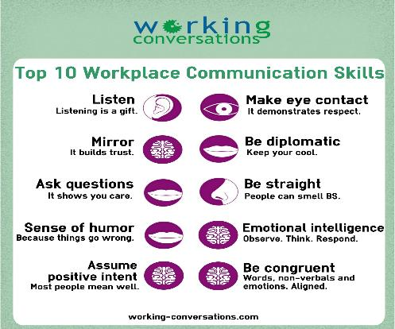
Academic Acumen – High Level Communication Skills- Diplomacy

Slide 11
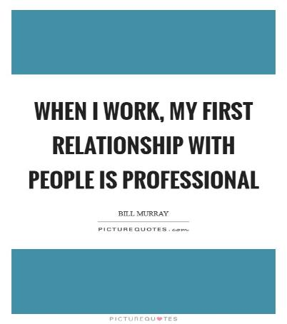
Build Department & Campus Professional Relationships

Slide 12
What “Unique” skills do Academic Curricular Innovators possess?
Curricular innovators are skilled in the following:
− identifying compelling reasons for change
− building shared goals and setting direction
− creating a climate of professional inquiry
− empowering and developing others
− being imaginative and systematic
− embedding and sustaining change
Source:
http://apps.nationalcollege.org.uk/resources/modules/curriculum/Leadership/Entries/2013/1/1_Why_Curriculum_Innovation_Matters.html

Slide 13
Create Professional Goals

Slide 14
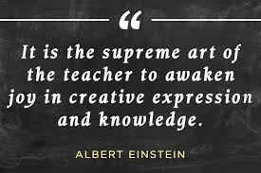
Questions & Comments
Please feel free to contact each of us for more information.
Silvester Henderson shenderson@losmedanos.edu Don Hopkins hopkind@flc.losrios.edu

