Slide 1
Navigating the College Culture
Andrew Delunas, Part Time Faculty Gavilan College
Conan McKay, ASCCC Area B Representative

Slide 2
Temperature Check
New Part Time Faculty
Two-Five Years Teaching Part Time
Six to Ten Years Teaching Part Time
More than Eleven years
Teaching at Multiple Colleges and Districts
Notes:
Ask faculty who is in the room. Maybe have each one say where they are from, what discipline, how long they have taught and DO they want a full time position or are they happy with Part Time. What else do they do besides teach?

Slide 3
Outcomes
Where to locate AP and BP on various College Webpages
Understand the ASCCC 10+1 and does your college rely primarily or mutually agree
College culture of campuses towards Part Time Faculty
Notes:
I will have 10+1 cards to give out at the breakout.

Slide 4
Administrative Policy and Board Policy
All but one district adopts board policies from the Community College League of California
Board Policies: Board Policies govern the college and provides directions on specific areas. Board Policies are legal documents.
Administrative Policies: Gives specific details on how to implement Board Policies

Slide 5
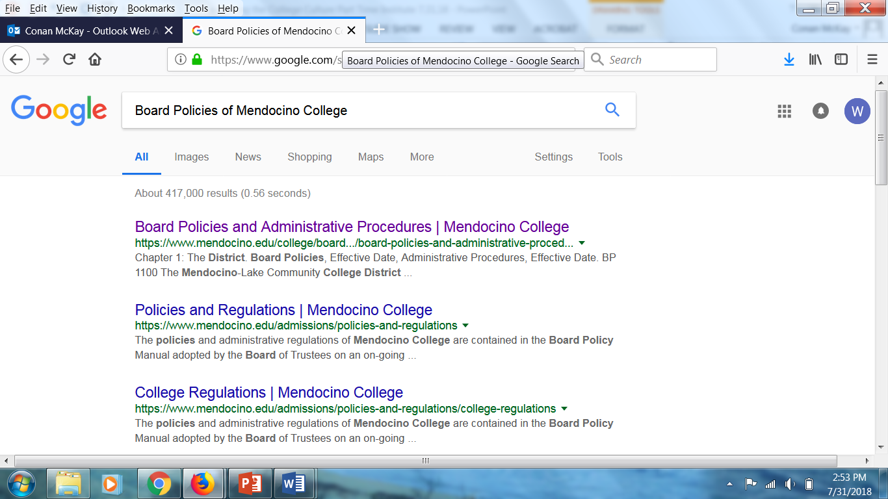
AP and BP continued.
Every college has their APs and BPs in different locations. The easiest way to look up the colleges AP’s and BP’s

Slide 6
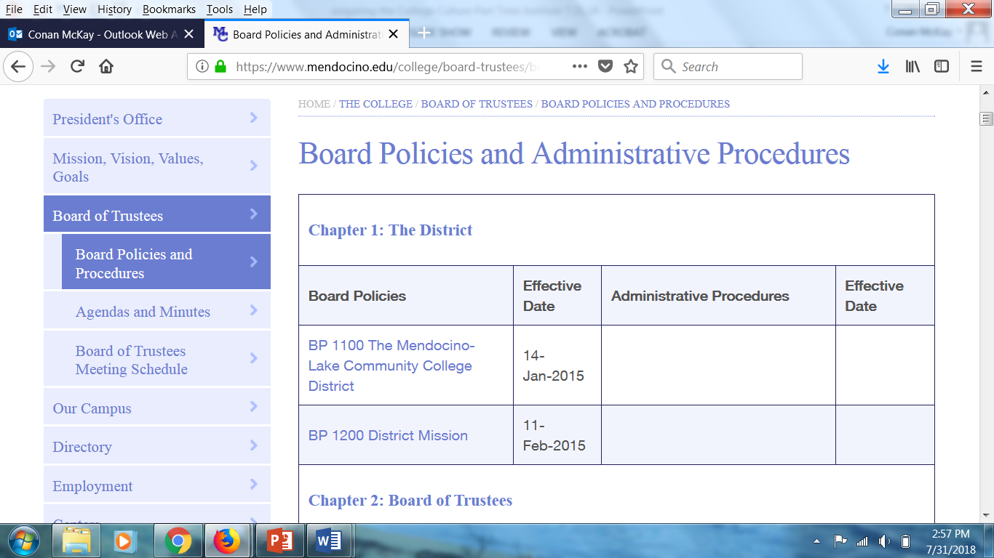
AP and BP Continued

Slide 7
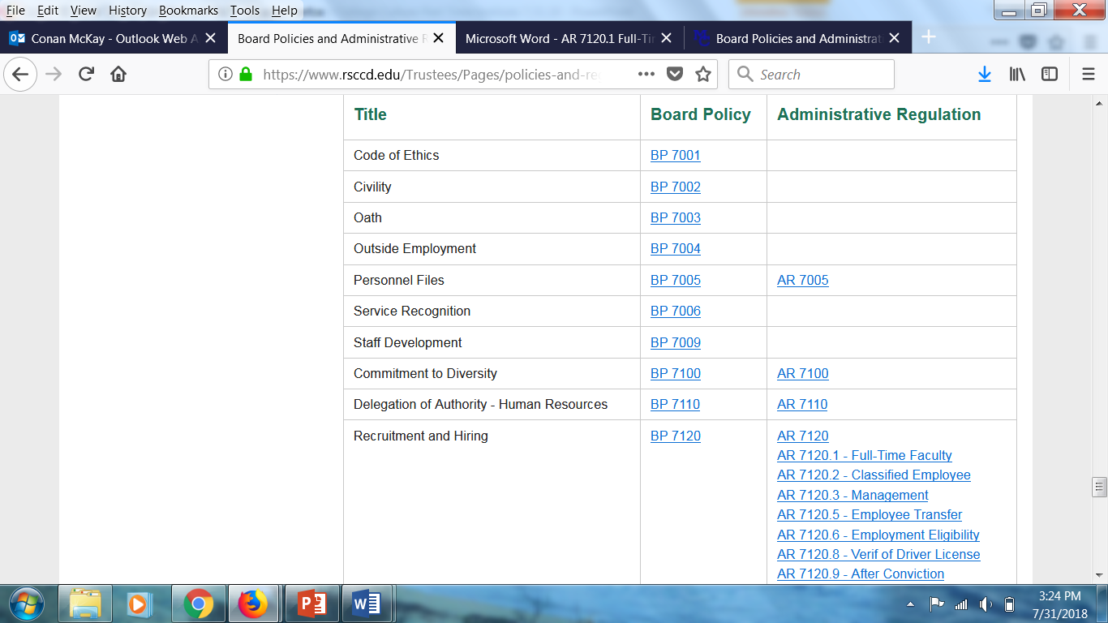
AP and BP Continued
All colleges have a BP on how they will conduct their hiring process.
Typically the hiring process will be in the 7000s and in Chapter 7

Slide 8
Campus Culture
All California Community College relay primarily upon the 42,000 part time faculty to teach the 2.1 million students in the system.
Approximately 67% of all courses are taught by Part Time Faculty across the California Community College system.
Often Part Time Faculty teach lower division classes and are the first face students meet on campus
Women make up a slightly lower percentage of the part-time faculty ranks compared to their male counterparts
All statistics taken from the FACCC report on Part-Time and Full-Time faculty, located at http://www.faccc.org/wp-content/uploads/2014/11/2012facprofile_report_final.pdf

Slide 9
Campus Culture
Are Part Time Faculty allowed to serve on campus-wide committees?
What are your Part Time faculty called and how does that affect the Part Time moral?
Are Part Time Faculty automatically put in the hiring pool if they have taught at the school for X amount of years?
Is that in your AP or just historical practice? Should it be in the AP?
Are Part Time Faculty allowed to serve on the local senate?
Are Part Time faculty encouraged to sign up for State wide Senate Committees?
Notes:
I am hoping to get lots of discussion on this slide. How various colleges encourage their PT to participate

Slide 10
Campus Culture
Many Part Time Faculty are not compensated for office hours.
Many Part Time faculty do not have rehire rights
Many Part Time faculty are delegated to either night classes or have little to no say what they are teaching

Slide 11
Thank you and Questions
Andrew Delunas adelunas@hartnell.edu
Conan McKay cmckay@Mendocino.edu

