Slide 1
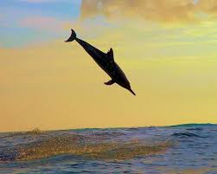
New ALO Training
February 22, 2018

Slide 2
Welcome and Introductions
Your Facilitators
Your role at the college
What do you expect to gain by attending this session?
What burning questions do you have?
Notes:
30 min. – introduce to table – 5 min.

Slide 3
ACCJC New Directions, Philosophy
Dual purpose of compliance and improvement
Approach to Peer Review
Mission centered
Portfolio model
Notes:
20 minutes - Fluid environment of college and ACCJC

Slide 4
Role of the ALO
Policy on Role of ALO and your role at college
What makes an effective ALO?
Notes:
15 min - ACCJC job description, your day job, how strengthen each other?
What are qualifications, knowledge, why did the President choose you?
Who are the key players you engage with in accreditation? CEO, CIO, Senate President, governance committees
College culture matters --

Slide 5
Responsibilities
Ongoing: Annual Report, Annual Fiscal Report, Subchange
Every 7 years: ISER
Every 4th year: Midterm Report
As needed: Follow up reports, special reports
Communications (internal & ACCJC)
Notes:
5 min -

Slide 6
ALO – The Standards Expert (Unpacking the Standards)
II.A.1 All instructional programs, regardless of location or means of delivery, including distance education and correspondence education, are offered in fields of study consistent with the institution’s mission, are appropriate to higher education, and culminate in student attainment of identified student learning outcomes, and achievement of degrees, certificates, employment, or transfer to other higher education programs. (ER 9 and ER 11)

Slide 7
Annual Reporting
Purpose of Annual Report
Purpose of Annual Fiscal Report
Forms
Instructions
Timing
Notes:
20 min

Slide 8
Substantive Change Process
Overview
Purpose
Prompts
Inquiry Form
Process
Notes:
30 min -

Slide 9
But wait, there’s more…
ISER – ISER training 2 years out and Advance ISER training
Follow up reports
Baccalaureates
More
More
More
Notes:
5 min -

Slide 10
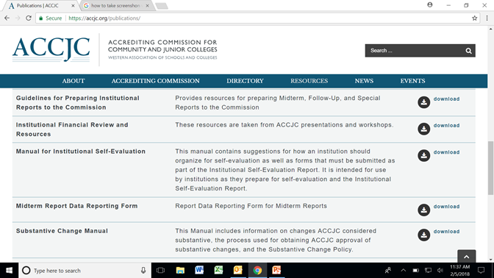
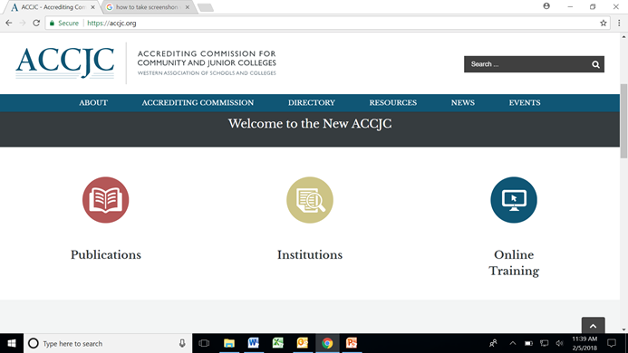
Resources
Notes:
3 min - Website, Manuals, CALL VP – emphasize availability and desire to support

Slide 11
Thought Experiment
1st - Think of a challenge you’ve encountered
2nd -Describe that challenge to your group
3rd – Choose which challenge to work on
4th - share strategies for solutions
Notes:
Split tables,
Outcome: focus on Relationships, leadership

Slide 12
Thoughts and Remaining Questions
Notes:
20 min -

