Slide 1
New Peer Reviewer Training Spring 2018
Ginni May, Sacramento City College and ASCCC
Steve Reynolds, ACCJC Vice President
Notes:
Room set up:
Chairs in groups of six to eight, or grouped around tables.
Projector and screen
Laptop hookup for PowerPoint
WiFi access

Slide 2
Welcome and Introductions
Welcome to New Reviewer Training!
Introduction of Facilitators
Introduction of Mentors
Why volunteer to be a peer reviewer?
Table Introductions
Notes:
MENTORS:
Hopefully in each group there will be at least one person who has been on a team who will be willing to share his or her experience. We can find these people from the sign-up sheet.

Slide 3
Agenda
On the Topic of Peer Review . . .
ERs, Standards, and Resources
The Review Process
Interviewing Techniques
The Evaluation Report
Evaluating the College: Triangulation of Data
Unexpected Situations
Open Discussion, Questions and Answers
Notes:
Brief review of the topics for discussion

Slide 4
Training Outcomes
Upon completion of this workshop, participants will be able to—
Understand the dual purpose of the peer review model: compliance and improvement.
Appreciate the role and responsibilities of a peer reviewer.
Evaluate an institution according to standards, within the context of the institution’s mission.
Write clear reports as the basis for the Commission’s consistent decision-making.
Notes:
Brief overview of expected outcomes

Slide 5
Background on Peer Review
The most appropriate and desirable approach to evaluate the complex environment of higher education
Process that uses academic inquiry to inform practices for quality improvement, based on evidence
Results are used to allow for the evolution of policies and practices
Frequently at odds with governmentally directed evaluation, which often relies on standardization of expectations (CHEA, 2016)
Notes:
Explain the importance of peer review, why/how it’s valid, relevant for higher education, and value-adding for institutions and professional development.
Explain the alternative—if not peer, then who?
A government agency, which is how it is done in most countries. Can a Ministry of Education do a better job than higher ed professionals when it comes to assessing institutional quality and encouraging improvement?

Slide 6
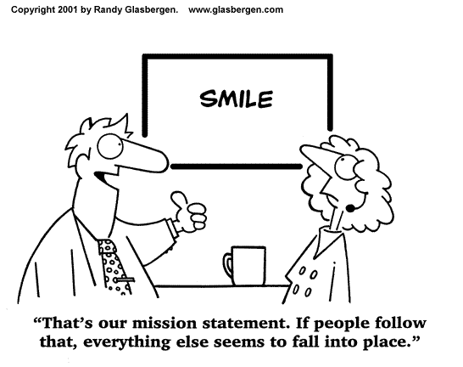
ACCJC Philosophy on Peer Review
Approaching the review with the right frame of mind
Celebrate the college, help the college, support the college
Mission-centered
Culture and environment
ACCJC staff role in the review
Notes:
Mentors can share experiences of how on a visit they have
Celebrated the college
Helped the college
Supported the college
Talk about the diversity of institutions in our region.
Discuss the new protocol: ACCJC vice presidents will accompany the teams on the visit.
To help the team to help the college
To support consistency in assessing of college strengths and weaknesses
To ensure that the team’s recommendations are supported by the team’s findings
To assist both the team and the college during the visit

Slide 7
Expectations of Peer Reviewers
Have a working knowledge of ACCJC Eligibility Requirements, Accreditation Standards, Commission policies, and relevant federal regulations
Review the college in the context of its mission
Remain objective, flexible, and refrain from imposing personal opinions and beliefs
Have strong analytical skills
Represent the Commission and the peer review process
Develop relationships with college personnel – take the fear out of the process
Communicate clearly and concisely, orally and in writing
Work as part of a team
Notes:
Facilitators can tag-team a quick review of these points.
Fairly self-explanatory

Slide 8
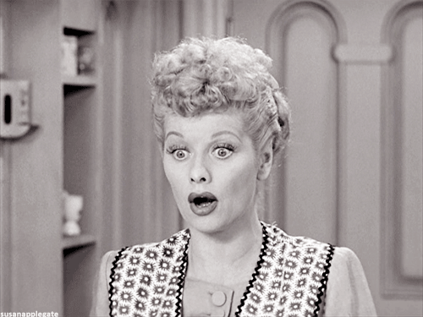
Eligibility Requirements, Accreditation Standards, and Commission Policies – Oh, My!
ERs
Standards
I: Mission, Academic Quality and Institutional Effectiveness, and Integrity
II: Student Learning and Support Services
III: Resources
IV: Leadership and Governance
Policies Cover Federal Regulations
Resources
ACCJC Website
Notes:
21 Eligibility Requirements: The basics. If an institution does not have these, it isn’t a college. 5 ERs must be addressed separately. The other 16 are covered within the analysis of the Standards.
4 Standards divided into 14 sections. 128 mini-standards. Explain how the Commissioners are trying to move into a more holistic review of colleges using the larger overarching standards (the 14). Known as the “new taxonomy.” Still, team members will still be required to report their findings on the 128 mini-standards. Their findings and conclusions will help the Commissioners to make the larger, more holistically based decisions.
The policies are reviewed as a checklist. The USDE is strict in holding accrediting agencies (peer reviewers) accountable for ensuring that colleges satisfy these regulations. For example: ensuring that Distance Education and Correspondence Education are clearly delineated at a college.
Click the link to show the participants the resources that are available.

Slide 9
The Review Process
Selection of chair and team staffing
Materials sent to team
Team training
Assignments 1 & 2
Team assignment
Site visit
Completion of report
Sent to ACCJC staff
Sent to CEO for corrections on errors of facts
Notes:
Possible discussion points:
What materials are sent to the team (Steve)
What is a team member’s reaction to the materials (Ginni)
Describe general assigning of assignments: who gets what. (Steve)
Describe expectations for Assignments 1 & 2 (the preparatory work before the visit) (Ginni)
Briefly zip through Site visit and the steps to complete the team report (Steve)

Slide 10
The Review Process Continued
Report is Finalized
Commission Meeting and Action
Mentors
What do you wish ACCJC would have told you regarding the work load?
Notes:
The Commission meets twice a year, January and June
Solicit Mentor feedback from the participants.
Before moving to Activity 1, review what happens prior to the Visit.

Slide 11
Activity 1
Outcome – to verify the information described in the ISER
Determine who you want to interview
Determine what questions you should ask
Determine what additional evidence is needed
Reading your assigned ISER excerpt, make a list of individuals or groups that need to be interviewed. What questions might you ask? What additional evidence, if appropriate, would you need to verify in order to write your findings?
Notes:
Half-hour with this handout.

Slide 12
Interviewing Techniques
Questioning
Open-ended, verify, reflect
What information do you need?
Listening
Responding
Body language (https://www.youtube.com/watch?v=p5WPVLljm1A)
Ask for examples
Seek clarification
Notes:
“Desk Review” of the evidence occurs before the visit. During the visit, conduct interviews to verify the initial findings and to fill in gaps for information you still need.
Prepare questions ahead of time.
Listen attentively and nonjudgmentally. Show the clip.

Slide 13
The Team Report (a.k.a. External Evaluation Report, or EER)
SECTIONS OF THE REPORT
General Observations
Findings and Evidence
Conclusions
Commendations
Recommendations
Notes:
What goes into the team report?

Slide 14
Activity 2 – Sample Team Reports
Outcome – to discover nuances of well-written Team Reports
Read the sample excerpts from peer review team reports.
Discuss your responses to the questions at the bottom of the page.

Slide 15
Activity 3 – Writing a Team Report
Outcomes –
Understand the writing process.
Evaluate the extent to which the college’s practices align with the Standards.
Appreciate the peer reviewer’s desire to help the college be a better institution.
Using the ISER excerpt from Activity 1, develop your initial thoughts for writing the team report. Use the template as a guide.
Notes:
How would you go about writing up this standard? What would you want to include?
When this slide opens, participants will not see the outcomes. Announce that we will reveal them when we discuss their responses to the activity.
Allow time for individual drafting, then small group discussion of issues and challenges.
Then click to reveal the outcomes, and discuss.

Slide 16
Triangulation: Validating Your Assumptions
The Standards
MISSION
Recurring Themes
Evidence
Documents
Observations
& Interviews
Notes:
Team members form assumptions regarding the extent to which a college’s practices are aligned to the Standards.
Be familiar with the Standards. Evaluate the college against the standards.
Evaluate how well the documentary evidence demonstrates that the college’s policies and practices are aligned to the standards.
Use observations and interviews to solidify your findings. Or use them to correct or revise your initial findings.
Keep the college’s mission at the center of the discussion. Avoid comparing the college to your own institution. Compare the college to the standards.
Share findings with the team. You will become aware of recurring themes across the standards. From these discussions, teams collaborate to write commendations and recommendations.

Slide 17
Reviewing a College According to the Standards: Do They Meet or Not Meet? That is the Question.
Exceeds the standard
Meets the standard
Does not meet the standard
Somewhat meets the standard????
Notes:
Discuss the difference between a holistic approach and parsing out all 127 mini-standards.
The College meets Standard II.C.
The College meets Standard II.C except Standard II.C.4.

Slide 18
Unexpected Situations that Teams Encounter
Stories from the field
Discuss Activity 4
Notes:
Stories:
Who has had a memorable experience on a site visit
When the documentary evidence lined up perfectly with interview data and observations?
When interviews and observations showed something very different from what was reported in the ISER or the evidence documents?
When interviews and observations actually showed that the college was doing better than revealed in the ISER or evidence documents?
Then try Activity 4

Slide 19
Training Outcomes (from the start)
Upon completion of this workshop, participants will be able to—
Understand the dual purpose of the peer review model: compliance and improvement.
Appreciate the role and responsibilities of a peer reviewer.
Evaluate an institution according to standards, within the context of the institution’s mission.
Write clear reports as the basis for the Commission’s consistent decision-making.
Notes:
So what do you think?

Slide 20
New Reviewer Round-Up
Table Debrief
What did you learn?
What questions or concerns do you have?
Next Steps – How do I get on a team?

