Slide 1
New Faculty Orientation
Dan Crump, American River College
Julie Oliver, Cosumnes River College
Instructional Design and Innovation 2017
San Jose, CA

Slide 2
Outcomes
Discuss content important to include in an orientation plan
Share experiences with new faculty orientation
Describe a orientation process at American River College
Share resources—handbooks, programs, websites, etc.

Slide 3
Fall 2001 Resolution 17.06
Whereas, The success of local academic senates and the Academic Senate for California Community Colleges are dependent upon new, energetic and informed faculty;
Whereas, It is important that local academic senates reach out to newly hired full-time and part-time faculty and educate them on the roles and responsibilities of their academic senates; and
Whereas, Most districts have in place a new faculty orientation process that may include orientation activities, new faculty handbooks and orientation materials;
Resolved, That the Academic Senate urge local academic senates to design and conduct faculty orientation processes including new faculty activities and appropriate representation of the roles of the academic senate in faculty handbooks and orientation materials.

Slide 4
Questions…
What information is important to share with new faculty?
How often should sessions occur—once, throughout a semester, etc?
What, if any, expectations are there for attendance?

Slide 5
New Faculty Orientations
B Based on a Presentation to the Los Rios Board of Trustees
by Heidi (Fuller) Bennett,
NFA Coordinator
Notes:
Tammy: Introduction

Slide 6
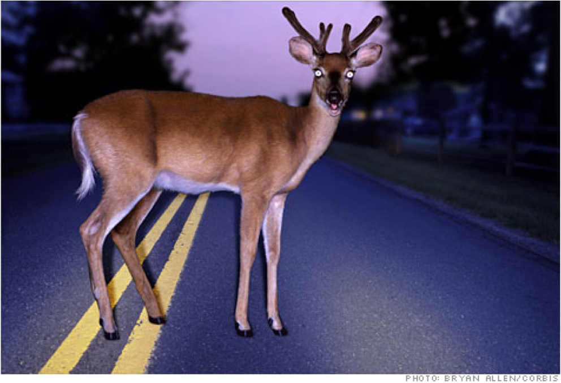
Welcome to ARC!
Notes:
Tammy: The needs!!

Slide 7
Notes:
Heidi: The Vision / Goals
The partnerships
Format
Content
The partnerships
Process
Communication
I
Website
Google Calendar of Events
Resources

Slide 8
NFA – First Year Experience
Fall
Spring
Year 2 Mentoring of new cohort
NFA Weekly Academy as a Cohort
.2 Release Time
Service Hours – Individual Learning Plan
Diversity in the Classroom: Reaching and Learning Institute
Online Teaching Institute
Periodic Cohort Gatherings
Individual Instructional Development
Notes:
What will this pilot look like?

Slide 9
“The Action”
Notes:
Tammy: Where to we go and how do we get there?

Slide 10
Partnerships
Center for Teaching and Learning | Instructional Technology | Academic Senate | Faculty Union
Notes:
Partnerships CTL, ITC, COP

Slide 11
Nuts and Bolts
Collaboration and Relationships
Notes:
Logisitic: The nuts and the bolts

Slide 12
Notes:
Faculty Orientations in the past

Slide 13
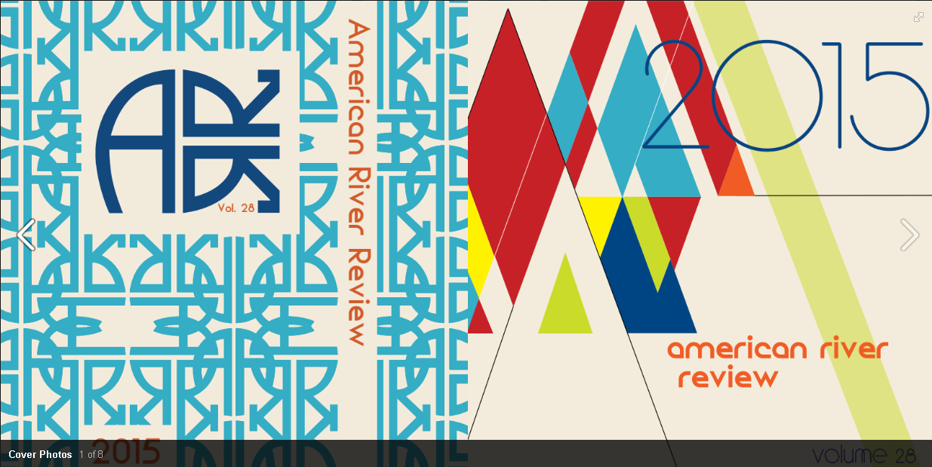
Notes:
CTL Provided resources that will help guide the work!

Slide 14
Notes:
The need for JITT and follow up from the “firehose”

Slide 15
Notes:
Building Connections and relationships

Slide 16
Basic Format
Weekly meetings
8am – 12pm
Set agendas
Student interaction
Classroom visitations
Social activities
Community involvement
Notes:
The format and overall schedule!

Slide 17
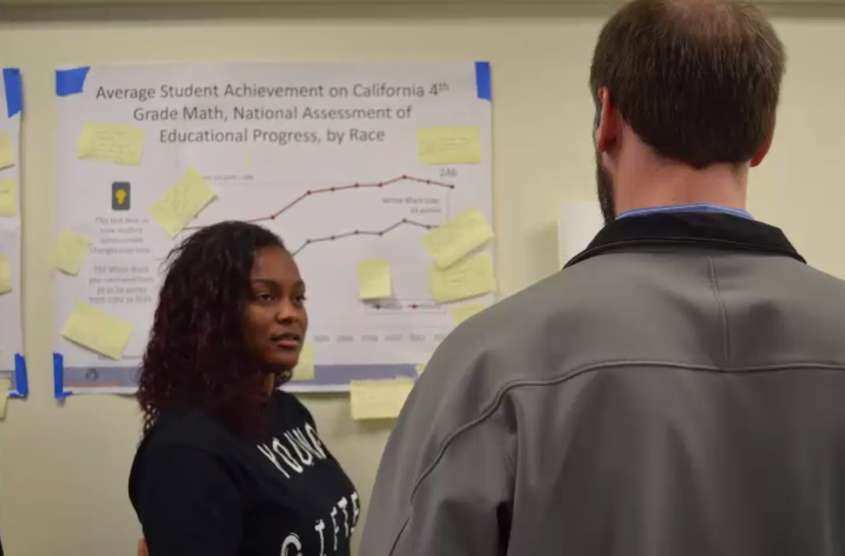
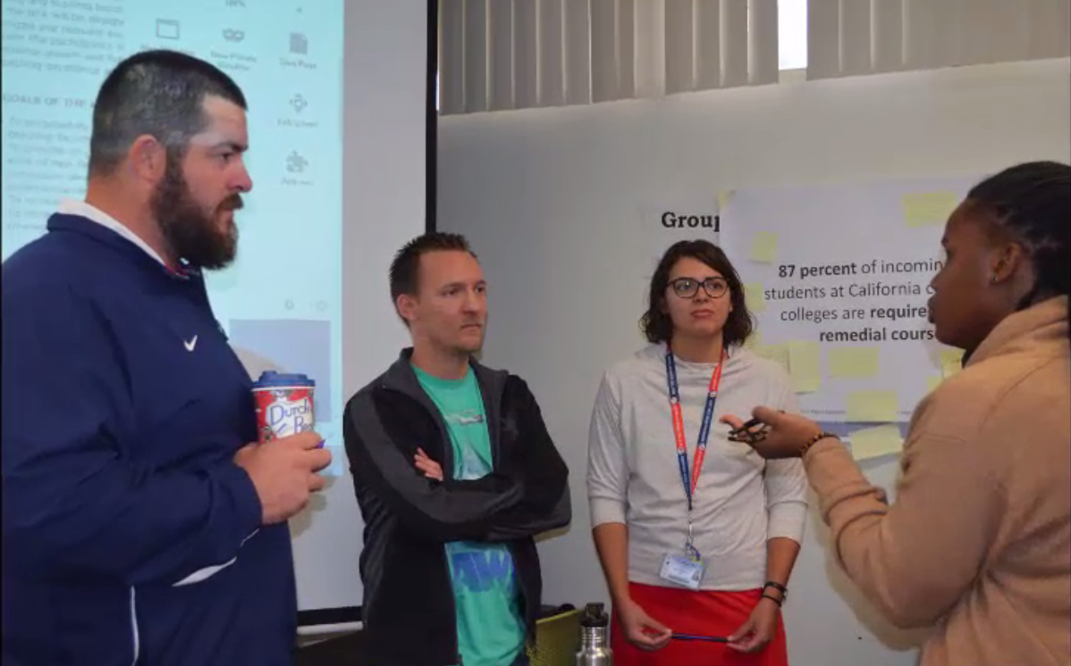
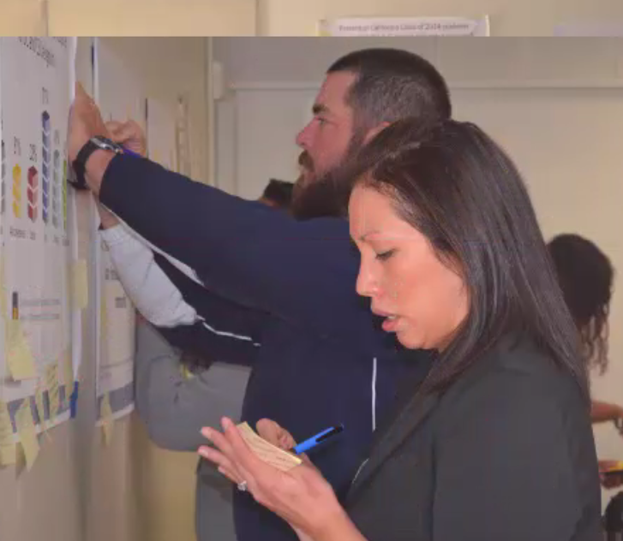
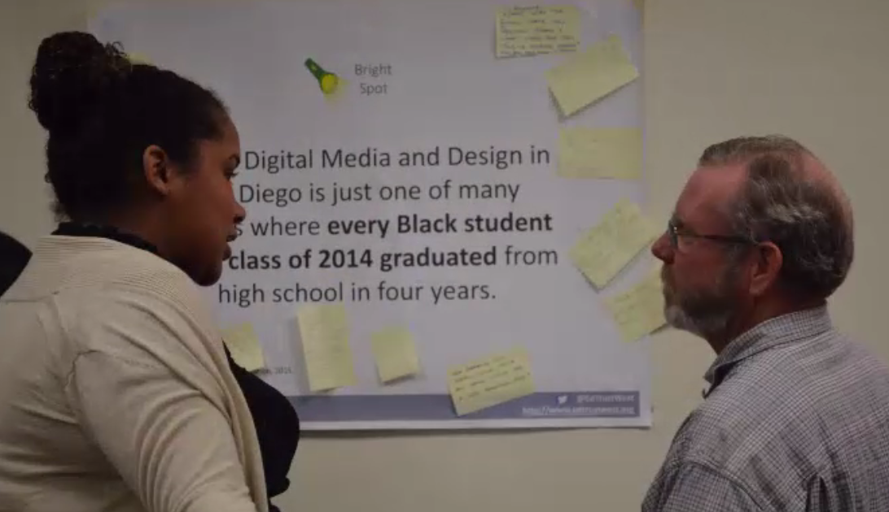
“If I Were Your Teacher”

Slide 18
Notes:
Ongoing and meaningful communication

Slide 20
Notes:
There is amazing work taking place across this campus and I am inviting you to join us.
Share the information, resource, the program.
Student panels
There is email going out today following this presentation

Slide 21
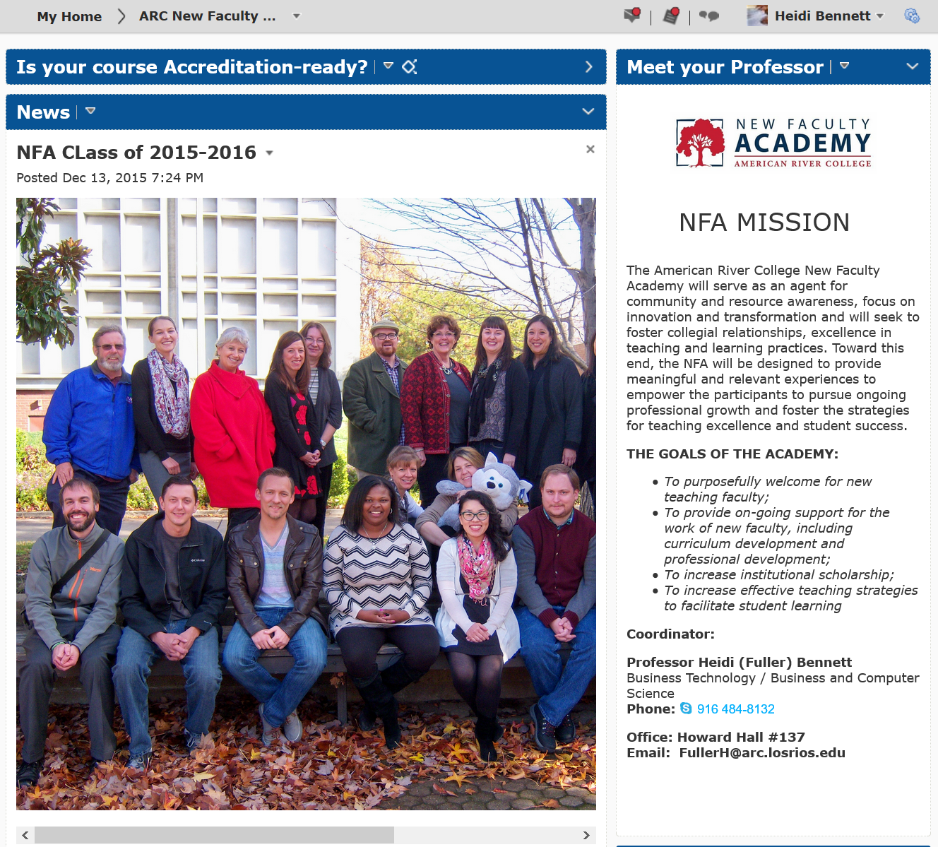
The Foundational Resources

Slide 22
Challenges / Lessons Learned
Vision – attention to detail
Organization and breadth of offerings
Responsive (ongoing evaluation process)
Flexible design
Student Services and Instruction
Horizontal and vertical perspective
Time for discussion and collaboration
Repository for resources

Slide 23
The Road Ahead

Slide 24
NFA at ARC
an extraordinary experience for our extraordinary new colleagues!
Notes:
Okay, you get the idea…
During any of the breaks today – share your thoughts and ideas and these works
The final products will be collected and shared at our first gathering.

Slide 25
Resources
New Faculty Handbooks
Web pages
Program Descriptions

Slide 26
Questions?

