Slide 1
Non-Credit Curriculum Basics Karen Chow, Area D Representative Manuel Vélez, South Representative
Emma Díaz, ACCE

Slide 2
Today we will discuss:
Noncredit Basics – what kind of courses CAN be noncredit, advantages for students
Standards and criteria for approving a noncredit course
Differences between credit and noncredit courses, and connections between them
Funding noncredit courses
Preparation for creating noncredit courses
What SHOULD you have in place?
What DO you have in place?
Who should be at the table?
A process for creating noncredit courses
The future? Preparing for post-pandemic
Notes:
Manuel

Slide 3
Notes:
Manuel

Slide 4
Eligible Noncredit Categories
EC § 84757;
CCR title 5 § 58160
The underlined instructional categories are eligible for equalized funding (CDCP*) in accordance with Education Code 84760.5 and CCR title 5 section 55151
CDCP* – Career Development and College Preparation
ESL
Workforce Preparation
Immigrant Education
Short-term Vocational
Noncredit Course Categories
Elementary and Secondary Basic Skills
Older Adults
Health and Safety
Home Economics
Substantial Disabilities
Parenting

Slide 5
Non-Credit Advantages for Students
Critical for disproportionately impacted individuals
FREE, flexible, offered across semesters, and open to all students
Classes repeatable and prevent accumulation of unneeded credit units
Open-entry/open-exit classes allow entry at any time during the term
Short-term classes for immediate employment, wage and skill gains, career path and college entrance

Slide 6
Even MORE advantages for students!
Improve math and English skills to increase college readiness
Competency-based model utilized in many courses
Pathway to citizenship
Independent living skills, self-advocacy, and employment for adults with disabilities
Older adult programs address the needs of the State’s aging population

Slide 7
Standards and criteria for approving a noncredit course
Notes:
Karen

Slide 8
Noncredit Courses: Standards and Criteria
A noncredit course is a course which, at a minimum is
Recommended by the college and/or district curriculum committee
Approved by the district governing board as a course meeting the needs of enrolled students
CORs for courses intended for special populations must clearly demonstrate that the course meets the needs of those populations (Immigrant Education, Parenting, Persons with Substantial Disabilities, Older Adults)
“No state aid or apportionment may be claimed on account of attendance of students in noncredit classes in dancing or recreational physical education” -Title 5, section 58130

Slide 9
Noncredit Course Approval
Title 5 Standards for Approval same as for credit:
Section 55002(c)1 – The college and/or district curriculum committee shall recommend approval of the course if the course treats subject matter and uses resource materials, teaching methods, and standards of attendance and achievement that the committee deems appropriate for the enrolled students.
The role of the local curriculum committee is to review and approve noncredit curriculum, just as it does for credit curriculum
The only program needing CCCCO approval in addition to local approval is for Short-term Vocational programs, just like credit CTE programs

Slide 10
Differences and connections between credit and noncredit courses
Notes:
Karen

Slide 11
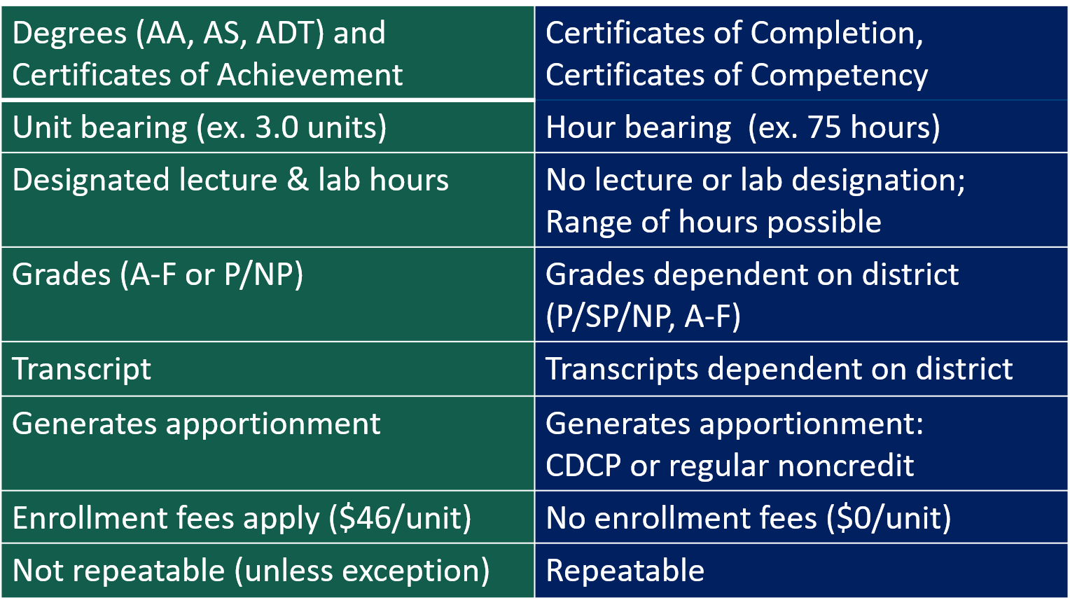
Credit vs. Non-Credit

Slide 12
Noncredit enrollment structures
Managed-enrolled
Offered at any time during or across terms
Students enter by a specified date; start and end date
Common for short-term vocational courses, VESL
Persistence and completion rates generally higher than open-entry courses
Open-entry/open-exit
Offered at any time during or across terms
Students enter and leave any time within the course dates
Common for all noncredit courses and programs
More difficult to determine persistence and completion

Slide 13
Noncredit Course Examples
Three examples of NC COR including modalities, disciplines, CMOs, methods of assessment, instructional hours, etc
NC courses fit into college’s Guided Pathways mapping; designed for transition to college or work
ESU - Contextualized ESL course offered in a Vocational ESL program
Basic Welding - Entry level welding class for NC students
AIME B-STEM math – Academic Intervention for Math and English, support for credit math success

Slide 14
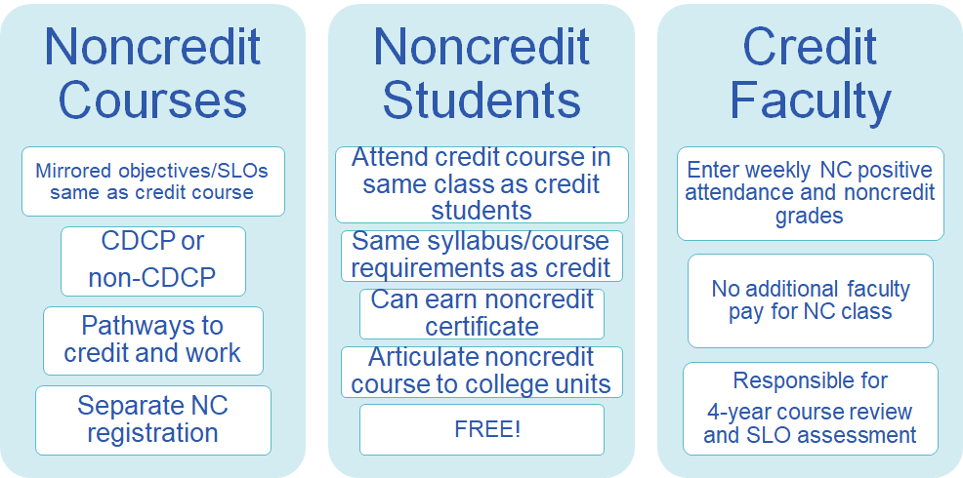
Noncredit Mirrored Courses

Slide 15
Funding noncredit courses
Notes:
Emma Diaz

Slide 16
Career Development & College Preparation (CDCP)
CDCP courses eligible for “enhanced funding” apportionment at a higher FTES rate
Noncredit courses in preparation for employment or success in college-level credit coursework
In accordance with provisions of Ed Code 84760.5, a sequence of noncredit courses leading to a:
Certificate of Competency, or
Certificate of Completion
CDCP categories are NOT “Special Populations” categories
CDCP Categories
ESL
(and VESL)
Basic Skills
Short-term Vocational w/High Empl.
Workforce Preparation

Slide 17
Noncredit CDCP Certificates
Certificate of Completion
Completed a sequence of courses in Short-Term Voc or Workforce Prep to progress in a career path or to credit study (§55151 (h))
Certificate of Competency
Gained competencies in a sequence of courses in ESL (or VESL) or Basic Skills to advance to credit, a degree, or baccalaureate institution (§55151 (i))

Slide 18
Funding sources
Earmarked for noncredit/adult education ONLY
California Adult Education Program (CAEP) –local/district funds for operations, course and program development, NC student transitions, equipment and all expenses related to noncredit students and programs (only up until apportionment is generated).
Workforce Innovation and Opportunity Act (WIOA), Title II (federal funds) – ESL, VESL, Citizenship, Adult Basic Education, Adult Secondary, and integrated CTE and ESL; course and program development, professional development, equipment, literacy
Other state funds:
Strong Workforce Program (SWP) – local SWP fund distribution determined at college/district level; regional funds open for NC Short-term Vocational programs; NC outcomes generate college SWP funding
Student Equity and Achievement Program (SEAP) – college/district determination for distributing SEAP funds tied to equity populations and achievement

Slide 19
Preparation for creating noncredit courses
Notes:
Emma

Slide 20
Questions requiring discussions to find answers
Is there student interest in the noncredit class or program?
For VOC, is it in a high demand field? LMI, employers?
Can it be offered short term (better retention for short term)?
Will it be part of a program or a stand-alone? Does it lead to a transition (job or college, CDCP)?
Should it be offered as open-entry/open exit or managed enrolled?
Who will monitor SLOs, outcomes?
How will registration take place? Who will be responsible to track data and enrollment?
Who will develop it and teach it? Credit or noncredit faculty?
Does everyone understand the noncredit load (it’s not like credit)?
How are program and course development going to be funded (non-instructional hours)?
Will it be delivered through DE?
Notes:
Emma

Slide 21
What Do You Have in Place?
What can you build upon?
Health Careers
Gaps in programs
Combine current courses for new certificate
RN
LVN
Psych Tech
Medical Assist
PTA
CNA
PCA
General Office
Medical Records
Medical Secretary

Slide 22
Steps in the process of creating noncredit courses
Notes:
Manuel

Slide 23
Who needs to buy-in?
Curriculum Committee – general discussions here start to get faculty on board
Faculty – continue CC conversations in Academic Senate
Administrators – easier to accomplish if you have some on your CC
IT – Administrators need to get IT on board from the start of discussions; NC does not have enhancements or attributes in most student data systems
Admissions – Administrators begin discussions when courses is “go” on who will be responsible
Student services - counseling and student resources
If there are noncredit faculty on campus, then credit/NC communication is critical!

Slide 24
Sources of information
ASCCC Career & Noncredit Institute – was held earlier this year, go here for materials from that institute: 2021 Career Noncredit Education Institute
ACCE events: Association of Community & Continuing Education (ACCE)
CCCCO: Noncredit Curriculum and Instructional Programs

Slide 25
Curriculum Committee Considerations
Curriculum committee structure/representation: should there be a designated NC review committee or member of Curriculum committee who is a designated NC reviewer/Noncredit Curriculum liaison?
If no NC faculty exists, reviewer can be a credit faculty who has learned about NC.
Either way, there needs to be a NC faculty champion!

Slide 26
On the Horizon for noncredit courses
AB-421 Community colleges: career development and college preparation courses
Would permit noncredit managed-enrolled courses to apply a census-based attendance collection procedure (like credit!)
In person open-entry/exit courses would still use positive attendance collection procedure
Legislation includes managed enrolled noncredit courses delivered through distance education
Has passed through the Assembly, Senate, and first Senate Appropriations reading
Similar bill fully passed the legislature in 2019 and was vetoed by Governor Newsom
Cross your fingers!
Notes:
Karen

Slide 27
Resources
ASCCC Website - http://asccc.org
Contact the ASCCC – info@asccc.org
Application for Statewide Service - http://asccc.org/content/application-statewide-service
ASCCC Events - http://asccc.org/calendar/list/events
ASCCC Services - http://asccc.org/services#
Disciplines List and MQs - http://asccc.org/disciplines-list
Association of Community and Continuing Education http://www.acceonline.org/
Program and Course Approval Handbook (PCAH 7th Edition) - https://asccc.org/sites/default/files/CCCCO_Report_Program_Course_Approval-web-102819.pdf

Slide 28
Thank You for attending! Here’s some contact information
Karen Chow, chowkaren@fhda.edu, De Anza College
Manuel Velez, mvelez@sdccd.edu, San Diego Mesa College

