Slide 1
Adult Schools and Community College Partnerships in a Post-COVID World

Slide 2
Introduction
Sherryl Carter, Ed.D.
Manager, Partnership Adult Academic Career Education - Cerritos College
scarter@cerritos.edu

Slide 3
Panel of Presenters
Sherryl Carter, Ed.D., - Manager – Partnership Adult Academic Career Education - Cerritos College
Jennifer Nieto, Program Assistant Partnership Adult Academic Career Education - Cerritos College

Slide 4
Poll Question
Do you currently have a pipeline from your school to a local community college?
Yes
No
In development

Slide 5
What is PAACE?
Partnership for Adult Academic and Career Education
Cerritos College Adult Education
Transition program from adult school to Cerritos College with individualized support
PAACE offers student’s individualized support in areas such as:
-Application
-Financial Aid or Dream Act Application
-Academic Counseling
-College Resources

Slide 6
PAACE Partners
PAACE is a partnership between 4 local adult schools and Cerritos College
ABC Adult School
Principal, Nancy Amara
nancy.amara@abcusd.us
Bellflower Adult Re-Entry
Principal, Tia Ewing
tewing@busd.k12.ca.us
Downey Adult School
Principal, Blanca Rochin
brochin@dusd.net
Cerritos College,
PAACE Program
Manager, Sherryl Carter
scarter@cerritos.edu
Norwalk-La Mirada Adult School
Director, Sharon Todd
stodd@nlmusd.k12.ca.us

Slide 7
Introduction
Jennifer Nieto
Program Assistant- Partnership Adult Academic Career Education - Cerritos College
jnieto@cerritos.edu

Slide 8
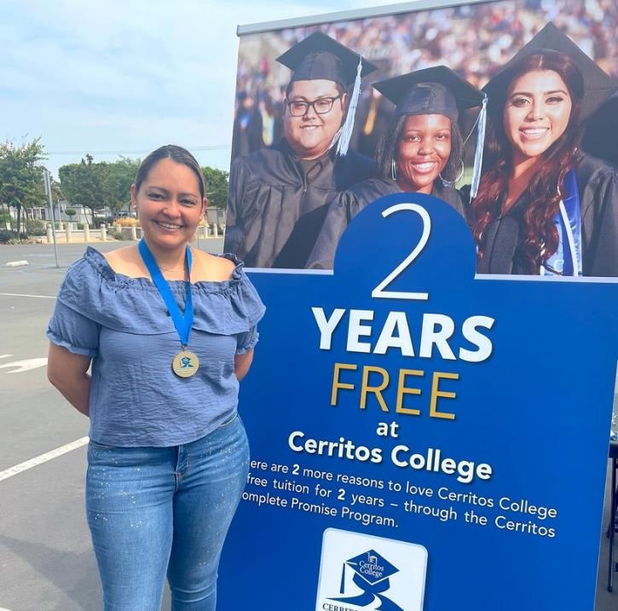
Paloma Rosas
2nd Year Cerritos Complete
Major: Spanish and Child Development
Cerritos College Adult Education and Diversity Programs
Transferring to UC Riverside

Slide 9
Student Transition
Scheduling Outreach
Meet with adult school administrators/counselors to schedule classroom visits
Visit ESL, GED/HSE, and CTE classes to present about PAACE program
Collect interested student information to continue process

Slide 10
Student Transition
Onboarding Process
Complete initial appointment to gauge student interest
Complete Cerritos College application, Financial Aid application, and college requirements
Provide guidance and resources to navigate the college system

Slide 11
Student Transition
Cerritos Complete Process
Assist students in meeting the Cerritos Compete Year 1 Requirements
Collaborate with the Cerritos Complete team in keeping database updated
Remind students of upcoming Year 2 deadlines and requirements

Slide 12
Final Words From Paloma Rosas

Slide 13
Poll Question
Do you as an Adult School currently have collaborative relationship with your local community college that builds personal connections with your students?
Yes
No
In Development

Slide 14
College Begins on the Adult School Campus
Students are onboarded at the adult schools
Eliminates fear and barriers
Students are taught by college instructors at the adult school
Students are familiar with college because of the personal connections they make while still attending adult school
Notes:
Include CC enrollment- Colleen

Slide 15
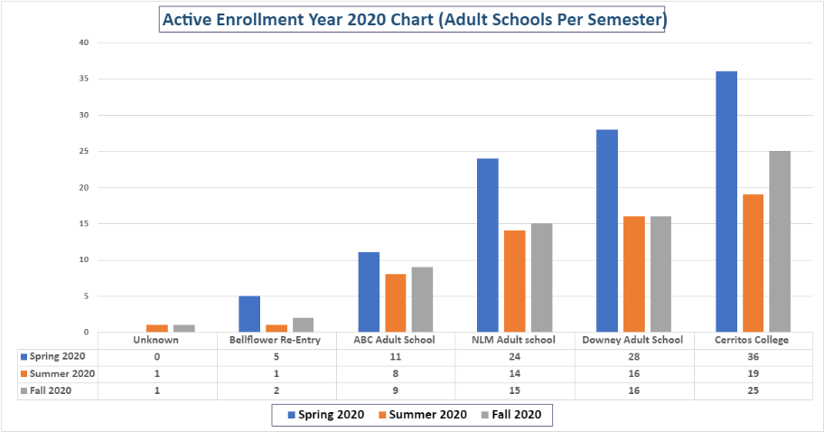
PAACE 2020 Enrollment

Slide 16
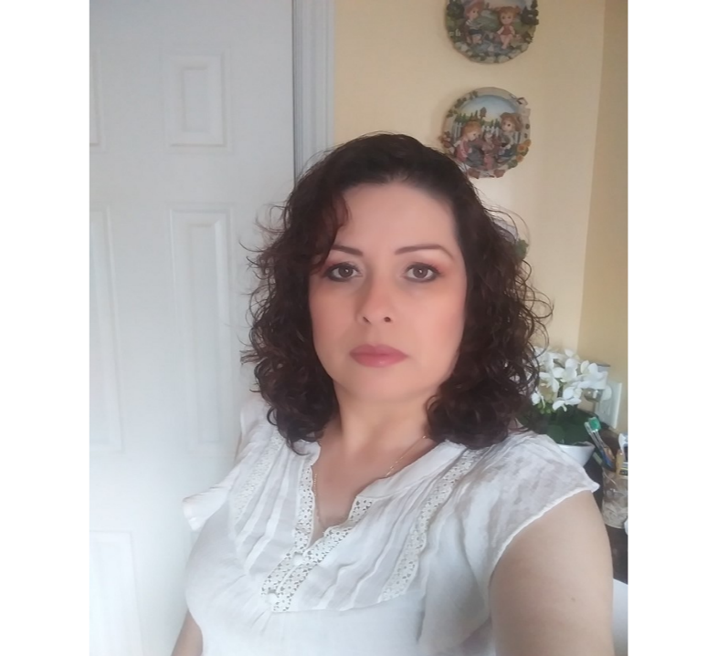
Cristina Collin
2nd-year student
Major: Child Development
Goal: Associate of Arts Degree

Slide 17
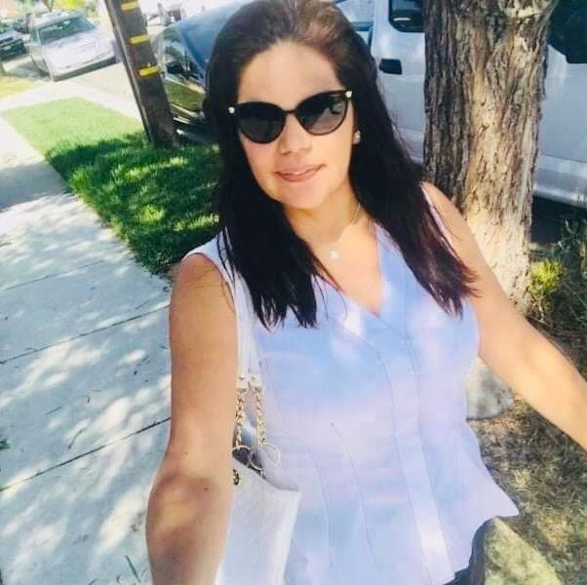
Carola Rodriguez
2nd-year college student
Cerritos Adult Education and Diversity Programs GED Student
Major: Child Development and Stress Management
Transferring to UCLA

Slide 18
Giselle Fernandez
2nd-year college student
Cerritos Adult Education and Diversity Programs GED Student
Major: Child Development and Stress Management

Slide 19
PAACE Contact Information
Sherryl Carter, Ed.D.,
PAACE Manager
scarter@cerritos.edu
(562) 860-2451 Ext. 2509
Graciela Vasquez
Adult Education Department
Associate Dean
gvasquez@cerritos.edu
(562) 860-2451 Ext. 2490
Email
paaceprogram@gmail.com

Slide 20
Questions?

