Slide 1
Welcome!
How aware are you of OER?
I am not aware of OER
I have heard of OER, but don't know much about them
I am somewhat aware of OER but I am not sure how they can be used
I am aware of OER and some of their use cases
I am very aware of OER and know how they can be used in the classroom
Intro to OER presentation by Suzanne Wakim is licensed CC-BY
Notes:
Link to our webinar page
Suzanne

Slide 2
Making Noncredit and CTE Free and Open - Ensuring Equitable Access to the Resources Needed for Success
May 1, 2021

Slide 3
Session Title and Description
Making Noncredit and CTE Free and Open - Ensuring Equitable Access to the Resources Needed for Success
The price of textbooks is a significant barrier to student success. This cost disproportionately impacts underserved populations. Open Educational Resources (OER) are the solution! These resources are not only free, they are also customizable for our courses. This allows us to build resources that most effectively teach our specialized student populations. This workshop will explain what OER is and will help you find OER for your classes.

Slide 4
Your Presenters
Jennifer Paris, ASCCC OERI Regional Lead
Suzanne Wakim, ASCCC OERI Project Facilitator
Photo by Richard Balog on Unsplash

Slide 5
Questions to be answered…
Why does OER matter?
What are OER?
How can I tell if something is Open?
How can I find OER for my classes?

Slide 6
Why does it matter?
Books, Pixabay license

Slide 7
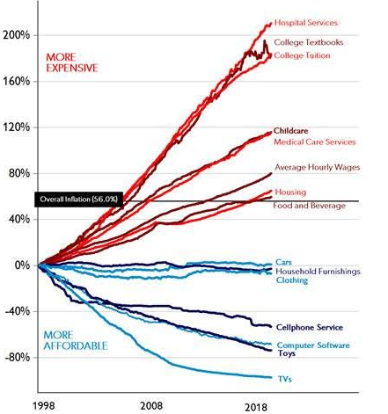
Price changes
(1998 - 2018)
Selected US
Consumer
Goods and
Services, Wages
Source: BLS
From the
American
Enterprise Institute
Notes:
Cost is an issue

Slide 8
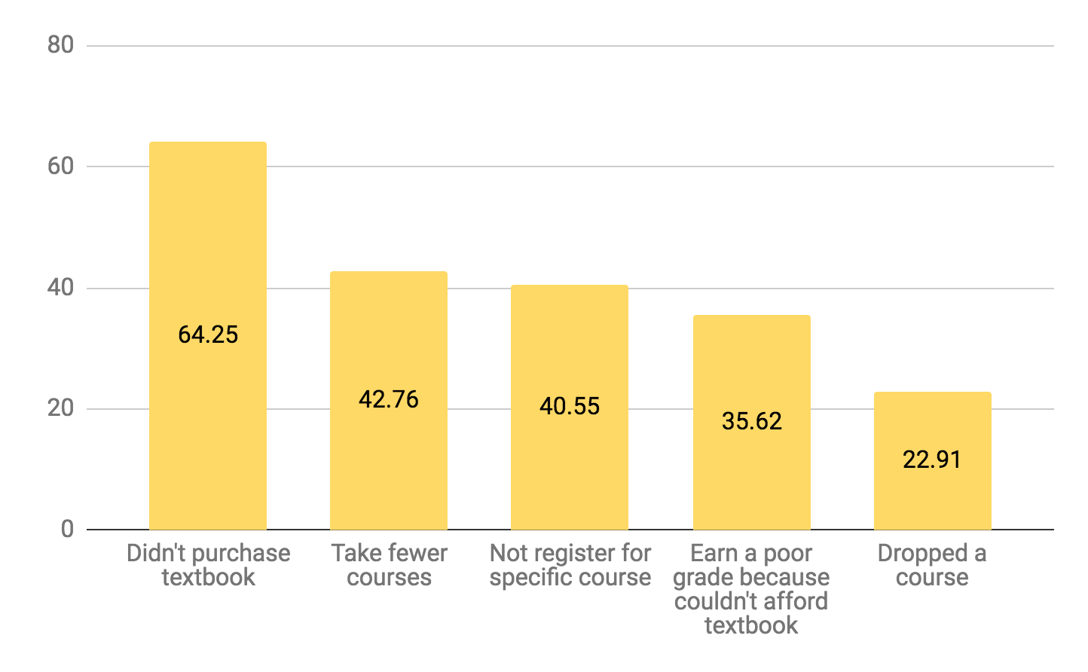
You can’t learn from a resource you can’t get.
2018 Student Textbook and Course Materials Survey Executive Summary
Notes:
Not having the resources - issue

Slide 9
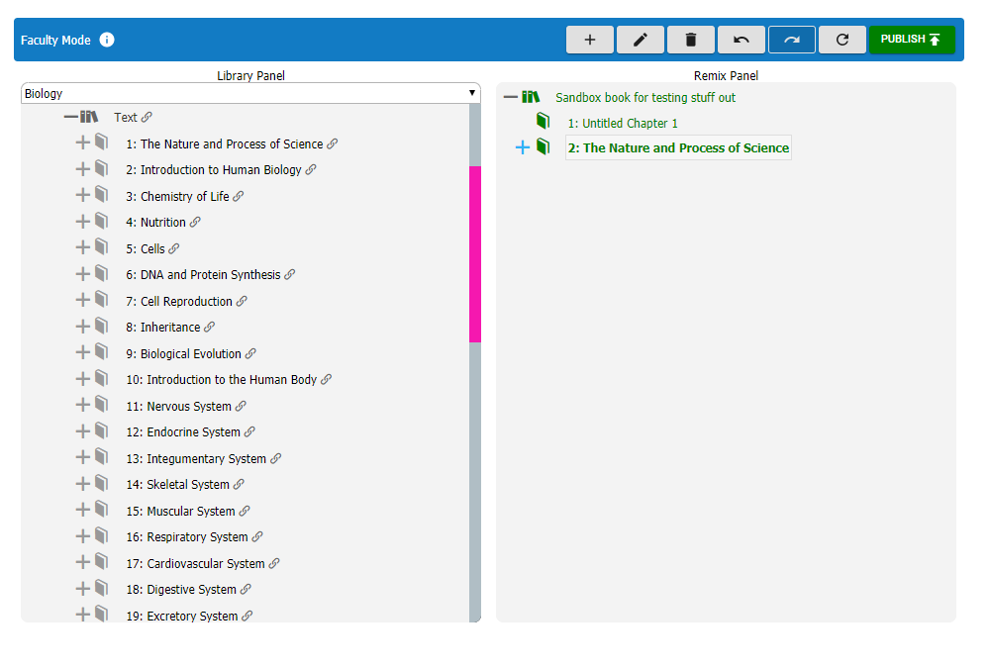
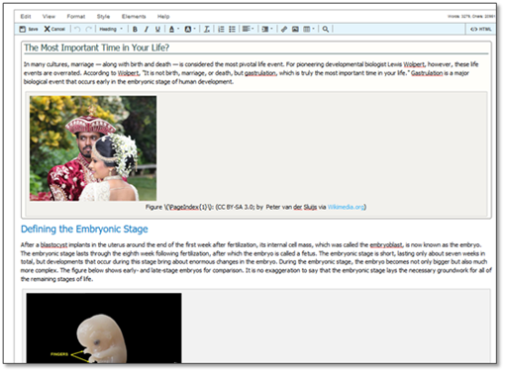
Academic Freedom
Notes:
Not having the right content - another issue
OER Addresses all of these….what is it?

Slide 10
What are Open Educational Resources?
“OER are teaching, learning, and research resources that reside in the public domain or are released under an intellectual property license that permits their free use and repurposing by others”
-- Hewlett Foundation

Slide 11
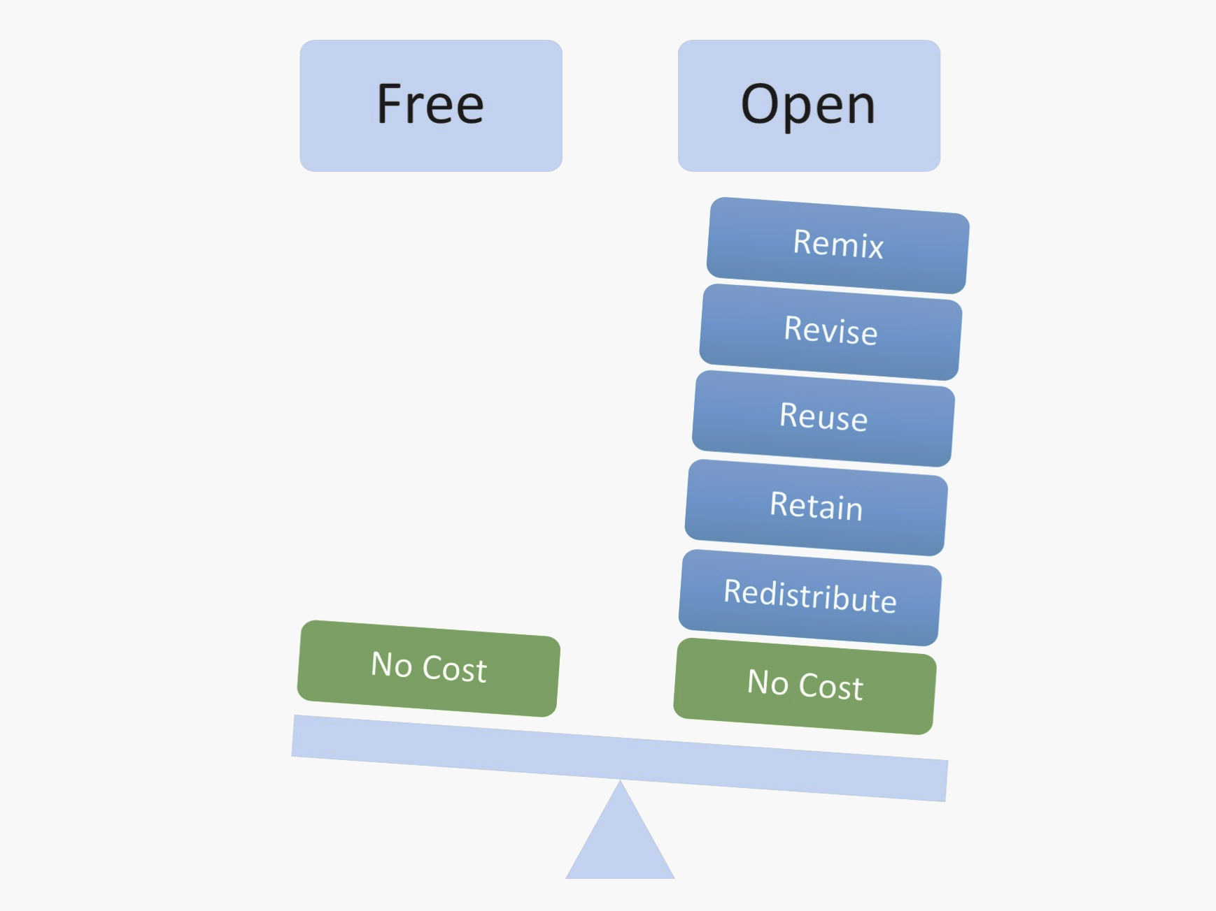
More than just free
Fair Use
Image by Designers for Learning: Gain Experience for Good, Jennifer Maddrell, Director (CC, BY, NC, SA)

Slide 12
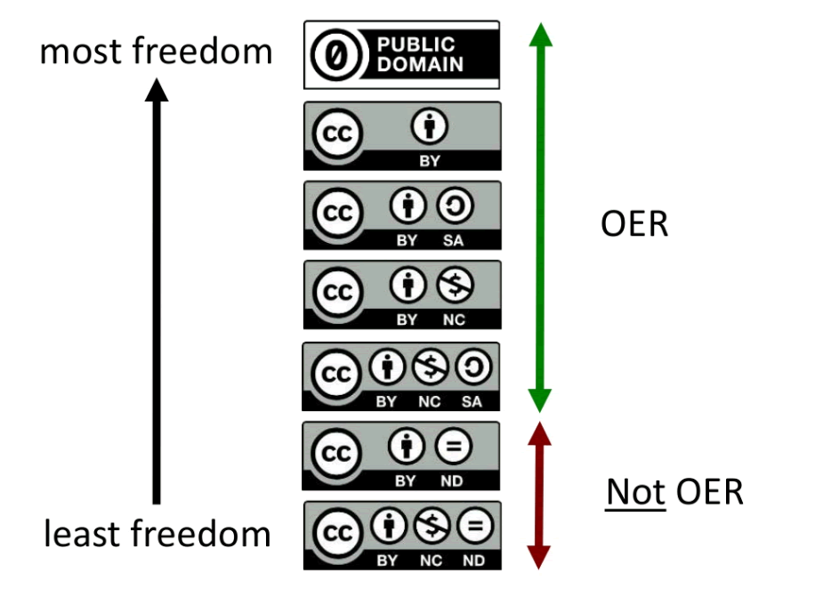
Creative Commons Licenses by D'Arcy Hutchings is licensed under a Creative Commons Attribution 4.0 International License.
All Ygraph.com content and data are available under the CCA 3.0 license.

Slide 13
Creative Commons Licenses & Adaptation
License | Attribution Required? | Adapt & Modify? | Commercial Use? | Change License?
CC0 | N | Y | Y | Y
CC BY | Y | Y | Y | Y
CC BY-SA | Y | Y | Y | N
CC BY-NC | Y | Y | N | Y
CC BY-ND | Y | N | Y | N/A
Notes:
Really just for adaption

Slide 14
Questions?
Photo by Pixabay from Pexels

Slide 15
Finding OER
pixabay
Finding OER by Suzanne Wakim is licenced CC-BY
Notes:
Jennifer

Slide 16
Searching for OER
Yes! It can be overwhelming at first
Where does one start?
Effective methods for searching
Practice makes perfect
Journey into curation

Slide 17
Complete Textbook Repositories
Notes:
Suzanne will share links

Slide 18
Open Textbook Library
https://open.umn.edu/opentextbooks
A peer-reviewed collection of hundreds of open textbooks spanning multiple subjects.
All textbooks are quality reviewed by faculty from a variety of institutions.
Suggestion: Browse by subject
Notes:
We’re creating a web…

Slide 19
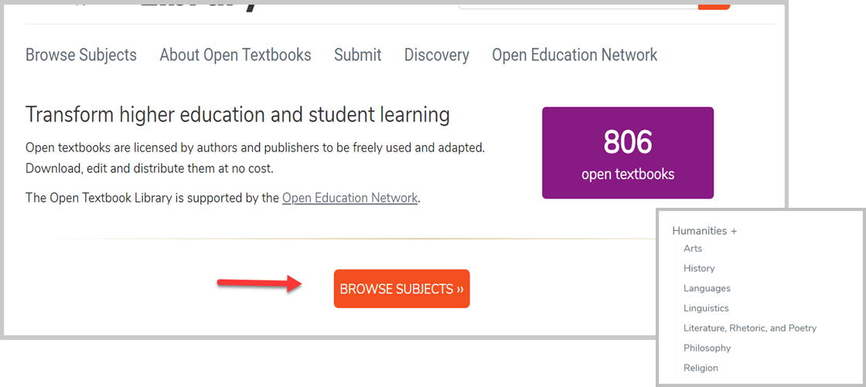
Looking at Open Textbook Library
Notes:
Here’s roughly what the regions consist of…

Slide 20
Open SUNY Textbooks
https://textbooks.opensuny.org/browse-oer/
Smaller repository
Publishing initiative established by State University of New York libraries and supported by SUNY Innovative Instruction Technology Grants

Slide 21
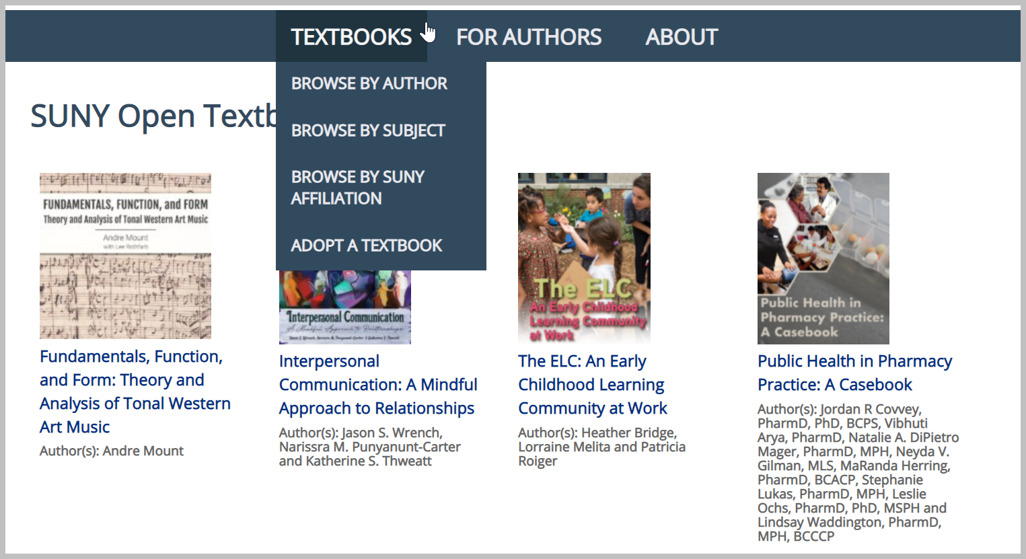
Looking At Open SUNY

Slide 22
BC Campus Open Ed
https://open.bccampus.ca/browse-our-collection/find-open-textbooks/
Reviewed by faculty
Meets BC Campus accessibility requirements

Slide 23
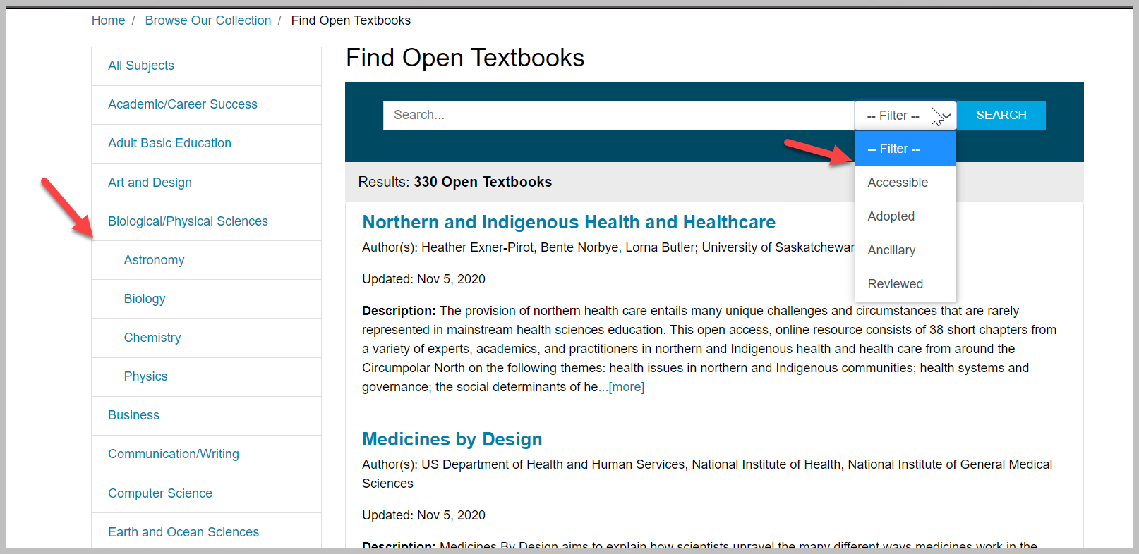
Looking at BC Campus Open Ed

Slide 24
OERI Canvas Site
http://tinyurl.com/ASCCC-OpenEd
Collections provided by
By CSU GE & TMC
By Discipline

Slide 25
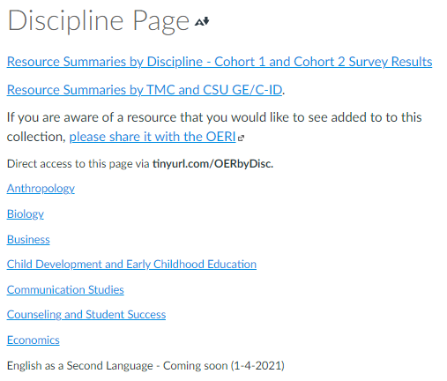
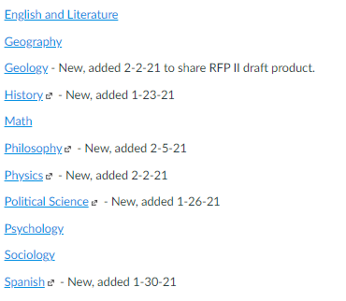
Looking at OERI Canvas Shell

Slide 26
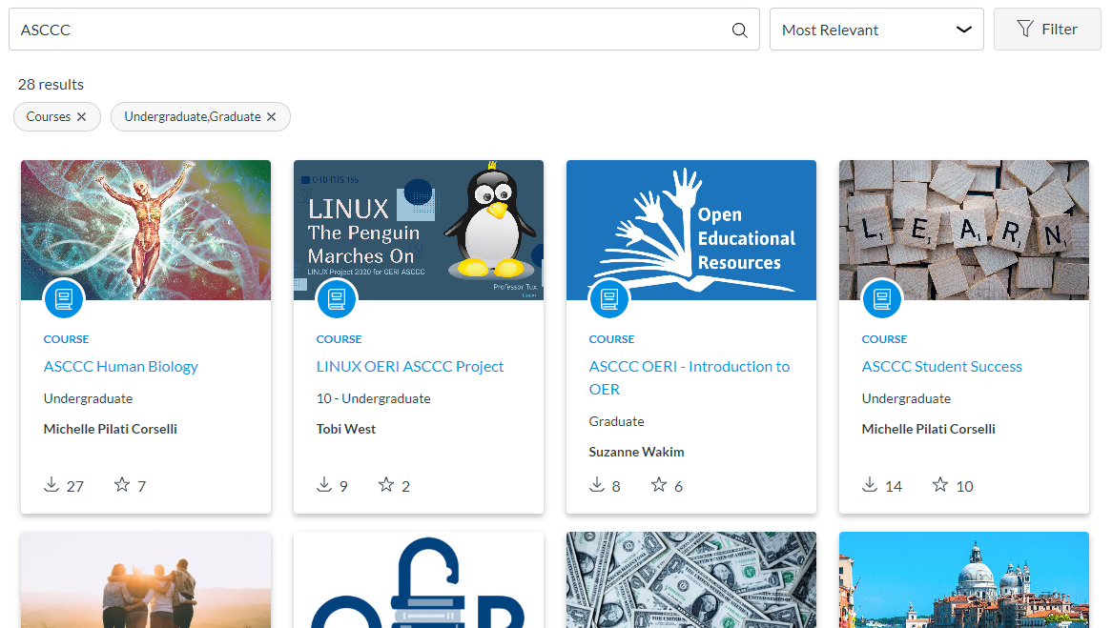
OERI on Canvas Commons
We have resources shared on the Commons

Slide 27
OERI Website
asccc-oeri.org
Showcases resources from funded projects

Slide 28
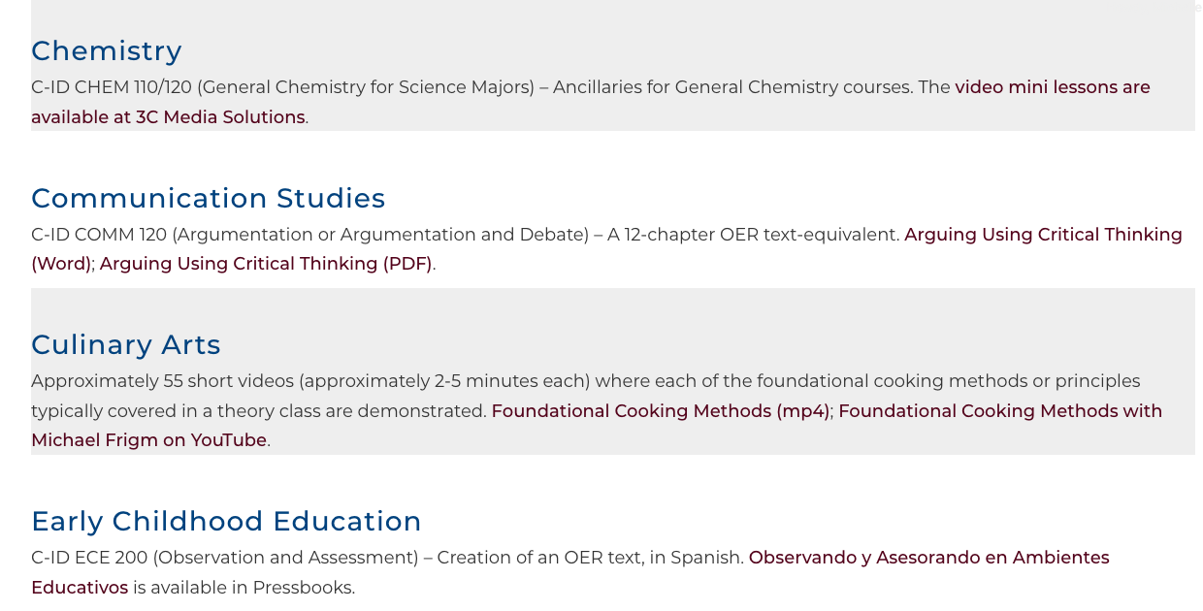
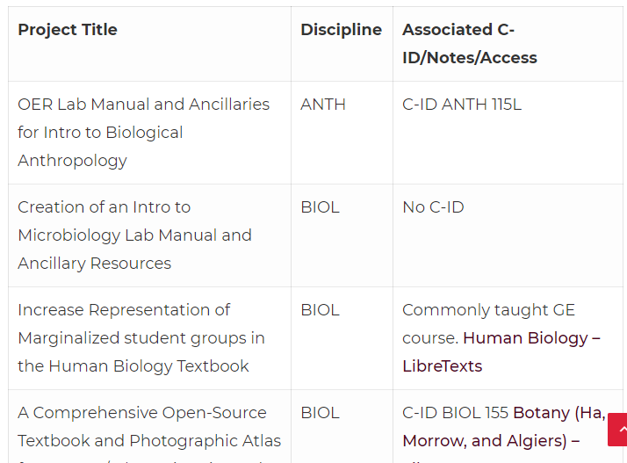
Looking at OERI Website

Slide 29
Other
Repositories
Notes:
? switch ?

Slide 30
Open Oregon
http://openoregon.org/resources/
Aggregates proprietary and openly licensed materials by:
Course name
Institution
Instructor information

Slide 31
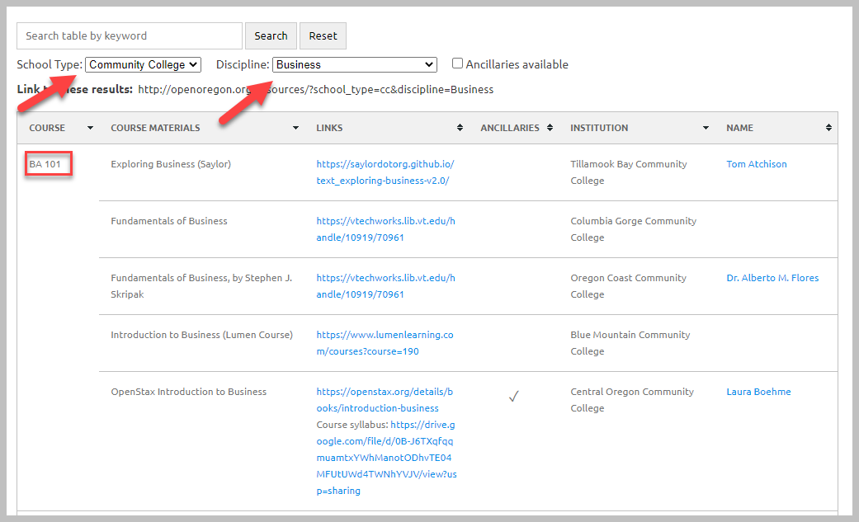
Looking at Open Oregon

Slide 32
OER Commons
https://www.oercommons.org/
Suggestion: Use limiters!
Also has building platform

Slide 33
Looking at OER Commons

Slide 34
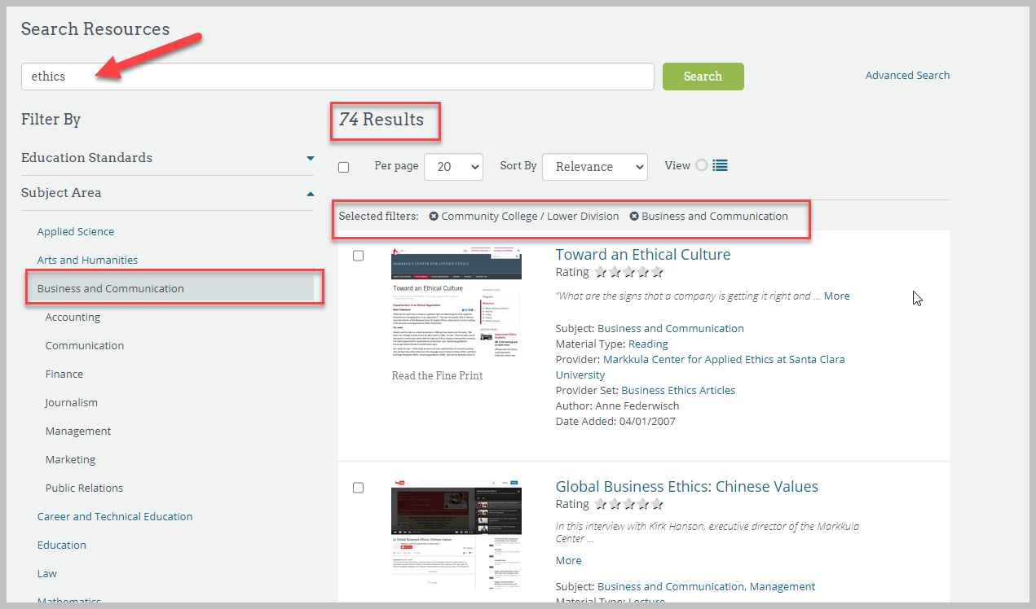
Looking at OER Commons cont.

Slide 35
LibreTexts
https://libretexts.org/
A repository of OER
Can “easily” remix various books together
Editable and importable

Slide 36
Looking at LibreTexts

Slide 37
OASIS Geneseo
https://oasis.geneseo.edu/
Search tool that aims to make the discovery of open content easier
Textbooks, videos and ready to use modules available

Slide 38
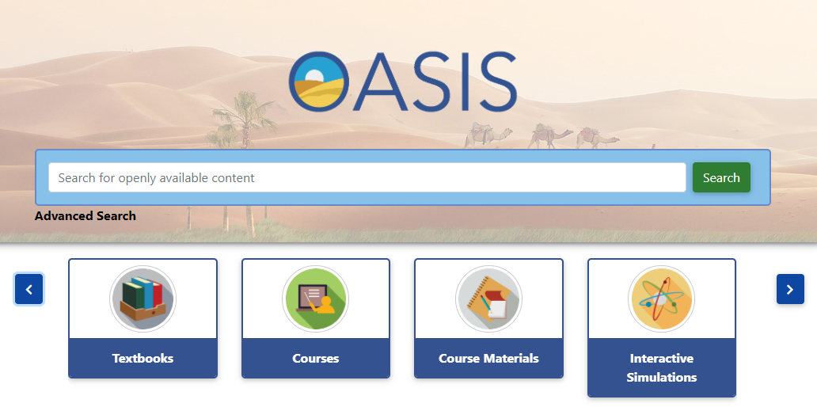
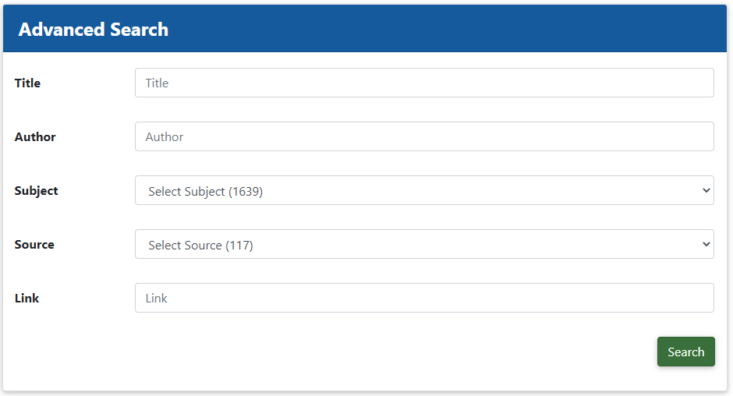
Looking at OASIS Geneseo

Slide 39
Skills Common
https://www.skillscommons.org/
Workforce Training Materials
Expansion through Trade Adjustment Assistance for Community Colleges and Career Training (TAACCCT) grant
“View Showcases”

Slide 40
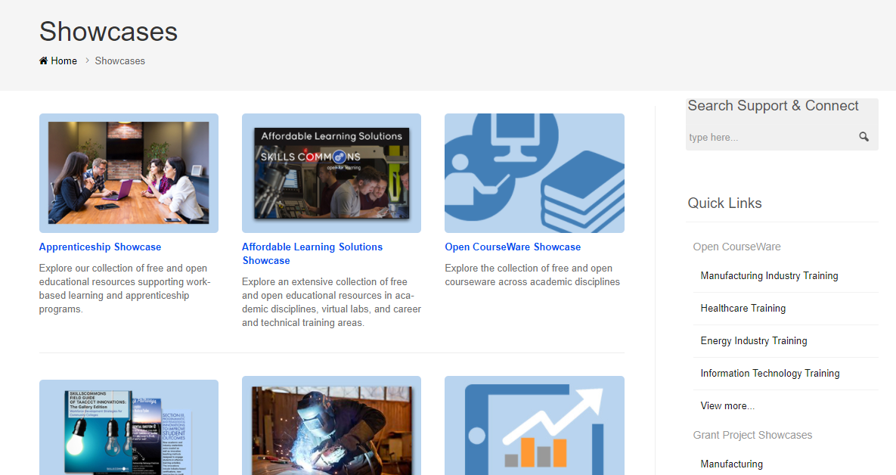
Looking at Skills Commons
Notes:
spend time here if we can

Slide 41
Google Advanced Search
Advanced option is under “settings” or “tools”
Select “usage rights”
Add lots of limiters

Slide 42
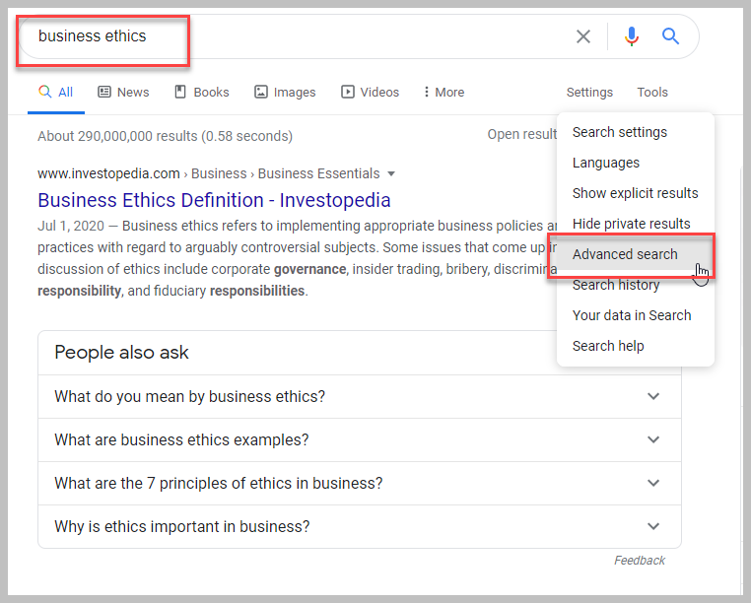
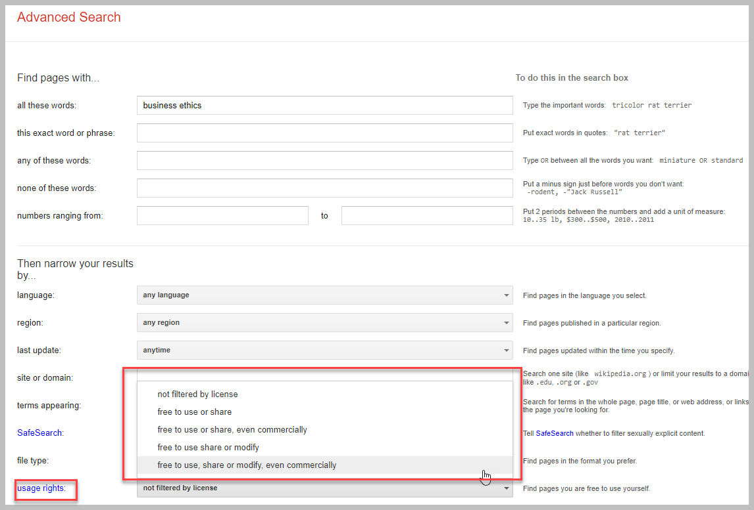
Looking at Advance Google Search

Slide 43
And to contact us…
Learn more about OER at asccc-oeri.org
General OERI E-Mail: oeri@asccc.org
Find your OERI Liaison: https://www.asccc.org/college_directory
Find our emails: https://asccc-oeri.org/about-us/

Slide 44
Thanks!
Photo by Thgusstavo Santana from Pexels

