Slide 1
Noncredit Curriculum Development and Approval Process
Thais Winsome, Mission College, ASCCC Noncredit Committee
Jan Young, Glendale College, ASCCC Noncredit Committee, ASCCC 5Cs

Slide 2
Noncredit Curriculum Development
Noncredit Course and Program Eligibility
Elements of the Course Outline of Record
III. Submission Process and Timeline to Chancellor’s Office

Slide 3
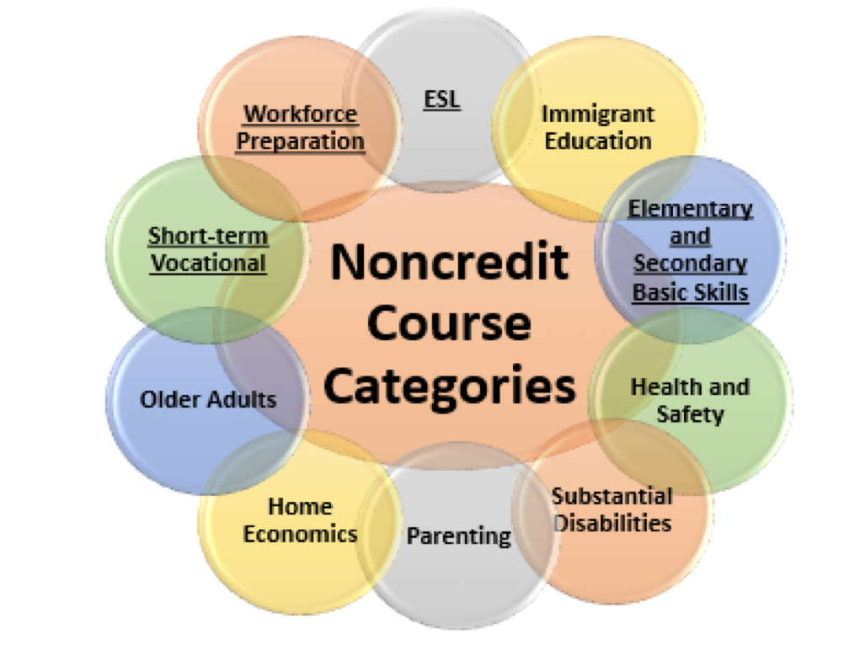
Eligible Noncredit Courses: Ten Categories
English as a Second Language (ESL)*
Immigrant Education
Elementary and Secondary Basic Skills*
Health and Safety
Substantial Disabilities
Parenting
Home Economics
Courses for Older Adults
Short-term Vocational*
Workforce Preparation*
*Areas (1), (3), (9), (10) are eligible for Enhanced Funding if associated with an approved noncredit program.

Slide 4
CDCP Certificates
Only credit courses can offer Certificate of Achievement
In Noncredit, students can earn either:
Certificate of Completion: Sequence of CDCP courses in Short-term Vocational or Workforce Preparation or
Certificate of Competency: Sequence of CDCP courses in ESL or Elementary & Secondary Basic Skills

Slide 5
CDCP Regulations
Education Code 84760.5 career development and college preparation courses and classes for which no credit is given, and that are offered in a sequence of courses leading to a certificate of completion, that lead to improved employability or job placement opportunities, or to a certificate of competency in a recognized career field by articulating with college-level coursework
CCR Title 5 section 55151 (f) Under no circumstances may a district separate an existing noncredit course which provides less than one hundred and ten (110) hours of instruction into two or more courses for the purpose of forming a noncredit educational program to satisfy the requirements of this section.
Notes:
Also in CCR Title 5 55000 (m)

Slide 6
Enhanced Funding Programs: CDCP
CDCP (Career Development and College Preparation) programs are funded at the same rate as credit courses, but use positive attendance as their accounting mechanism.
In new performance-based funding formula, noncredit courses are not included (yet) in the success metrics and are funded based solely on hours accrued.

Slide 7
CDCP Categories
Data element CB22 is used to designate a course as CDCP
A - ESL: includes vocational English as a second language
C - Basic Skills: may include co-requisite learning assistance, but not stand alone supervised tutoring. May also include high school equivalency.
I - Short-term Vocational: high employment potential
J - Workforce Preparation: in the areas of basic skills of speaking, listening, reading, writing, mathematics, decision-making, and problem solving skills that are necessary to participate in job-specific technical training

Slide 8
Noncredit Special (Target) Population Courses
Short-term Vocational courses or Basic Skills classes geared to specific populations such as Older Adults, Students with Substantial Disabilities, Citizenship for Immigrants, and Parenting are not eligible for CDCP funding.
E.g. Course entitled “Career Preparation for Students with Substantial Disabilities” would not be eligible for CDCP funding.
No state aid or apportionment may be claimed on account of attendance of students in noncredit classes in dancing or recreational physical education” -Title 5, section 58130

Slide 9
AB705 Noncredit Options
Colleges can create intensive review courses that could be offered during the summer session (or winter intersession) for students to catch up before entering the transfer level.
If the course is noncredit, it can be easily scheduled to begin at any time during the term.
These courses would likely be optional, but they could be a way for students to refresh their skills and build confidence before the semester.
Again, these noncredit courses are restricted to basic skills.

Slide 10
Modularized Support
Colleges can create modularized courses (particularly using noncredit) that would allow the student to get help with a specific issue at any point during the semester (depending on how the college schedules them).
A student could access as many or as few modules as they need during the term.
Remember that noncredit courses are restricted to basic skills.

Slide 11
Corequisite Noncredit Course
A corequisite course in noncredit is allowable and the FAQ makes it clear that it can be required.
The corequisite course could have variable hours to allow different amounts of corequisite support to be scheduled with only one course outline.
Courses are required to have an approved course outline of record that meets the requirements outlined in Title 5 §55002 (this includes specifying possible topics that will be covered in the course content).
Noncredit courses are built on completion of outcomes, not time if open entry/ open exit are used.
Noncredit courses can also be based upon managed enrollment.

Slide 12
Mirrored Courses – Credit/Noncredit
Colleges can have equivalent versions of credit and noncredit courses (usually seen in ESL or short term vocational).
These courses are scheduled at the same time, with a credit instructor. Usually 3-5 noncredit seats are reserved.
These types of courses can be helpful for students that are transitioning from noncredit to credit.
Colleges can choose whether they allow noncredit students to petition for course credit through credit by exam.
If noncredit student receives a “P”, local college can choose to articulate noncredit student to next level course.

Slide 13
Elements of the COR for Noncredit
Title 5 § 55002 (c) 1
Course Number and Title
Course Description
Total Contact Hours
Course Objectives
Course Content
Method of Instruction
Methods of Evaluation
Assignments and Other Activities

Slide 14
TOP vs. CIP vs. SOC
When codes are accurately assigned for CTE courses (credit and noncredit), colleges are better able to implement degree audit systems, can avoid inconsistencies in federal reporting, and see data that are consistent with similar programs in tools like Salary Surfer, Data Mart, and the LaunchBoard. California community colleges
TOP (Taxonomy of Programs) unique to CA Community College, 4 digits
CIP (Classification of Instructional Programs) Fed code used by all other post-secondary institutions 6 digits. Need to use CIP codes when compile federal Gainful Employment figures or document CTE outcomes for accreditation, so many colleges use both codes to designate program content.
SOC (Standard Occupational Codes) Many different programs train for the same occupation

Slide 15
MIS Coding
Every course is described or defined by CB coding (Course Basic coding) that assign data element to allow reporting and analysis according to specific curriculum functions. Noncredit courses: CB 11, 22
Increasingly important for AB705 and Student Centered Funding Formula that courses readily align between adult schools, noncredit, and credit. Skill gains can more readily be reported with one rubric.
EFL (Educational Functioning Levels) are based on Federal Common Core State Standards. Needed to align with Community College CB21 courses-- prior to transfer level basic codes-- for English, Math, and ESL.
Each level has a broad description of the outcomes a student should have attained by the end of the course at that level. The description is not intended to include all student learning outcomes of each course at that level, but rather indicate an educational level that student has attained.

Slide 16
English As A Second Language
MIS Data Element Code: CB11 K, CB22 A
Valid T.O.P. Code (Taxonomy of Programs):
4930.84, 4930.85, 4930.86, 4930.87, 4931.00
Top Discipline “49” Interdisciplinary Studies
TOP 49 – Interdisciplinary Studies: …courses in guidance, student success, and other categories, which do not fall into any other discipline, may be coded in the 6-digit 4930.xx series or 4931.00 through 4999.00.
Specific TOP codes for courses that provide general studies: Use one of the following six digit codes for courses in orientation, leadership, personal dynamics, study skills, and other subjects that contribute to the capacity of students to succeed in college.

Slide 17
Elementary and Secondary Basic Skills
MIS Data element code : CB11 K, CB22 C
Valid T.O.P. codes: 1501.00, 1520.00, 1701.00, 1702.00
4930.09, 4930.14, 4930.30, 4930.31, 4930.32, 4930.33
4930.60, 4930.60
(”15” Humanities, “17” Mathematics, “49” Interdisciplinary Studies)

Slide 18
Short Term Vocational
MIS Data Element Code: CB11- J or K, CB22- I
Valid T.O.P Codes : Any Vocational TOP Code
Unlike credit, do not have to have an advisory board for noncredit STV
No regional or advisory input required for STV certificate proposals
Do need to provide LMI data or or attach another data source containing current labor market or job availability data with an explanation of how the data is verified.

Slide 19
Workforce Preparation
MIS Data Element Code: CB11 – J, CB22 – J
Valid T.O.P. Codes: Any VOCATIONAL TOP code or:
4930.10, 4930.11, 4930.12, 4930.13, 4930.72 (Interdisciplinary Studies)
Specific TOP codes for courses that provide general studies: Use one of the following six digit codes for courses in orientation, leadership, personal dynamics, study skills, and other subjects that contribute to the capacity of students to succeed in college.

Slide 20
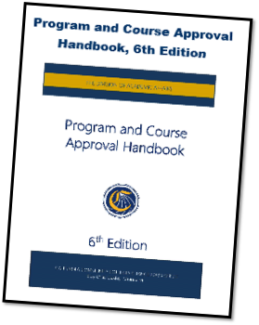
PROGRAM AND COURSE APPROVAL HANDBOOK (PCAH) 6th EDITION
•Part III…Noncredit Curriculum

Slide 21
Noncredit Program Approval
Five criteria used by the Chancellor’s Office to approve noncredit programs and courses. These criteria are as follows:
Appropriateness to Mission
Need
Curriculum Standards
Adequate Resources
Compliance
Notes:
Madelyn
academic integrity – same standards as credit, complies with the statute and CC regularions for curriculum, curriculum approval, etc,; there is a student need, and that the program is feasible. And can be sustained

Slide 22
What is Approved Locally and What’s Approved by CCCCO?
Local Approval/ CCCCO Chapters CCCCO Approval
New credit courses
Modifications to credit courses
New programs including ADTs
All noncredit curriculum
Work Experience courses

Slide 23
Curriculum Review Process and Timeline
Local Curriculum Committee Approval
District Governing Board Approval
CCCCO Proposal Review & Approval
College Submits Curriculum Proposal to CCCCO
Timeframe determined per local policy
Timeframe determined per local policy
Submit proposal into COCI
Occurs within 60 days of submittal to CCCCO; timeframe subject to total number of proposals received*
*Note: Curriculum proposals are reviewed in the order in which they are submitted into the COCI queue, to include revision requests
Notes:
Cheryl Notice how processes illustrated above occur in a perfectly neat and linear fashion…
*Approval timeframes are not in the PCAH 6th edition since we separated out the COCI submission guidelines and technical assistance portions of the PCAH, which will be provided at a future date. However, there is nothing to suggest that there will be a change to the timeframe (PCAH 5 Ed, p. 15) for proposals that are NOT on the automated process (i.e., colleges will still need to build in this buffer).
Follow your local curriculum approval process, first.
Local Curriculum Committee
District Governing Board
Once approved locally, a designated college staff with access to the online CCC Curriculum Inventory can proceed with:
Submitting the proposal record to the Chancellor’s Office for review.
The average Chancellor’s Office approval timeframe is 60 days
Curriculum proposals are reviewed in the order in which they are submitted into the queue
Proposals submitted with discrepancies will be returned as a “Revision Request”
Revision Requests will cause delays in the curriculum proposal approval timeframe.

Slide 24
Curriculum Review Process and Timeline (Reality)
Draft
Prepared in the college queue
Submitted
To the CCCCO for review
Approved
Active in Curriculum Inventory (in COCI 2.0, the college determines when to change status “Active”)
College withdraws and proposal
CCCCO sends revision request back to college
*Note: Curriculum proposals are reviewed in the order in which they are submitted into the COCI queue, to include revision requests resubmitted to CCCCO for review
Notes:
Cheryl

Slide 25
Program Submission
Courses must first be approved before the college can submit a proposal for a new CDCP program
CDCP funding for courses that are part of a CDCP program cannot be received until the program is approved
Cannot divide a class that is 110 hours or less into two courses to create a certificate
Notes:
Cheryl
I’m really proud of this design ☺ I hope you like it! Yes, LE it’ s great

Slide 26
Change is A’Coming! not approved yet
Streamline noncredit approval process to achieve parity with credit
Recommended by Curriculum Committee/Academic Senate
Approved by Local Board of Trustees
Chaptered by the Chancellor’s Office
Certified by the Curriculum Chair, CIO, Academic Senate President, CEO:
All noncredit courses
Modified noncredit programs
New noncredit programs with the exception of CDCP short-term vocational noncredit programs
The Chancellor may at any time limit or terminate the college district’s ability to self-certify such curriculum.
Notes:
Approved Consultation Council Apr 18th Board of Governors 1st reading May 19-20, 2nd reading July 15th 2019

Slide 27
Exception to Noncredit Approval Process
CDCP Programs for Short-term Vocational must be submitted to Chancellor’s Office for approval
California Code, Education Code - EDC § 84760.5 3) Short-term vocational programs with high-employment potential, as determined by the chancellor in consultation with the Employment Development Department utilizing job demand data provided by that department.
Ed code changes require legislative initiative.

Slide 28
What about Noncredit Distance Ed?
Local Curriculum approval is the same process as credit Distance Ed courses. Curriculum must be submitted with DE addendum.
Funding for noncredit DE courses based on different formula. Because noncredit accounting is based on positive attendance, colleges must use attendance at 20% mark and the 80% mark, not census data.
Difficult for colleges to make MIS adjustments to capture this information. Most schools are doing this manually.
Formula for noncredit DE courses does factor in outside of class hours
At odds with how Online College is being funded even though targeting same students as noncredit.

Slide 29
Questions????
Thais Winsome, Mission College, thais.winsome@missioncollege.edu
Jan Young, Glendale College, jyoung@glendale.edu

