Slide 1
Basics of Noncredit
Thais Winsome, Mission College, ASCCC Noncredit Committee
Jan Young, Glendale College, ASCCC Noncredit Committee, ASCCC 5Cs
Career and Noncredit Institute, San Diego, April 2019

Slide 2
What is Noncredit?
Noncredit courses are zero unit courses offered to students without the expense of enrollment fees and designed to help students reach personal, academic, and professional goals.
Noncredit courses often serve as a point of entry for underserved students as well as a transition point to prepare students for employment or credit instruction.

Slide 3
Educational Attainment Highest level of education among people aged 25 years and older. 2017
United States
N = 4.57M

Slide 4
Why Noncredit?
Tuition is free
No financial aid necessary
Accessible to students
Open entry/open exit format (optional) can serve students at point of inquiry.
Flexible scheduling
Access to counseling

Slide 5
Why Noncredit?
Focus on skill attainment, not grades or units
Repeatable and not affected by 30 unit basic skills limitation
Elementary level skills to pre-collegiate
Prepare for employment or credit programs
CTE: preparation, practice, and certification
Bridge to other educational/career pathways
Allows returning adults to develop self efficacy, low risk environment

Slide 6
Why Noncredit? Faculty Perspective
More freedom to tailor course curriculum
Focus on skill attainment, not units
Courses have immediate impact on students’ lives and communities
Innovate! Create new courses and programs to meet students’ needs.
Opportunity for students to repeat a course, practice skills, and become more proficient.

Slide 7
Why Noncredit? Faculty Perspective
Opens the equity door—provides access to underserved students
Most noncredit students are our DI students
Opportunity for students to start/prepare for a career path
Option for students needing review courses in math and English.

Slide 8
Lacking High School Diploma By Race

Slide 9
CREDIT VS. NONCREDIT
Degrees and Certificates of achievement | Certificates of completion competency
Unit bearing | Hour bearing
Designated lecture & lab hours | No lecture or lab designation
Grades (A-F or P/NP) | Grades dependent on district (P/SP/NP, A-F)
Transcript | Some schools noncredit courses
Generated Apportionment | Generates apportionment CDCP or regular noncredit
Student fees apply | No student fees
Not repeatable | Repeatable

Slide 10
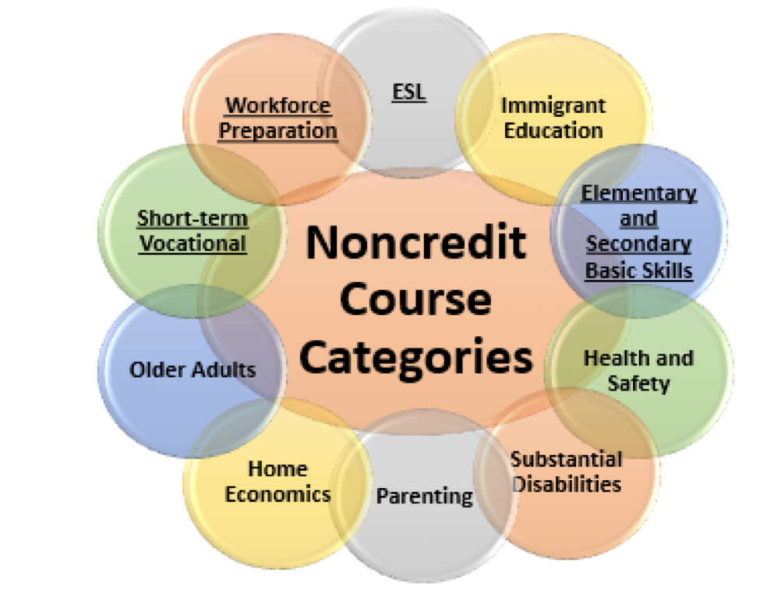
Eligible Noncredit Courses: Ten Categories
English as a Second Language (ESL)*
Immigrant Education
Elementary and Secondary Basic Skills*
Health and Safety
Substantial Disabilities
Parenting
Home Economics
Courses for Older Adults
Short-term Vocational*
Workforce Preparation*
*Areas (1), (3), (9), (10) are eligible for Enhanced Funding if associated with an approved noncredit program.

Slide 11
English as a Second Language (ESL)
Provide instruction in the English language to adult, non=native English speakers with varied academic, career, technical, and personal goals. Courses include, but are not limited to: skills or competencies needed to live in society; skills and competencies needed to succeed in an academic program; preparation for students to enter career and technical programs at the community colleges; programs focusing on skills parents need to help their children learn to read and succeed in society; skills needed to fully participate in the United States civic society or to fulfill naturalization requirements; ESL-based skills and competencies in computer software, hardware, and other digital information resources and functional language skills.
MIS Data Element Code CB22=A

Slide 12
Immigrant Education
Designed for immigrants eligible for educational services in citizenship, ESL, and workforce preparation courses in the basic skills of speaking, listening, reading, writing, mathematics, decision-making and problem-solving skills, and other classes required for preparation to participate in job-specific technical writing. Instructional courses and programs should support the intent of the Immigrant Workforce Preparation Act.
MIS Data Element Code: CB22= B

Slide 13
Elementary and Secondary Basic Skills
Elementary and Secondary Basic Skills includes basic skills academic courses in reading, mathematics, and language arts. Basic skills courses provide instruction for individuals in elementary and secondary-level reading, writing, computation and problem-solving skills in order to assist them in achieving their academic, career, and personal goals. Elementary-level coursework addresses the content and proficiencies at levels through the eighth grade. Secondary-level coursework focuses on the content and proficiencies at levels through the twelfth grade and may incorporate the high school diploma.
MIS Data Element Code CB22=C

Slide 14
Health and Safety
Lifelong education to promote health, safety, and the well-being of individuals, families, and communities. Courses and programs in health and safety provide colleges with the opportunities to network or partner with other public welfare and health organizations.
Concern from Chancellor’s Office that colleges are reclassifying advanced and highly specialized public safety courses as noncredit classes. Additionally, public safety courses for which prerequisite skills are learned in a basic academy do not fit criteria for courses in Short Term Vocational with High Employment Potential.
MIS Data Element Code CB 22=D

Slide 15
Substantial Disabilities
Designed to provide individuals with life-skill proficiencies essential to the fulfillment of academic, career technical, and personal goals. A student with a disability is a person who has a verified disability which limits one or more major life activities, as defined in 28 Code of Federal Regulations section 35.104, resulting in an educational limitation as defined in title 5, section 56001. Courses for students with substantial disabilities are an “assistance class” according to provisions of title 5, section 56028, and Education Code section 84757 (a)(5).
MIS Data Element Code CB22=E

Slide 16
Parenting
Designed to offer lifelong education in parenting, child development, and family relations in order to enhance the quality of home, family, career, and community life. Instructional areas may include, but are not limited to the following: ages and stages of child growth and development; family systems; health nutrition and safety; family resouces and roles; family literacy; fostering and assisting with children’s education; guiding and supporting children; and court=ordered parenting education.
MIS Data Element Code CB22=F

Slide 17
Home Economics
Courses and programs designed t offer lifelong education to enhance the quality of home, family, and career and community life. This area of instruction provides educational opportunities that respond to human needs in preparing individuals for employment, advanced study, consumer decision making, and lifelong learning. Instruction in family and consumer sciences emphasizes the value of homemaking The focus of the categories of coursework includes, but is not limited to, child development, family studies and gerontology, fashion, textiles, interior design and merchandising, life management, nutrition and foods, and hospitality and culinary arts.
MIS Data Element Code. CB22=G

Slide 18
Older Adults
Lifelong education that provides opportunities for personal growth and development, community involvement, skills for mental and physical well-being, and economic self-sufficiency. Courses in the category of noncredit instruction for older adults may include, but are not limited to, health courses focusing on physical and mental process of aging, changes that occur later in life, and steps to be taken to maintain independence in daily activities; consumer resources, self-management and entitlement; creative expression and communication; or family, community, and global involvement.
No state aid or apportionment may be claimed on account of attendance of students in noncredit classes in dancing or recreational physical education. Title 5 §58130
MIS Data Element Code CB22=H

Slide 19
Short-Term Vocational
Designed for high employment potential that lead to a career-technical objective, or a certificate or award directly related to employment. Short-term vocational programs should be designed to: improve employability; provide job placement opportunities; or prepare students for college-level coursework or transfer to a four-year degree program. They shall also be mission appropriate (Ed. Code § 66010.4 (a)(1), meet a documented labor market demand, ensure there is no unnecessary duplication of other employment training programs in the region, demonstrate effectiveness as measured by the employment and completion success of students, and be reviewed in the institution’s program review process every two years.
MIS Data Element Code CB22=I

Slide 20
Workforce Preparation
Provides instruction for speaking, listening, reading, writing, mathematics, decision-making and problem-solving skills that are necessary to participate in job-specific technical training.
MIS Data Element Code CB22=J

Slide 21
Career Development and College Preparation
CDCP certificates prepare for employment or success in college-level credit coursework.
Four categories of courses that, if combined into a noncredit certificate, can be eligible for apportionment funding equal to credit.
Four categories: ESL, Basic Skills, Short-term Vocational, Workforce Prep
Requirements established in Ed. Code § 84760.5

Slide 22
Career Development and College Prep
Programs and required courses classified as noncredit CDCP prepare students for employment or to be successful in college-level credit coursework. In accordance with Title 5, section § 55151, colleges may offer a sequence of noncredit courses that culminate in:
Certificate of Competency
Certificate of Completion-leading to improved employability or job opportunities
Adult High School Diploma

Slide 23
Noncredit Certificates
Certificate of Completion
Sequence of CDCP courses in Short-term Vocational or Workforce Prep
Defined in Title 5, section 55151(h)
Certificate of Competency
Sequence of CDCP courses in ESL or Elementary & Secondary Basic Skills
Defined in Title 5, section 55151 (i)

Slide 24
Noncredit Course Categories for Special Populations
Citizenship for Immigrants
Parenting
Persons
w/Substantial Disabilities
Older Adults

Slide 25
Effects of Student Centered Funding Formula
Credit – $3,727/FTES For 2019-2020 (65% FTES) + Supplemental (low income metrics 20%) + Student Success Metrics (10%)
Regular Noncredit – $3,347/FTES
CDCP Noncredit – $5,457/FTES

