Slide 1
Using Noncredit To Support Students
Geoffrey Dyer, Resolutions Committee Chair
Tina McClurkin, North Orange Continuing Education LaTonya Parker, ASCCC South Representative
ASCCC Fall 2018 Plenary Session
Irvine Marriott

Slide 2
Agenda
What is Noncredit?
How can noncredit help with AB 705?
Noncredit as a Corequisite
Support Services

Slide 3
What is Noncredit?
CDCP
Noncredit
Elementary and Secondary Basic Skills and remedial education
English as a second language
Short-Term Vocational programs
Workforce Preparation
Citizenship for immigrants
Parenting education
Education programs for persons with disabilities
Education programs for older adults
Home economics
Health and safety education
Notes:
Noncredit courses are zero unit courses offered to students without the expense of enrollment fees and designed to help students reach personal, academic, and professional goals
They often serve as a point of entry for underserved students as well as a transition point to prepare students for credit instruction.
Non credit is divided into to categories CDCP and Noncredit
Read list
Most noncredit courses culminate in: Certificate of Competency, Certificate of Completion – leading to employability or job opportunities, and adult high school diploma.
These classes can have an open entry/open exit format, flexible scheduling, and access to support services
The focus is on skill attainment; however, in CDCP courses grades are received.
They are repeatable and serve as a bridge to other educational/career pathways.

Slide 4
CCC Instruction Funding Rates Over Time
Course Type | 2005-2006 | 2006-2007 | 2015-2016
Credit | $4,189 | $4,367 | $5,004
CDCP (Enhanced) noncredit | N/A | 3,092 | 5,004
Regular noncredit | 2,057 | 2,626 | 3,009
CCC: Effects of Increases in Noncredit Course Funding www.lao.ca.gov
Program Costs
Program Quality
Financial Incentives
Notes:
The CDCP category was created in 2006 and enhanced the funding rate for CDCP to 71 percent of the credit rate, compared with 60 percent of the credit rate for regular noncredit instruction.
Eight years later, the rate was increased to 100 percent of the credit rate.
The state’s intent for raising the rate was never clearly stated. Leading up to the law’s passage the discussion centered around three main considerations:
Program Costs – colleges maintained that noncredit funding rates did not adequately support noncredit vocational programs, that sometimes have above-average costs due to expensive equipment, supplies, and facilities, as well as lower student-to-faculty ratios.
Program Quality – Colleges typically have a low share of full-time faculty in their noncredit programs compared with their credit programs. The lack of full-time faculty – who are paid for program planning an other academic activities beyond teaching – can hamper course and program development, faculty coordination, and program oversite. An increase in funding could facilitate the hiring of more full-time faculty.
Financial Incentives – Lawmakers were concerned that – because of the higher funding rate for credit instruction colleges had a financial incentive to emphasize degree and transfer programs over noncredit adult and vocational education, even if local workforce demand for graduates of noncredit programs went unmet. Equal funding rates would remove this incentive, making it more likely that colleges would offer the types of programs needed to meet workforce needs.
As for the New Funding Formula, the new guidelines do not apply to noncredit. Efforts are currently being made to add CDCP noncredit to the new funding formula.

Slide 5
What is AB 705?
Pursuant to AB 705, a college shall not require students to enroll in remedial English or math coursework that lengthens their time to complete a degree unless placement research shows that those students are highly unlikely to succeed in transfer-level coursework in English and mathematics.

Slide 6
AB 705
A college may require students to enroll in additional concurrent support, including additional language support for ESL students during the same semester that they take a transfer-level English or mathematics course, but only if it is determined that the support will increase their likelihood of passing the transfer-level English or mathematics course.
Notes:
After
Everyone is in a panic over how they will implement this and keep the students best interest in mind. One way is through noncredit.
Noncredit education encompasses a full range of instructional and support services. It is also a way to provide equity and to close the achievement gap.
So how do we make noncredit and AB 705 work together?

Slide 7
How Can Noncredit Help with AB705?
Math Co-Lab
Basic Skills Learning Center and Cypress College Math Department
A noncredit lab to acquire entry-level math skills necessary to enroll in credit courses
Flexible Scheduling
Notes:
One way is to develop a Co-Lab.
When a counselor feels the best placement for a student would be Math 10 or Math 15, the student can take the semester long course or they can go to the Math Co-Lab. The Math Co-Lab was created in partnership with the Cypress College Math Department and the NOCE Basic Skills Learning Center in 2010-2011. The class is a noncredit lab that provides instruction to help students acquire the entry-level math skills necessary to enroll in credit courses; it helps students matriculate to a credit pathway.
Students are assessed when they come into the course, so they only have to learn what they don't know.
6 – 8 hours per week is required, but they can schedule their time during the labs open hours.
There is an exit test that combines exit skills from Math 10 and Math 15; If they pass with 80% or higher, they are guaranteed a spot in Math 20. (With the new law, they are looking to possibly expand it to include math 20 so the college would only teach one level below transfer.

Slide 8
Math Co-Lab Advantages
Students may complete both math 10 and 15 in a single term.
Flexible hours
Self-paced
Just-in-time instruction
Free tutoring inside the classroom
Tuition free (minimizing the impact on the student's financial aid)
Textbooks are free

Slide 9
Transfers to Cypress College

Slide 10
Math Co-Lab Student Success Rate
Notes:
Roughly 45% of Cypress College students successfully complete MATH 20 upon attempting.
Co-Lab students have approximately 75% success rate in the course.

Slide 11
Noncredit as a Corequisite
Noncredit courses will not increase the unit load for students.
Doesn’t restrict the ability of students to take other courses.
Noncredit corequisites have no repetition issues.
Corequisites courses must have an approved course outline that includes specific content and assessments.
Notes:
Another way noncredit can help with AB705 is noncredit as a corequisite.
They don’t count towards financial aid requirements and it gives the student more time in the classroom.
Having corequisites that bring the units for English or mathematics to 7, 8, or more restricts the ability of the student to take other courses and could cause financial aid issues for the student if they need to drop or don’t pass.
Theses courses are not sessions for students to get help with their homework from the parent lecture.

Slide 12
Scheduling Corequisite Courses
Paired Scheduling (Credit or Noncredit) – The same students will be enrolled in the lecture and the support course with the same instructor.
Unpaired Scheduling (Credit or Noncredit) – Maximizes the flexibility for the student because they can choose any open corequisite section.
Open Entry/Open Exit (Noncredit) – Colleges could schedule noncredit corequisites as open entry/open exit to allow students to enroll late and drop early depending on when they realize they need help and when they complete the task.
Notes:
Many colleges that have attempted corequisites in CCC have used this method successfully. This reduces the scheduling flexibility for the student.
This could mean that the student will have different instructors for the parent and the corequisite courses and the parent lecture will likely have a mixture of student preparation levels.

Slide 13
Student Support Services
Resource Center
21st Century Workplace Skills
EEL Navigator
Notes:
The Center serves as an open resource lab for students to participate in activities related to career exploration, resume writing, interviewing techniques, soft skills workshops, and much more!
Monday – Thursday 10:00 am - 7:00 pm
Friday 10:00 am - 3:00 pm

Slide 14
Understanding your Personality Strengths/Weakness
Resume Writing
College Readiness
Interview for Success
How to fill out a Job Application
Classroom Skills for Success
LinkedIn
Communication
Collaboration
Notes:
21st Century skills are career readiness and workplace success skills necessary to gain and maintain employment, as well as advance in a career. These skills include knowledge, work habits, and character traits that employers are looking for and find valuable in the workplace.
The skills are broken into three categories:
Learning skills (4C’s)– Critical thinking, creativity, collaboration, communication. Teaches students about the mental processes required to adapt and improve upon in a modern work environment. -
Literacy skills (IMT) – Information, media, technology Focuses on how students can discern facts, publishing outlets, and the technology behind them.
Life skills (FLIPS) – Flexibility, leadership, initiative, productivity, social Take a look at intangible elements of a student’s everyday life. These intangibles focus on both personal and professional qualities.

Slide 15
Notes:
English Language Learner Navigator
The ELL navigator holds weekly office hours in the Career Resource Center. They are available to work with all ESL students from all three NOCE campuses with individualized case management and career advising, facilitate workshops on a variety of different topics relevant to English Language Learners and immigrants, and help connect them to a variety of services to help ESL students transition into employment.
The ELL Navigators speak Spanish, Arabic, Vietnamese, and French.
Another great support service is

Slide 16
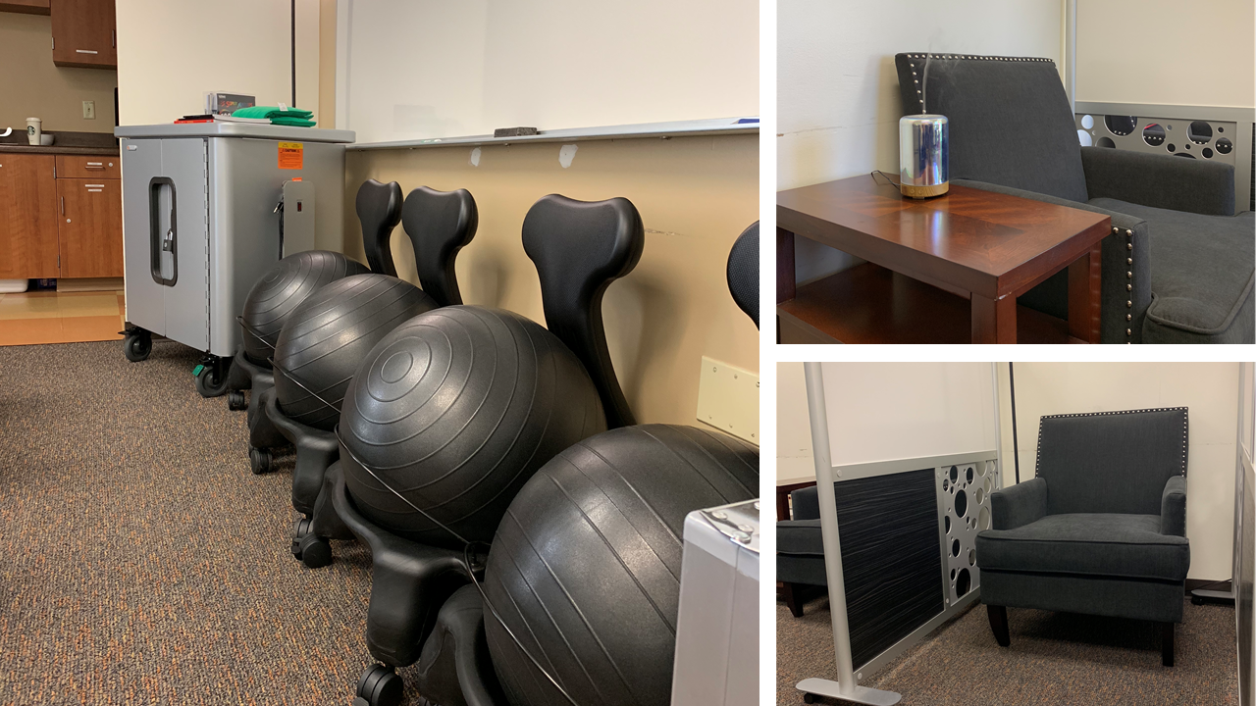
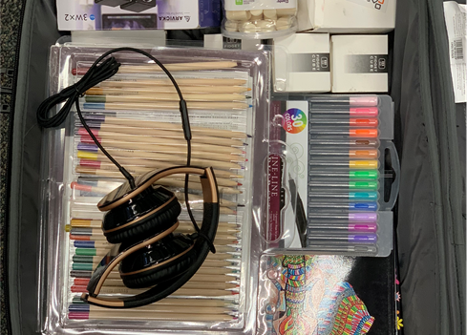
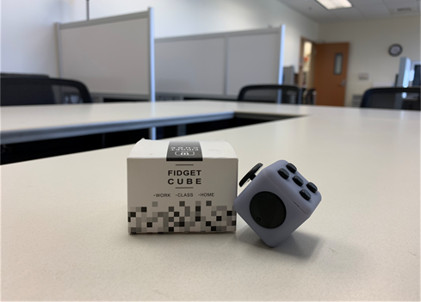
Notes:
Academics, Relationships, Independence, Self-Advocacy, and Emotional Health
This lab came about through the AEP (Adult Education Program) NOCRC (North Orange County Regional Consortium), and DSS (Disability Support Services) workgroup identifying regional needs. It was noted that there was an increase of students with ASD (Autism Spectrum Disorder) who are and will be entering Adult Education at a rapid rate. A need was recognized for additional supports and resources for students with ASD
A safe, quiet space for students who feel overstimulated or overwhelmed
Specialized lighting, equipment, furniture & materials that make the lab a safe, calm, comfortable place to be
1:1 and group counseling and instruction
Social groups, stress management workshops
Professional development - training, and technical assistance to faculty and staff on campus
AEP is partnering w/credit institutions to expand the ARISE lab to Cypress and Fullerton College

Slide 17
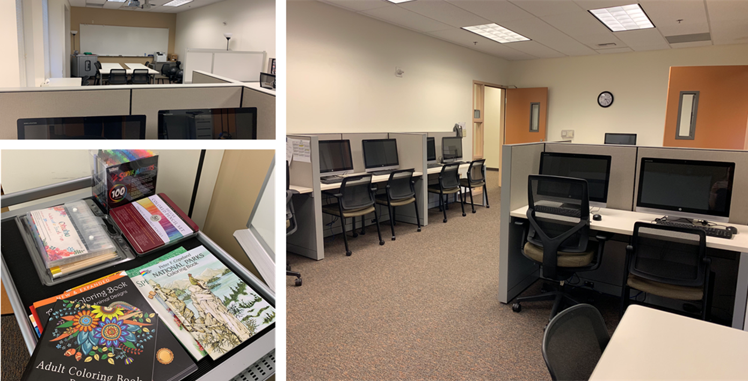
DSS Counselor/Instructor (general fund)
Instructional Assistant (AEP funded)
Facilities re-model; Equipment (AEP funded)
Notes:
The goals of the ARISE lab include:
Completion of education goals
Support transition to higher level education goals & employment
Increase persistence
It started on 1 campus and has expanded to all 3 NOCE campuses
FT staffing at Anaheim campus
PT staffing at Wilshire and Cypress centers

Slide 18
I-BEST
Integrated Basic Education and Skills Training Program
Literacy, work, and college-readiness skills
Team-teaching approach
Notes:
There are so many levels in ESL that many students will drop out before finishing ESL or don't want to continue because they have already spend so much time in ESL and they need to work. One way we have found that can cut down on the amount of time is IBEST (Integrated Basic Education Skills and Training).
The Integrated Basic Education and Skills Training (I-BEST) classes help students move through school at a faster pace.
Pioneered by Washington’s community and technical colleges, I-BEST uses a team-teaching approach. Students work with two teachers in the classroom: one provides job-training and the other teaches basic skills in reading, math or English language. Students get the help they need while studying in the career field of their choice; they learn by doing.
The I-BEST model is also used in academic transfer classes so students can brush up their skills as they learn college-level content toward a degree.
I-BEST challenges the traditional notion that students must move through a set sequence of basic education or pre-college (remedial) courses before they can start working on certificates or degrees. The combined teaching method allows students to work on college-level studies right away, clearing multiple levels with one leap.
Currently we have I-BESTed our Pharmacy Tech (ESL), Medical Assisting, Early Childhood (Basic Skills), and the Administrative Assistant (Basic Skills) rogram.
IBEST Contact
William Durden Policy Associate, Basic Education for Adults wdurden@sbctc.edu 360-704-4368
https://www.sbctc.edu/colleges-staff/programs-services/i-best/

Slide 19
How do you bring about the change?
Throw out the “silo” model
Campus leaders reaching out to include noncredit participation
Noncredit leaders reaching out to credit leaders
Throw out “us” and “them” vocabulary
Full-time vs. Part-time
Credit vs. Noncredit
Integration does not happen overnight.

Slide 20
Opportunities
Local Senates need to have voting noncredit members
Provide funding for adjunct faculty to be paid for committee meetings if few or no full-time faculty are employed
Provide professional development for noncredit adjunct faculty
Count noncredit full-time faculty in FON
Respect noncredit faculty for their advocacy, expertise, and efforts in serving the college and community
Notes:
There should be adjunct representation on the Academic Senate.
Our adjunct are paid for the time they spent at the Academic Senate meeting.

Slide 21
Questions?
Geoffrey Dyer
Gdyer@taftcollege.edu
Tina McClurkin
tmcclurkin@noce.edu
LaTonya Parker
LaTonya.Parker@mvc.edu
Thank you for attending this session!

Slide 22
Some Resources
ASCCC Efforts to Support and Advocate for Noncredit Instruction — A Review
https://www.asccc.org/content/asccc-efforts-support-and-advocate-noncredit-instruction-%E2%80%94-review
Noncredit Distance Education: Demystifying the Myth
https://www.asccc.org/content/noncredit-distance-education-demystifying-myth
Noncredit Instruction: Opportunity and Challenge (2009)
https://www.asccc.org/papers/noncredit-instruction-opportunity-and-challenge

