Slide 1
Things Credit Folks Need to Know about Noncredit

Slide 2
Are you a credit-centric faculty member or administrator who has an interest in noncredit or has already started developing or offering noncredit courses but are finding it difficult to relate to your experiences in credit? There are elements of noncredit course and program development and instruction that can be difficult for credit-centric people to grasp. Join presenters to de-mystify noncredit from a credit lens. This is a beyond the basics presentation but may have some overlap with Noncredit Basics.
Madelyn Arballo
Mt. San Antonio College
ACCE Past President
Jan Young
Glendale College
ACCE President
Cheryl Aschenbach
Lassen College
ASCCC Secretary

Slide 3
First, there is no hyphen in noncredit!

Slide 4
You can’t just rename a credit course noncredit (and you’ve tried…)
Categories: English as a Second Language, Immigrant Education, Elementary and Secondary Basic Skills, Health and Safety, Substantial Disabilities, Parenting, Home Economics, Courses for Older Adults, Short-Term Vocational, and Workforce Preparation.
Career Development and College Preparation (CDCP) programs have enhanced funding in four disciplines (above). Programs must be comprised of at least two courses.
Certificate of Competency: ESL, Elementary and Secondary Basic Skills
Certificate of Completion: Short-Term Vocational, Workforce Prep
Dodging the repeatability issue
Positive Attendance Accounting needs to be captured

Slide 5
Noncredit: A Tool in Your Toolbelt
Goal: Develop curriculum based on identifying the needs of students.
Not just a progression from noncredit to credit. Many credit students take noncredit classes
Students may need more than 16-18 weeks to learn new skill
Original Competency Based Learning program
Time is the variable until mastery is achieved
Students can have repeated enrollment in course.
Progress is measured, P, SP, NP
Noncredit is not Community Ed

Slide 6
Why would my college need noncredit courses?
The Public Policy Institute of California recently did a study (2020) of the graduation of high school-age students. The typical multi-year decline in CA persists over a decade or more and is greater than 20 percent.
Access of students: older, immigrants, returning adults who wanting to upskill --broadens base of college meeting the needs of 2.5m adults without degrees
Student Success Funding formula -100% of funding based on FTES

Slide 7
How do noncredit courses complement credit courses?
Students may have gaps in education and want more preparation before accessing financial aid and starting credit programs-- especially true with AB705. With high number of students working, there is no time to devote to 6-8 units of co-requisite Math or English.
How prepared are credit students in introductory classes?
Gap analysis of introductory courses: what skills would you like entering students to be more proficient at?
Examples:
Glendale CC - Intro to Engineering
Mt. Sac – Intro to Anatomy

Slide 8
How do noncredit courses strengthen the success rates of credit students?
Opportunity to learn college “skills” e.g. time management, Canvas, awareness of student support services on campus
Noncredit prep courses can introduce vocabulary of credit course, ensuring better preparation in credit course.
At Glendale, many accounting students take noncredit course prior to credit course. Need B in Financial Accounting to transfer to Cal State

Slide 9
Noncredit students entering credit programs are more successful than students entering credit programs directly (Source: GCC Research and Planning)
 | 2014-2015 to 2016-2017 | 2015-2016 To 2017-2018 | 2016-2017 To 2018-2019
Pass Rate of English 101 Students
Credit Students | 66.4% | 67.6% | 70.2%
Noncredit Students | 71.5% | 70.7% | 80.1%
Pass Rate of English 104 Students (2 courses later, success continues)
Credit Students | 76.6% | 76.5% | 74.2%
Noncredit Students | 75.2% | 76.6% | 80.1%

Slide 10
Glendale Community College: Success in Credit Math Courses of Noncredit Students (Source: GCC Research and Planning)
Course | 2016-17 | 2017-18 | 2018-19 | 2019-20*
Math 155/255 - Arithmetic & Pre-Algebra Math Success Credit Only | 39.6% | 45.3% | 48.5% | --
From Noncredit | 66.5% | 70.1% | 72.4% | --
Math 141/145/146/245/246 – Elementary Algebra
Math Success Credit Only | 48.8% | 45.1% | 40.2% | 40.0%
From Noncredit | 66.8% | 69.5% | 62.1% | 67.9%
Math 101/119/120/219/220 – Intermediate Algebra Math Success Credit Only | 50.7% | 46.7% | 44.0% | 65.7%
From Noncredit | 70.3% | 63.9% | 63.4% | 74.5%
*Spring 2020 data not included

Slide 11
What is different about designing curriculum?
Ten allowable categories: English as a Second Language, Immigrant Education, Elementary and Secondary Basic Skills, Health and Safety, Substantial Disabilities, Parenting, Home Economics, Courses for Older Adults, Short-Term Vocational, and Workforce Preparation
Design to achieve outcomes, not to meet a necessary number of hours
Outcomes-based design
Design with the end in mind
Think outside traditional term lengths
Design for a broad, diverse student population

Slide 12
What is different about designing curriculum?
There is no distinction between lecture and lab hours
Learning outcomes determine the number of course hours. Range of hours is permissible.
Short Term Vocational Programs: must be approved by the Chancellor’s Office.
Short Term Vocational Courses:
Do not need an Advisory Board
Do not need Regional Consortium approval
Do need Labor Market data (LMI) to demonstrate high employability

Slide 13
What is different about teaching noncredit?
More students are intrinsically motivated
Individualized instruction
Stronger sense of mentoring/coaching relationship between instructor and students
Each student potentially on a different timeline, working at a different speed
Integrated student support
Instructors help with tasks like registering and connecting to campus services while also helping advise students
Individualized instruction allows for individual assistance and support

Slide 14
How do noncredit courses strengthen efforts of Guided Pathways?
Noncredit courses are not just part of the on-boarding process!
One of the major barriers of entry to credit courses is student’s confidence level and self-efficacy.
Mirrored courses provide seamless transition to credit and an opportunity to “test the waters”

Slide 15
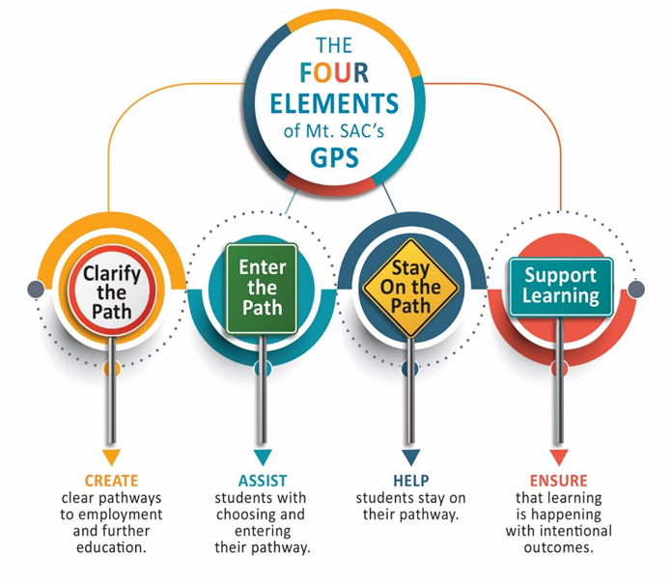
Guided Pathways is not new in Noncredit Pathways developed with equity mindedness
We don’t ask the students to change for us – we change for them
Scheduling, registration, intake
Competency-based instruction, modules (homework, rigor, assessments)
Elements of GPS were the norm for noncredit before institutionalization into colleges
Career counseling
Case management approach
Tutors, counselors in the classrooms
Bridge from adult schools to community colleges as well as bridge to credit courses.
Need noncredit metrics in statewide GPS outcomes
Notes:
I combined SWP and credit relationship

Slide 16
Support Services and Transitions
Career Development and College Prep (CDCP) – the name says it all
A noncredit CDCP certificate is an official state certificate
Noncredit students and programs have official college transcripts
Noncredit students really do develop noncredit student educational plans (NSEP)
Students can earn college units in articulated noncredit mirrored courses
Noncredit is the gateway for undocumented students who otherwise will have no opportunity to take credit courses (SB554/NC special admit, SB68/residency)
Wrap-around services, i.e., America’s Job Center’s of California (AJCC), CalWORKs, Dreamers

Slide 17
Resources
Association of Community and Continuing Education (ACCE) acceonline.org. Archives of past noncredit presentations and webinars
Noncredit Instruction: Opportunity and Challenge. ASCCC paper Spring 2019 https://asccc.org/sites/default/files/Noncredit_Instruction.pdf
Program and Course Approval Handbook (PCAH), 7th Ed. https://www.cccco.edu/-/media/CCCCO-Website/Reports/CCCCO_Report_Program_Course_Approval-web-102819.pdf?la=en&hash=06918DD585E9F8C0805334FEA3EB1E6872C22F16

Slide 18
Questions?
Madelyn Arballo, Associate VP, Continuing Ed, Mt. San Antonio College marballo@mtsac.edu
Cheryl Aschenbach, Secretary, ASCCC, Lassen College, caschenbach@lassencollege.edu
Jan Young, Division Chair, Continuing Ed, Glendale College, ACCE President, jyoung@glendale.edu

