Slide 1
Effective practices for creating and using noncredit certificates
Cheryl Aschenbach, Lassen College, ASCCC Executive Committee
Sofia Ramirez Gelpi, Allen Hancock college, dean Academic Affairs

Slide 2
Description
The equalization of CDCP noncredit apportionment with credit apportionment has spurred interest in the effective use of noncredit. This breakout explores effective practices for the creation and use of noncredit certificates of completion and competency.

Slide 3
Career Development and College Preparation (CDCP)
Programs and required courses classified as noncredit Career Development and College Preparation(CDCP) prepare students for employment or to be successful in college-level credit coursework. In accordance with Title 5, section §55151, colleges may offer a sequence of noncredit courses that culminate in:
Certificate of Competency
Certificate of Completion - leading to improved employability or job opportunities
Adult High School Diploma

Slide 4
Workforce Preparation
Provide instruction for skills necessary for job-specific technical training
Speaking
Reading
Listening
Writing
Mathematics
Decision-making
Problem-solving
Career Development

Slide 5
Short-term Vocational
Designed for high employment potential
Lead to a CTE objective, certificate, or award related to employment
Should do one or more of the following:
Improve employability,
Provide job placement opportunities,
Prepare students for further college-level coursework
Also need to
Meet documented labor market demand

Slide 6
Elementary & secondary basic skills
instruction for individuals in elementary- and secondary-level reading, writing, computation, and problem-solving skills
Elementary-level generally considered content and proficiencies at levels through the 8th grade
Secondary-level generally considered content and proficiencies at levels through the 12th grade and may incorporate a high school diploma
Supplemental instruction, which includes supervised tutoring and learning assistance, is also authorized under this heading.
Learning assistance can be a required component of another course for all students in that course (California Code of Regulations, Title 5, section 58172), or the learning assistance may be optional and is provided through an open-entry/open-exit course, which is intended to strengthen student skills and reinforce student mastery of concepts taught in another course or courses (California Code of Regulations, Title 5, section 58164)
Supervised tutoring, as addressed in Title 5, sections 58168 and 58170, must be provided only in noncredit courses with the title “Supervised Tutoring” that are designated with the TOP code 493009. More than one supervised tutoring course may be developed and offered in specific disciplines—such as mathematics skills for construction trades, writing skills for business management, or reading comprehension in support of history courses—but they cannot be designed for a specific course or courses.
PCAH, 5th ed., pages 96-97

Slide 7
ESL
instruction in the English language to adult, non-native English speakers with varied academic, vocational, and personal goals
listening
speaking
reading
writing
may integrate other areas
computer literacy
cultural competency
study skills
vocational skills
life skills

Slide 8
Noncredit Enrollment by Instruction Area 2013-2014
Basic Skills – 713,263 ESL – 414,832 CTE – 239,077 AWD-75,204
*Source: LAO Workforce Education Consortia

Slide 9
CA Demographics 18-65 years

Slide 10
Noncredit certificates
Certificate of Completion
Sequence of CDCP courses in Short-term Vocational or Workforce Preparation
Defined in Title 5, section 55151(h)
Certificate of Competency
Sequence of CDCP courses in ESL or Elementary & Secondary Basic Skills
Defined in Title 5, section 55151(i)
Standards for approval are defined in 55151(j)
Same standards of quality as credit certs (55070)

Slide 11
Considerations for noncredit courses and programs
Impact on students
Access & Success
Financial aid
Academic loads
Athletic eligibility
Appropriateness of content for noncredit/credit
Impact on other courses and programs
What else?

Slide 12
Ways to Use Noncredit for Student Access & Success in CTE

Slide 13
CTE & Noncredit
Noncredit ESL courses alongside credit or noncredit CTE offerings (VESL)
Noncredit basic skills (BS) courses alongside credit or noncredit CTE offerings
Noncredit career development courses to help convey job search and job retention skills
Noncredit CTE prior to credit CTE
Noncredit CTE instead of credit CTE

Slide 14
VESL & CTE
Noncredit vocational ESL (VESL) courses can be taught with credit or noncredit CTE courses to contextualize english skills within a vocational environment
Examples:
VESL Automotive at San Diego CC
English for Special Uses (ESU) & Welding at Mt. SAC
Designed for advanced level ESL students – currently being modified for all students
Opportunity to improve English language skills, including specialized vocabulary and language functions for academic and vocational purposes
Strengthen critical thinking skills, ability to work in teams, and autonomous learning strategies
May be offered concurrently with other courses as a supplemental course, and Can be tailored to accommodate a variety of academic and vocational subjects

Slide 15
Basic Skills & CTE
Similar to VESL, basic skills English and math courses can be taught with credit or noncredit CTE courses
Skills can be contextualized for relevance
Noncredit BS courses can provide support for more advanced English and math needs within CTE program
Examples:
Transitional Math for Allied Health @ Mt. SAC

Slide 16
Career Development & CTE
Career development courses can be taught with credit or noncredit CTE courses to help students prepare for work and retain work
Job search skills, resume writing, interviewing, training skills, employment soft skills
Examples:
Retraining Readiness @ Southwestern
Career & Life Skills @ Lassen College

Slide 17
Noncredit CTE Prior to Credit
While credit courses can be used to lead to certification or licensure, noncredit courses can be used for entry-level or foundational skill development
Examples:
Funeral Service Assistant in noncredit @ North Orange SCE with Mortuary Science credit program @ Cypress College
Medical assisting in noncredit (or credit) with LVN program in credit

Slide 18
Noncredit CTE Instead of Credit
Noncredit courses rather than credit can open up career opportunities to more students
Examples:
Electronic Systems Technology @ Mt. SAC
Pharmacy Technician @ North Orange SCE
Accounting @ glendale

Slide 19
“We are getting a population of students that is different from our usual electronics students. Most of the Continuing Ed students have never been exposed to technology before or ever considered a career in a field such as electronics wiring.
As a non-credit student, they do not have to go through a lengthy registration process, we do not charge them any fees, not even any materials fee. Some of our supplies, such as fiber optics terminators, can be quite pricey. We do not have any pre-requisites in math or science; we cover all the basic math and principles needed. All the EST courses, like our credit electronics courses, have equal components of lecture and hands-on lab time.
As a result, the students are eager to learn, enthusiastic, hard-working, and happy to be here. I have encouraged them to continue on to get an electronics degree after they have completed the EST program and have an entry level job. Many have expressed a desire to do so; many have expressed to me that an entire world of possibilities has opened up before them. Sometimes, I think I have more satisfaction teaching these students than the credit students.
I have already had two students approach me to tell me that they cannot continue the program because they found jobs; one as a computer cable tech and the other at a phone system refurbishing company. If I have to lose students, that’s the way I want to lose them.”

Slide 20
Need Ideas? Let’s see what others are doing with noncredit & CTE

Slide 21
Common CTE-related Noncredit Programs
General enough to support employment possibilities in a wide variety of settings
Customer Service
Office Clerk
Beginning
Advanced
Field-specific: General, Medical, Dental
Executive or Administrative Assistant
Computer Skills / Keyboarding
Business Office Systems / Microsoft Office

Slide 22
Common CTE-related Noncredit Programs
General enough to support employment possibilities in a wide variety of settings
In-Home Support Service / Health Aide
Medical Assistant
Retail Sales
Culinary and Service Skills
Project Management

Slide 23
More Specific CTE-related Noncredit Programs
Designed for employment in specific jobs but applicable to a variety of employment settings:
Graphic Design
Tax Preparation
Warehousing
Food Preparation
Multimedia Artists and Animators
Supervision or Management
Carpenter
Gardener or Landscape Management

Slide 24
Very Specific CTE-related Noncredit Programs
Designed for employment in specific jobs in specific fields:
Recreation Assistant in a Marine Environment
Shelter Dog Training
Construction Technology
Paraprofessional Mental Health Worker
Textile and Fabric Design
Bakeshop
Linux Server Administration

Slide 25
Very Specific CTE-related Noncredit Programs
Designed for employment in specific jobs in specific fields:
Appliance/Refrigeration/Air Conditioning Repair
Cisco Certified Network Associate
Building Information Modeling and CADD
CA Conditional Real Estate License
Welder
Automotive Welding, Cutting and Fabrication
Gas Tungsten, Arc Welding
Semiautomatic Arc Welding

Slide 26
Very Specific CTE-related Noncredit Programs
Designed for employment in specific jobs in specific fields:
Horse Ranch Management
Electronic Cabling and Wiring
Utilities and Construction Preparation
Bank Teller
Mechanic – Auto, Maintenance, Manufacturing
Auto Body and Paint Technician
Pipe Welding / Pipe Fitting
Braille Transcribing

Slide 27
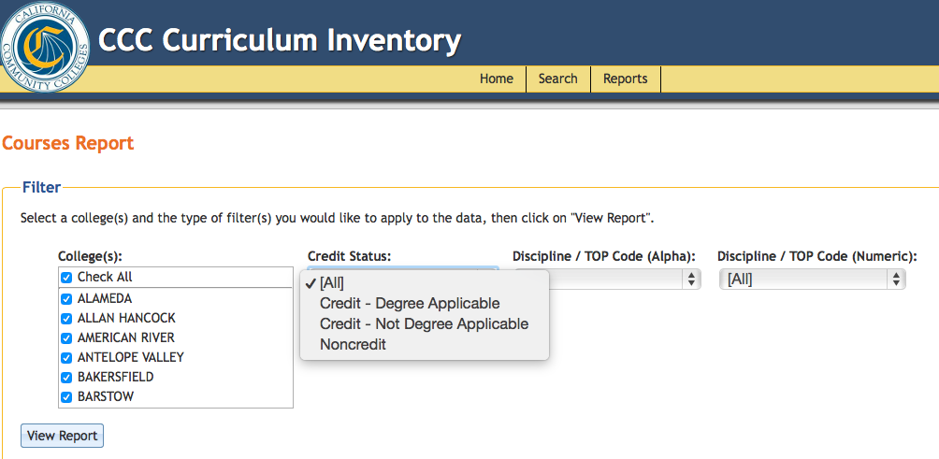
Want to see for yourself?
Review or explore other noncredit programs in the Chancellor’s Office Curriculum Inventory
http://curriculum.cccco.edu
Reports → Programs Report → Program Award: Noncredit
Reports → Courses Report → Credit Status: Noncredit

Slide 28
Questions?
Cheryl Aschenbach
caschenbach@lassencollege.edu
Sofia RaMirez Gelpi
sgelpi@hancockcollege.edu

