Slide 1
Noncredit and Distance Education
Ingrid Greenberg, SDCCE
Manuel Velez, ASCCC South Representative
Gevork Demirchyan, Glendale Community College

Slide 2
Noncredit and Distance Ed
Prior to the pandemic-related restrictions, the common perception regarding noncredit and distance education was that it simply wasn't cost effective. However, is it has in all other areas of instruction, the need to offer noncredit courses through distance education has forced many colleges to explore and even offer noncredit courses through an online format. Join us for this session where we'll discuss the current state of noncredit and distance education.
Overview

Slide 3
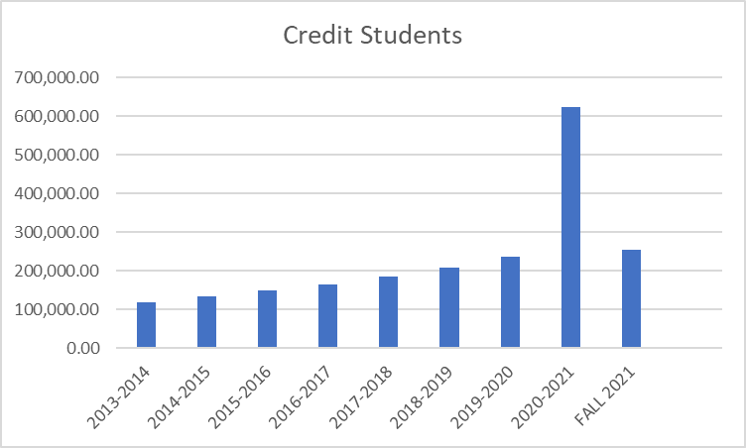
Number of Credit FTES according to Chancellor’s Office Datamart

Slide 4
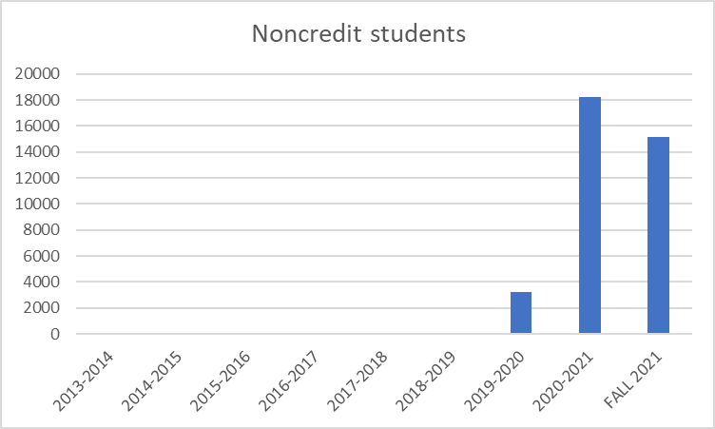
Number of Noncredit FTES according to Chancellor’s Office Datamart

Slide 5
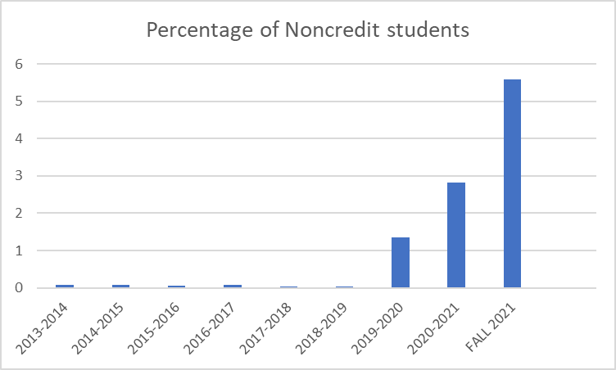
Percentage of DE students who are Noncredit FTES

Slide 6
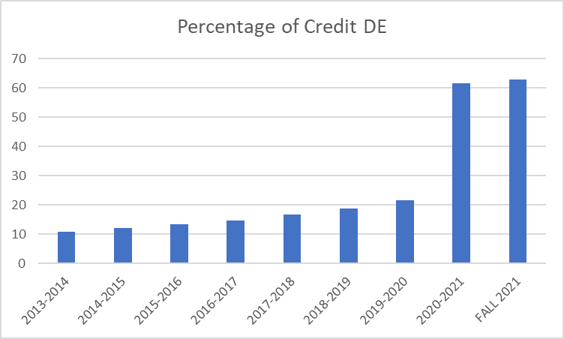
Percentage of all Credit students who are DE

Slide 7
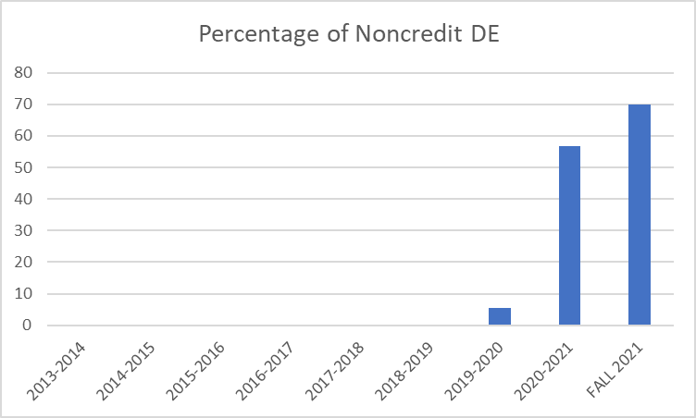
Percentage of all Noncredit students who are DE

Slide 8
Noncredit DE
An opportunity to serve the community, new and returning students.

Slide 9
SDCCE at SDCCD
San Diego College of Continuing Education
One of four colleges of San Diego Community College District
One of the largest noncredit institutions in CA
WASC Accreditation
7 campuses + 150 offsite locations
104 years serving San Diego

Slide 10
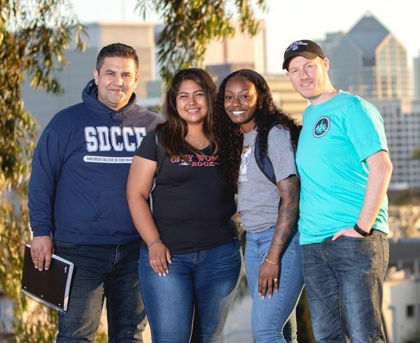
SDCCE
As the largest provider of noncredit education in California, SDCCE’s mission is to provide accessible, equitable, and innovative quality education and career training to adult students.
Serving 38,000 students transitioning to career and college

Slide 11
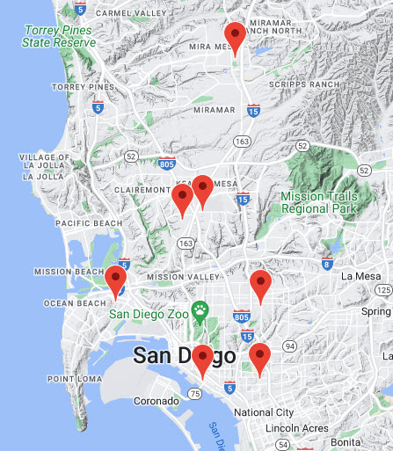
SDCCE
7 campuses and 150 offsite locations

Slide 12
Innovation and Distance Education at SDCCE
Innovation and Launch of Distance Education in Noncredit & Career
#BetterTogether
College, Industry and Labor Union
2006-2007 Shipyards Safety & Communication classes
Quia.com: puzzles & games
2009-2013 Hospitality, Hotels, Restaurants
Audio conferencing with slides
Best Practices for College
2016 - 2017: SDCCE ESL program
Fully online ESL Pilot
Canvas
Zoom video conferencing
Equitable access for students, employees, entrepreneurs, and the community

Slide 13
SDCCE DE Enrollments
2013-14: 3,443 online enrollments
2017-18: 7,372 online enrollments
= 114% increase of SDCCE students enrolling in noncredit online classes
Before pandemic

Slide 14
SDCCE DE Enrollments
SDCCE Distance Education Student Enrollments as of May 11, 2022 (Spring 2022 enrollments will be adjusted after last day of semester, June 10, 2022.)
Active enrollment definition:
The number of students with a current enrollment status of enrolled.
Drops and never-attends are excluded.
Source: SDCCE Tableau Enrollment Management Dashboard
Pandemic

Slide 15
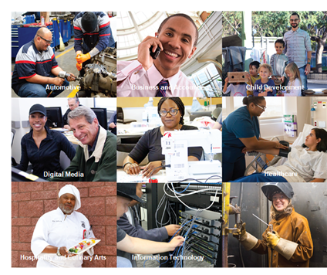
SDCCE student enrollment
Some marginalized students did not adapt to fully online education in 2020.
Digital Divide
Low income students lack access to internet and computer technology.
Either/or options do not support fluid nature of students’ lives.
Waitlists ESL
Beginning students
Pandemic

Slide 16
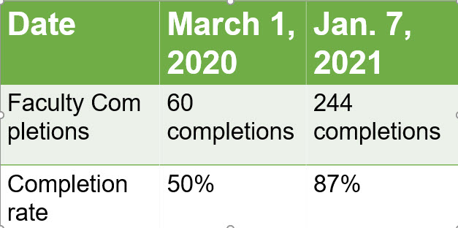
#BetterTogether
District Online Faculty Certification Program (OFCP)
20 hours
Accessibility
Online Course Design
Canvas
Zoom
SDCCE Faculty Professional Development

Slide 17
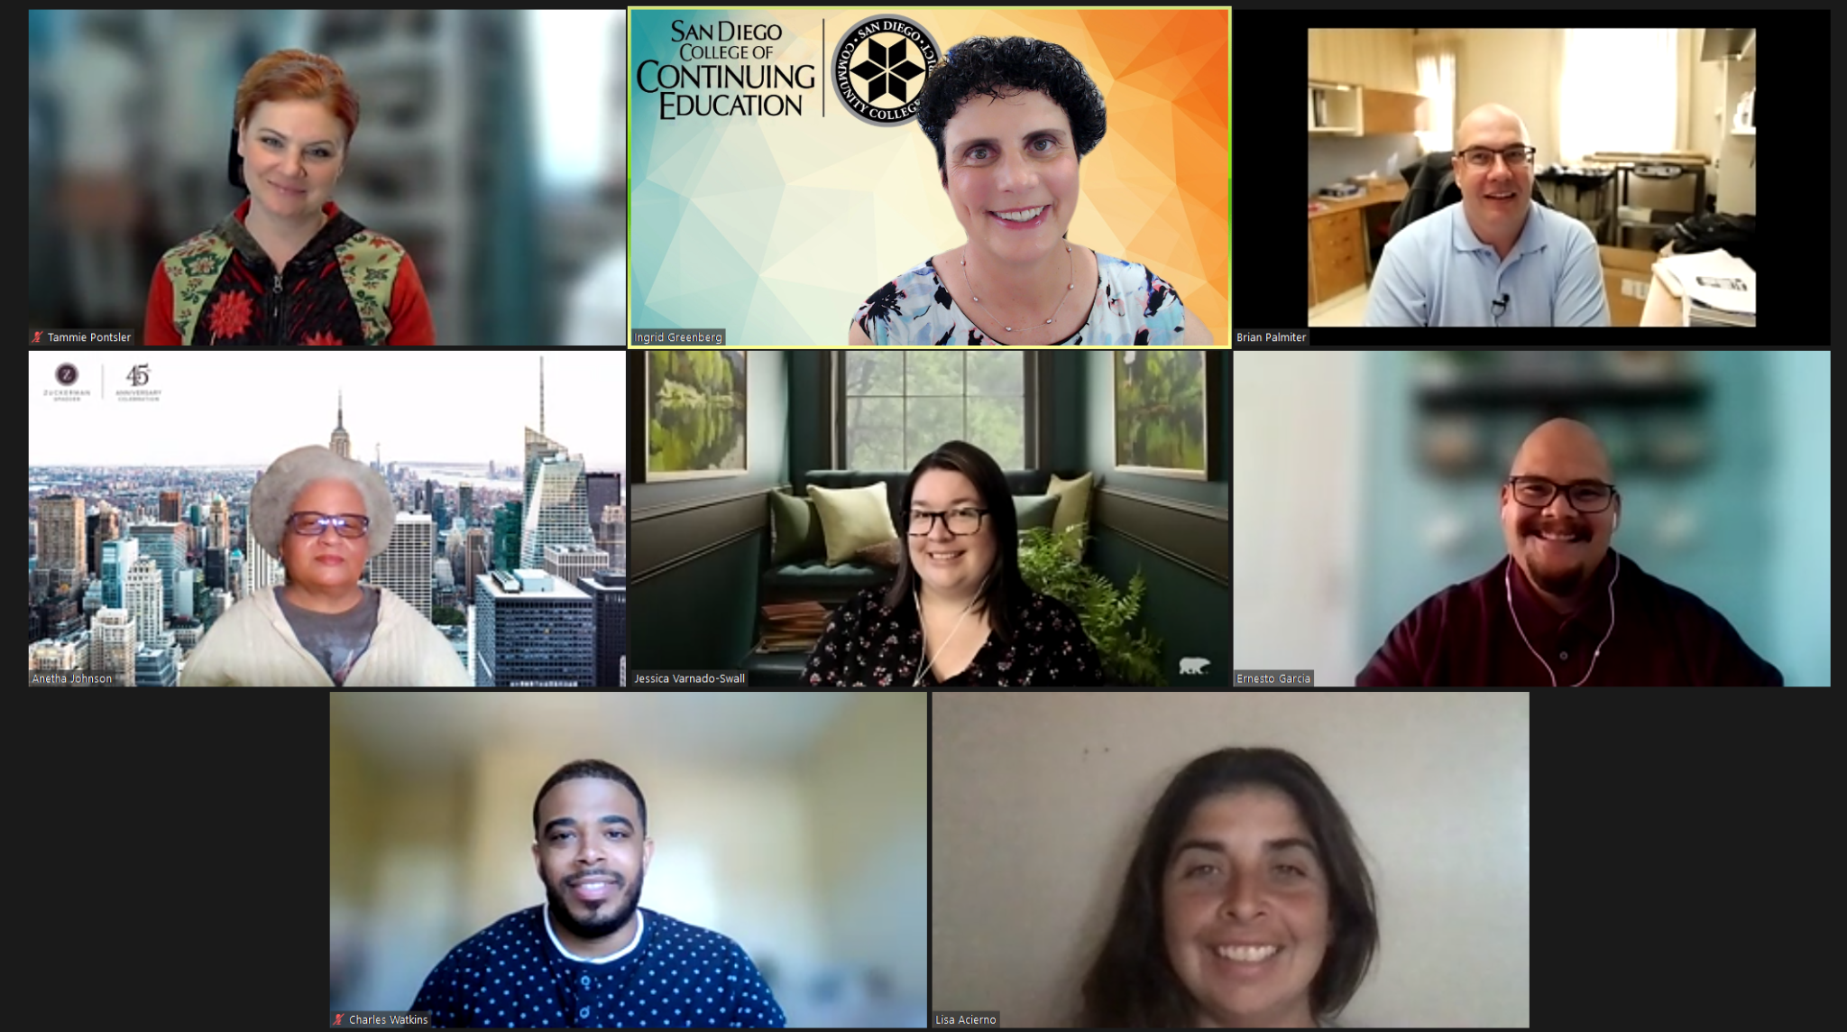
#BetterTogether
SDCCE Online Faculty Mentor Team
May 2020 to present
CAEP Model Program 2021
2020-2021
309 hours of one-to-one mentoring
58 faculty served

Slide 18
Best Practices
Modelled after Passport to Success Faculty and Staff Academy
Faculty
Instructional Classified Professionals
One-to-One live mentoring for personalized training: Canvas, Zoom, GDrive & more
SDCCE Online Faculty Mentoring

Slide 19
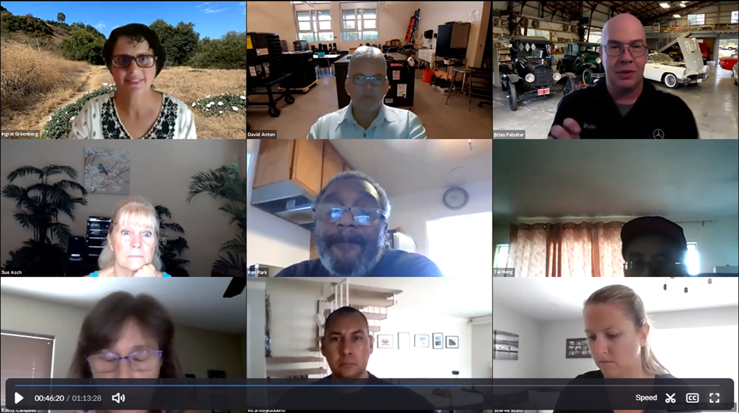
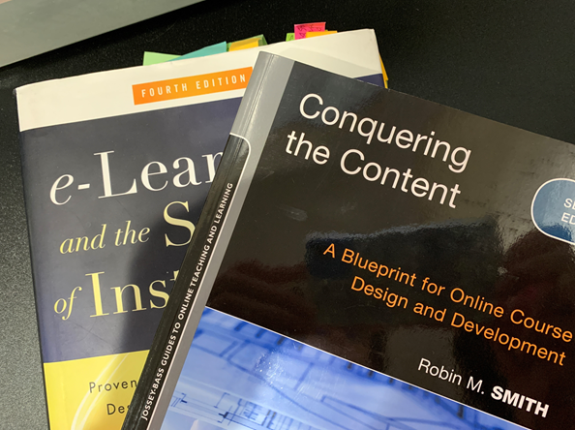
Best Practices
Four-week professional development courses
35 faculty and instructional staff served
815 hours of participation
Online Course Design Classes
Summer 2020 - Spring 2021

Slide 20
HyFlex
300+ beginning ESL students waitlisted
2021 summer:
Field tested HyFlex technology and pedagogy
Review of the HyFlex literature
2021 Fall:
39 HyFlex ESL and DSPS courses
2022 Spring
45 HyFlex ESL, DSPS, IT, and Emeritus courses
Pilot 84 HyFlex courses 2021 - 2022

Slide 21
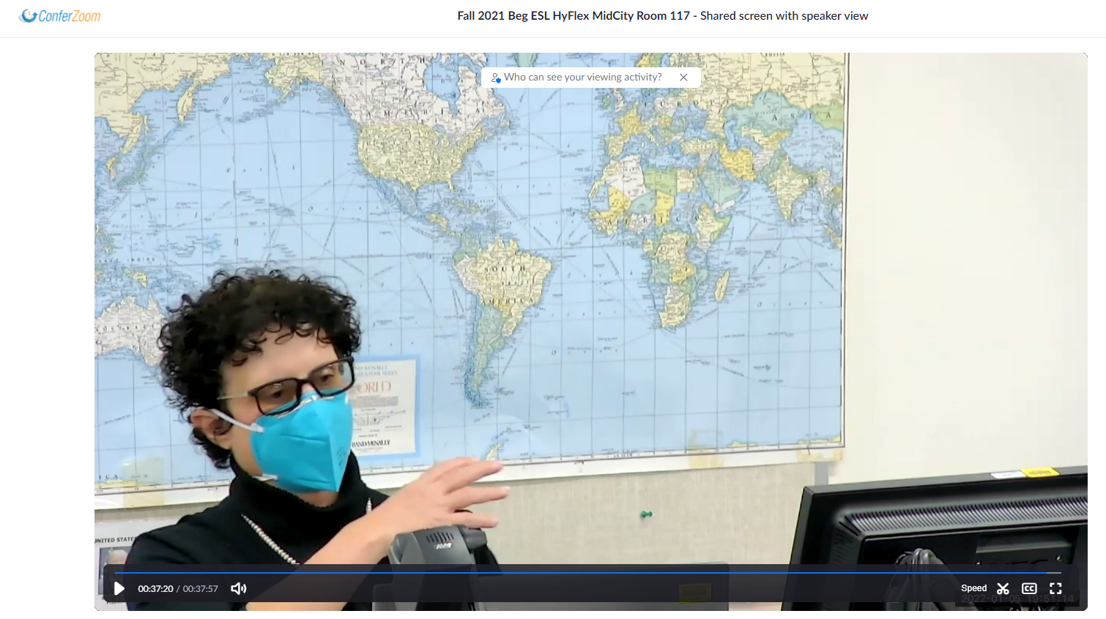
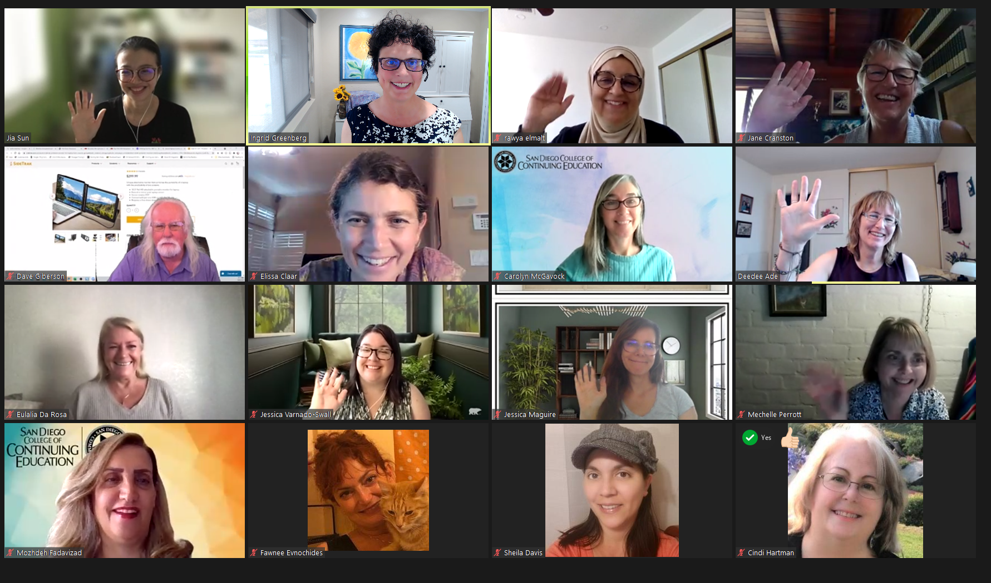
Best Practices
Summer field testing
One Instructional aide per HyFlex class
COP Meetups
Mentors
Beginning of semester: HyFlex tech troubleshooting
HyFlex Pilot

Slide 22
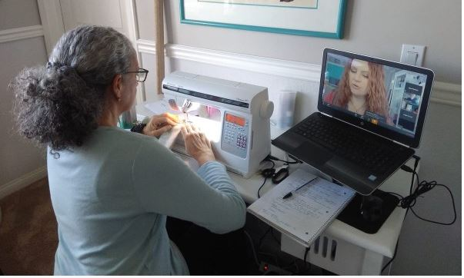
Noncredit Student Attendance
Onsite noncredit classes = positive attendance, open entry, open exit
Distance education =
census attendance, managed enrollment
San Diego College of Continuing Education

Slide 23
ASCCC 2021 Career Noncredit Education Institute
Community College Noncredit Funding: Tracking Student Attendance in Noncredit
Michelle Fischthal, D.B.A. VPI San Diego College of Continuing Education
LaTonya Parker, ASCCC Area D Representative
Matthew Rivaldi, MBA, Faculty San Diego College of Continuing Education
Jan Young, MBA Glendale College, ACCE President
Virtual Event

Slide 24
Future
Update Title V noncredit DE student attendance language
“It is recommended that each institution consult with Title 5 and stakeholders before implementing a noncredit attendance procedure. Due to the complexity of the Noncredit Alternative Accounting Method, institutions may interpret the language differently.”
Wishlist for Noncredit DE

Slide 25
SDCCE DE Attendance Procedures
Attendance Accounting Policies and Procedures memo, for Online Classes (including Fully Online, Hybrid, and Hyflex)
Spring 2022

Slide 26
SDCCE DE Strategic Planning 1
Create DE Leadership Team
Identify goals
Multiple measures
DE Faculty Survey each semester
Student Enrollment
Student waitlists
ASB leaders and meetings
Ad Hoc DE & Remote Workgroup
VPs
Deans of Online Education & Student Equity
Faculty Leaders
Professional Development Flex Coordinator
Curriculum Committee
DEI
DE Committee
#BetterTogether

Slide 27
SDCCE DE Strategic Planning 2
Seven tier professional development plan
Coordinate, curate, write and communicate resources and updates
Create and curate self-paced video tutorials.
Coordinate online faculty mentoring
Provide stand-alone group trainings
Design, develop and implement Multi-week Online Teaching and Design PD courses
Coordinate Training and Development for Self-Evaluation of Online Education using Online Course Design Rubric and Peralta Online Equity Rubric
Coordinate Peer Online Course Review (POCR)
Seven tier PD plan

Slide 28
Best Practices
Online Faculty Mentor Coordinator Leadership
Professional organizations: State, Regional, District
ACCJC/WASC
CVC.edu
CVC OEI
CCCDECO
DET/CHE
SDICCA-DE Committee
District Online Faculty Mentor Team
SDCCE ESL Program
ASB
Academic Senate
Classified Senate
IT Staff
AFT Union
Vendors
DE Strategic Planning: #BetterTogether

Slide 29
Future
Digital Inclusion Funding in the Infrastructure Investment & Jobs Act, Dec. 9, 2021 webinar.
National Skills Coalition Dec.13, 2021 30-minute webinar and slides New Federal Investments in Digital Equity: What Skills Advocates Need to Know
Regional Digital Equity Strategy, by San Diego Association of Governments (SANDAG)
San Diego Council of Literacy
Partner with community, regional, statewide, national organizations

Slide 30
Call to Action
What role will noncredit play in advancing digital equity and inclusion?
How will noncredit serve community of learners who need access to affordable internet, devices, and digital skills learning?
Noncredit DE

Slide 31
Career and Noncredit DE
Q & A
Thank you!

