Slide 1
Number 1 of the 10+1: Assigning Courses to Disciplines
Mark Edward Osea, 5C,
Bakersfield College
Erik Shearer, 5C,
Napa Valley College
Jeff Waller, ASCCC Curriculum, Grossmont College
Notes:
Jeff

Slide 2
Technical Business
Pathable vs Zoom
How to use chat
Where to find polls
Where to find resource documents
Notes:
Jeff

Slide 3
Please use the Pathable chat to tell everyone what college you are from, your discipline/leadership role and how long in that role.
Please post your questions in the chat. We will address as many as possible throughout the session.
Notes:
Jeff

Slide 4
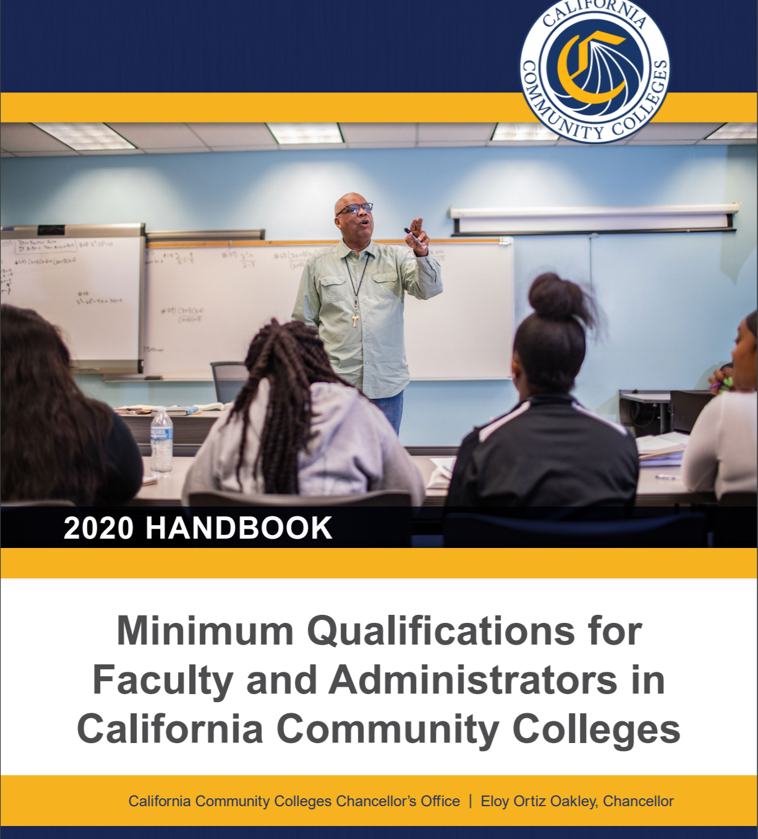
Today we will discuss…
Why? Legislation
What? Disciplines, departments, min quals/equivalency
How? Local determination
Principles for academic senates and relation to curriculum committees
Conflicts and Challenges
Scenarios
Effective Practices
You will want to have the MQ Handbook ready to use during this breakout.
Click here for that document. There’s also great information here: Disciplines List | ASCCC
Notes:
Jeff

Slide 5
WHY? Legislation & Regulations
Notes:
Erik

Slide 6
Title 5 and Ed Code
Title 5 §53200(c): “(1) Curriculum, including establishing prerequisites and placing courses within disciplines” ...also known as the 10+1!
Equivalency: Ed. Code §87359(b)
Minimum Qualifications: Ed. Code §87360(b)
Minimum Qualifications
Degrees and credits generally must be from accredited institutions (§53406).
An occupational license or certificate is required in certain instances (§53417)
A district may hire a person who possesses qualifications different from, but equivalent to, those on the disciplines list, according to criteria and procedures agreed upon by the governing board and the academic senate (§53430)
Second Minimum Qualification
Education Code section §87360 requires that sensitivity to and understanding of diversity be included in the district’s final hiring criteria.
Notes:
Erik

Slide 7
What?
Disciplines, departments, min quals/equivalency
Notes:
Erik

Slide 8
What is a Discipline?
A “discipline” is defined as a grouping of courses that share common academic or vocational preparation and are typically defined by a degree, degrees (MFA, MA, BA, MS, etc), or specific professional preparation.
Discipline is from the perspective of faculty preparation.
Faculty must meet the MQs for the discipline(s) of the course they are assigned to teach.
Not the same as local departments or subject areas. Example:
Local Department or Subject Name: Child and Family Studies
Official Discipline: Early Childhood Education
Not the same as your local designator, a TOP code, or a FSA!
Notes:
Erik

Slide 9
What is the Disciplines List?
Specifies the minimum qualifications for each discipline
Revisions to the list are considered annually
Through local senate or through professional organization
Must have two separate senate districts approve the proposal
Must provide evidence to support rationale for change
Minimum of two statewide hearings
The Board of Governors considers the recommendations of the Academic Senate and formally acts on them.
Faculty must meet the MQs for the discipline of their assignment.
Notes:
Erik

Slide 10
Min Quals for Interdisciplinary Studies
Master’s in the interdisciplinary area OR master’s in one of the disciplines included in the interdisciplinary area and upper division or graduate coursework in at least one other constituent discipline.
Any time interdisciplinary studies is used, the disciplines for a particular course MUST be specified.
Notes:
Erik

Slide 11
Disciplines vs Departments
Departments are locally-defined organizational structures.
Disciplines as defined in the Min Quals Handbook are not necessarily the same as local departments or subject areas.
Example:
Local Department or Program Name: Child and Family Studies
Local Subject Code: CFS
Official Discipline: Early Childhood Education
Instructional faculty teach courses assigned to disciplines, not departments.
The term “assigned” frequently leads to confusion for local faculty and Senates. Don’t mistake “assigned” with “owns”.
Notes:
Erik

Slide 12
Minimum Qualifications
A college/ district may establish additional qualifications which are more rigorous than the state-established MQs.
However, local MQs cannot be less rigorous than the state-established MQs.
Equivalency must be established locally and must be at least equivalent to the minimum qualifications.
Notes:
Erik

Slide 13
Why Do We Care About Faculty Qualifications?
Minimum Qualifications are requirements that
Ensures faculty preparation in the content area
Ensures Learning
Addresses accreditation standards
ACCJC Standard III.A.1:
“The institution assures the integrity and quality of its programs and services by employing administrators, faculty and staff who are qualified by appropriate education, training, and experience to provide and support these programs and services.”
ACCJC Standard III.A.2:
Faculty qualifications include knowledge of the subject matter and requisite skills for the service to be performed. Factors of qualification include appropriate degrees, professional experience, discipline expertise, level of assignment, teaching skills, scholarly activities, and potential to contribute to the mission of the institution
Notes:
Erik

Slide 14
Local Considerations
Equivalency must be established locally and must be at least equivalent to the minimum qualifications.
A district may establish additional qualifications which are more rigorous than the state-established MQs.
However, local MQs cannot be less rigorous than the state-established MQs.
Do you know where your local minimum qualifications are maintained?
Do you know where your list of course assignments to disciplines is maintained?
Notes:
Erik

Slide 15
HOW?
Notes:
Mark

Slide 16
Basic Considerations
Determine the minimum qualifications necessary to teach a course. (Who should be included in these discussions?)
Local academic senates maintain responsibility for placing courses in disciplines (§53200(c)(1)).
All credit & noncredit courses must be placed within a discipline or disciplines.
Notes:
Mark

Slide 17
Options for Assigning Courses
Course assigned to a single discipline
Example: ENGL 101 assigned to English. The minimum qualifications for English provides adequate preparation to teach the course content.
Course assigned to more than one discipline with an “or”
Example: ARTS 101 assigned to Art or Graphic Design. The minimum qualifications for either discipline provide adequate preparation to teach the course content.
Course assigned to more than one discipline with an “and”
Example: HUMA 120 assigned to Humanities and Ethnic Studies. The minimum qualifications for both disciplines together provide adequate preparation to teach the course content.
Notes:
Mark

Slide 18
Multiple Disciplines
Do not need to have more than one course outline of record (COR) or be listed in the catalog under multiple subject codes.
Example: ARTS 101 is assigned to Art OR Graphic Design on the COR. The college only maintains one COR for ARTS 101. The course is listed in the catalog ONLY as ARTS 101. However, faculty who meet MQ for Art or Graphic Design can teach the course.
May be “double-coded” or “cross-listed”—i.e., recorded on two or more CORs and listed in the catalog under each subject code.
Example: Social Psychology is recorded on two separate CORs, one as PSYC 120, one as SOCI 120. It is listed in the catalog under both subject codes. These courses should have identical CORs.
Be careful about creating double-coded / cross-listed courses. It’s rarely to the students benefit and is sometimes a bad solution to a local conflict or misunderstanding of who is eligible to teach a course.
Notes:
Mark

Slide 19
Local Disciplines Assignment
A district may locally assign any discipline on the state list for local use, but they do not have to use any particular discipline.
For instance, if a district has not locally adopted the discipline of Art History, it could assign all of its Art History courses to the discipline of Art.
In this case, the MQs for Art History classes in that district would be those defined for the Art discipline, not the Art History discipline (unless/until the district chose to change this).
Notes:
Mark

Slide 20
Multi-College Districts
While some multi-college districts have common courses, others do not.
Since your district has one set of minimum qualifications, similar courses should be placed in the same discipline, even if they are called different things.
Your local process may be different than those in single college districts.
Notes:
Mark

Slide 21
Impacts of decisions made
Single Discipline
Faculty who meet minimum qualifications or the locally-determined equivalent for THAT listed discipline are eligible to teach the courses within that particular discipline.
More than one discipline with an “or”
Faculty who meet minimum qualifications or the locally-determined equivalent in ANY of the listed disciplines are eligible to teach the course.
More than one discipline with an “and”
Faculty who meet minimum qualifications or the locally-determined equivalent for ALL of the listed disciplines are eligible to teach it.
Notes:
Mark

Slide 22
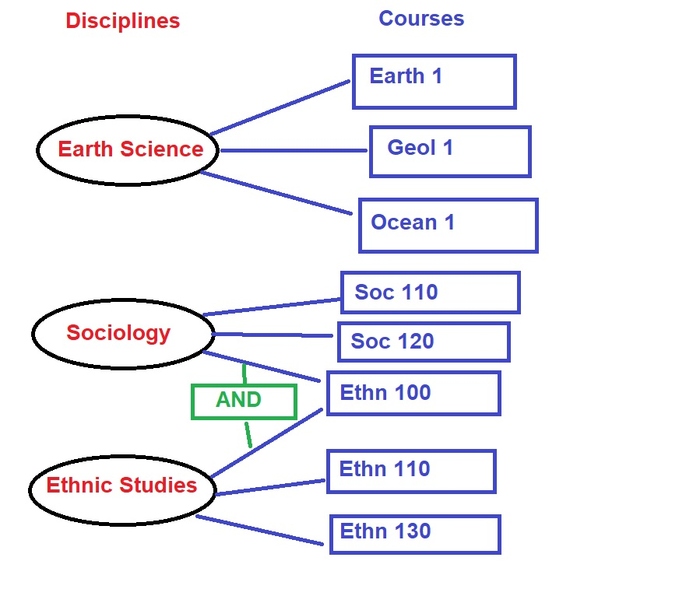
Examples
Notes:
Mark

Slide 23
Conflicts When Assigning Courses
Notes:
Jeff

Slide 24
Scenarios to consider To which Discipline(s) would you assign the following courses?
Notes:
Jeff

Slide 25
Scenario A
Course: Multimedia Applications for the Web
Description: Introduction to the use of multimedia components, images, typography, motion and audio, for designing websites. Software may include Photoshop, Dreamweaver, SoundEdit 16 and Flash. Projects include conceptualizing, storyboarding, and designing Web page layout. Application of design elements to Web page creation.
Notes:
Erik

Slide 26
Scenario B
Course: Asian American Studies
Description: This course explores Asian American, immigrant, and refugee experiences in the United States (Southeast Asian, Chinese, Japanese, Korean, and Filipino). Using an interdisciplinary approach (social, historical, cultural, religious, geographic, economic, linguistic, and artistic), special attention will be given to major Asian communities in the San Joaquin Valley (Lao, Hmong, Mien, Lahu, Cambodian, Vietnamese, and Filipino).
Notes:
Jeff

Slide 27
Scenario C
Course: Introduction to Geographic Information Systems
Description: This course introduces basic scientific principles of Geographic Information Systems (GIS) as they relate to working with data that have important spatial orientation and organization. Geometric and geographic concepts and theories are used to develop scientific methods for proper communication of the data and the solution of problems that have spatial relationships. Course covers basic concepts in mapping and orientation, the development of map scales and comparison of different coordinate systems and data error analysis.
Notes:
Mark

Slide 28
Wrapping Up
Notes:
Jeff

Slide 29
Summary
All Courses must be assigned to a discipline listed in the Discipline’s List and the assignment of courses is under the academic senate’s/curriculum committee’s authority.
The process for assigning courses is locally determined and may differ from college to college.
A clear local process that outlines who is involved and who makes the ultimate decision should be created at your college if it does not already exist.
All involved parties should have access to information on state requirements and locally decided policies/procedures.
Notes:
Jeff

Slide 30
Resources
ASCCC Technical Visits
Who Gets to Teach That Course? (Rostrum article, pg8)
Untangling the Knots . . . (Rostrum article)
Equivalence to the Minimum Qualifications (2016 Paper)
CTE Minimum Qualifications Toolkit
Notes:
Jeff

Slide 31
Thank You for attending! Here’s some contact information
Academic Senate for California Community Colleges, info@asccc.org
Mark Edward Osea, mark.osea@bakersfieldcollege.edu, Bakersfield College
Erik Shearer, erik.shearer@napavalley.edu, Napa Valley College
Jeff Waller, jeff.waller@gcccd.edu, Grossmont College
Notes:
Jeff

