Slide 1
The Nuts and Bolts of the ISER— Demystifying the Process of Writing the Institutional Self Evaluation Report
Ginni May, ASCCC Area A Representative, Accreditation Committee Chair
Gohar Momjian, Vice-President, ACCJC
Deborah Wulff, Vice-President Academic Affairs Cuesta College, Accreditation Committee
Accreditation Institute, Garden Grove, CA
February 23, 2018
10:30-11:45 am
Notes:
Ginni

Slide 2
Overview
Accreditation
The ISER
Getting Started
Laying Foundations/Communications
Engagement and Focus
Simplifying the Process
Evidence Based
Notes:
Ginni

Slide 3
Acronym-ese
ACCJC – Accrediting Commission for Community and Junior Colleges
WASC – Western Association of Schools and Colleges
ISER – Institutional Self Evaluation Report
QFE – Quality Focus Essay
ER – Eligibility Requirement
SLO – Student Learning Outcome
ALO – Accreditation Liaison Officer
USDE – United States Department of Education
NACIQI – National Advisory Committee on Institutional Quality and Integrity
CEO – Chief Executive Officer (College President or District Chancellor)
CIO – Chief Instructional Officer (Vice President of Instruction or Academic Affairs)
Notes:
Ginni

Slide 4
Accreditation
Purpose
Improvement
Compliance
New approach
Frame of mind
Context of college mission and fluid environment
Celebrate the college
Notes:
Gohar – flipping pyramid (necessity of compliance & focus on improvement); assume meeting (degree of alignment) standards (and if not what doing about it); peer reviewer (not external evaluator); collegial,supportive; look at how align standard in context of college mission (e.g. rural, urban, private, HI); not about how to get the ‘A’, always depends on college; benefits of authentic self-reflection & peer review process contributing to body of knowledge which evolves;

Slide 5
The ISER
Depth, Breadth, and Length
Evidence – should it stay or should it go?
Gaps
Then and now
Notes:
Gohar - ISER compliance piece, focus on language in the standard, look for RELEVANT evidence. Start with evidence first, then write narrative, helps to address gaps early and more focused report. Think of reader (peer reviewer), make easy to make connection that meet standard; no data dumps. Hope to get online platform, helps stay focused, not dissertation. Quality and culture of college comes through during visit (don’t need fancy formatting and pictures); not print doc anymore -- Focus on improvement to strengthen alignment to standard; QFE – big picture what doing to move needle in student achievement and learning

Slide 6
Getting Started
Timeline
Who should be involved?
Faculty
Administrators
Staff
Students
Others…
Committee Structure
Co-Chairs? Tri-Chairs?
Steering Committee?
Advisory Committee?
Writing Team?
Roles and Responsibilities
Budget/Reassigned Time
Notes:
Ginni

Slide 7
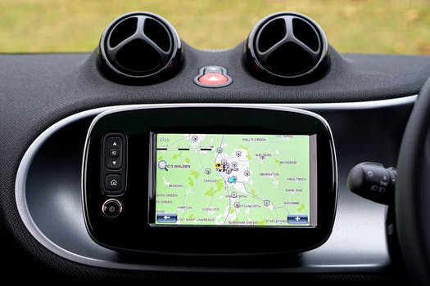
Laying Foundations/Communications
Fostering of a Culture of Involvement
College-Wide Workshops
College-Wide Communication-Accreditation Updates
Creating Information Tools
Maintaining Accreditation Website and providing resources
Educating about the Standards & new regulations
Notes:
Deborah

Slide 8
Stories from Three Institutions
Sacramento City College
City College of San Francisco
Cuesta College
Notes:
All three of us:
Gohar – how organize self and method will vary on culture/climate; e.g. transparency/trust key at CCSF so lots of pre-mtg meetings (AS Pres, Class Pres, Admin Assoc pres, student pres); explicit clarity on responsibilities, providing clear expectations, homework assignments & mini-milestones to move from one stage to next key; google doc for writing process so can review doc as it gets edited and see how doc evolves

Slide 9
Engagement and Focus
Get your hands dirty
Warning signs
Manic workers
Slackers
Make meetings fun
Acknowledge the hard work
Camaraderie
Notes:
Deborah

Slide 10
Engagement and Focus
Share document versions
Invite college-wide feedback
Open Forums
Present at meetings
Notes:
Deborah

Slide 11
Simplifying the Process
Be open and honest about your college
Highlight your accomplishments
Share your plans for improvement
Notes:
Gohar – put best self forward based on evidence, show how aligning with standard, if need stronger alignment address in report what you are doing about it (as improvement plan), integrity key; reminder understand college in fluid environment (eg. not about 100% completion, but that have process and following process – think SLOs IB/IIA or completion of evaluations IIIA)

Slide 12
Evidence Based
Evidence supports statements in the ISER…
Notes:
Deborah
Gohar-only what is needed and relevant to the standard; no data dumps; focus on student achievement, how use that information for improvement, provide examples as evidence; keep in mind all evidence is snapshot in time

Slide 13
When is it over?
Attainable Goals
Celebrate successes
Prepare for visit
Ongoing improvements
Notes:
Gohar – something about how its never over, best to embed (raise level of awareness) of accreditation work in existing committee structures or depts/units, so not starting from scratch, and internal monitoring and continuity of process (and responsibility) is owned by various stakeholders engaged

Slide 14
Still have questions??
Notes:
Ginni

