Slide 1
CTE Regional Collaborations
Orange County
September 21, 2023

Slide 2
Welcome
Coastline College
Cypress College
Fullerton College
Golden West College
Irvine Valley College
North Orange Continuing Education
Orange Coast College
Saddleback College
Santa Ana College
Santiago Canyon College

Slide 3
Academic Senate Resolution
21.01 S21 Collaborate with Regional Consortia
Resolved, That the Academic Senate for California Community Colleges collaborate with the regional consortia and the state and regional directors to empower and engage regional faculty leaders by working with the faculty leaders on regional boards, providing professional learning for career technical education faculty, sharing and developing new and emerging curriculum, and discussing how to streamline curriculum processes to move at the speed of industry and business so that students can be prepared for the jobs of tomorrow.

Slide 4
Today's Agenda
Welcome and Introductions
Working with your Regional Consortium
ASCCC, Local Senators and CTE Faculty Engagement
What is new in your Region
CTE Related Updates and Emerging Issues
A closer look at CTE Topics
Minimum Qualifications
CBE and CPL
New Title 5 Regulations- Work Experience
Early College/Dual Enrollment
Wrap Up

Slide 5
Your Regional Consortium
What is the Regional Consortium?
What does the Regional Consortium do?
What are the current Regional Consortium projects in this region?
Why should faculty care?

Slide 6
ASCCC, Local Senates and CTE Faculty Engagement

Slide 7
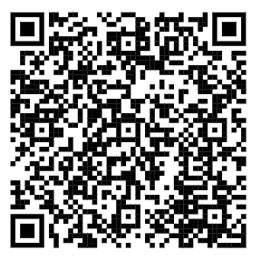
The “10 +1”
Title 5 §53200(b): Title 5 §53200 (b): Academic Senate means an organization whose primary function is to make recommendations with respect to academic and professional matters. In Section 53200 (c), “Academic and professional matters” means the following policy development and implementation matters:
Curriculum including establishing prerequisites and placing courses within disciplines
Degree and certificate requirements
Grading policies
Educational program development
Standards or policies regarding student preparation and success
District and college governance structures, as related to faculty roles
Faculty roles and involvement in accreditation processes, including self-study and annual reports
Policies for faculty professional development activities
Processes for program review
Processes for institutional planning and budget development
(otherwise known as +1) Other academic and professional matters as mutually agreed upon between the governing board and the academic senate

Slide 8
ASCCC Resources
CTE Liaisons
Services
Accreditation Resource Teams
ASCCC Coaching Model
Guided Pathways Resource Teams
Local Senate Visits
Technical Assistance-Curriculum
Technical Assistance-Governance (Collegiality in Action)
Notes:
Technical assistance could also be for equivalency and MQs

Slide 9
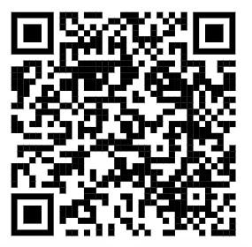
Faculty Volunteer to Serve
ASCCC appoints almost 1,000 faculty members to work on statewide committees, workgroups, and task forces. Applying to serve provides you the opportunity to:
Create change within the California Community Colleges system
Network with other faculty from all over California
Gain experience serving on a committee
Access professional development
Increase your knowledge on issues within the California Community Colleges system
Apply here to volunteer to serve.

Slide 10
ASCCC CTE Liaisons
In Spring 2015 – Delegates Passed Resolution 17.02 S15
Resolved, That the Academic Senate for California Community Colleges urge local academic senates to identify a CTE faculty member to act as a liaison to facilitate communication among local CTE faculty, the local academic senate, and the Academic Senate for California Community Colleges
Role and Responsibilities
Stay connected to local senate
Join ASCCC Listserv
Create listservs of interested faculty
Hold local events to discuss related issues
Let’s check out other suggested responsibilities

Slide 11
CTE Faculty Engagement
CTE Faculty and Local Academic Senates
CTE faculty are actively involved in your local senate
Your local senate has a CTE liaison and you know who that person is
Your CTE liaison presents at every senate meeting
Your CTE liaison reports on regional activity as well as statewide efforts
You attend the regional consortia in your area
Benefits include
Better communication between ASCCC and local senate
Building leadership for local senate
Another opportunity to recruit faculty to volunteer
Keep issues current
Seek advice from select faculty
Identify your CTE Liaison in the ASCCC Directory

Slide 12
CTE Related Updates and Emerging Issues
California Community College Chancellor’s Office Vision 2030
CCCCO California State Plan for CTE
AB 928 and General Education Impacts on CTE
CTE Related Legislation
Chat GPT/AI

Slide 13
CCCCO Vision 2030

Slide 14
California Community College Chancellor’s Office Vision 2023
Vision 2030 is a framework that builds on the goals of the Vision for Success (20172022) and the governor’s Roadmap (2022-2027). It incorporates:
o Equity in access, a focus on proactively bringing learning opportunities to prospective students where they are rather than waiting for them to come to us.
o Equity in support, a focus on strengthening learning spaces to ensure every student experiences a sense of belonging and connectedness and has easy access to an ecosystem of high-touch services.
o Engagement with the challenges and opportunities of generative artificial intelligence (AI) and the urgent need to address the troublesome effects of climate change.
The intent of the framework is to:
o Draw from what we have learned in recent years to continue with what works, fix what doesn’t, and create what is missing.
o Galvanize local, regional, and statewide action toward demolishing barriers for students and communities.

Slide 15
3 Goals and 6 Outcomes
(1) Equity in Success
i. Increase completion of a degree or certificate with equity
ii. Increase baccalaureate attainment with equity
iii. Increase share of graduates earning a living wage
(2) Equity in Access
iv. Increase participation/enrollments for dual enrollment, justice involved individuals, veterans, working adults, low-income adults
(3) Equity in Support
v. Increase number of Pell grant and CCPG recipients
vi. Reduce units to Associate Degree for Transfer

Slide 16
CTE State Plan
The California State Updates to CTE Plans and Programs
1

Slide 17
CTE Technical Education Guiding Principles
Career Technical Education
Guiding Principles
Focus on a Student-Centered Delivery of Services for all K–14+ college and career pathways
Promote Equity and Access
Achieve System Alignment
Support the Continuous Improvement and Capacity Building
Ensure that State Priorities and Direction Lead the State Plan
9
Notes:
.

Slide 18
CA Economy
The California Economy
California Future of Work Commission
31 percent of California’s workers made less than $15 per hour
45 percent of Californians in poverty have at least one family member working full time
California Future of Work Commission Recommendation
Future-proof California with jobs and skills to prepare for technology, climate, and other unpredictable events
13

Slide 19
Short Term Goals
Career Technical Education Plan
Short-Term Goals and Strategies
Boost data-informed decision-making for equity and impact
Expand work-based learning
Grow dual enrollment
Understand and plan to address career education teacher and faculty shortages
13

Slide 20
Key Priorities
Career Technical Education Plan
Key Priorities
Supply that Meets Demand
Effective Delivery and Support
Data that Informs Investments
Systems Alignment
8

Slide 21
Major Themes
Career Technical Education Plan
Major Themes
Pathways that bridge secondary and postsecondary education
Strategic Dual Enrollment
Regional Partnership Development
17

Slide 22
Major Themes 2
Career Technical Education Plan
Major Themes (continued)
CTE Teacher and Faculty Preparation and Pipeline
Work Based Learning
17

Slide 23
AB 928, General Education and CTE

Slide 24
Cal-GETC 2
Area | Subject | Courses (minimum 3 semester/4 quarter units)
1 | English Communication English Composition Critical Thinking and Composition Oral Communication | 1 course 1 course 1 course
2 | Mathematical Concepts and Quantitative Reasoning | 1 course
3 | Arts and Humanities Arts Humanities | 1 course 1 course
4 | Social and Behavioral Sciences Two disciplines | 2 courses
5 | Physical and Biological Sciences Physical Science Biological Science Laboratory (for physical or biological science course) | 1 course 1 course (1 unit)
6 | Ethnic Studies | 1 course
Total Courses (units) |  | 11 courses (34 semester units)

Slide 25
Cal-GETC: Differences from other GE Patterns
Oral communication included; adjustments to CCC courses required
Arts and Humanities Area limited to two courses
Behavioral and Social Sciences Area limited to two courses
Lifelong Learning and Self-Development not included
Ethnic Studies included

Slide 26
Proposed Title 5 Associate Degree GE Pathway

Slide 27
Proposed CCC Baccalaureate Lower Division Degree GE
ACCJC currently requires 36 units of GE for CCC baccalaureate degree students (27 lower division; 9 upper division)
Students are currently required to follow IGETC or CSU GE (which are being replaced by Cal-GETC)
The proposed GE pathway:
Helps address the challenge of high-unit technical degree programs
May be more appropriate for our baccalaureate degree students (in terms of structure of pattern and area criteria)
Would allow for increased flexibility for local approval of courses

Slide 28
(proposal consideration) Baccalaureate Degree Lower Division GE Pathway

Slide 29
Opportunities and Challenges for Colleges and Students with GE
Opportunities:
Clear GE pathway for local degrees and transfer
For local associate degrees, colleges may include additional areas (watch for additional units in degrees)
All associate degree requirements will be GE or majors; no competency or additional graduation requirements needed
Challenges:
All transfer students will need to take courses meeting UC course standard requirements, even if transferring to CSU
Reduced options for students – Fewer courses are UC transferable or approved for GE/majors requirements than at CSU
CTE Courses currently in CSU GE pattern may not be included in CalGETC

Slide 30
CTE Faculty Engagement in GE Revisions
Local Senate's leadership in GE revisions and updates
CTE faculty should be engaged in degree and program impacts of GE revisions and impact of CalGETC on transfer CTE programs
Programs should look plan for addition of Ethnic Studies Associate Degree requirement 2024-2025
CTE faculty should be engaged in GE for Baccalaureate Degree local discussions

Slide 31
CTE Related Legislation

Slide 32
Legislation and Executive Order
Executive Order N-11-23- Development of a new Master Plan on Career Education
Breakdown Silos
Strengthen Career Pathways
Prioritize Hands-On Learning and Real-Life Skills
Advance Universal Access and Affordability
AB 368 (Holden)-Priority reg. for students taking CCAP partnership courses. Exemption from fees
AB 634 (Ward)-Changes “sequence” to “a compliment”, allows for F2F or DE, and includes a means for FTES accounting
AB 1096 (Fong)- Allow for instruction of courses in a language other than English without also requiring students to enroll in an ESL course
SB 467 (Portantino) - Prohibit a student from being denied admission to apprenticeship or internship program because student uses ITIN for background check instead of SSN.

Slide 33
Chat GPT/AI

Slide 34
What is Chat GPT
ChatGPT (Chat Generative Pre-Trained Transformer) is a chatbot that uses Artificial Intelligence (AI).
It was developed by OpenAI using the vast pool of texts and data accumulated from the internet in 2021 and prior.
It was trained to mimic human writing to produce informative dialogue through its conversations with people.
Instructors might receive remarkable submissions or written work from students that are plagiarized from the program. ChatGPT can produce content that might be worth high grades in the class.
It is “free” to use and easily accessible. It only requires the user to create an account with the OpenAI site.

Slide 35
How AI in Education can be used
It can generate human-like responses to inquiries from people.
It can provide data and info on an almost seemingly endless number of subjects.
It can write poems, essays, songs, short stories, and various other literature.
It can create prompts for essays and other forms of writing.
It can create and write data scripts or code.
It can provide research on numerous topics.
It can serve as a language translation program

Slide 36
AI in Education Limitations
It cannot provide "non-text” based responses.
It is highly sensitive to question phrasing.
It cannot provide much, if any, data for questions referencing in-class material.
It has difficulty discerning between the truth and misinformation or fantasy.

Slide 37
13.05 S23 Considering the Merits and Faults of Artificial Intelligence in the Community College Classroom
Whereas, California Code of Regulations Title 5 §41301 [1] and the California Community Colleges Chancellor’s Office Legal Opinions 07-12 [2] and 95-31 [3] promote academic integrity and aim to stymie academic dishonesty by outlining academic and professional ethics and disciplinary actions;
Whereas, Advancements in artificial intelligence (AI) have progressed rapidly, with generative technologies such as OpenAI’s ChatGPT, AI-powered Bing, and Google’s Bard among other AI technologies, have created powerful tools whereby students and faculty may generate powerful responses to queries that are not a product of the individual’s own effort, and could lead to potential questions and ethical dilemmas related to academic integrity; and
Whereas, Generative artificial intelligence is a new technology that could disrupt higher education should it go unregulated;
Resolved, That the Academic Senate for the California Community Colleges prioritize the development of resources addressing artificial intelligence and its implications on education and academic integrity, develop a framework for local colleges to use in developing academic and professional policies, and present these resources no later than the 2024 Spring Plenary Session or as soon as feasible.

Slide 38
Regional Impact?
What are you hearing about Chat GPT/AI in your region?

Slide 39
CTE Minimum Qualifications

Slide 40
Challenges hiring CTE faculty?
Recognizing that our communities are filled with experts that never got an Associates Degree.
Finding the best possible faculty for our students is a crucial part in CTE program excellence.
Document credentials and get local industry experts into the hiring pool.
Notes:
find it nearly impossible to hire industry experts
Chancellor’s Request of a Survey: 43 Colleges
Comments in the survey
Recognize the abilities people have
Eminent or nationally recognized experts in their field, without an Associate Degree
Very small pool of applicants, often far less than 10, as opposed to general education areas that get xxx’s of applicants
Not understanding their CTE colleague’s issues and programs
Many comment on the irony of college preparing people for work, yet we didn’t accept industry credentials (the very place we are sending students to work) as equivalent to an Associate Degree
a mismatch of what colleges require and what the industry actually needs and wants. Colleges are preparing people for jobs in industries that sponsor the industry credentials, yet the college does not accept the industry experts as instructors with the industry credentials
“Boils down to this- Experience should be the most important factor in any CTE discipline.”
“The need to revise the equivalency evaluation process for industry experts that do not have an AA/AS degree is extreme.”

Slide 41
Need for Support?...Pull together a diverse team!
“The Team”: CCCCO CTE Minimum Qualifications Work Group: Academic Senate, Chief Instructional Officers, College Presidents, Human Resources, California Community College Chancellor’s Office
Colleges and districts who are struggling with consistent application of equivalency.
Address difficulties surround equivalence to the associate’s degree, particularly to the general education component.

Slide 42
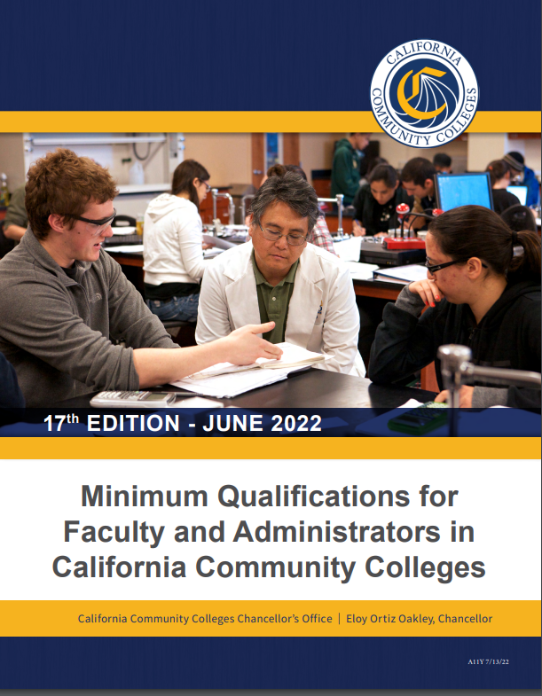
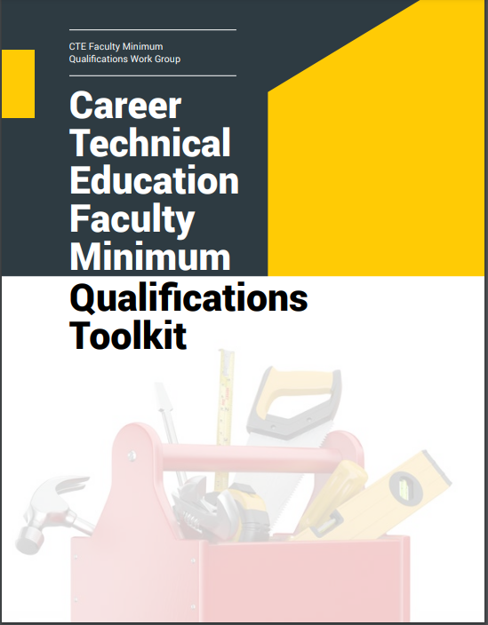
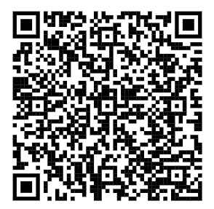
MQ Handbook & CTE Minimum Qualifications Toolkit
Notes:
Although we already have a published CCCO MQ handbook that recognizes CTE, the toolkit is a supplemental document/resource that colleges and districts can use to elevate their local practices.
Equivalency
Faculty Internship
Apprenticeship Minimum Qualifications

Slide 43
CTE Faculty MQ Toolkit Contents
Pre-planning checklist for Equivalency by Department
Equivalency Checklist for Human Resources Departments
Model Equivalency Committees Composition and Policies
Information and Checklist for Potential Equivalency Applicants
Credit for Prior Learning

Slide 44
Change to Apprenticeship Minimum Qualifications
In May 2018, the Board of Governors approved a Title 5 change revising the minimum qualifications for apprenticeship instructors (§ 53413 of article 2 of subchapter 4 of chapter 4 of division 6 of title 5 of the California Code of Regulations). The goal and the result of this change was to expand the pool of industry experts to teach in apprenticeship classrooms. In the past, the minimum qualifications required a community college apprenticeship instructor to have 18 units of general education courses.

Slide 45
Change to Apprenticeship Minimum
Qualifications
The new regulations allow for credits earned within an apprenticeship program to count toward meeting the new minimum qualifications. In practice, this means anyone who completes a credit-based registered apprenticeship program (and nearly all community college apprenticeship programs are credit based) and has six years of work experience can qualify to teach.

Slide 46
Effective CTE Minimum Qualifications/Hiring Practices:
Train the local equivalency committee
Professional development/ learning
Disseminate resources
Consider who is at the table, who is missing
What else?

Slide 47
Scenario 1
Diesel Mechanics
Barron Drivetrain is actively managing one of the largest diesel repair facilities in the region. He has 15 years of experiences in diesel repair and is considered one of the region’s most highly respected diesel repair experts. He has extensive experience in training new mechanics and has established the first online, industry supported, professional development program in California for diesel professionals. Barron hires about 35% of the local program graduates and has been recognized by the High School Board of Trustees for his work with non-traditional students. Barron has a high school and certification from a private trade school.

Slide 48
Scenario 2
Health Information Technology (Medical record technology)
Danika Datawinski currently manages an office of 5 staff at a regional Health Information Technology (HIT) company and has 15 years experience implementing HIT recommendations from California’s Department of Health Services. Danika has completed several industry recognized credentials. She is responsible for the staff development of her employees and has developed a training handbook as a resource. Danika’s organization provides internships for the local community college’s HIT graduates. Danika speaks fluent Spanish, is a veteran, and has a certificate of achievement in HIT from her local community college.

Slide 49
CBE and CPL

Slide 50
Competency Based Education (CBE)
Our students need freedom and flexibility ​from the rigidity of the Carnegie hour demands and arbitrary use of time as a measure of learning
Direct assessment leads to more personalization​ of instruction at the student’s pace
Student self-pacing leads to more affordability​ for students
Direct assessment promises more personalized student support from faculty and staff (case management approach)​
Students work with a trusted local institution rather than national provider ​
CBE programs are developed with the local community workforce needs and the institution’s equity mission in mind

Slide 51
The Direct Assessment CBE Pilot
Eight colleges participating in design and implementation of a direct assessment CBE program since Summer 2021
Bakersfield College
Coastline College
East LA City College
Madera College
Merced College
Mt. San Antonio College
Shasta College
Southwestern College
Support from Jobs for the Future; Competency-Based Education Network (C-BEN); Volta Learning Group; Various CBE SMEs and practitioners, others

Slide 52
How Does Direct Assessment Work?
Students enroll in a program of competencies, not courses
Competencies are faculty-written statements of knowledge, skills, and abilities relevant to the discipline, often industry-recognized
Learning is defined by demonstration of knowledge, skills, abilities and not seat time
Demonstration of “Mastery” level of achievement of summative assessments for each competency is the required proof of learning
Rigor is increased because mastery (or higher) is required for ALL competencies
Students move as quickly or slowly as needed; moving quickly through content they understand, slower when more support is needed
Students receive a competency transcript and a traditional course transcript

Slide 53
Faculty Roles and Competency-Based Education
CBE offers opportunity for new instructional models
Faculty duties can be split across a team of faculty; referred to as “unbundled faculty”
Faculty curriculum designers (writing competency statements)
Faculty instructional designers (creating instructional content)
Assessment faculty (formative and summative assessment)
Coaching faculty (student progress monitoring and relationship-building)
Others…?
Requires reimagining of traditional approaches to faculty compensation and extensive professional development that supports collaborative work
Notes:
Randy

Slide 54
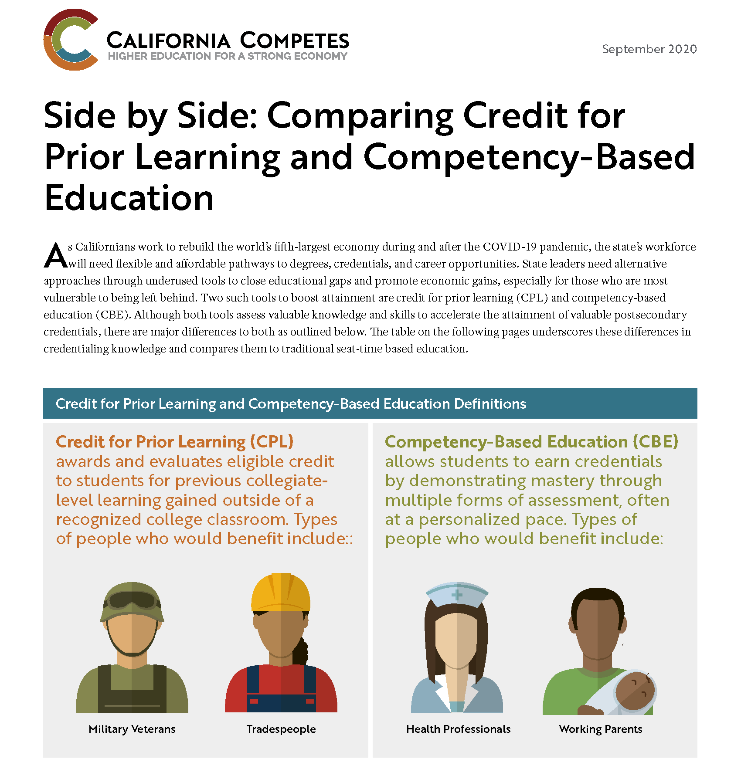
Infographic

Slide 55
How CPL is Awarded
Advanced Placement Examination (AP)
International Baccalaureate Examination
College-Level Examination Program (CLEP)
Industry-Recognized Credential
Student-Created Portfolio
Credit by Examination in lieu of…
Assessment Approved
Notes:
SW
•Advanced Placement (AP) examination administered by the College Entrance Examination Board
•High-level International Baccalaureate (IB) examination
•College-Level Examination Program (CLEP) examination
•Evaluation of industry-recognized credential
•Evaluation of a student-created portfolio
•Evaluation of Joint Services Transcripts
•Exam administered by the college in lieu of completion of a course listed in the college catalog
•Exam administered by other agencies approved by the college
•Assessment approved or conducted by proper authorities of the college.
State/federal government training
Military training (JST Transcripts)
Volunteer and civic activities (e.g. Peace Corps)
Apprenticeships, internships, work-based learning, or other industry-based experiential learning

Slide 56
Impact on Students
Equity Bump: Latinx +24%, Black +14% , Enrolled in community college +25%, Pell recipients +19%
Reduced time to degree: 9-14 months
Savings: $1,500 to $10,200. $68K for Vets.
Completion Bump: 49% vs. 27%
When analyzed in isolation, CPL increases the likelihood of higher ed completion by more than 17% in adult learners.
Validation and Motivation!
Notes:
SW
Recognizing Prior Learning in the COVID Pandemic Era: Helping Displaced Workers and Students One Credit at a Time
Twice the higher ed completion rate for adult learners: 49% vs. 27%
24,512 adult students (ages 25 and older) who earned
PLA credits had a credential completion rate of 49
percent over the seven-and-a-half-year observation
period, compared to 27 percent of adult students with
no PLA credits. This includes completion of bachelor’s
degrees, associate degrees, and certificates.

Slide 57
CA MAP Initiative and CPL Workgroup Efforts
Broad group of CPL professionals from various systems including faculty, staff and administrators
Meeting since Summer 2022
Recommendations and sharing of best practices
Guide in CA MAP Initiative direction and trainings
Recommend and advise on workgroups for policy and CPL crosswalks
Notes:
TN

Slide 58
Example Outcomes & Activities
1000+ JSTs in MAP Student Intake​
41 of 76 colleges uploaded JSTs since May 2023​
650+ ACE Courses Articulated or Pending Approval​
150+ College Courses Articulated​
Statewide first responder credit recommendations underway​
Non-military CPL exhibit building underway
Notes:
Need more

Slide 59
Title 5 Regulations- Work Experience

Slide 60
Work-Based Learning in California Community Colleges
Work-based learning is an educational strategy used to connect classroom instruction to careers by providing students with opportunities to reinforce and make relevant their classroom experiences. It also allows students to explore potential careers through immersion in their fields and, most importantly, to apply their learned skills in an authentic setting.
INTENT:
Expand opportunities for students
Support the student experience
Changes to and confusion of “work experience” for students
Need for work experience for students and employers
Need for universal aspects of a work experience program
Notes:
Amy

Slide 61
Work Experience Regulation Update Timeline
Revised Title 5 Work Experience Regulations Approved by BOG July 2022.
Chaptered in July 2023 and official on August 26, 2023
Text of Updated Regulations
CCCCO Guidance
Notes:
Mark

Slide 62
Revisions – General
Simplify regulations to allow local districts to increase work experience opportunities for students and expand beyond a strict focus on CTE programs. Existing regulations include onerous and archaic requirements that stifle innovation and expansion of work experience
Rename from “Cooperative Work Experience” to “Work Experience Education”
Establish new numbering for all of Article 4 on Work Experience Education, previously organized as §§55250 – 55257 with revised regulations organized as §§55250 – 55254.
Collapses 14 existing separate sections into more intentionally organized and sequenced 5 sections.
Notes:
Mark

Slide 63
Revisions – Alignment with System Goals
Simplify regulations to allow local districts to increase work experience opportunities for students and expand beyond a strict focus on CTE programs. Existing regulations include onerous and archaic requirements that stifle innovation and expansion of work experience
Rename from “Cooperative Work Experience” to “Work Experience Education”
Establish new numbering for all of Article 4 on Work Experience Education, previously organized as §§55250 – 55257 with revised regulations organized as §§55250 – 55254.
Collapses 14 existing separate sections into more intentionally organized and sequenced 5 sections.
Notes:
Mark

Slide 64
Revisions – Highlights Impacting Curriculum
Simplify regulations to allow local districts to increase work experience opportunities for students and expand beyond a strict focus on CTE programs. Existing regulations include onerous and archaic requirements that stifle innovation and expansion of work experience
Rename from “Cooperative Work Experience” to “Work Experience Education”
Establish new numbering for all of Article 4 on Work Experience Education, previously organized as §§55250 – 55257 with revised regulations organized as §§55250 – 55254.
Collapses 14 existing separate sections into more intentionally organized and sequenced 5 sections.
Notes:
Mark

Slide 65
Updated Regulations: Units/Hours
Previous Regulation:
§ 55256.5 (c): The following formula will be used to determine the number of units to be awarded:
(1) Each 75 hours of paid work equals one semester credit or 50 hours equals one quarter credit.
(2) Each 60 hours of non-paid work equals one semester credit or 40 hours equals one quarter credit.
(3) Units may be awarded in 0.5 unit increments.
Updated Regulation:
§ 55253 (a): (a)Units of credit for work experience education shall be calculated as follows:
(1) work experience education offered as a credit course: one semester unit of credit will be awarded for every 54 hours of work experience, or one quarter unit for every 33 hours of work experience, or the equivalent locally determined minimum threshold for awarding one unit of credit as codified in local board policy or procedure. Units of credit may be awarded in increments of .5 units; and
(2) work experience education integrated as a component of a course: units of credit will follow standards for credit hour calculations in section 55002.5 for all activity, lab, or other instructional course components. Units of credit for the work experience component shall be calculated according to the formula in subparagraph (1).
Notes:
Mark

Slide 66
Updated Regulations: Total Units
Previous Regulation:
§ 55253(a): For the satisfactory completion of all types of Cooperative Work Experience Education, students may earn up to a total of 16 semester credit hours or 24 quarter credit hours, subject to the following limitations:
(1) General Work Experience Education.
A maximum of six semester credit hours or nine quarter credit hours may be earned during one enrollment period in general work experience education.
(2) Occupational Work Experience Education.
A maximum of eight credit hours may be earned during one enrollment period in occupational work experience education.
Updated Regulation:
§ 55253(c): A maximum of fourteen semester credit hours or twenty-one quarter credit hours may be earned during one enrollment period in work experience education. Students may repeat a work experience education course subject to section 55040.
Notes:
Sarah

Slide 67
Updated Regulations: General/Occupational
Previous Regulation:
§ 55252: Cooperative Work Experience Education is a district-initiated and district-controlled program of education consisting of the following types:
(a) General Work Experience Education is supervised employment which is intended to assist students in acquiring desirable work habits, attitudes and career awareness. The work experience need not be related to the students' educational goals.
(b) Occupational Work Experience Education is supervised employment extending classroom based occupational learning at an on-the-job learning station relating to the students' educational or occupational goal.
Updated Regulation:
This distinction is removed – all “work experience education” follows the same requirements.
§ 55250(a) defines the purpose of “work experience” in part as: “The purpose of work experience education is to provide students with an integrated instructional program that provides opportunities to connect academic curricula to applied experiential learning in the workplace. Work experience education should be substantive in nature, linked in a way relevant to a student’s educational pathway, and contribute to demonstrable learning outcomes that have value towards a degree or certificate.
Notes:
Sarah

Slide 68
Updated Regulations: Noncredit
Previous Regulation:
Did not explicitly include noncredit instruction
Updated Regulation:
§ 55250(b) defines work experience and explicitly allows noncredit instruction and instruction as part of a course:
Work experience education within the California Community Colleges involves student employment and/or internships selected, approved, and supervised by districts to provide meaningful work experiences related to the course of study, or specific career pathway training, combined with instruction in critical workplace skills. Work experience education may include paid or unpaid employment, full or part-time employment, and may be structured as separate credit or noncredit classes, or integrated as a component of a course. It should be integrated as part of a student’s educational pathway allowing students to achieve both educational and occupational goals. It should also assist the student in developing career awareness, learning industry culture, competencies and norms, and developing professional networks in their desired field to support career mobility. Work experience education should provide economically disadvantaged students with opportunities to earn a wage while completing program requirements and earning academic credit.
Notes:
Sarah

Slide 69
Regional Impact
Orange County Regional Consortium/Convener
Orange County Regional Consortium Program Recommendation Participation
Orange County Regional Consortium Ecosystem
Orange County Regional Consortium Workgroups
Orange County Regional Consortium Regional Strategies
Orange County Regional Consortium Funding Structures/Investments

Slide 70
Early College Credit
What is Early College Credit
Forms of Early College Credit
Vision 2030
Regional Initiative
Orange County Department of Education - OC Pathways
Orange County Community Colleges Regional Strategy
Talent and Development Retention Director
Objective 3 (Comprehensive Support)
K-12 SWP Key Talent Regional Initiative
Funding Streams Supporting Early College Credit

Slide 71
Early College Credit in Orange County
Articulation Regional Master Sheet
Regional Occupational Program Instructional Service Agreement
Dual Enrollment Outcomes: Data Source
Year | DE Enrollments in OC | Year to Year Growth
2018 | 19,390
2019 | 21,156 | 9.10%
2020 | 24,053 | 13.71%
2021 | 25,888 | 7.62%
2022 | 28,122 | 8.63%

Slide 72
Strategies to Increase ECC Awareness
Regional Strategies
Articulation Regional Master Sheet Update
Dual Enrollment Regional Training
Dual Enrollment Consultation Services (April 2024)
Proposed Institutional Strategies
Institutional Research ECC Review
Feeder LEAs
Student Enrollment
Student Performance

Slide 73
Strategies to Increase ECC Opportunities
Proposed Faculty Strategies
Collaborate with Institutional Research
Identify Courses for Enrollment
Gain Understanding of K-12 CTE Pathways
Contact K-12 Pathway Coordinators to Begin Discussion
David Foster - South Orange County CCD
Brandon Currin - North Orange County CCD
Margaret Llamas - Rancho Santiago CCD
Julia Budd - Coast CCD

Slide 74
Wrap Up and Next Steps
Today’s Take-Aways
Staying Connected and Engaged in all CTE Regional Collaborative Opportunities
Planning Spring 2024 CTE Regional Collaborative Meeting
Regional Consortium Meetings, Convenings, and Activities Calendar of Events
Joining the Orange County Regional Consortium Business and Collaborative Listserv
Academic Senate Presidents and CTE Liaisons Engagement

Slide 75
Resources
Questions? Email the Academic Senate for California Community Colleges: info@asccc.org
Updated regs: Text of Updated Regulations
CA Internship & Work Experience Association: CIWEA.org
Join the CA Community College Curriculum Chairs Listserv: https://groups.io/g/CCCCurriculumChairs/
Volunteer for Statewide Service: https://www.asccc.org/content/new-faculty-application-statewide-service
CTE Minimum Qualifications Toolkit: https://asccc.org/sites/default/files/ADAversion_CTEMinQualsToolkit.pdf
Technical visits, including training your Equivalency Committee: https://www.asccc.org/contact/request-services
CCCCO Vision 2030 https://www.cccco.edu/About-Us/Vision-2030
CCCAOE https://cccaoe.org/
MAP Program (Norco College) https://www.norcocollege.edu/services/enrollment/vrc/Pages/map.aspx

