Slide 1
Welcome!
On behalf of the ASCCC OERI, we are please to have you here with us for “Open Educational Resources (OER), Curriculum, Articulation, and Student Success”
If you are not already muted, please mute yourself upon arrival. As this is set up as a meeting, we will be able to have an actual discussion – but we need all those who are not speaking to be muted.
You are also encouraged to use the “chat” feature.

Slide 2
Open Educational Resources (OER), Curriculum, Articulation, and Student Success
ASCCC Curriculum Institute 2021 Thursday, July 8, 3:00 – 4:30 pm
Notes:
Michelle

Slide 3
Session Title and Description
Open Educational Resources (OER), Curriculum, Articulation, and Student Success
Why and how do you make OER part of your curriculum as an integral component of addressing inequities? When supporting the adoption OER, how do you contend with articulation myths? Is there a connection between OER and student success? Join us as we explore OER basics, approaches to encouraging OER adoption in the curriculum process, articulation facts, and the benefit of OER for students, faculty, and the college.
Notes:
Michelle

Slide 4
Your Presenters
Julie Bruno, Communication Studies, Sierra
ASCCC OERI Communications Lead
Michelle Pilati, Psychology, Rio Hondo
ASCCC OERI Faculty Lead
Sally Potter, English for Multi-Lingual Students/Linguistics, Fresno City
ASCCC OERI Area A Lead
Notes:
Michelle

Slide 5
Overview
OER Basics
OER and Curriculum
OER and Articulation
OER and IDEA
OER and Student Success
OERI and Curriculum Resolutions
Q and A
Notes:
Michelle

Slide 6
OER Basics
What is OER?
Introduction to WHY OER…
Photo by Jp Valery on Unsplash
Notes:
Julie

Slide 7
What are Open Educational Resources?
“OER are teaching, learning, and research resources that reside in the public domain or are released under an intellectual property license that permits their free use and repurposing by others”
-- Hewlett Foundation

Slide 8
Why OER – what are the benefits for students?
Sky-rocketing textbook costs
Ensures access to resources is equitable
Photo by Micheile Henderson on Unsplash
Notes:
Will discuss more later - just a few minutes

Slide 9
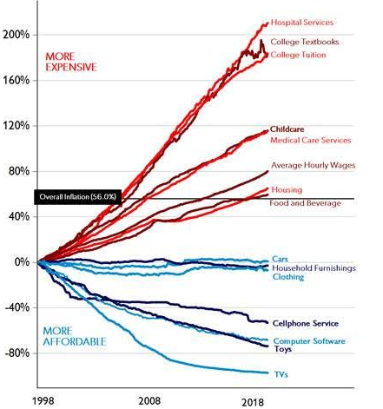
Price changes
(1998 - 2018)
Selected US
Consumer
Goods and
Services, Wages
Source: BLS
From the
American
Enterprise Institute
Notes:
Suzanne
Cost - increasing even though technology is getting cheaper

Slide 10
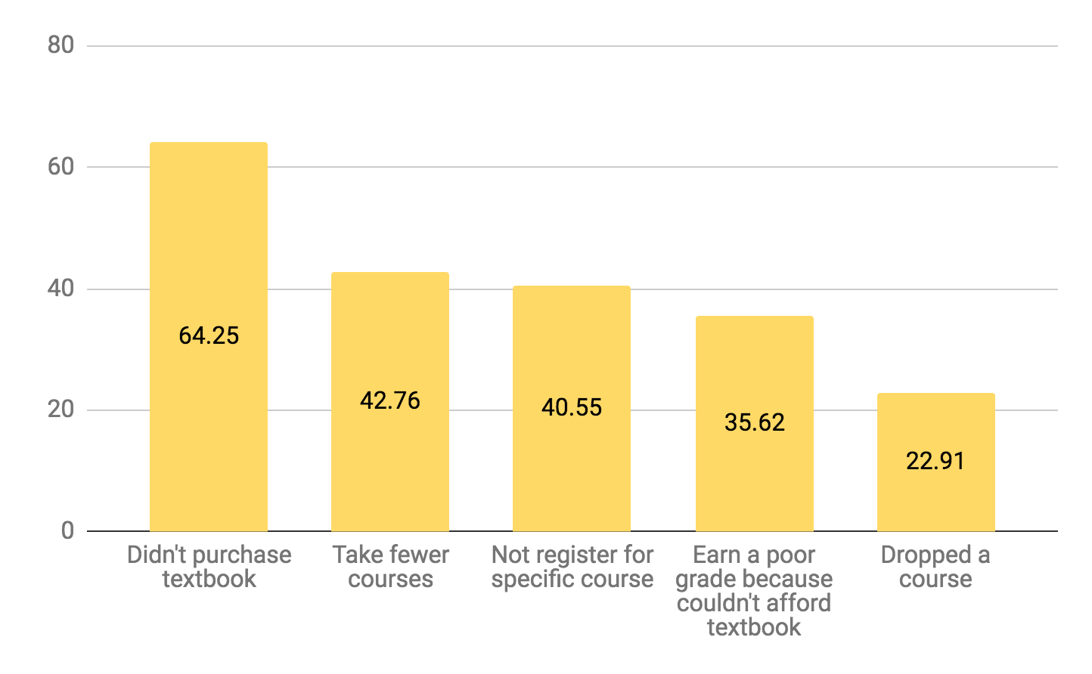
You can’t learn from a resource you can’t get.
Source: 2018 Student Textbook and Course Materials Survey Executive Summary
Notes:
Suzanne

Slide 11
Why OER – what are the benefits for faculty?

Slide 12
Why OER?
Customizable
Remove elements you don’t use
Re-order to match your teaching preferences
Re-mix existing OER
Photo by Susan Holt Simpson on Unsplash
Notes:
Suzanne - Focus here is on the basic reasons for adopting OER.
Will discuss more later - just a few minutes

Slide 13
Academic Freedom
“Academic freedom establishes a faculty member’s right to remain true to his or her pedagogical philosophy and intellectual commitments. It preserves the intellectual integrity of our educational system and thus serves the public good.”
When OER are truly “open”, they can be modified in whatever way a faculty member chooses.
Teach the course the way you want to teach it, not the way a publisher dictates...
… and do what it best for your students.

Slide 14
OER – The Ultimate in Academic Freedom
Adapt OER for you and your students’ needs - allows for customization, improvement and perfection
Improve explanations and descriptions
Update research, scenarios, case studies
Collaborate with colleagues
Address biases
Modify language, images, examples
Add emphases
Enhance accessibility and useability
Introduce new ways of thinking

Slide 15
Is OER part of your curriculum process? If so, how?
Notes:
Michelle

Slide 16
OER and Curriculum
Should OER be part of your curriculum process?
If so, how do you make OER a part of your curriculum process?

Slide 17
How?
Clear way of representing OER on the Course Outline of Record.
OER encouraged on the COR.
OER referenced in curriculum processes and documents.
Senate guidance on the use of OER. (policies, resolutions, papers, etc…)

Slide 18
Articulation and OER Myths
OER is of lesser quality – and less rigorous - than commercial texts.
*CSU and UC won’t accept OER.
CSU and UC won’t articulate courses that use texts that have not been reviewed or don’t have an ISBN.
Others?

Slide 19
OER and Articulation
The CSU and the UC, over and over again, repeatedly, have made it explicit that they do not have an issue with OER.
https://asccc-oeri.org/articulation-curriculum-and-open-educational-resources/
Other evidence?
Cool4ed.org

Slide 20
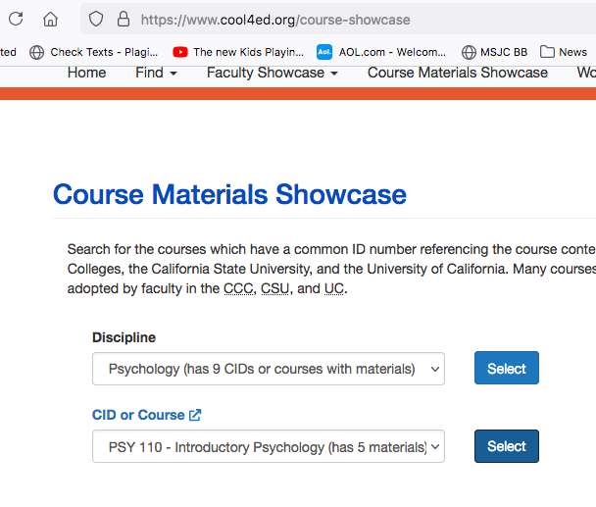
Our transfer partners USE OER…

Slide 21
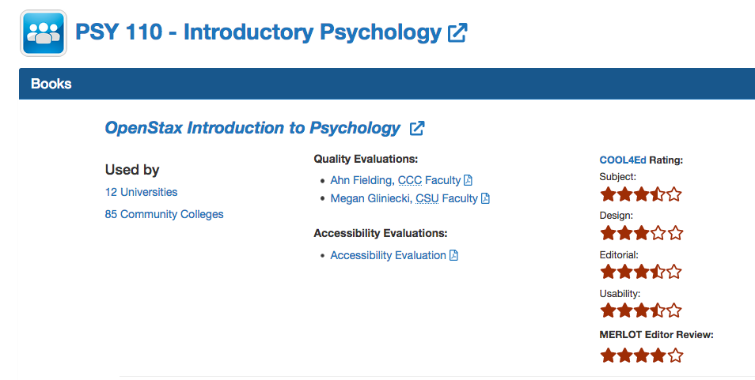
12 Universities, 85 Community Colleges

Slide 22
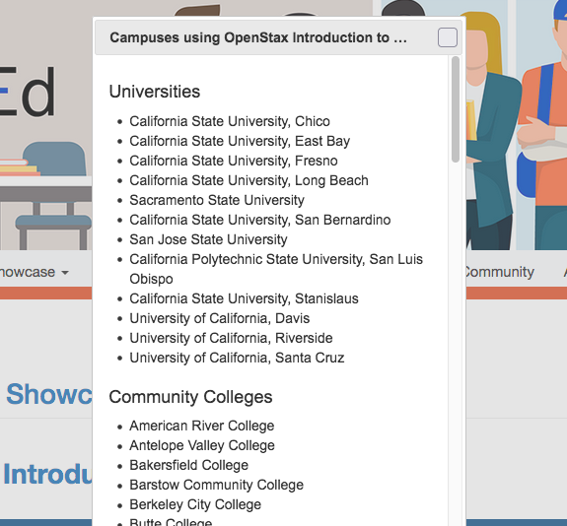

Slide 23
OER and Articulation - Resources
Cool4Ed.org
ASCCC-OERI.org > Resources > ASCCC OER Quick Guides > Articulation, Curriculum and OER
https://asccc-oeri.org/articulation-curriculum-and-open-educational-resources/

Slide 24
OER and IDEA
IDEA stands for Inclusion, Diversity, Equity, Anti-Racism
“Open” allows you to modify anything…
“CIS gender, White men from Western countries make up about 20 percent of the global population and yet they are writing 80 percent about the world.”
- Siko Bourterse
Notes:
Should be here no later than 3:40. SALLY.
Explain IDEA as it is a newer acronym.
Dave/Shagun[Slides: 17-20; Time: 8 mins]
2:48 - 2:56

Slide 25
OER Creates Opportunities
Opportunity for improvements in design in open authoring and publishing
Culturally responsive teaching with culturally responsive textbook examples
Create resources relevant to your students
Photo by Womanizer WOW Tech on Unsplash

Slide 26
IDEA
Inclusion, Diversity, Equity, Anti-Racism
Type “teacher” in Google Images and see what pops up even with a CC BY license.
But what if we went to:
Disabled And Here: Photography featuring disabled BIPOC (Black, Indigenous, people of color), varied body sizes/types, sexual orientations, and gender identities in the Pacific Northwest; License CC BY 4.0
We need:
Diverse authors and artists to tell multiple stories & perspectives.
To think about WHO is our audience.

Slide 27
IDEA
Inclusion, Diversity, Equity, Anti-Racism
Improvements can vary from small to large
Biology text: Updating images and case studies to reflect our student body; including current understanding of sex and gender; adding diverse scientists.
Spanish text: Modifications of gender pronouns
Psychology text: Presenting gender as a non-binary concept
Statistics for Social Justice Studies
Collaborations

Slide 28
The Impact of OER:
University of Georgia Study
Population | Change in Grade | Change in DFW*
All Students | +8.6% | -2.68%
Non-Pell Eligible | +7.4% | -2%
Pell Eligible | +12.3% | -4.4%
Non-White | +13% | -5%
Part-Time | +28% | -10%
Total Students: 21,822 *DFW= Drop, Fail, Withdraw
Source: AAC&U, University of Georgia The Impact of Open Educational Resources on Various Student Success Metrics, in International Journal of Teaching and Learning in Higher Education, 2018

Slide 29
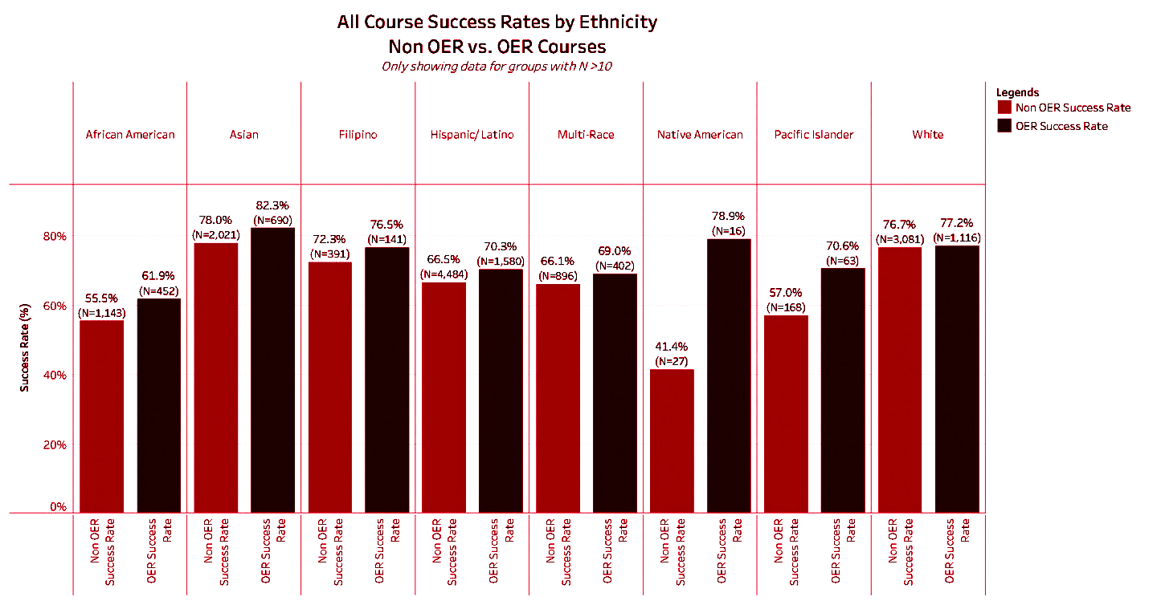
Sacramento City Study
Source: Sample Course Success Rates by Ethnicity
Notes:
The success rates are higher for all groups when using OER than when not using OER. [Sally 1 min]

Slide 30
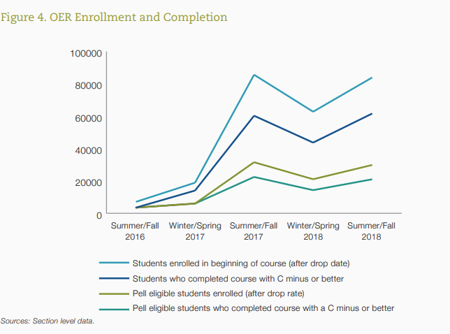
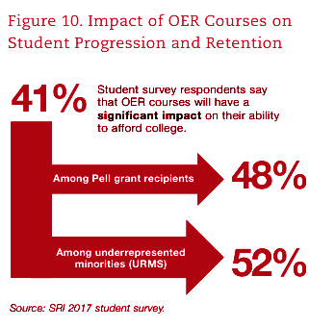
Achieving the Dream Stats
28% of students surveyed reported that they would use the money they saved with OER to take additional courses
Notes:
(For Sally’s data section) Griffiths, R., Mislevy, J., Wang, S., Ball, A., Shear, L., Desrochers, D. (2020). OER at Scale: The Academic and Economic Outcomes of Achieving the Dream’s OER Degree Initiative. Menlo Park, CA: SRI International
OER project involving a total of 38 community colleges across 13 states, four grant partners, and five funding organizations [Feb 2020]
file:///C:/Users/email/Downloads/atd_oer_at_scale_academic_economic_outcomes_feb_2020.pdf

Slide 31
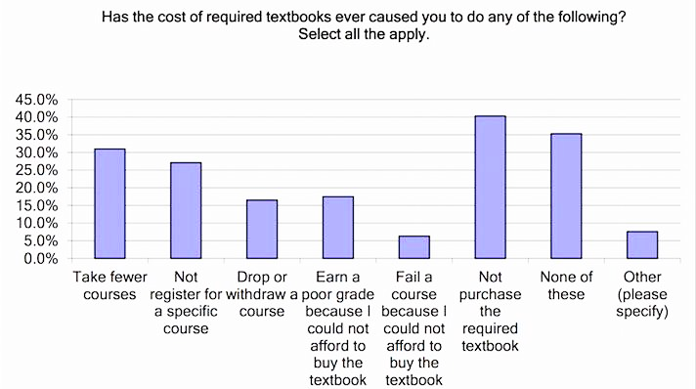
Butte College Study
Source: cccoer.org
Notes:
Sally

Slide 32
Resolution 9.05
Developing an Anti-Racism, Diversity, Equity, and Inclusion Curriculum Audit Process for the Open Educational Resources Initiative
If we can review OER for such things, why not review all texts to ensure that they are not sending the wrong messages to students?
Adopt and adapt IDEA curriculum audit process at your own college

Slide 33
09.05 Develop an Anti-Racism, Diversity, Equity, and Inclusion Curriculum Audit Process
...develop an audit process and review framework to review and revise, as necessary, existing open educational resources to ensure that ASCCC OERI-supported open educational resources are equitable, inclusive, diverse, and anti-racist.
...develop a curriculum audit process and review framework to assess instructional materials for equity, inclusiveness, diversity, and anti-racism and the process and framework available for local consideration, modification, and implementation; and
….encourage local senates to provide guidance to faculty in developing and selecting equitable, inclusive, diverse and antiracist instructional materials.

Slide 34
11.04 Ensure Compliance with Required Instructional Materials Regulations
...encourage local academic senates to review, revise, and implement their district policies or practices that “shall direct instructors to take reasonable steps to minimize the cost and ensure the necessity of instructional materials” to ensure that they are effective and take steps to ensure that all faculty are informed of the requirements established in California Code of Regulations Title 5 §59400; and
...collaborate with system partners to provide local academic senates and colleges with guidance related to ensuring they are compliant with the following element of California Code of Regulations Title 5 §59400:
(c)Where instructional materials are available to a student temporarily through a license or access fee, the student shall be provided options at the time of purchase to maintain full access to the instructional materials for varying periods of time ranging from the length of the class up to at least two years. The terms of the license or access fee shall be provided to the student in a clear and understandable manner prior to purchase.

Slide 35
13.01 Institutionalizing Open Educational Resources
...encourage local academic senates to collaborate with other constituencies to integrate open educational resources into their colleges’ guiding resources, including institutional goals, educational master plan, equity plan, accreditation institutional self-evaluation report, board policies, and administrative procedures or regulations; and
...curate a collection of resources to assist local senates in pursuing the institutionalization of open educational resources at the local level no later than Spring 2022.

Slide 36
Questions and Answers
Photo by Pixabay from Pexels
Notes:
ALL
3:21- 3:45

Slide 37
Open Culture Sky Image by Suzanne Wakim is based on OA-prezi-1 by Gideon Burton. These works are licensed under an attribution-ShareAlike 2.0 Generic (CC BY-SA 2.0) license.

Slide 38
More Information
ASCCC OERI Website (asccc-oeri.org)
Resources
Webinars and Events
ASCCC OER E-Mail (oeri@asccc.org)

Slide 39
Thanks!
Photo by Thgusstavo Santana from Pexels

