Slide 1
Open Educational Resources
Jackie Escajeda, Dean, Curriculum and Instruction, CCCCO
Conan McKay, ASCCC Area B Representative
Michelle Pilati, ASCCC OER Task Force Chair

Slide 2
Overview
OER Basics – What/Why
Why not?
Existing OER-related efforts in the CCCs
ASCCC’s OER Initiative
Questions for you

Slide 3

What are Open Educational Resources (OER)?
Teaching and learning materials that are openly licensed and freely available online for everyone to use.
OER most often refers to open access textbooks and ancillary materials that are available at little or no cost to students.

Slide 4

Why OER?
Between 1978 and 2010 The price of textbooks has grown over 800%. Source: Bureau of Labour Statistics; FHFA; Thomson Reuters
What is the impact of high textbook costs?

Slide 5


Slide 6

Notes:
Why OER? Students can’t succeed if they don’t have the resources they need for success.

Slide 8
How can our students learn, succeed, persist, and accomplish their goals when they don’t have required materials?

Slide 9

Why not Use OER?

Slide 10
Concerns about…
quality.
currency.
articulation.
ease of adoption.
time.
impact of “free”.
reliance on digital resources.

Slide 11
What OER efforts currently exist in the CCCs?
Are you, perhaps, feeling a “push” to use OER?

Slide 12
Senate Bill 1359 (Block, 2016)
Requires California Community Colleges and California State Universities and requests the University of California system to clearly highlight, by means that may include a symbol or logo in the online campus course schedule by January 1, 2018 for courses that exclusively use digital course materials that are free of charge to students and therefore not required to be purchased.
Notes:
MP - “Clearly highlight, by means that may include a symbol or logo in a conspicuous place on the online campus course schedule, the courses that exclusively use digital course materials that are free of charge to students and may have a low-cost option for print versions.”

Slide 13
OER in the Colleges Today
Individual colleges have ZTC grants
AB 798 funds, equity dollars
2018-2019 OpenStax Institutional Partnership Program
ASCCC OER Task Force
Notes:
AB 798 - Funds from the Campus Open Educational Resources Adoption Incentive Program can NOT be used to support the following:
Direct compensation for faculty members who adopt open educational resources, except as provided to compensate for professional development.
The development of MOOC's or online courses that include non-matriculated students.
The creation of new OER materials.
The purchase of new equipment.
Past curricular conversions to OER materials.

Slide 14
OER in the CCCs Tomorrow
At present, no effort is underway to:
  systematically identify and address barriers to OER adoption,
  support local OER implementation efforts, and
  leverage the expertise in the CCC system to create a sustainable OER ecosystem.
Notes:
DAVE - SYSTEMATIC AND SUSTAINABLE = key words in discussing difference between previous bills and funding versus what we need “tomorrow”
Diversity of CCC’s: Some colleges/faculty have different OER needs (i.e. - some need unique discipline OER development (i.e. water systems technology), some need ancillary development (my open math), some need funding for positions of support (OER librarian, instructional design, OER coordinator)…

Slide 15
ASCCC OERI
A 5-year project (~1million/per year) to implement OER system-wide, coordinating state level activities to increase OER availability and supporting local OER implementation.
What does that mean?
Notes:
MP

Slide 16
Fall 2018
Identify and establish connection to existing OER and OER-related efforts
  Coordinating council/committee proposed
  Identify opportunities to leverage efforts
  Avoiding duplication
Determining the “hows” of moving forward
  Where will OER resources “live”?
  How can discipline faculty conversations about OER be encouraged/supported?
Identifying – and addressing – common institutional barriers/concerns
“Seeding”

Slide 17
Common barriers to OER adoption?
College-level issues/challenges?

Slide 18
Barriers?
Printing
Accessibility
Impact on/working with book store
Copyright questions

Slide 19


Slide 20

ASCCC OERTF Webinars
https://www.asccc.org/directory/open-educational-resources-oer-task-force

Slide 21
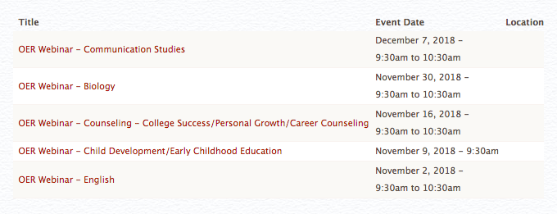
Upcoming…
Developing spring schedule..

Slide 22
Implementation Challenges - Accountability
How do we measure OER use on a system-wide basis?
While it is easy enough to track what the Initiative is doing, how do we really measure the impact at 114 colleges?

Slide 23
Implementation Challenges – How do we determine what is really needed?
What “holes” in OER availability exist?
Where an OER text-equivalent exists, what do faculty need to facilitate adoption of that resource?
When you have 114 colleges that are each doing their own thing, how do you develop a comprehensive assessment of their needs that somehow corrects for lack of awareness?

Slide 24


Slide 25
So…
We need an OER go-to person at each and every college >> “an OER Liaison”
  To answer questions
  To share information
  HOPEFULLY to become a local OER advocate
Short survey to assess baseline OER use
Discipline-based survey

Slide 26
Initial (“Pilot”) Disciplines
  Child Development (Early Childhood Education)
  Communication Studies
  Computer Science
  Cybersecurity
  English
  Math
  Psychology
  Sociology

Slide 27
Next Steps
Appoint Regional OER Leads
Convene coordinating group
Establish advisory structure
Identify OER Liaisons (hopefully!)
Review survey results to determine how to proceed - and establish an approach to prioritizing the work
Address the “hows”…
What else?

Slide 28
What would you do…
…if you had a million dollars – to increase OER adoption?

Slide 29
Goals
Ensure OER availability for at least 70% of all C-ID courses by the end of the 5-year term.
Significantly reduce costs for students in at least 50% of the most highly enrolled courses.
Notes:
MP - Increase adoption of OER, thus allowing more students access to material and giving them greater opportunity to be successful.

Slide 30
Goals
Develop systems to replace high-cost homework systems such as "My Math Lab” and other ancillary materials that facilitate faculty OER adoption.
Notes:
MP - Increase adoption of OER, thus allowing more students access to material and giving them greater opportunity to be successful.

Slide 31
Goals
Establish a network of OER Liaisons to serve as local OER champions.
Develop OER resources for selected CTE areas.
Leverage prior related work.
Facilitate achieving the goals of AB 705 and other legislation/initiatives.
Notes:
Increase adoption of OER, thus allowing more students access to material and giving them greater opportunity to be successful.

Slide 32
Other Objectives
Support local OER efforts
Advocate for OER within other statewide initiatives
Identify - and develop - OER solutions related to initiatives and legislation

Slide 33

Thanks!

Slide 34
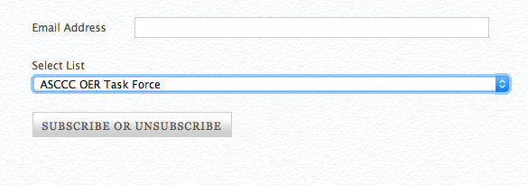
More information…
Michelle Pilati – mpilati@riohondo.edu
https://www.asccc.org/signup-newsletters
Next webinar – November 9 – Child Dev/ECE
https://www.asccc.org/calendar/list/events

