Slide 1
UDL, SLO, OEP The alphabet soup of good course design
Amanda Taintor
Suzanne Wakim
Notes:
We trade off:
Intro - & intro to ULD - Amanda (this section is the why)
Q&A / Discussion
20 min (1:40)
THE HOW’s
Multiple means of representation - tied to OER - Suzanne
Q&A / Discussion
20 Q&A (2:00)
Multiple means of action and expression - tied to SLOs & backwards design - Amanda
Q&A / Discussion
20 Q&A (2:20)
Multiple means of engagement & final wrap - tied to OEP - Suzanne
20 Q&A (2:40)

Slide 2
Introduction to Universal Design for Learning
AKA: UDL

Slide 3
Understand how basic UDL principles relate to Open Educational Practices, Open Educational Resources and Student Learning Outcomes
Lay the foundational knowledge for Open Educational Practices and first steps to implementation
Describe how backward design, Student Learning Outcomes and becoming expert learners are connected
Learning Outcomes
Notes:
These are our outcomes/goals what are your goals?
What do you hope to get out of this talk? Maybe it’s just to learn what the heck OEP is
-We will revisit when we talk about going from novice leaner to expert learner

Slide 4
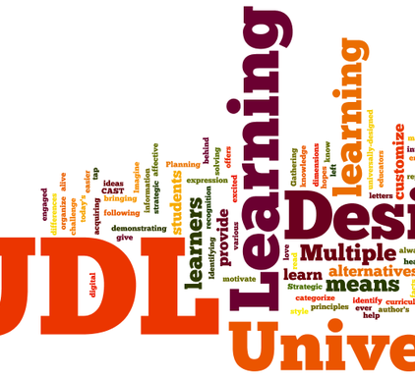
Un-Packing UDL
Notes:
•Universal: Regardless of the circumstances affecting the student
•Curriculum that can be used and understood by everyone.
•Curriculum provides genuine learning opportunities for each and every student
•Learning: Our brain has three broad networks (basics of learning UDL centered on)
•Recognition; The WHAT of learning
•Skills and strategies; The HOW of learning
•Caring and Prioritizing: The WHY of learning
•Design: Flexible and accommodate all kinds of users
the way we teach
the content we offer → we are flexible enough I our design that it can support all students

Slide 5
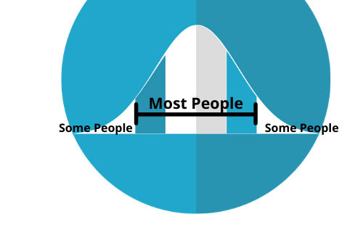
The Myth of Average…….
Image adapted from mcmurryjulie from Pixabay
Notes:
Todd Rose → End of average
-Tell personal teaching story and struggle with meeting all needs
-United States air force 1940’s
-Unusual number of crashes → planes not malfunctioning human error
-cockpits were designed for average male pilot in 1926 → average sized hadn’t change the problem was there is no average
“If you’ve designed a cockpit to fit the average pilot you’ve actually designed it to fit no one”
-and so airplane manufacturers were told their design had to fit a range → also adjustable seats and seat belts were made
Personal story: I’m 5’3” husband is almost 6’2” lots of adjustments
had to figure out how to drive based on average neither of us would be a very good driver

Slide 6
Universal Design for Learning
Notes:
The UDL framework offers an overarching approach to designing meaningful learning opportunities that address learner variability and suggests purposeful, proactive attention to the design of goals, assessments, methods, and materials. CAST’s UDL Guidelines are a tool to support educators, curriculum developers, researchers, parents, and more to apply the UDL framework to practice.
Representation = OER
Action/Expression=SLO
Engagement=OEP

Slide 7
What is Universal Design for Learning - UDL
“Education should help turn novice learners into expert learners—individuals who want to learn, who know how to learn strategically, and who, in their own highly individual and flexible ways, are well prepared for a lifetime of learning.
Universal Design for Learning (UDL) helps educators meet this goal by providing a framework for understanding how to create curricula that meets the needs of all learners from the start.”

Slide 8
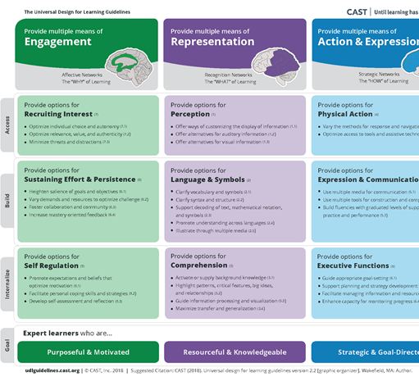
Universal Design for Learning (http://www.cast.org/our-work/about-udl.html)
Notes:
** Good place to bring in equity piece**
As you go down the vertical you have more internal controls
The UDL Guidelines are a tool that can be used to design learning experiences that meet the needs of all learners. These Guidelines offer a set of concrete suggestions for applying the UDL framework to practice and help ensure that all learners can access and participate in meaningful, challenging learning opportunities.
Organization
The UDL Guidelines are organized both horizontally and vertically. Vertically, the Guidelines are organized according to the three principles of UDL: engagement, representation, and action and expression. The principles are broken down into Guidelines, and each of these Guidelines have corresponding “checkpoints” that provide more detailed suggestions.
The Guidelines are also organized horizontally. The “access” row includes the guidelines that suggest ways to increase access to the learning goal by recruiting interest and by offering options for perception and physical action.
The “build” row includes the guidelines that suggest ways to develop effort and persistence, language and symbols, and expression and communication.
Finally, the “internalize” row includes the guidelines that suggest ways to empower learners through self-regulation, comprehension, and executive function.
Taken together, the Guidelines lead to the ultimate goal of UDL: to develop “expert learners” who are, each in their own way, resourceful and knowledgeable, strategic and goal-directed, purposeful and motivated.
Applying to Practice
The UDL Guidelines are not meant to be a “prescription” but a set of suggestions that can be applied to reduce barriers and maximize learning opportunities for all learners. They can be mixed and matched according to specific learning goals and can be applied to particular content areas and contexts.
In many cases, educators find that they are already incorporating some aspects of these guidelines into their practice; however, barriers to the learning goal may still be present. We see the Guidelines as a tool to support the development of a shared language in the design of goals, assessments, methods, and materials that lead to accessible, meaningful, and challenging learning experiences for all.

Slide 9
Provide Multiple Means of Representation
OER and giving learners various ways of acquiring information
Suzanne Wakim
Notes:
We’ll start with Multiple Means of Representation. How do we give learners various ways of acquiring information?
Two ways to think about this:
learning preferences - students have different preferences
multiple modalities - the more different ways students interact with the information the better they learn it.

Slide 10
Multiple Means of Representation
The enzyme used for this process is DNA polymerase. (“poly” means many “mer” means pieces and “ase” tells me this is an enzyme). So, the name tells me this is an enzyme (“ase”) that binds many (“poly”) pieces (“mer”) of DNA to each other. There are a number of other enzymes involved in this process as well (as you can see below). Some enzymes open the DNA strand, others copy the strand, and others fill in any gaps.

Slide 11
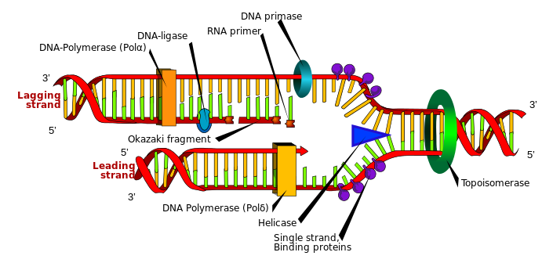
Multiple Means of Representation
The enzyme used for this process is DNA polymerase. (“poly” means many “mer” means pieces and “ase” tells me this is an enzyme). So, the name tells me this is an enzyme (“ase”) that binds many (“poly”) pieces (“mer”) of DNA to each other. There are a number of other enzymes involved in this process as well (as you can see below). Some enzymes open the DNA strand, others copy the strand, and others fill in any gaps.

Slide 12
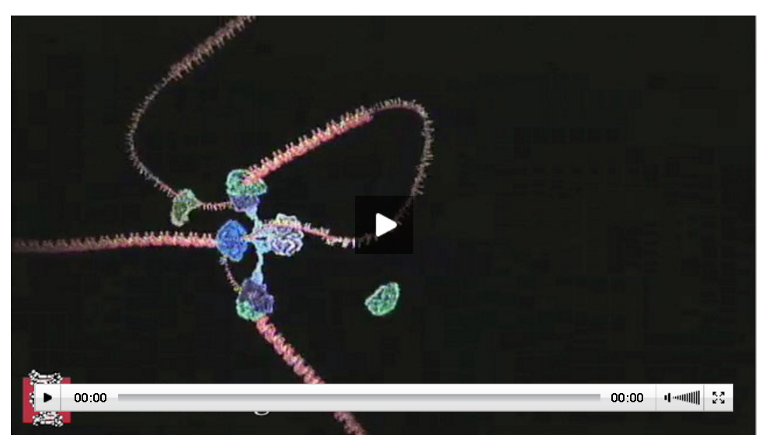
Multiple Means of Representation
The enzyme used for this process is DNA polymerase. (“poly” means many “mer” means pieces and “ase” tells me this is an enzyme). So, the name tells me this is an enzyme (“ase”) that binds many (“poly”) pieces (“mer”) of DNA to each other. There are a number of other enzymes involved in this process as well (as you can see below). Some enzymes open the DNA strand, others copy the strand, and others fill in any gaps.

Slide 13
Multiple Means of Representation
The enzyme used for this process is DNA polymerase. (“poly” means many “mer” means pieces and “ase” tells me this is an enzyme). So, the name tells me this is an enzyme (“ase”) that binds many (“poly”) pieces (“mer”) of DNA to each other. There are a number of other enzymes involved in this process as well (as you can see below). Some enzymes open the DNA strand, others copy the strand, and others fill in any gaps.
Helicase unwinds DNA strands
Topoisomerase prevents supercoiling
SSBP prevent reattachment
RNA primase adds RNA primer
And so on...

Slide 14
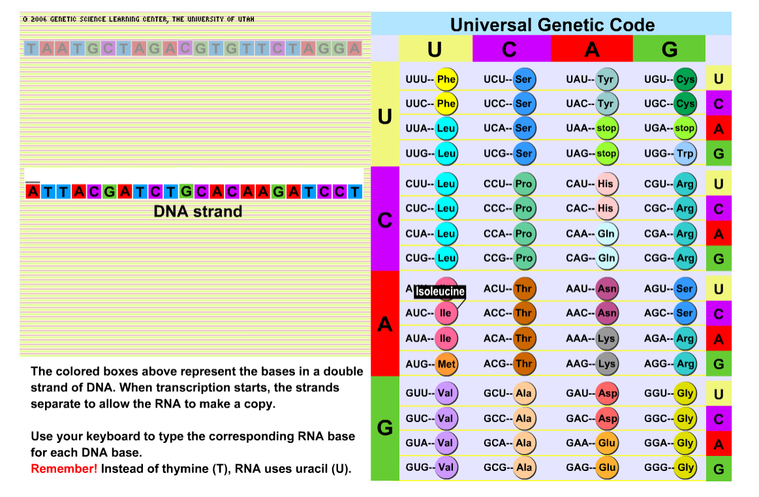
Multiple Means of Representation
The enzyme used for this process is DNA polymerase. (“poly” means many “mer” means pieces and “ase” tells me this is an enzyme). So, the name tells me this is an enzyme (“ase”) that binds many (“poly”) pieces (“mer”) of DNA to each other. There are a number of other enzymes involved in this process as well (as you can see below). Some enzymes open the DNA strand, others copy the strand, and others fill in any gaps.
Helicase unwinds DNA strands
Topoisomerase prevents supercoiling
SSBP prevent reattachment
RNA primase adds RNA primer
And so on...
Notes:
This works because of the vast resource available for free online

Slide 15
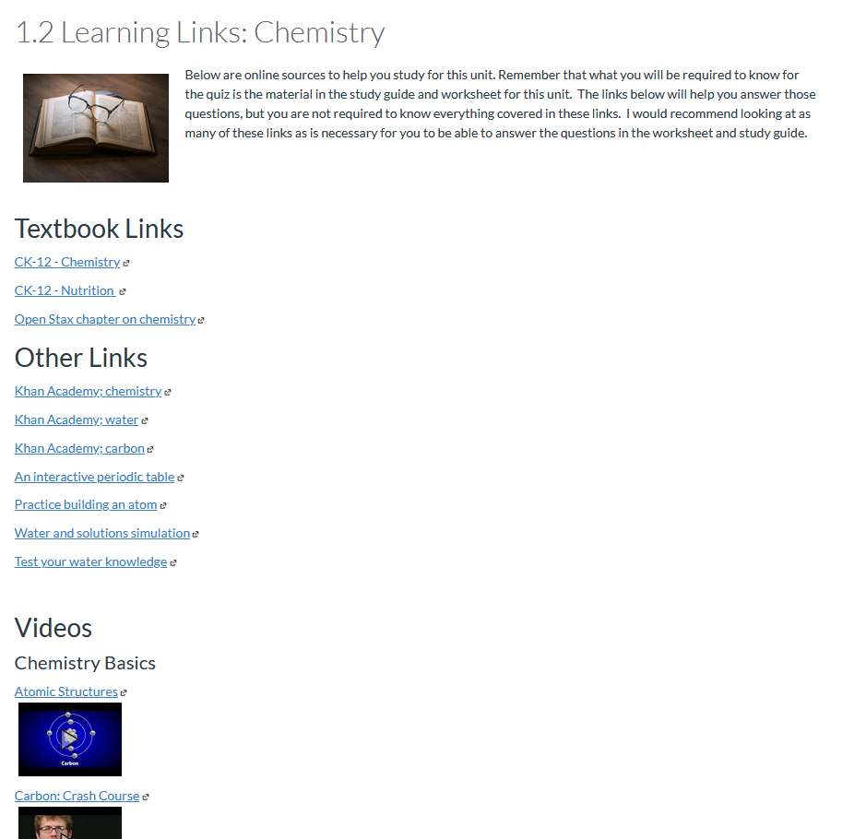
Notes:
I have a long list of links in my class. This works because I also have very specific Learning Outcomes. Students are taught to focus on WHAT they are learning rather than what chapter in the book we are reading.
It’s not a free-for-all. There is still an end goal. Students just have the choice of how they get there.

Slide 16
Customized OER Text
Free Resources
Text and Interactive
Free Online Videos
Notes:
I do put the resources in order
One additional advantage is that I use OER. These are resources that can be customized. So the top resource tracks the class content exactly - because I curated it. The rest are extra. Students can pick what they like.

Slide 17
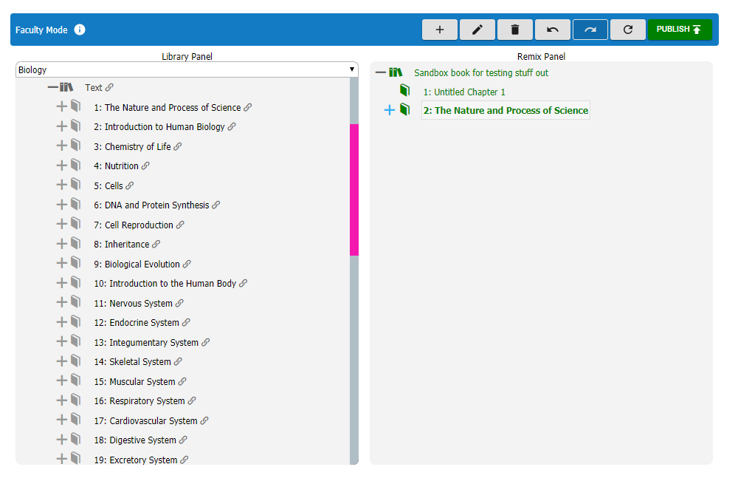
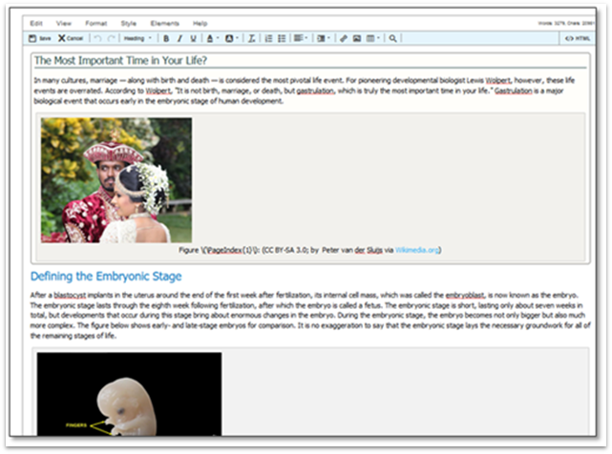
Curated and Customized Resources
Notes:
Can customize.
Platforms - Libre, others - Word or Google Doc….Canvas

Slide 18
Personalize for OUR students - increase relevance and engagement
Notes:
Can also customize to meet our student demographic.

Slide 19
Provide Multiple Means of Representation: OER and giving learners various ways of acquiring information
Q & A Time

Slide 20
Provide Multiple Means of Action and Expression
SLO and Backward Design: Flexible options for HOW we learn and express what we know
Amanda Taintor

Slide 21
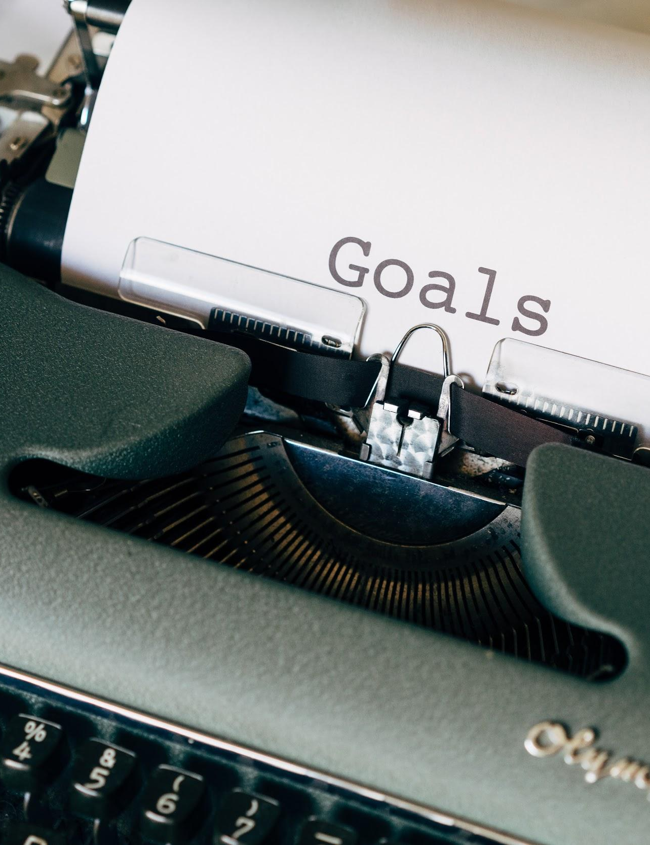
Multiple Means of Action and Expression
UDL emphasizes the importance of building expert learners in any context.
To foster expert learners support relevant goal-setting
Setting the route
Photo by Markus Winkler on Unsplash
Notes:
Setting the Route-GPS
When you create the means to get to the goal
Among the top 5 UDL tips for fostering expert learns is to support relevant goal-setting (by the way the other ones are Communicate high expectations for all and recognize variability, Promote disciplinary expertise, Focus on the process, not just the outcome, Guide self-reflection). With a clear, explicit learning goal, learners are empowered to choose their best pathway to achieve that goal. (USE GPS example, set a goal or destination and then decide how I want to get there. Meandering pathway, toll road, freeway. Each route provides different opportunities and I might want a different route depending on my comfort level. When I was first learning to drive I might have avoided the freeway because of the emotions it elicited.) So here we want to stop and spend a minute are two (maybe a little bit more) to invite you to reflect on learning goal through the lens of your personal experience or work you want accomplish. When you do this the goals become purposeful and meaningful and maximize your opportunity to transfer the knowledge into real world experience.
Not right now
Not good or bad

Slide 22
Multiple Means of Action and Expression
Effective Learning Goals
Separating the means from the ends
providing UDL options in the materials, methods and assessments
Addressing variability in learning
Notes:
A UDL approach to effective learning goals in postsecondary settings consists of three key components:
separating the means from the ends
addressing variability in learning
providing UDL options in the materials, methods, and assessments
SEPARATING THE MEANS FROM THE ENDS
From a UDL perspective, goals and objectives should be attainable by different learners in different ways. In some instances, linking a goal with the means for achievement may be intentional; however, often times we unintentionally embed the means of achievement into a goal, thereby restricting the pathways students can take to meet it.
The following sample curricular goal is articulated as: “Write a paragraph about how the circulatory system works.” What are the barriers this goal might pose for students?
Writing a paragraph is an additional task layered over mastery of the content knowledge that you want your students to attain. Rephrasing this goal into something like, “Describe a complete cycle in the circulatory system” is more explicit about what students should be able to explain, and allows flexibility in terms of how students convey their knowledge (create a diagram, label an image, write out the steps in the process, make a short video explaining an image, etc.). It is also more of a learning goal than a performance goal in that it invites students to demonstrate the fullest extent of their understanding – rather than asking them to prove that they can write a paragraph.

Slide 23
Outcomes as Barriers
“Write a paragraph about how the circulatory system works.”
Photo by Dillon Winspear on Unsplash
Notes:
From a UDL perspective, goals and objectives should be attainable by different learners in different ways. In some instances, linking a goal with the means for achievement may be intentional; however, often times we unintentionally embed the means of achievement into a goal, thereby restricting the pathways students can take to meet it.
The following sample curricular goal is articulated as: “Write a paragraph about how the circulatory system works.” What are the barriers this goal might pose for students?
Writing a paragraph is an additional task layered over mastery of the content knowledge that you want your students to attain. Rephrasing this goal into something like, “Describe a complete cycle in the circulatory system” is more explicit about what students should be able to explain, and allows flexibility in terms of how students convey their knowledge (create a diagram, label an image, write out the steps in the process, make a short video explaining an image, etc.). It is also more of a learning goal than a performance goal in that it invites students to demonstrate the fullest extent of their understanding – rather than asking them to prove that they can write a paragraph.

Slide 24
Alternatives
Provide open-book quizzes: What does a timed test assess?
Use a computer program, software for creating drawings, Mind-mapping software for outcome
Demonstrate process of working a complex problem: Allow students to take a video of themselves solving a problem and talking through their thought processes
Provide a choice of problems for students to complete to demonstrate mastery of a learning objective
Co-Create assessments with students to demonstrate knowledge.
Students can:
Write questions for future quizzes, exams
Co-Create captions for complex figures and diagrams to include in future work: What would this demonstrate?
Create open-ended questions that allow creativity in response and submission type

Slide 25
Provide Multiple Means of Action and Expression SLO and Backward Design: Flexible options for HOW we learn and express what we know
Q & A Time

Slide 26
Provide Multiple Means of Engagement : OEP Tapping into Students Interests
Suzanne Wakim
Notes:
We saved this one for the end because it’s the most complicated. We’re going to put two concepts together - UDL and OEP

Slide 27
Optimize individual choice and autonomy
Heighten salience of goals and objectives
Optimize relevance, value, and authenticity
Vary demand and resources to optimize challenge
Foster collaboration and community
Promote expectations and beliefs that optimize motivation
Multiple Means of Engagement
Notes:
Let’s go back to UDL These are from the big table we saw at the beginning of the presentation. How can we engage students?
clarify what is important and why
give them choices AND challenge them
build community

Slide 28
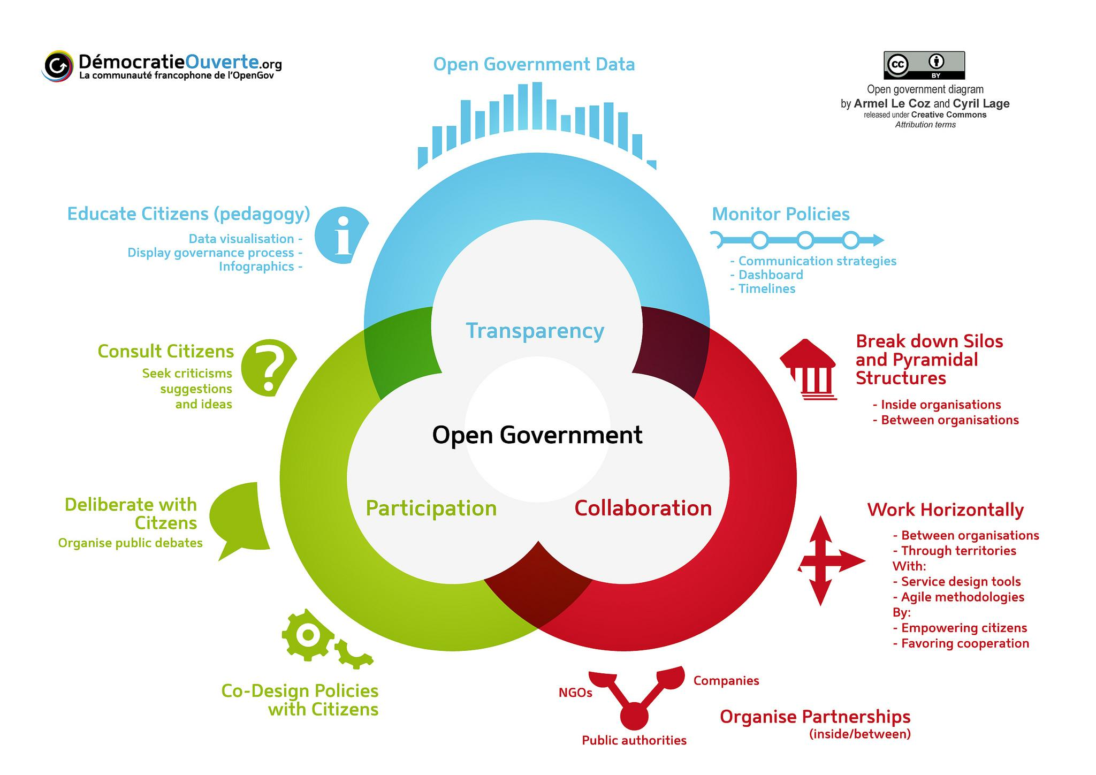
OEP
Notes:
Open Educational Pedagogy. This is defined in many different ways by different folks. It’s still a relatively new concept.
I think the clearest framework is similar to how Open Government is defined. Think of our class as a monarchy v. an open democracy.
Transparency.
students know what to expect - what they will learn and how they will be graded. The assessment from the last section only works if students know how they will be graded. Rubrics
Participation
students are an active part of the class. they aren’t just passive recipients of information.
like voting
Collaboration
students are invited to help design aspects of the class
like ballot initiative petition

Slide 29
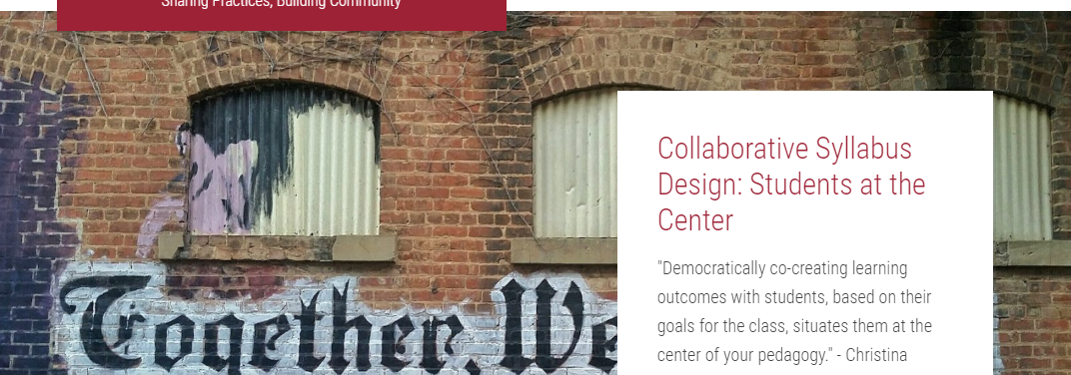
Open Educational Practices - Transparency
Notes:
Having students help create the syllabus. Transparency
set class norms - netiquette, etc.
set class rules - late policies, etc.
contract grading
demystifies grading and holds students accountable
UDL
Optimize individual choice and autonomy
Heighten salience of goals and objectives

Slide 30
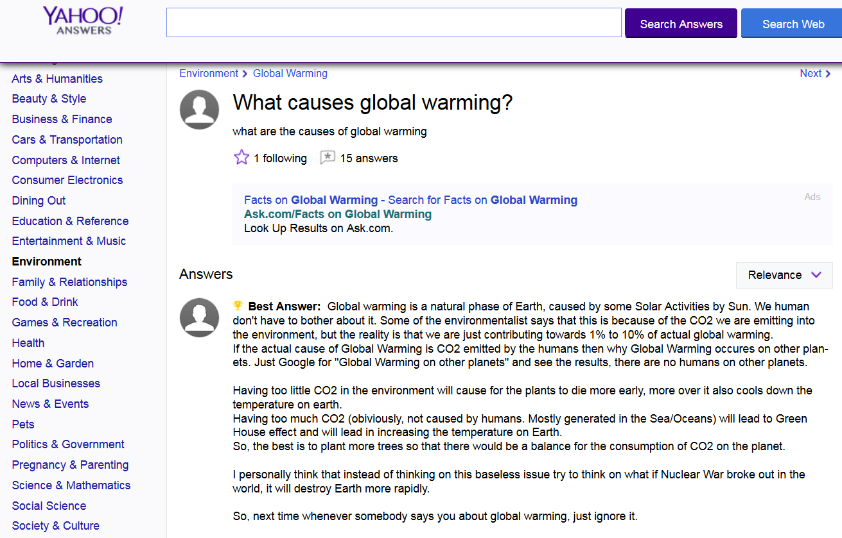
Open Educational Practices - Participation
Co-design the course with students
Living Assignments
Notes:
An OEP that focuses on participation. Compare to “throw away assignments”
Examples
answer questions (example)
Create content to share
students who draw great pictures
Wikipedia
Invites students into the academic space. Not just passive recipients - active participants.
Optimize relevance, value, and authenticity
Vary demand and resources to optimize challenge

Slide 31
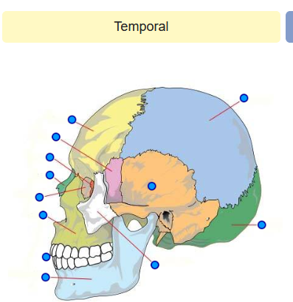
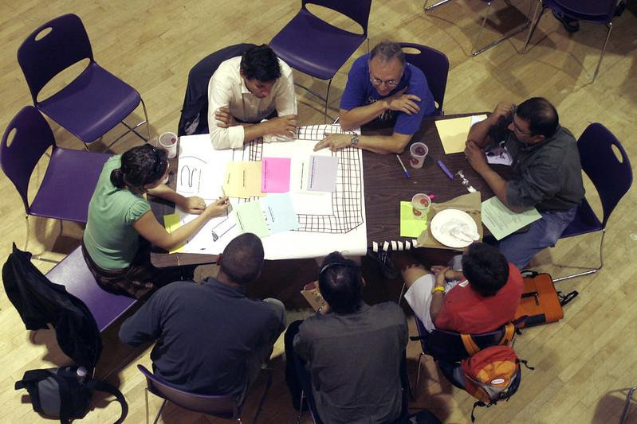
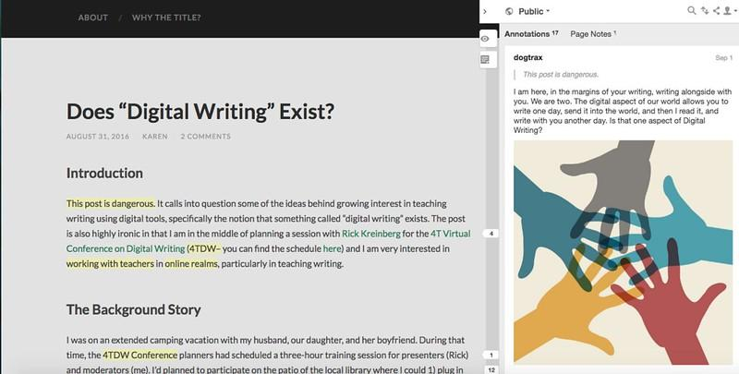
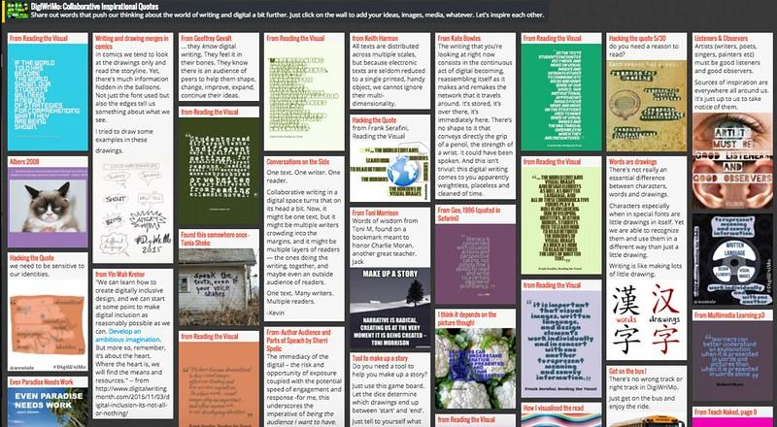
Open Educational Practices - Collaboration
Notes:
Group Work by Kate McCarthy [CC-BY-ND] via Flicker
Digital Writing, in the margins by Kevin Hodgson [CC BY 2.0] via Flickr.
The Digiwrimo Quote Wall by Kevin Hodgson [CC BY 2.0] via Flickr.
Example tied to collaboration.
Students can work together to create course content.
Quiz questions
study resources
quizlet
Purpose Games
Diigo - share links
padlet
study guides
Google Docs
Hypothesis - annotate the book together (Perusall)
Textbook
Foster collaboration and community
Promote expectations and beliefs that optimize motivation

Slide 32
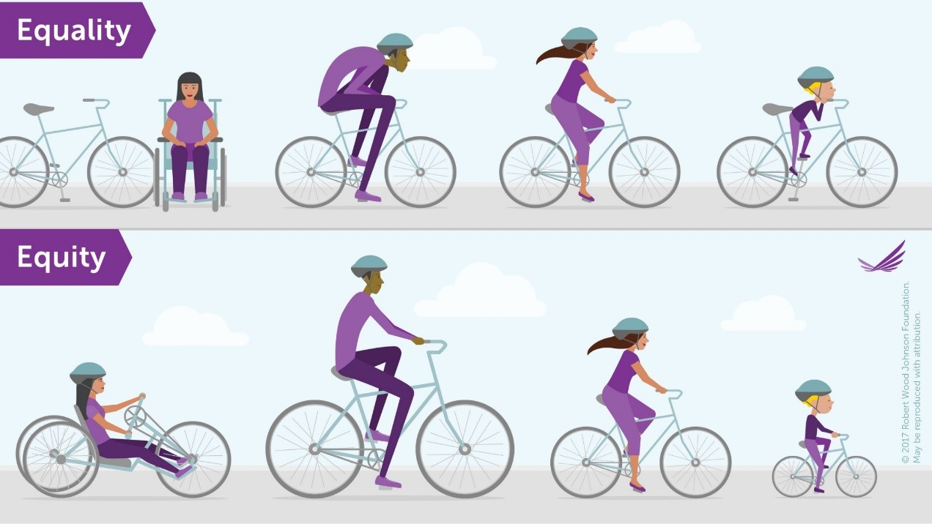
UDL-SLO-OEP
Notes:
Bringing it all together. Bike on road.
This is my favorite equity image because it doesn’t focus on students needing “more” or “less” (boxes). It focuses on students needing different assistance. We give them a choice of bikes and let them find their own path to the end goal.

Slide 33
Provide Multiple Means of Engagement : OEP Tapping into Students Interests
Q & A Time
Notes:
We saved this one for the end because it’s the most complicated. We’re going to put two concepts together - UDL and OEP

Slide 34
Provide Multiple Means of Engagement : OEP Tapping into Students Interests
Q & A Time
Notes:
We saved this one for the end because it’s the most complicated. We’re going to put two concepts together - UDL and OEP

Slide 35
Contact Information
Amanda Taintor
Faculty Coordinator Instructional Design and Distance Education
ASCCC OERI Project Lead
SLO Coordinator
559-638-0300
Amanda.taintor@reedleycollege.edu
Suzanne Wakim
Coordinator of Distance Education,
Open Educational Resources,
and Student Learning Outcomes - Butte College
ASCCC OERI Regional Lead
wakimsu@butte.edu

