Slide 1
Open Educational Resources and AB 798 Grants
Cheryl Aschenbach, Lassen College
Dan Crump, American River College
Dolores Davison, Foothill College

Slide 2
Breakout Description
Open educational resources (OER) are seen by many as ways to reduce student costs for textbooks and course materials. AB 798 (Bonilla, 2015) created OER incentive funding opportunities for colleges interested in integrating OER materials into their campuses. This breakout will examine the status of OER efforts as well as Z Pathways and Degree programs.

Slide 3
Topics
OER Overview
CA OER Council Overview
Curation
50 high impact courses
cool4ed.org
Articulation
Adoption
AB798
Z-Degrees

Slide 4
What is OER?
Open Education Resources
Teaching and learning materials that are freely available online for everyone to use, whether you are an instructor, student, or self-learner.
Examples of OER include: course modules, syllabi, lectures, homework assignments, lab and classroom activities, pedagogical materials, games, simulations, and many more resources contained in digital media collections from around the world. (as defined by www.oercommons.org)

Slide 5
But…
OER most often refers to open access textbooks and ancillary materials that are available at little or no cost to students

Slide 6
Why should OER matter to students?
How much are your textbooks costing students per semester/quarter?
Example
Introduction to Child Development
Commercial publishers hold a monopoly on the 2 primary textbooks for this course, with revised editions published every 3 years:
Developing Person, pub Worth, $197
The Developing Child, pub Bee & Boyd, $209
In the California Community Colleges alone, more than 1000 students enroll in this course EACH SEMESTER. A low cost OER alternative would save students $100 or more.

Slide 7
Articulation
Wait a minute!
Is adopting OER as the instructional materials for my course going to screw up the articulation agreements (and ADT qualification) that my college has with the UCs and CSUs?

Slide 8
Nope!

Slide 9
Responses from UC and CSU system articulation leadership:
“For UC, it’s fine to use assembled materials or Open Educational Resources, so long as they’re as stable and publicly available as published textbooks (and not a list of links). “
Nancy Purcille
Transfer Articulation Coordinator
University of California, Office of the President
“Same for the CSU.”
Ken O’Donnell
Senior Director, Student Engagement and Academic Initiatives and Partnerships
CSU Office of the Chancellor

Slide 10
What can we do???
The Legislature to the rescue...

Slide 11
SB 1052/1053, CA-OER Council, and Open Source Digital Library
SB 1052 and SB 1053 (Steinberg, 2012) were approved for the California public higher education systems to create an online library of open educational resources and open textbooks
SB 1052 authorized creation of CA-OER Council with the goal of identifying OER materials for 50 high impact courses across UC, CSU, and CCCs.
SB1053 authorized development of a CA Open Source Digital Library

Slide 12
CA-OER Council
Composition defined by SB 1052
Representatives from UC, CSU, and CCC (3 each) plus a project leader (non-voting)
Coordination by CSU, but administered by Intersegmental Committee of Academic Senates (ICAS)
$500,000 budgeted by SB 1053 with requirement for matching grant funds – matched by William and Flora Hewlett Foundation and the Bill and Melinda Gates Foundation

Slide 13
As a result of SB1052 and 1053,
CA-OERC…
Selected 50 high impact courses across segments
Identified available free and open e-textbooks
Created and administered a rigorous review process
Established COOL4Ed.org as a repository for free and open e-textbooks and the reviews

Slide 14
California Digital Open Source Library
www.coolfored.org or www.COOL4Ed.org
COOLforEd = California Open Online Library for Education
See courses listed by C-ID number
Textbooks reviewed by faculty from all 3 systems
Some textbooks noted as highly recommended based on faculty reviews
Recommend additional OER etextbooks

Slide 15
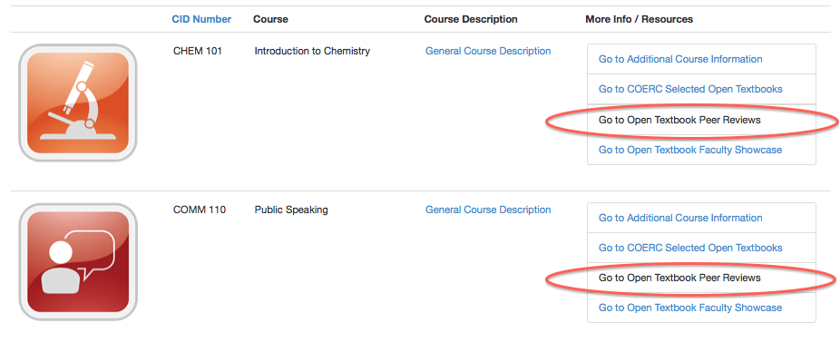
How can I find the reviews?
http://coolfored.org/courseshowcase.html

Slide 16
What is next for OER in CA?
AB 798 (2015) – grants to implement OER in CSUs and CCCs.
OER funding for CCCs in Governor’s January budget
$5 million
Z-degrees (and certificates)
ASCCC Task Force on OER

Slide 17
AB798 (Bonilla, 2015)
College Textbook Affordability Act of 2015
Section 67423 of California Education Code, as amended by SB 798 (Bonilla, 2015) defines open education resources as “high-quality teaching, learning, and research resources that reside in the public domain or have been released under an intellectual property license, such as a Creative Commons license, that permits their free use and repurposing by others, and may include other resources that are legally available and free of cost to students. ‘Open educational resources’ include, but are not limited to, full courses, course materials, modules, textbooks, faculty-created content, streaming videos, tests, software, and any other tools, materials, or techniques used to support access to knowledge.”

Slide 18
AB798 (Bonilla, 2015)
College Textbook Affordability Act
Up to $3 million may be used in CSU and CCCs for the following:
Professional development for faculty; faculty may be compensated for PD
Professional development for staff whose work supports providing students with OER
OER curation activities
Curriculum modification
Technology support for OER adoption efforts

Slide 19
AB 798
AB 798 proposals were due June 30, 2016
Almost 50 applications were submitted
Proposals to be reviewed and scored by CA-OERC in July & August
Recommendations to CSU Chancellor’s Office by August 30
Funding to colleges by early November (latest)

Slide 20
What’s next?

Slide 21
ASCCC OER Task Force
Chaired by Dolores Davison
(ASCCC Secretary)
Faculty
Students
Community College League of CA

Slide 22
What’s next? (part deux-zwei-dos-due)

Slide 23
Z-Degrees
Zero-Textbook Cost Degrees

Slide 24
Developed or Being Developed at…
Tidewater Community College (VA)
Northern Virginia Community College
Virginia Community College System
Washington State Community College System

Slide 25
Background Info
The “Z-Degree”: Removing textbook costs as a barrier to student success through an OER-based curriculum. (Tidewater Community College, Virginia)(note: 70+ pages).
https://web.tcc.edu/academics/zdegree/docs/Z-Degree%20Booklet%20for%20Hewlett.pdf
Z-Degree: introducing the nation’s first Z-Degree, the Business Administration Association of Science degree (info from Tidewater Community College, including links to other resources)
http://web.tcc.edu/academics/zdegree/index.html
Z as in Zero: Increasing College Access and Success through Zero-Textbook-Cost Degrees (blog posting from the Hewlett Foundation).
http://www.hewlett.org/blog/posts/z-zero-increasing-college-access-and-success-through-zero-textbook-cost-degrees#.VvSJg_Ixj3g.email
The Portable Z: How Virginia is Scaling the Z-Degree Across Its 23 Colleges with the Zx23 Project. (presentation at Open Ed Conference-Vancouver-November 2015)
http://www.slideshare.net/richardsebastian/the-portable-z-how-virginia-is-scaling-the-zdegree-across-its-23-colleges-with-the-zx23-project
Northern Virginia Community College Shares OER Degree Programs.
https://campustechnology.com/articles/2015/11/16/northern-virginia-community-college-shares-oer-degree-programs.aspx

Slide 26
What about California?
Trailer Bill…
no, this isn’t about campers and RVs

Slide 27
Trailer Bill Budget Language--- AB 1602
$5 Million (One Time) for Creating Zero–Textbook–Cost Degrees (Z-Degrees) at the California Community Colleges.
Z-Degrees would allow students to complete a degree entirely by taking courses that use only OER materials.

Slide 28
Z-Degrees
Z-Pathways

Slide 29
AB 1602 (Education Budget Trailer Bill)
Grants of up to $200,000 will be distributed to CCC districts for each degree developed and implemented…details to come from CCCCO by early fall
http://www.leginfo.ca.gov/pub/15-16/bill/asm/ab_1601-1650/ab_1602_bill_20160627_chaptered.htm
(www.leginfo.ca.gov)

Slide 30
What will a z-degree be?
A degree from an existing associate degree, or a new or existing CTE certificate program, that has high value in the regional market, developed and implemented as a zero-textbook-cost certificate program
Prioritize the degree or certificate from existing OER materials before creating new content

Slide 31
And…
Develop and implement a degree that other community college districts can use or adapt, and post each degree, and the contents of the degree, on the online
clearinghouse of information---California Digital Open Source Library.

Slide 32
And…
Consult with the local academic senate
Use a multimember team approach…that includes faculty, college administrators, and other content-focused staff, including, but not limited to, librarians, instructional designers, and technology experts.

Slide 33
And…
Strive to implement degrees by the first term of the 2018-19 academic year.
CCC Chancellor’s Office shall award an initial round of grants no later than
January 1, 2017.

Slide 34
Legislative Analyst Office (LAO) Report
The 2016-17 Budget: Assessing the Governor’s Zero-Textbook-Cost Proposal
http://www.lao.ca.gov/Publications/Report/3392

Slide 35
Key Support Services for Successful OER Initiatives
Provide training for faculty, instructional designers, and librarians.
Provide individual help to instructors in finding, selecting, and adapting OER to meet course learning objectives.
Certify materials.
Make resulting OER publicly available.
Provide evaluation data.

Slide 36
Questions?
Cheryl Aschenbach
caschenbach@lassencollege.edu
Dan Crump
crumpd@arc.losrios.edu
Dolores Davison
davisondolores@fhda.edu

