Slide 1
Online Education Planning Tool
Nichelle Williams
Sacramento City College
Robert Melendez
Irvine Valley College

Slide 2
Overview
Sacramento City College – iSEP
Irvine Valley College – MAP
Q&A

Slide 3
Sacramento City College
Los Rios Community College District - iSEP
American River College
Cosumnes River College
Folsom Lake College
Sacramento City College

Slide 4
Sacramento City College
Select a College

Slide 5
Sacramento City College
Select Educational Goal, Major or Add New College

Slide 6
Sacramento City College
Course Planning Page
This page is the main working page for constructing the student’s iSEP. This page provides the following functionality:
Edit Student Phone number
Select Transfer information for a Primary 4 Year College
Add standard comments by iSEP, by term and by course
Indicate Referral Services for a Student
Select Courses by Term and GE Area
Select Courses from the Academic Advisement Report
View Student Assessment Placements and select courses from the Assessment Template
Move Courses to another term
Add additional terms

Slide 7
Sacramento City College
Transfer Data for Primary Choice
4 Year College Options:
This is an example of the possible selections when selecting transfer information for a 4 year college.

Slide 8
Sacramento City College

Slide 9
Sacramento City College
Example of Exempted:
The student’s matriculation services status is now displayed in the Matric Services box on the Edit SEP page.

Slide 10
Add Courses by Term
Sacramento City College
This section allows you to select courses by college, subject and catalog.
You can also add courses by GE AREA: CSU and IGETC AA/AS

Slide 11
Enhance Assessment Results Page
Sacramento City College

Slide 12
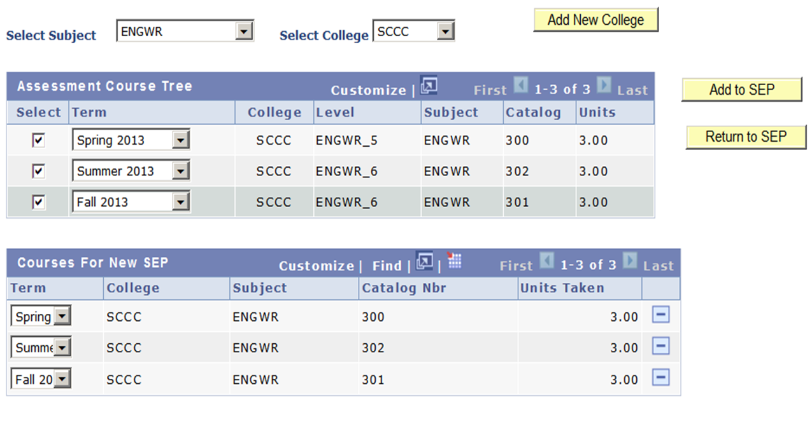
Plan by Prerequisites
Sacramento City College

Slide 13
Add courses from the student’s planner in eServices
Sacramento City College
Provides the ability to access the student’s My Planner page in eServices and copy the courses in the student’s planner directly into the iSEP.
Selecting the Planner button opens the student’s eServices to My Planner page.
Selecting the button moves the courses in the student’s planner to the iSEP.

Slide 14
Sacramento City College

Slide 15
Sacramento City College
Finalize the SEP
This is the last step in the Student iSEP process. Clicking on the Finalize button saves the iSEP and marks it as official with a date stamp. This also makes the student’s iSEP viewable in eServices by the student.
If the iSEP in not finalized, a copy of the work that has been prepared will be available under the search tab marked as ‘In Progress’. Once you finalize the iSEP subsequent changes or modifications to the student’s iSEP will be displayed with a sequence number and a date stamp.
Click on the Finalize button to save the SEP
You can also click on the Print button to print the SEP for the student.
Clicking on the Finalize button returns you to the View SEP page:

Slide 16
Sacramento City College
eServices – Student Center
Once the iSEP for a student has been finalized the iSEP is viewable by the student in eServices. The student can review the iSEP as well as add the courses from the iSEP to their student planner in eServices. What follows are screen shots of how the student views the iSEP in eServices.

Slide 17
Sacramento City College
In eServices the student clicks on he My Ed Plan tab to view their SEP.

Slide 18
Sacramento City College
The Future

Slide 19
Sacramento City College
Components – Student
New “iSEP” tab in eServices
Official SEP courses
Copy to “My Planner”
Review “Steps to Success”
Student copies courses from iSEP into their Planner
Term by Term course plan
Facilitates class registration process
Planner courses appear in the students Degree Audit interactive report as “planned” (Plan by My Requirements)
View of counselor comments

Slide 20
Sacramento City College
Components – Counselor
Student Information
Ed goal, Major, Requirement Term
Assessment Placement and Competency
Course Plan
From pre-defined templates
From course catalog
Comments
Multiple text comments entered by counselors
Viewable by student in eServices
Referral Services
View of current participation
Selection to refer student to services

Slide 21
iSEP Summary
Sacramento City College
PLUS:
Interfaces with student data, degree audit, Basic Skills, student planner, & assessment portability
Can be viewed & updated by any counselor in the district at any time
Drop down assessment, Basic Skills Paths, and three GE templates (AA/AS, CSU and UC)
All data entered can be turned into a report (e.g. referral follow up)
Students can always find it in eServices
Key features:
Well informed Student
Course plan by term
Counselor comments
Referral to support services
Signature section

Slide 22
Irvine Valley College
South Orange County Community College District – MAP
Irvine Valley College
Saddleback College

Slide 23
Irvine Valley College

Slide 24
Irvine Valley College
Matriculation Process
Orientation (Online & In Person)
Assessment
(Native, ESL, Math)
Online Advisement
(1st semester educational plan completed by student)
In Person Advisement
(1st semester educational plan completed with a counselor)
Fully Matriculated
Fully Matricualted
Application Submission

Slide 25
Irvine Valley College
My Academic Plan (MAP)
Used to create 1st semester/abbreviated academic plan & comprehensive academic plans
Will create plans for certificate, associate degrees and transfer
Linked to SIS and ASSIST

Slide 26
Irvine Valley College
Comprehensive Academic Plan Completion Options

Slide 27
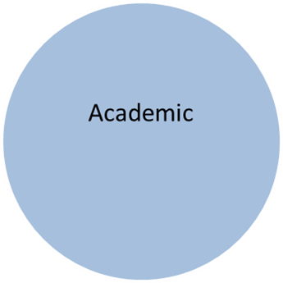
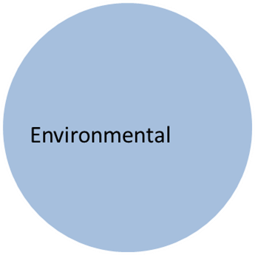
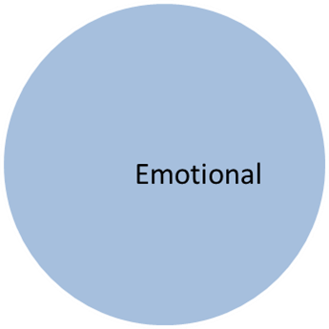
Irvine Valley College
Anatomy of an Academic Plan
Not just about courses
Must meet short and long term goals
Must be from a holistic approach and take into account psycho-social aspects
i.e. First generation college student
who is Psychology major, but also
thinking medical school

Slide 28
Irvine Valley College
Strengths and Shortcomings
Strengths
Available to students
Connection to ASSIST
Plans available electronically to students 24 hours a day
Multiple plans can be created
Shortcomings
Need more counselors
MAP needs constant updating
Having student commit/decide on a major in a timely manner
Private/out-of-state schools

Slide 29
Irvine Valley College
Future Plans
Develop MAP system for out-of-state and private schools
Creation of a separate MAP lab
True online counseling
Replacement of SARS

Slide 30
Question and Answer

Slide 31
Thank you!
Contacts:
Robert Melendez, Irvine Valley College
rmelendez@ivc.edu
Nichelle Williams, Sacramento City College
Willian@scc.losrios.edu

