Slide 1
Online Education Regional Meetings
Mt. San Antonio College
March 21, 2015

Slide 2
Welcome
Bill Scroggins, President, Mt. San Antonio College
Daniel Smith, Academic Senate President, Mt. San Antonio College

Slide 3
ASCCC Online Education Committee (2014-2015)
John Freitas, Los Angeles City College (Chair)
Gregory Beyrer, Cosumnes River College
Kale Braden Cosumnes River College
Dolores Davison, Foothill College
Christina Gold, El Camino College
Eileen Smith, Shasta College
Fabiola Torres, Glendale College

Slide 4
Chancellor’s Office Update
LeBaron Woodyard,
Dean of Academic Affairs,
California Community Colleges Chancellor’s Office

Slide 5
Chancellor’s Office Update
(DE-all) Distance Education List Serve
State Authorization Reciprocity Agreement (SARA) Legislation
SB 364, Block
Flexible Calendar Planning for 2015-16
Financial Aid Fraud
Distance Education Annual Survey

Slide 6
Afternoon Breakout Sessions*
ADA Compliance – John Freitas, Jayme Johnson and LeBaron Woodyard
Effective Practices – Kale Braden and Fabiola Torres
Landmines – Dolores Davison and Christina Gold
*each session will be repeated twice

Slide 7
Online Education Initiative Updates
Pat James, Executive Director, Online Education Initiative
Jory Hadsell, Chief Academic Officer, Online Education Initiative

Slide 8
Update March 2015

Slide 9
A Little Background
Notes:
Funding for the California Community Colleges was cut $1.5 billion between the 2007-08 and 2011-12 academic years
Course offerings statewide were cut by roughly 25 percent due to the five consecutive years of deep budget cuts.
The cuts forced community colleges to ration course offerings and as a direct result, nearly 500,000 students were shut out of the system.

Slide 10
Where We Are Now
2010-2013 Turning away students
2015 Trying to get them back!

Slide 11
Distance Education in CCC
The average time it takes a student to graduate from a CCC:
7 years
The average time it takes for a student to transfer from a CCC to a four-year institution:
4 years
Source: CCC Research and Planning Group (February 2015) based on data from the CCC Chancellor’s Office MIS Data Warehouse.
Notes:
Facts: Impact of Budget Cuts on the California Community Colleges System During the Recession:
Funding for the California Community Colleges was cut $1.5 billion between the 2007-08 and 2011-12 academic years (PPIC report).
Course offerings statewide were cut by roughly 25 percent due to the five consecutive years of deep budget cuts.
The cuts forced community colleges to ration course offerings and as a direct result, nearly 500,000 students were shut out of the system.

Slide 12
What do we hope to accomplish in a nutshell?
Increase the ability of our students to complete their educational goals.

Slide 13
General Components of the OEI
OEI
Technology resources that maximize economies of scale
System wide resources for online students
System wide resources for developing high-quality online courses

Slide 14
Completion by….
Improve success and retention in online courses for the CCC’s
Prepared students
Prepared faculty
Quality course design and content resources
Providing resources to colleges to allow for the addition of quality online courses
Providing students with opportunities to take classes when and where they need them

Slide 15
Pilot Colleges
Readiness | Tutoring | Full-Launch
Antelope Valley | Barstow | Butte
Cabrillo | Columbia | Coastline
College of the Canyons | Imperial Valley | Foothill
Hartnell | Mt. San Antonio | Shasta
Mira Costa | Ohlone | Fresno City
Monterey Peninsula | Pierce | Lake Tahoe
Rio Hondo | Saddleback | Mt. San Jacinto
West Los Angeles | Victor Valley | Ventura

Slide 16
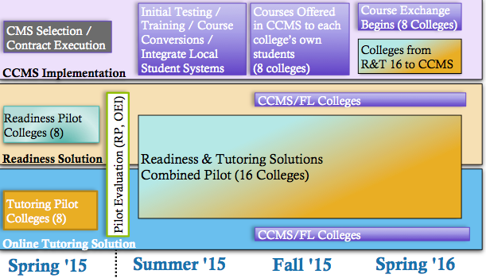
Initial Pilot Phase

Slide 17
Resource Updates!
Tutoring:
Pilots underway at 8 colleges
Extension to all pilot colleges by fall 2015 (no cost)
No cost platform to connect local tutors to students online for all colleges (End of March 2015)
Low cost 24/7 online tutoring for all students available for all colleges (End of March 2015)
Link Systems via the Foundation for the CCCs
Embedded Basic Skills Support Resources
In Planning and pilot stages
Shared resources and strategies

Slide 18
Resource Updates!
Online Student Readiness:
Pilots underway at 8 colleges
Extension to all pilot colleges by fall 2015 (no cost)
No cost online student readiness modules will be available to all colleges via Canvas implementation
Currently piloting readiness modules combined with Smarter Measure Assessment

Slide 19
Online Learner Readiness Modules (Pilot Phase)
Module 1: Introduction to Online Learning
Module 2: Getting Tech Ready
Module 3: Organizing for Online Success
Module 4: Online Study Skills and Managing Time
Module 5: Communication Skills for Online Learning
Module 6: Online Reading Strategies
Notes:
Picture of screen hyperlinks to the actual module you can show if you want

Slide 20
Resource UPDates
Professional Development & Course Design Support
Professional Development Clearinghouse (End of April)
Online Course Design Standards (piloted and revised)
Online Course Review (67 courses in pilot colleges have been reviewed—20 more in process now)
Reviewer Training: Peer Online Course Review (POCR)
March 27th (Foothill College)
May 1st (Cerritos)
June 17th (OTC: San Diego)
Professional Development Summits
Access to Instructional Designers
Access to Accessibility support
Notes:
Explain the clearing house
Explain the reviewer training: one day meeting and then eligible for week long online reviewer training.

Slide 21
Technology Resources
Common Course Management System
Will allow for state wide online community
Enable the deployment of integrated student and faculty resources
Provide no and/or low cost access to an up-to-date, easy to access, fully-functional CMS
Currently researching state wide procurement of add-on tools for online proctoring, plagiarism, etc.
Canvas was selected on February 5, with an intent to award announced the following week.
Currently in contract negotiations

Slide 22
Common Course Management System! Canvas!
We considered
what was best for students.

Slide 23
Why Canvas?
Overwhelming support from students
Nearly unanimous decision
Ease of use and robust functionality
Partnership and customization opportunities
History of strong completion and success rate improvements
Site visits and reference checks (including students & faculty) were overwhelmingly supportive

Slide 24
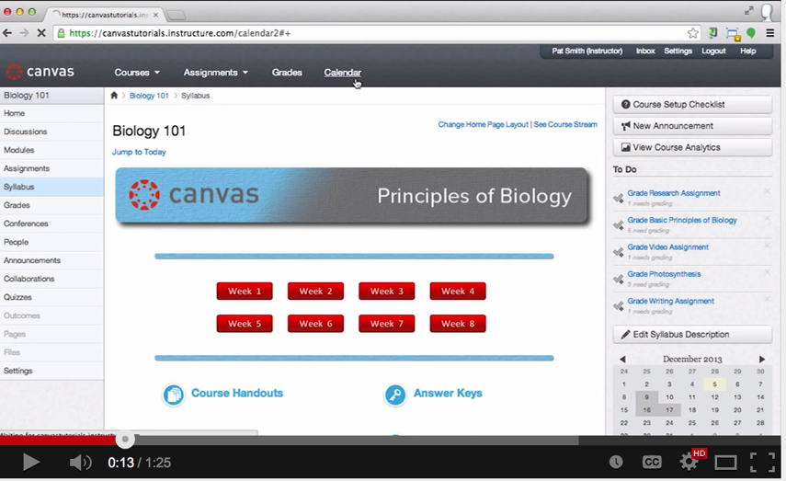
Common Course Management System! Canvas!
Canvas
Notes:
1. The committee of 55 members reached a nearly unanimous decision
2. There was overwhelming support for Canvas from students 3. Canvas offers an intuitive end user experience 4. It has a history of strong completion and success rate for students 5. Faculty user adoption rate at colleges has been significantly higher than other systems 6. Site visits and reference checks were overwhelmingly supportive of vendor product and was a confirmation of information shared by the vendor. 7. Canvas also offers flexibility for students to indicate a choice for how to receive notifications and course information.
8. Canvas offers an intuitive interface for faculty allowing for more time spent on pedagogy rather than on learning or teaching the technology tool.

Slide 25
Do all colleges have to move to Canvas?
NO!
We hope you will want to, though!
Ease of use and upgrades will be managed at the system level
Cost will be significantly reduced
Resources will be integrated for both faculty and students
Opportunities for collaboration for both faculty and students
Partnership with Canvas will allow for customization for the CCC’s
Many resources will still be available to those who stay in their own CMS.

Slide 26
Only One Component…..
Student Exchange

Slide 27
Only One Component….. Student Exchange
College # 113
We are NOT the 113th CCC.

Slide 28
What’s the Exchange?
Will allow students needing courses that are not available at their home college, to seamlessly enroll in those courses, as needed, at other CCCs, thereby, leveling the enrollments in high demand or difficult to fill courses.
Will include access to resources for both colleges and students
Improve completion rates across the state.

Slide 29
Implications of the Exchange…
Access to the hard to get courses needed to graduate or transfer
Exchange courses seamlessly articulate between colleges (C-ID, ADT courses)
Streamlined application and registration processes
Financial aid combined across colleges in the Exchange
Common learning environment (CCMS / Canvas)
Course status and final grade shared back to home college automatically (credit toward degree or transfer goal)

Slide 30
Does Everyone have to be in the Exchange?
Courses in CCMS do not have to be part of the Exchange
Exchange courses must be in the CCMS
CCMS (Any college)
Local Online Courses
Local F2F, Hybrid Courses
Online Course Exchange (Consortium Colleges)
Requires OEI Course Review
C-ID, ADT Approved Courses
Who gets credit?
Home College: Completion
Teaching College: FTE ($)
Focused on Student Completion

Slide 31
The OEI Consortium
Organization to form, initially with 24 pilot institutions as members.
Governing body for implementation decisions that affect the member colleges.
Will be formally convened sometime in early- or mid-2015.

Slide 32
Governance
27 Member Steering Committee:
Chair and Vice-Chair
Representatives of constituent groups: Librarians, A&R, CIO, CSSO, CEO, Students, DE Coordinators, etc.
9 ASCCC faculty representatives
Makes broad policy recommendations to the OEI Management Team (Foothill-De Anza CCD)

Slide 33
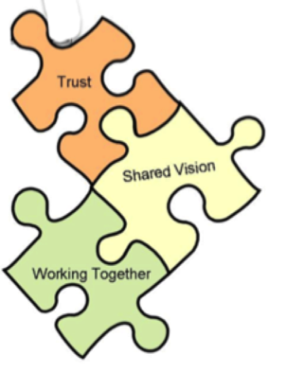
Develop a cross-system collaborative culture focused on what works for students.
.
.
.
.
.
.
.
.
.
.
.
.
.
.

Slide 34
Contact Information
Website:
http://CCCOnlineEd.org
Tech Edge Newsletter:
http://ccctechedge.org
Updates Blog:
http://ccctechedge.org
Jory Hadsell: hadselljory@fhda.edu
Pat James: jamespat@fhda.edu

