Slide 1
Open Pedagogy
Who is Steering the Ship?
And Where are You Going?
2020 Academic Academy: Redefining Distance Education
Licensed CC BY 4.0 by Tia Germar and Suzanne Wakim

Slide 2
Overview
What is Open Pedagogy?
What are living assignments?
Examples
engage students with the learning process
Invite students into academia
empower students as content creators
Notes:
Examples
Engaging students – small examples of OEP
Inviting – larger examples (but still in the classroom)
Empowering – students add to the larger world.
Starting with definitions
because flexible - multiple definitions & multiple terms
Spending a bit of time on definitions b/c this is a shift in how we think about the purpose of assignments
More of a Conceptual framework - but we will discuss concrete examples

Slide 3
OER-enabled Pedagogy
A set of teaching and learning practices only possible or practical when you have permission to engage in the 5R activities.
Disposable v. Living Assignments
Wiley & Hilton; 2018 and David Wiley; 2013
Paper Projects by JerzyGorecki pixabay license
Adapted from Creative Commons Certificate licensed CC-BY 4.0
Notes:
Retain, reuse, revise, remix, redistribute
Disposable assignments

Slide 4
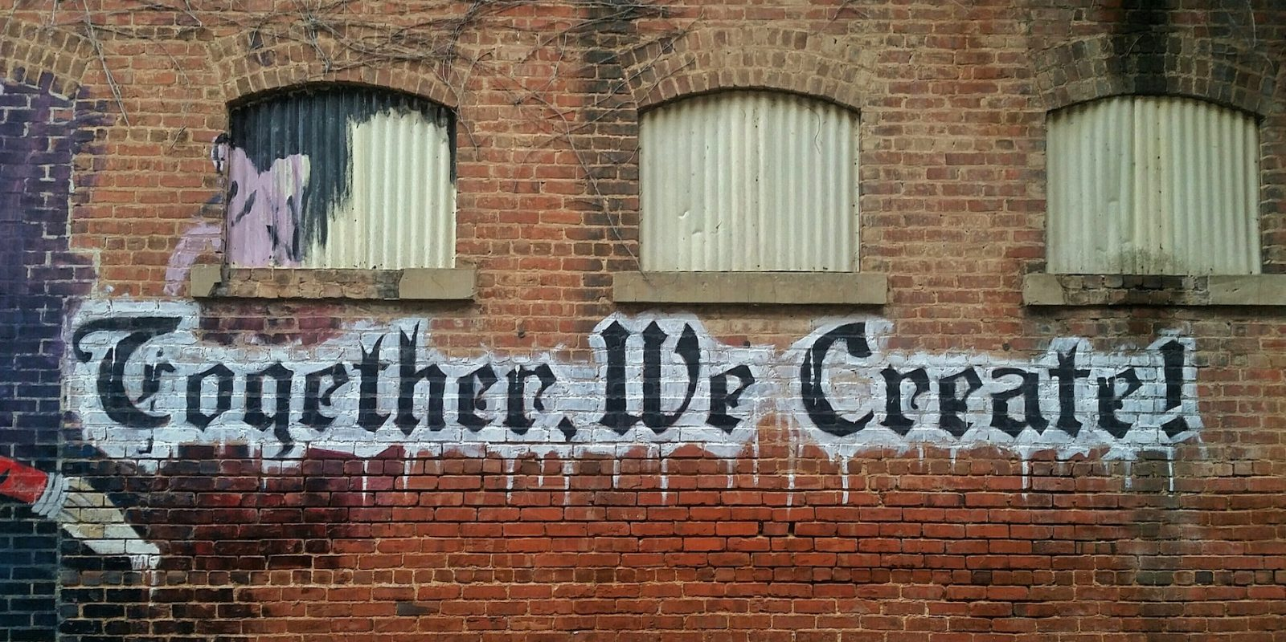
Open Pedagogy
An access-oriented commitment to learner-driven education and a process of designing architectures and using tools for learning that enable learners to shape the public knowledge commons of which they are a part.
Year of Open
Open Pedagogy Notebook
Together we Create; public domain
Adapted from CC Certificate; CC-BY 4.0
Notes:
Students helping to create course content - example, writing test bank questions (will discuss more)
Open Pedagogy Notebook has lots of great examples!

Slide 5
Open Educational Practices
Use / reuse / creation of OER and collaborative, pedagogical practices employing social and participatory technologies for interaction, peer-learning, knowledge creation
and sharing, and
empowerment of learners.
Cronin’s 2018 Open Edu Global presentation
Adapted from CC Certificate; CC-BY 4.0
Adapted from www globe and social media; pixabay license
Notes:
Similar to Open Pedagogy but I prefer this b/c “pedagogy” & b/c acronym
And really underlines the connections

Slide 6
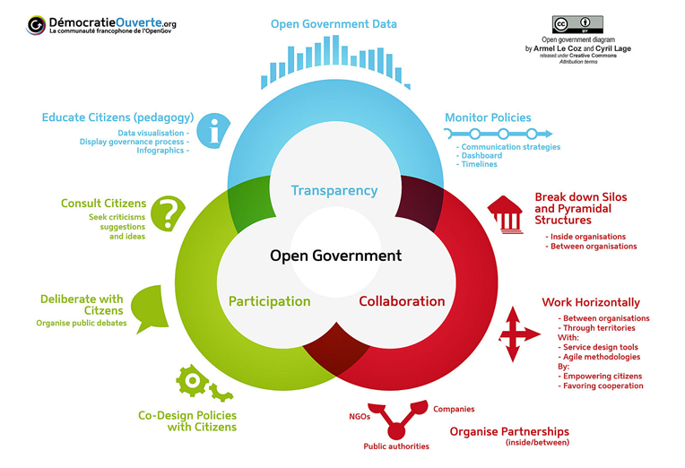
Open Government
Democratie Ouverte by Armel Le Coz and Cyril Lage [CC BY 3.0]
Notes:
I think Open Pedagogy makes most sense when compared to Open Government
Transparency - students always know WHAT & WHY they are learning and HOW they will be graded
Participation - students are actively part of the class (not just passively absorbing information)
Collaboration - students are brought “back stage” in the learning process

Slide 7
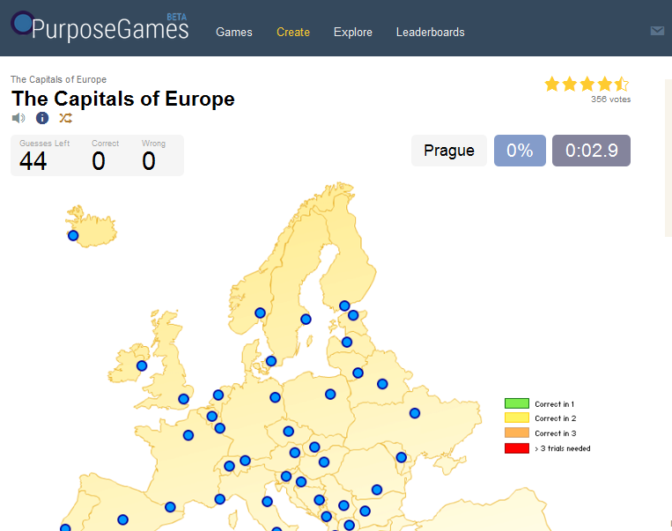
Start Small - Helping each other study
Test banks
with feeling! I mean, feedback.
Study Resources
flashcards
games
Roola: Review of Online Learning Aids
Notes:
Start small - things for your class
Feedback is key - what are misconceptions others may have and how can I clarify that
Study resources - lots of great places for students to build stuff - quizlet, purpose games, etc.
Roola

Slide 8
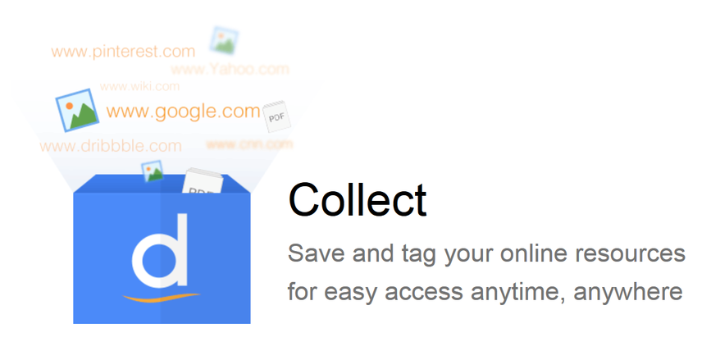
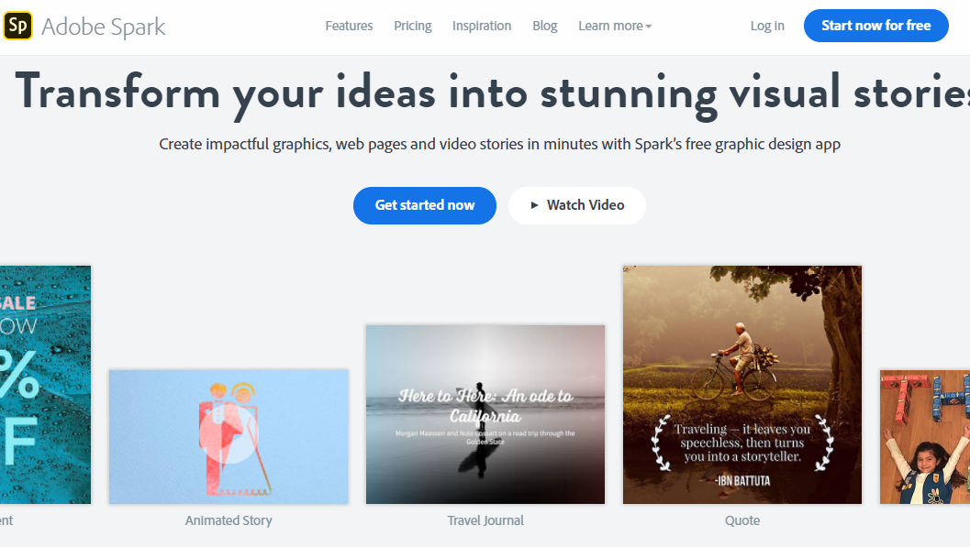
Helping each other learn
Sharing links
Creating videos
Creating lessons
Recording an audio book
Notes:
Diigo - shared bookmarks
Adobe Spark, Animation programs

Slide 9
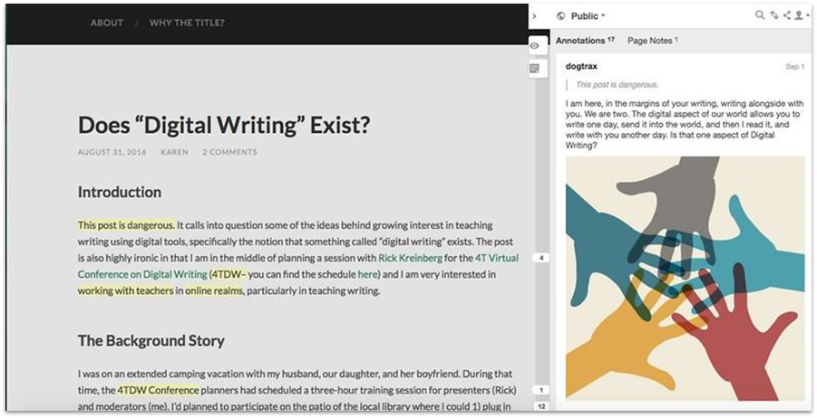
Learning together
Annotation
collaborate on study guides
Digital Writing, in the margins by Kevin Hodgson [CC BY 2.0] via Flickr.
Notes:
Annotate - hypothes.is
Study Guides - Google Docs

Slide 10
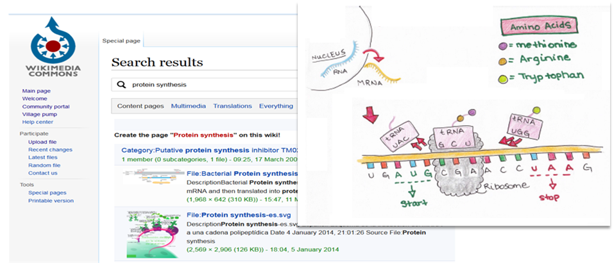
Encourage students to share

Slide 11
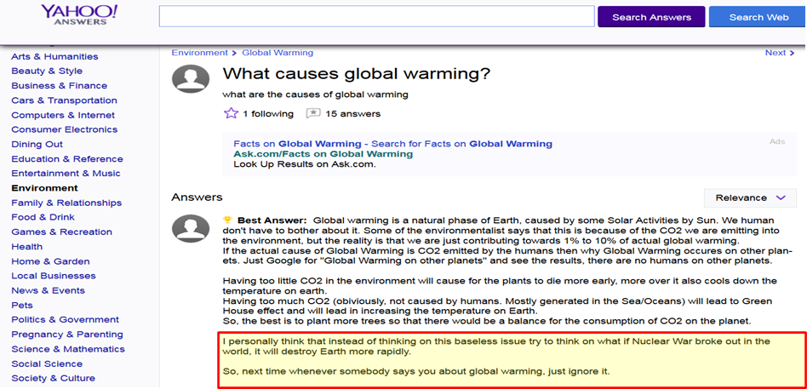
Public Service

Slide 12
Wikipedia
Why Wikipedia
Project Organization
WikiEdu Tools & Support
Impacts & Challenges

Slide 13
Why Use Wikipedia
Ultimate taboo source
Students use it anyways
WikiEdu.org provides support
"Wikipedia" by giulia.forsythe is marked with CC0 1.0

Slide 14
Project Organization
Students start by developing topics
Find a related Wikipedia article
Write an annotated bibliography
Prepare a draft
Peer review classmates’ drafts
Add their work to live a Wikipedia page
"Wikipedia" by giulia.forsythe is marked with CC0 1.0

Slide 15
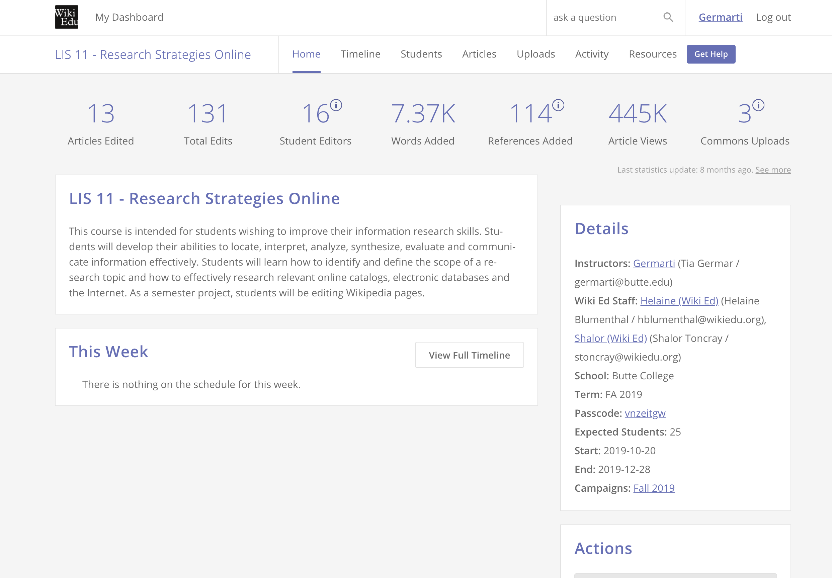
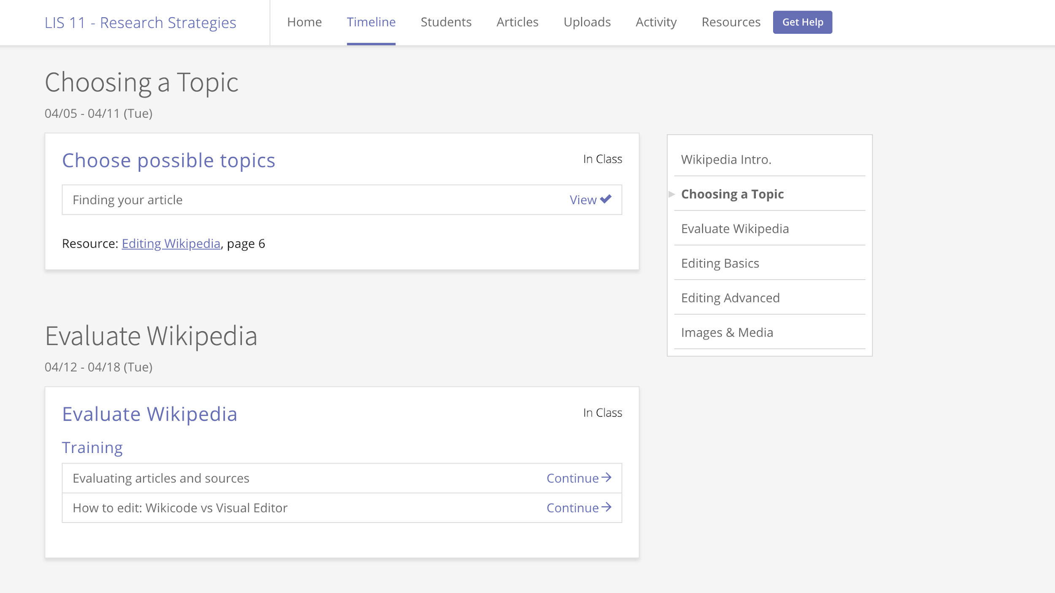
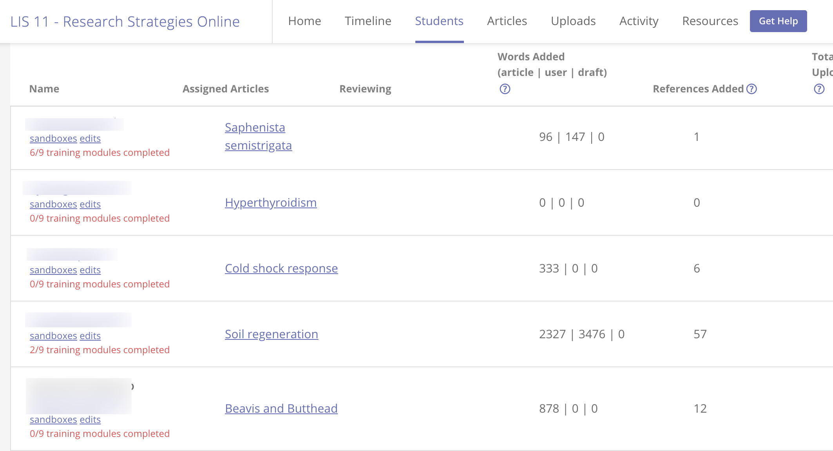
Wikipedia’s Instructor Support

Slide 16
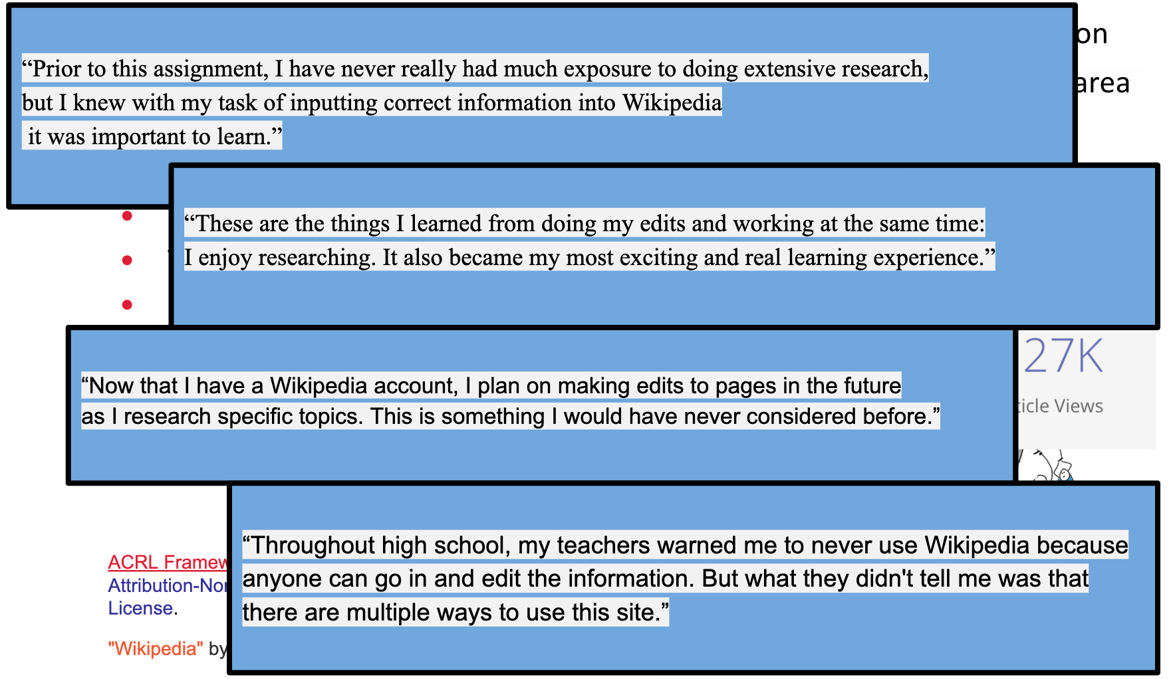
Impacts
From ACRL Framework: “Learners who are developing their information literate abilities seek out conversations taking place in their research area and see themselves as contributors to scholarship rather than only consumers of it.”
Changes the representation on Wikipedia
The ability to share paywalled information
Personal significance
ACRL Framework licensed under a Creative Commons Attribution-NonCommercial-ShareAlike 4.0 International License.
"Wikipedia" by giulia.forsythe is marked with CC0 1.0

Slide 17
Challenges
Technology
Time
Topic Choice
Privacy
Don’t grade by what sticks
"Wikipedia" by giulia.forsythe is marked with CC0 1.0

Slide 18
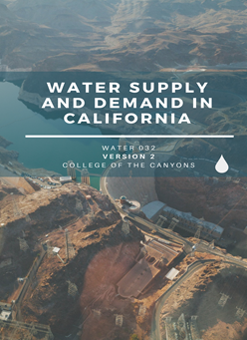
Update the textbook
Customize the book
what do they think is important?
Are they reflected in the book
Case studies
locally relevant
student guided
Image: Water Technology Dept, College of Canyons OER Textbooks, CC-BY

Slide 19
Class Textbook
Anthology of Early American Literature
The story
My Slipper Floated Away
Biology: Outline of process
Outlining Topics
Finding Sources and Samples
Writing the First Draft
Adding images and applications
Editing
Building Study Tools

Slide 20
Discussion
Notes:
How would you define OEP.

