Slide 1
Escape! How to Build Faculty Assessment Teams Through the Use of Escape Rooms
Riverside City College
Program Assessment Workgroup (PAW)
Presenters: Denise Kruizenga-Muro and Jude Whitton
Notes:
Presentation Description
This presentation will highlight the work that Riverside City College’s Assessment Committee has done to create a multi-discipline program assessment workgroup and then walk participants through an “escape room” scenario used to build assessment teams by providing an assessment-related problem for the teams to solve.

Slide 2
Agenda
Introductions
PAW: The Background
Our Process Toward Program-level Assessment
Escape Room Basics
Escape Room Scenario

Slide 3
What we hope you to take from today
How we built a broad coalition of willing faculty.
How RCC moved from student learning outcome level assessment to program level assessment.
How to develop escape room games as a way to engage and excite faculty.

Slide 4
Denise Kruizenga-Muro
Lead Instructor in the Writing and Reading Center
English and Media Studies Department
Languages, Humanities, and Social Sciences Division
Riverside Assessment Committee Co-Coordinator
Notes:
Denise

Slide 5
Jude Whitton
Associate Professor of Communication
Communication Studies Department
Languages, Humanities, and Social Sciences Division
Riverside Assessment Committee Co-Coordinator
Notes:
Denise

Slide 6
Background: History of Assessment at RCC
SLO Assessment 2009-2015
Assessment Committee has members from 19 disciplines on campus.
Nursing department was the most advanced with 100% of their SLOs being assessed each year and assessment informing teaching.
Other departments were at 0% of SLOs assessed with some faculty resistant to doing assessments.

Slide 7
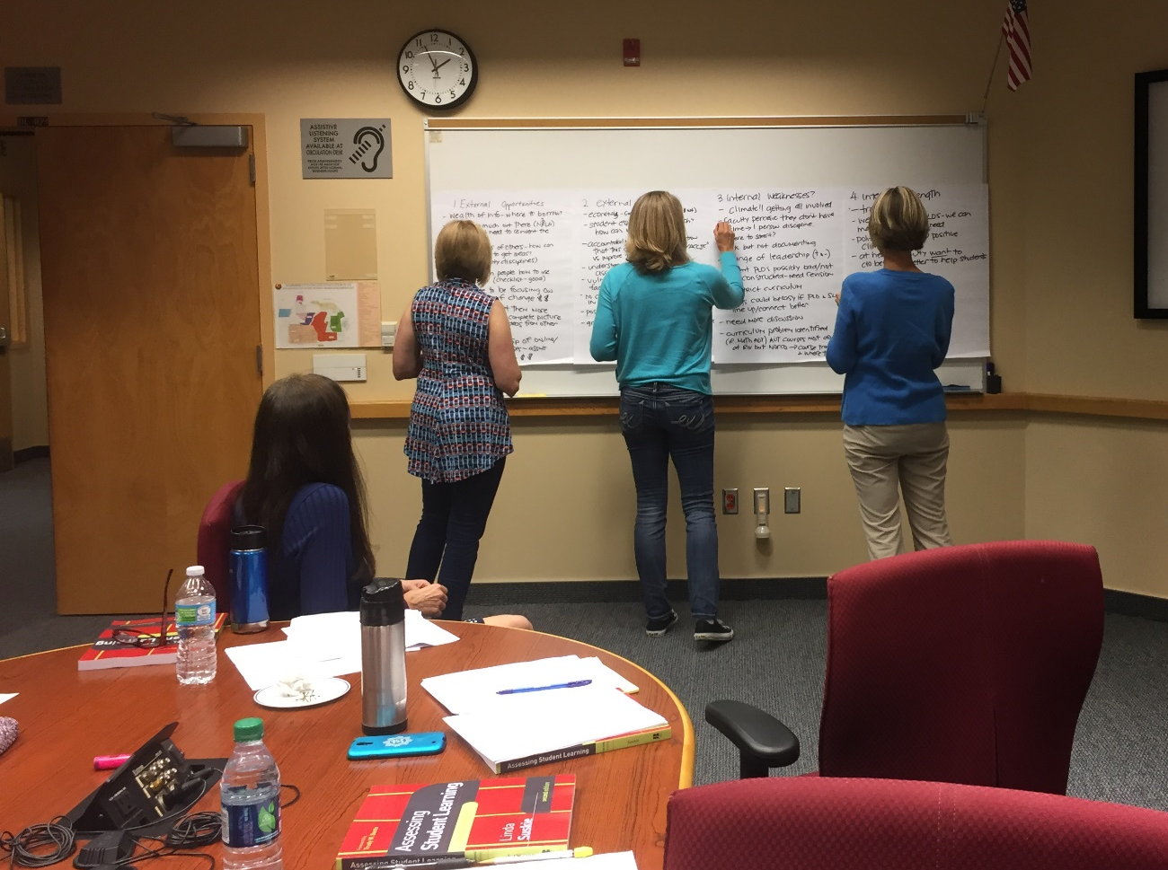
Formation of the PAW
A workgroup charged with helping faculty move into regular, sustainable program assessments.
Most of our first year was spent doing a SWOT analysis, developing a vision statement, and developing goals.
Subsequent efforts focused on accomplishing PAW’s established goals.

Slide 8
SMART Goals – PAW Example
Goal 1: By January 1, 2017 design program assessment models using identified best practices and share them online to assist others in the design of their program assessment projects.
Goal 2: By June 30, 2017 explore ways to help faculty see the value of program-level assessment.
Goal 3: By June 30, 2017 develop mechanisms to increase the discussion of program learning outcomes and program-level assessment, so that conversations are documented and evidence is shared broadly across the college.

Slide 9
Vision Statement – PAW Example
The purpose of the Program Assessment Workgroup (PAW) is to lead Riverside City College toward regular, sustainable, and efficient program-level assessment that maximizes the ability to evaluate and improve student learning. By June 2017, PAW will create and pilot examples of various approaches to program assessment that are adaptable and easy for faculty to use. PAW will attain these desired results by identifying best practices, attending and providing training, developing models, and sharing information broadly across the College. These assessment practices will serve full-time and part-time faculty responsible for assessing academic programs, and staff and administrators who evaluate student support programs.

Slide 10
Since We Were Last Here
Completed:
Researched best practices
Developed an annotated bibliography
Developed adaptable assessment models
Piloted models and presented to the college
Still to be done:
Work with disciplines to customize program assessment
Extended training and dialogue through an Assessment Summit

Slide 11
Escape Room:

Slide 12
Escape Room Basics
What is an Escape Room?
Why it is effective?
Tips to execute
Escape Room in Action
Notes:
By no means do I consider myself an expert on escape room basics. This is a benchmarking that we did and of what we have learned in putting this together.
The goal of this particular section is just to go over what an escape room is, why it is effective for our purposes (and beyond) and the tips we have learned in researching and putting together the escape room activity we’ll be doing today and how our escape room with run.
So let’s get started…

Slide 13
Escape Room Basics
What is an Escape Room?
Various types of escape rooms:
Simple Breakout
Monitored Breakout
Complete Escape Room
Notes:
What is an Escape Room?
Groupon
An escape room is:
A physical adventure game where the players solve a series of puzzles using hints, clues, knowledge and strategy to complete the particular objective.
Typically this is done over a set amount of time where participants look at clues and sources that have been left around the room.
If this is done well genuine learning, collaboration and contributions can be made.
If it is not done well it can become a time consuming gimmick where there is plenty of fun but nothing of value is produced or ascertained (more on this in a bit)…
There are various types of escape rooms that can be done and ultimately this depends on the time you have to run the activity, the prep you want to do and the level of interaction you want to take in the activity itself.
Simple breakout: low prep and interaction on your part.
Here you put students in their groups and give them the task up front and whoever finishes the task first ‘wins’.
You could also do it where there is a 1 – 3rd place so that other groups are still motivated to continue working.
This is all done in one place and there is little to no movement.
Monitored breakout: still low prep but you are more interactive with your participants.
This is because you are giving your participants one task at a time.
They have to show you the correct answers before you give them the next task.
Complete Escape Room: high level prep and interaction.
This is a true Escape Room.
You set up your tasks as stations throughout your space and permit the participants to play through them at the same time.
This involves more movement and energy.
Here students are assessing all of the tasks and divide and conquer together depending on the makeup of the group.

Slide 14
Escape Room Basics
Why is it an effective tool?
Getting colleagues collaborating and communicating in a different way
Problem solving
Overcoming roadblocks together can lead to a growth mindset!
Notes:
Why is it effective tool for collaborating and learning?
There is a plethora of research on gameplay within groups and how this create a collaborative environment where individuals work together, thinking critically to complete various tasks, so of course then this would make sense for Escape Rooms too.
Why though is this an effective tool for our purposes?
Often times when it comes to SLO assessment, PLO assessment and/or GE assessment, many of the same skills used in escape rooms are required. = you have to collaborate together to reach a common goal.
Additionally, assessment is often times met with moans and groans no matter how much you can change the hearts and minds of your community.
If however, you incorporate something new and innovative this can create the buzz and new type of interactivity that your college can benefit from.
It is effective because you have your colleagues communicating and collaborating on a task, which is ultimately assessment based.
Your colleagues are working together to solve an assessment based problem.
It is just being done in a creative and innovative way which could lead (and research supports it does lead) to creative an innovative work and solutions together.
Breakout games have the potential to help your participants develop communication with one another and the assessment-specific skills you want them to hone in on and develop together (Rouse, 2017).
Lastly, it is an effective tool for our purposes because overall when toying with puzzles and challenges there will be roadblocks that are encountered and if the group works well together and finds a way around the roadblock they are also often times changing their fixed mindset when it comes to various challenges we face with assessment.
So much like when we incorporate a type of collaborative learning in our classrooms to increase the effectiveness of learning in our classrooms, the same is true here!

Slide 15
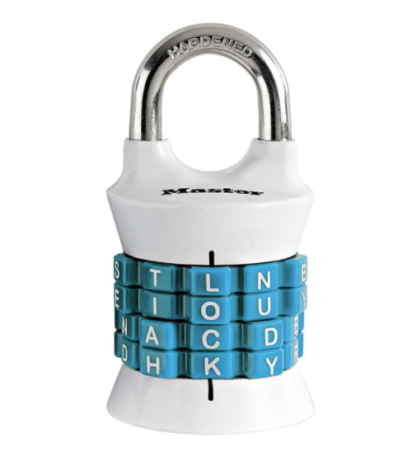
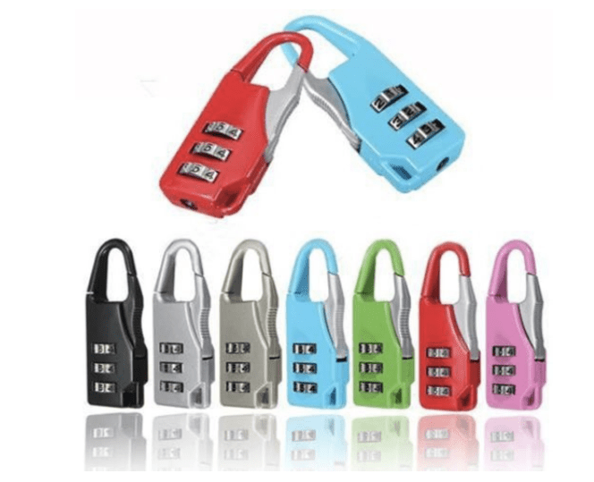
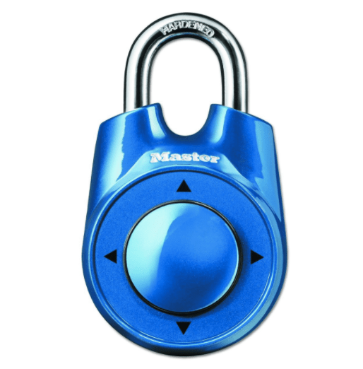
Escape Room Basics: Tips to execute
DON’T PANIC!
Start with your outcome in mind
Brainstorm & Plan
Think of the environment
Add in the puzzles, riddles and locks
Do a test-run!
Create a buzz
The struggle is real
Debrief, debrief, debrief
Assess, assess, assess
Notes:
DON’T PANIC!
You have a lot of experience here in lesson prepping.
The same fundamental knowledge that you have about preparing a lesson for your classroom is the same way that you will approach your escape room.
You start with your learning objectives! What do you want them to take from your time with them?
It isn’t about the escape room activity itself – the escape room is merely a vessel used to provide your participants with the opportunity to collaborate about the topic at hand.
So just like when you are planning a specific lesson or even your class as a whole…
Start with your outcome in mind
Remember this could be used for a mere teambuilding activity OR it could be tied directly to an assessment based goal that you have.
Will this be something that is used to kick off an assessment goal or something you’re using to synthesize work that has been done?
Whatever your rationale for selecting to use an escape room, you're going to want to start with what learning objectives you want to focus on, your goal in a fuzzy sense and then use a pointed brainstorm methodology to develop your Escape Room.
Ultimately you want to design your puzzles and various room activities that get your participants to use the skills you want them to develop (or in some cases learn).
You want to ask yourself (much like when you assess your classes):
What do you want them to learn from the exercise overall?
What is your purpose in doing this?
How many topics do you want to include to achieve your goal?
What is the most important thing facet you want to cover?
What will your theme be?
How long do you have? (Typically you’re going to need at least 30 minutes but ideally you want 40-60 minutes to run your room).
This will give you a better idea as you begin brainstorm.
Brainstorm [NOTE: Provide the Building Your Escape Room Checklist and Brainstorming Worksheet]
To properly execute your Escape Room and have it be a success you are going to have to brainstorm your tasks.
You need to decide what tasks you are going to have your students do, what keys or codes will they find to ‘get out’ of the room.
You want to brainstorm at least three puzzles:
Easy: Which tasks can create a “quick win” to build participant confidence?
Moderate: What tasks will be straightforward, but take a little more time to complete?
Hard: Which tasks can demonstrate content expertise and critical thinking?
Starting with a small easy achievable task, leading to a more moderate puzzle or riddle and then to a more complex and difficult task.
This allows your players to build a sense of competence and confidence in escape room modality.
Players also learn their group member’s strengths/weakness when it comes to solving tasks.
Also in making at least one of your tasks easy it helps with those who may be resistant to jump in and try because they perceive themselves as “not good at puzzles” to try.
Too many challenging tasks can leave some ready to quit.
You want to balance the level of your puzzles.
Plan out the storytelling element/aspect of your escape room (Share our premise).
Think of the environment
Think of how you want to involve the environment:
How much space are you going to have?
How much movement do you want at one time?
What noise-level do you want for your activity?
You will you need puzzle/room monitors to check on their progress, provide hints as needed and to ultimately check their puzzles in some cases depending on which Escape Room option you select.
Add in the puzzles, riddles and locks [Show some sample of keys and locks, provide sample in handouts?]
Add in the puzzles, riddles and locks with the goal in mind of tying them back to the overall goal you have in mind. Never lose sight of this or else the escape room just becomes a “kitschy gimmick”.
Simply put:
You’re going to have a task (3-4 total).
Students will complete the task until they have found the clues to solve the code to move on to the next task.
You could arrange the tasks any way you want.
They could be done sequentially or the participants could complete 1-3 in any order and use all of the clues together to solve the final task.
When designing your puzzles, you want to stagger the levels of your challenges.
When planning your tasks (puzzles, riddles, etc.), establish your keys or passwords.
How are your participants going to demonstrate they have completed their task?
What keys/passwords will they need for each level?
How are you going to be executing this (will they be writing it down, using a Google form, their cell phones, QR codes, etc.)
Will there be prizes for your winners?
From here you will then build your puzzles and create answer sheets.
In terms of the types of tasks you can have your participants do there are many and by no means are we covering all of them today, we are providing you with a list of resources that’s is a great starting place for you!
Close Read – your participants complete a close read of a passage and when they answer multiple choice questions correctly the answers reveal a key.
Encrypted message – they find parts of a Pigpen Cipher as they progress through their puzzle or riddle. They then solve the final encrypted message revealing a word or quote you have selected.
Transactional Solutions – you could have your participants solve a math problem to receive a letter (or letters) for their code.
Word search or scramble
Fill in the blank or matching
Misinformation puzzles – you could include codes that ask them to identify what is wrong with something and then reveals numbers or letters to them.
Jigsaw puzzles – you can create via PowerPoint, online or as we did we asked our graphics department to help us.
Clue cards – leave clues in an envelope and hide them in your classroom. The students look at the clue card to then put information on their answer sheet.
Optional items
Clue cards have them move, you can decide how much you want to involve your environment.
If you are going to use your environment, be mindful what your participants will and will not be using in the environment and clearly mark off areas they won’t be using.
This can be done with masking tape and write “no” on the tape.
If you do this be sure you have enough clues for all and encourage folks to be discreet when they find things.
Good hiding spots – under tables or desk, trashcans, behind doors or projector screens.
Ultimately too the participants will know how many stations there are from their answer sheet.
You could even do “oops” cards
For increased difficulty and equitable participation.
You select a member from each team (strongest, most vocal or bossies – since your goal is collaboration) and they can’t participate again until the designated time is up.
Could be random or planned out.
Winning – to win you have to get a copy of your answer sheet with all of the correct ‘keys’ to escape.
If they have an incorrect task, then send them back to try again…resist the urge to help and you’ll see why in a moment.
Do a test-run!
Ideally if you can try the game out first on family, friends, and colleagues beforehand this will be the best option you have.
Then you can look for issues with your game or your narrative itself.
They can also tell you if they believe your students will be learning, building, or heightening the skills you want them to learn.
If you can’t do this, than be sure you give this area thought or it could prove to be disastrous when you run the actual room.
Create a buzz
This will be new and innovative so sell it!
Get your campus(es) excited for this new experience!
Advertise and make signs like “The Escape Room is coming…Are you ready?)
Frontload the excitement!
The struggle is real
Let them struggle!
If you know that you ran the room with others and the puzzles are solvable, than let them struggle.
Avoid jumping in and providing your participants with hints until they ask for them AND you believe they have actually put in the effort to solve the task on their own.
Hints should, when you provide them, lead them to the solution without specifically providing them the solution.
This goes back to why you opted to use the escape room –
Its effective way to provide your colleagues a new framework to work on a task.
They should enjoy the challenge!
Assessment at any level can be challenging!
You’re building their growth mindset together, as Carol Dweck presents in her work on the growth mindset, “sustained effort over time is the key to outstanding achievement.”
Ultimately this is what you general goal is.
Debrief, debrief, debrief
You can’t just run the escape room and move on, much like you would do in your classroom you have to provide your students with a chance to process the activity they just did.
You want to go back through the tasks again to make sure that everyone understood the process (because some may have just watched passively).
This will then provide a great opportunity for them to share about how they collaborated together, what they discovered and also you to dig deeper with them into the goals you set out.
Not to mention that this will also give your perspective on how the activity went.
Assess, assess, assess
Assessing and reflecting is key.
Use what your participants shared with you to evaluate how well you met your learning objectives.
Were there some puzzles that were too easy or hard?
Were there shortcuts that were taken that decreased the effectiveness of meeting the goal you set out for a particular task? Or was it too difficult that the goal was difficult to have been met.
This is key if you plan on using this modality again for another time with your college.

Slide 16
Escape Room:
Notes:
So we are planning a summit for our faculty to kick off for them our program level assessment.
As part of this we are going to be having our faculty participate in an escape room activity.
The goal of our escape room is our faculty work together and collaborate with folks from across disciplines.
This is especially important since this will be a huge component of PLO assessment.
We will have them complete various tasks that will lead to them ‘escaping’
The tasks range from providing folks with assessment terminology (since some present at the summit will be assessment novices in terms of the ‘language’ we use).
To examining who uses and views our assessments.
To discussing the ways in which we conduct assessment (indirect and direct assessment)
To ultimately how they may conduct in our case a PLO assessment.
For our purposes here today, we are going to have your run through some of this to see what this looks like and we’ll provide you with the tasks we don’t complete here today!

Slide 17
Escape Room:
Find your group.
Send a group member to pick up your task.
Work within the time allotted to complete your assigned task.
When you think you’ve solved your puzzle & completed your task, bring your key to one of us.
REMEMBER: Work together & have fun!
Notes:
So we are planning a summit for our faculty to kick off for them our program level assessment.
As part of this we are going to be having our faculty participate in an escape room activity.
The goal of our escape room is our faculty work together and collaborate with folks from across disciplines.
This is especially important since this will be a huge component of PLO assessment.
We will have them complete various tasks that will lead to them ‘escaping’
The tasks range from providing folks with assessment terminology (since some present at the summit will be assessment novices in terms of the ‘language’ we use).
To examining who uses and views our assessments.
To discussing the ways in which we conduct assessment (indirect and direct assessment)
To ultimately how they may conduct in our case a PLO assessment.
For our purposes here today, we are going to have your run through some of this to see what this looks like and we’ll provide you with the tasks we don’t complete here today!

Slide 18
resources
Johnson, H. E. (2017). Breaking Into Breakout Boxes: Escape Rooms in Education. Charleston, SC: Create Space Independent Publishing Platform.
Mathis, M. (2017, September 1). 10 Awesome Supplies for Classroom Escape Room Activities. Retrieved January 16, 2018, from https://www.weareteachers.com/classroom-escape-room-supplies/
Mathis, M. (2017, October 23). So you want to build a classroom escape room. Retrieved January 11, 2018, from https://www.weareteachers.com/build-a-classroom-escape-room-lesson/
Rouse, W. (2017). Lessons Learned While Escaping From a Zombie: Designing a Breakout EDU Game. The History Teacher, 50(4), 553-565.
Venturino, M. (2017, April 23). Breaking Into Breakout EDU. Retrieved January 12, 2018, from http://blog.cue.org/breaking-breakout-edu/
Breakout EDU: https://www.breakoutedu.com/ (some pay and some free examples that you can glean information from)
Pinterest Escape Room Info: https://www.pinterest.com/ldrees/escape-classroom-ideas/?lp=true
RCC PAW Group: http://www.rcc.edu/about/outcomesassessment/Pages/PRW.aspx
Timer: https://www.timeanddate.com/timer/ (to use when running escape rooms)
Teachers pay teachers: https://www.teacherspayteachers.com/ (some pay and some free examples that you can glean information from)

Slide 19
questions

