Slide 1
PASS: Brain Food Project Pedagogy of Encouragement & EAS Working Together For the Better

Slide 2
Why are we here?
To learn about the PASS program at Fresno City College
To understand how equity and culture can be uplifted in student services programs, such as SI and tutoring
To realize a possibility for change on your campus

Slide 3
What is PASS? ONE STOP SHOP FOR ENGLISH/ESL Tutoring
Logistically, PASS is:
Peer Assisted Study Sessions (P.A.S.S.) at Fresno City College
Supplemental instruction adaptation and tutoring for English, ESL, linguistics, and literature classes– I call it a SIT program/center:
Embedded element/option
Provide drop in one-on-one sessions
Scheduled group sessions
24/7 online sessions (group and one-on-one)
Workshops
English placement test prep workshops
*CENTER/LAB MODEL

Slide 4
What is PASS? ONE STOP SHOP FOR ENGLISH/ESL
Logistically, PASS is:
CENTER MODEL/LAB APPROACH
TWO LOCATIONS
ONE TRADITIONAL LAB (computer lab set-up)
ONE COLLABORATIVE LEARNING LAB (large tables, laptops)

Slide 5
The Culture of PASS
The heart of PASS is:
A judgement free zone to learn from and work with peers
A safe-haven that meets basic needs of students
Holistic Center
Free printing
Brain Food
School supplies (USBs, Scantrons, blue books, pens, min-staplers, etc.)
A place to study and receive needed academic assistance
A place to learn about campus resources
A place to belong

Slide 6
What Does PASS Do?
The PASS Center serves ALL English, ESL, linguistics, and literature classes/sections (developmental through transfer) and is embedded in roughly 70 classes per semester
Over 50 leaders/tutor and front-desk aides (all students)
Open six days a week and serve students online 24/7 (our leaders during open hours and professional tutors in off hours)
Provide holistic service (e.g. brain food, special training)

Slide 7
What Does PASS Do?
Mission: Uplift student lives through supplemental instruction and tutoring hybrid offerings in and out of class while recognizing and celebrating students as whole people with whole and diverse needs to support equity, academic success, and lifelong success (*term student refers to students and student employees)

Slide 8
What Does PASS Do?
PASS students are significantly more successful than non-PASS students
PASS students access SI/tutoring services significantly more than average community college students
PASS attendance rate: 85% (based on the students who have a PASS leader)
Average SI attendance rate in CC: 18%
Average tutoring attendance rate in CC: 24%
(Center for Community College Student Engagement, 2012)

Slide 9
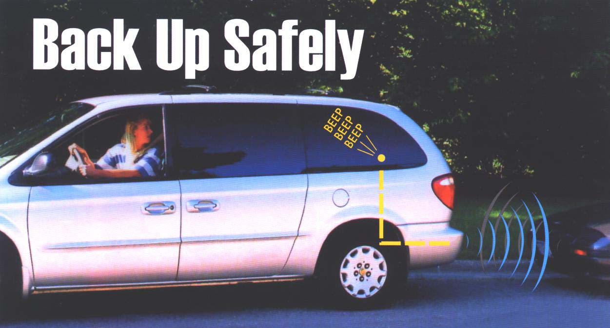
Let’s Back Up to the Problem: Why did I need to redesign the program??

Slide 10
So, What’s the Problem?
STUDENTS ENCOUNTER THESE PROBLEMS
1) FOOD INSECURITY
Fresno is the second most food insecure city in the United States. More than 25% of our community is unable to consistently provide food due to extreme poverty (Metro Ministries, 2016). FOOD INSECURITY is the dirty little secret of higher education. Central Valley is #1 ag area; half of all US food comes from us
2) ACADEMIC SUPPLIES INSECURITY
3) NEED TO BELONG
4) FEELINGS OF DISENFRANCHISEMENT (underprepared academically)
5) NEED FOR ENCOURAGEMENT TO DEVELOP SELF-CONFIDENCE and SELF-EFFICACY

Slide 11
So, What’s the Problem?
These problems lead to these ACADEMIC problems:
1) ACADEMIC UNDERPREPAREDNESS: 2/3rds of students entering into CC are underprepared
2) LOW ATTENDANCE FOR SI/TUTORING SESSIONS (THIS IS A PROBLEM FOR COLLEGES NATIONWIDE)
National Averages: 18% attendance for SI and 24% attendance for tutoring
(CCCSE, 2012/2016)
2 years ago, FCC had an attendance rate of 26%; WE HAD A PROBLEM!

Slide 12
Response to the Problems: “Brain Food Project™” for Equity
“Brain Food Project ™” is a holistic implementation that provides food to students during PASS Center sessions
“Brain Food” considers the nutritional and hedonic value of food: what students want and what students need
Items are prepackaged and range from full meal options (e.g. peanut butter and jam sandwiches, apple chips, string cheese, and yogurt) to snack items (e.g. super-food bars, chips, fruit/veg snacks, and gluten free rice bars)

Slide 13
Response to the Problems: “Brain Food Project™”
Positive Reinforcement: Brain Food is presented to students immediately upon arrival to align with positive reinforcement practices
Normalizes Receiving Help: Brain Food is offered continuously during PASS Center visits (no limits; no questions)
Changes the Environment: Breaking bread together has been shown to reduce anxiety (tutoring can be frightening!)
Reduces Food Insecurity: Students can study longer and focus energy on academics rather than funding food

Slide 14
Response to the Problems: Brain Food Project™ Provides School Supplies & Free Printing
School supplies (USBs, Scantrons, blue books, pens, min-staplers, etc.)
Free printing (for essays and homework assignments, only)
Textbook Library (to be used in the centers)
These non-traditional supportive measures create equity!
Small items make a big impact by meeting student need to create equity in and out of the classroom

Slide 15
Response to the Problems: Brain Food Project™ Provides Sense of Belonging
CULTURE SHIFT!
PASS is a student hang-out
Student office away from home
PASS leaders and students are walking advertisements for our services
We encourage its use as a
A place to study and receive needed academic assistance
A place to join with others and break bread
A place to GET WHAT YOU NEED TO SUCCEED
A place to belong
Our school even has a pop-up grocery store (food pantry) now! Culture shift!

Slide 16
Theoretical Foundations for Positive Reinforcement and Meeting of Needs
Learning Theories
Behaviorism (Thorndike, Pavlov, Skinner, et al.)
Operant Conditioning (modifying behavior) (Skinner)
Positive Reinforcement (Skinner)
Hierarchy of Needs (Maslow)
Survival (Darwin)- we want students to THRIVE
Brain Food Project is positive reinforcement to increase SI/tutoring session attendance, reduce food insecurity, and increase student success.

Slide 17
None of this works without proper implementation: Cultural shift Programmatic Equity Redesign with the BFP
Training and Professional Development are MUSTS!
Pedagogy of Encouragement acts as an overarching pedagogical drive: weaves encouragement into every concept and action
Example: every action in PASS is fueled by “how can I encourage the people I serve today?”
EAS (Empathy, Awareness, and Sensitivity) is a training methodology that teaches tutors and faculty how to properly interact with students when working creating equity and uplift student lives- purposeful and thoughtful actions
Example: understanding how to properly offer food or school supplies without insulting students
Example: learning how to serve students by celebrating them rather than providing “a favor” attitude
Brain Food Project™ must be implemented with the above

Slide 18
How Does the Brain Food Project™ Work? How Does it Uplift Student Equity?
Brain Food not only reduces food insecurity, but it also motivates students to attend the PASS Center. Brain Food acts as a positive reinforcement instrument that is meaningful to our students.
Breaking break together changes the environment
By meeting this normally unmet need, students visit more often and stay longer, which helps mitigate underpreparedness in English classes; approximately 75% of our students take one or more remedial courses in English or math. THIS IS THE KEY!
PASS students have higher SI/tutorial attendance than average CCs
PASS students also have significantly higher success rates and GPAs compared to non-PASS students
Retention is also higher
Help-seeking behaviors and self-regulated learning improved (survey)

Slide 19
I know what you’re thinking…
We can’t do this at our school!
Students must grab food and leave!
Why do we have to feed college students?
Who pays the bill?
I can’t add another thing to my plate!

Slide 20
Let me explain…
We can’t do this at our school! The WAY HAS BEEN PAVED
You CAN do this! The Brain Food Project ™ has an online certification process with a complete handbook! Learn the steps to begin this on your campus by connecting with me after the presentation.
With the proper professional development, YOU CAN successfully implement these equity building programs
Data already exist
Students must grab food and leave!
Student sessions last well-over 1 hour on average (voluntary visits)
They break bread and learn
One hour a week of tutoring over the course of a semester can improve outcomes by one letter grade (Munley et al., 2010)
Why do we have to feed college students?
Believe it or not, many administrators have asked me this question.
The answer: students are hungry, and food creates community, which results in SI/tutoring attendance and increased outcomes. WE HAVE DATA TO PROVE IT!

Slide 21
Let me explain…
Who pays the bill? (you won’t have to do what I did!)
Step One: The community (community food bank donations)
Step Two: The school/general funds & foundations (there are monies allocated for food costs for meetings; these funds can be used for Brain Food in SI programs)
Step Three: Grants (writing for mini-grants or requesting funds from grants (action plans) already awarded to your institution, such as Student Equity Grant and Basic Skills Grant; many grants allow the purchase of food for students with food safety guidelines)
And more (creative ideas including fundraisers)
TIPS
Connect with your cafeteria to find out about accessing a storage space for food.
Obtain a refrigerator for use in the office/center

Slide 22
Let me explain…
I can’t add another thing to my plate!
The Brain Food Project ™ is a labor of love (there’s no way around it)
Anything great requires work
Institutions often seek to REFORM education to improve outcomes;
this implementation seeks to ENCOURAGE students by meeting their needs as human beings to improve outcomes
Doing good, feels good, gets good
Once coordinators and leaders are trained/certified, the workload is shared
Boosts morale and creates a new marketing platform for SI/tutoring (Equity Redesign)
Priceless shift in campus culture!

Slide 23
Do Students Actually Visit the PASS Center due to the “Brain Food Project™”?
YES!!!
Attendance without Brain Food: 26% (FA14) of students connected to PASS attended PASS
Attendance with Brain Food: 85% (FA15) of students connected to PASS attended PASS
Before the redesign: 265 unique students served
Currently, 1375 unique students served (we are only half way through!)
PASS grew astronomically with the Brain Food redesign
We have served over 1375 unduplicated students with over 10,000 contact hours & 10,000 visits this semester! (half way through!)

Slide 24
Do Students Actually Visit the PASS Center due to the “Brain Food Project™”?
Results of my recent true experiment demonstrated that students who had access to SI/tutoring with food attended SI/tutoring significantly more than students who only had access to SI/tutoring without food.

Slide 25
Numbers: Student Outcomes (Success/Completion, GPAs, and Retention; equity gaps improved)
PASS students perform better than non-PASS students (students who have access to PASS but do not attend)
Disaggregated data to show improvement for disproportionately impacted student groups and all levels of English and ESL

Slide 27
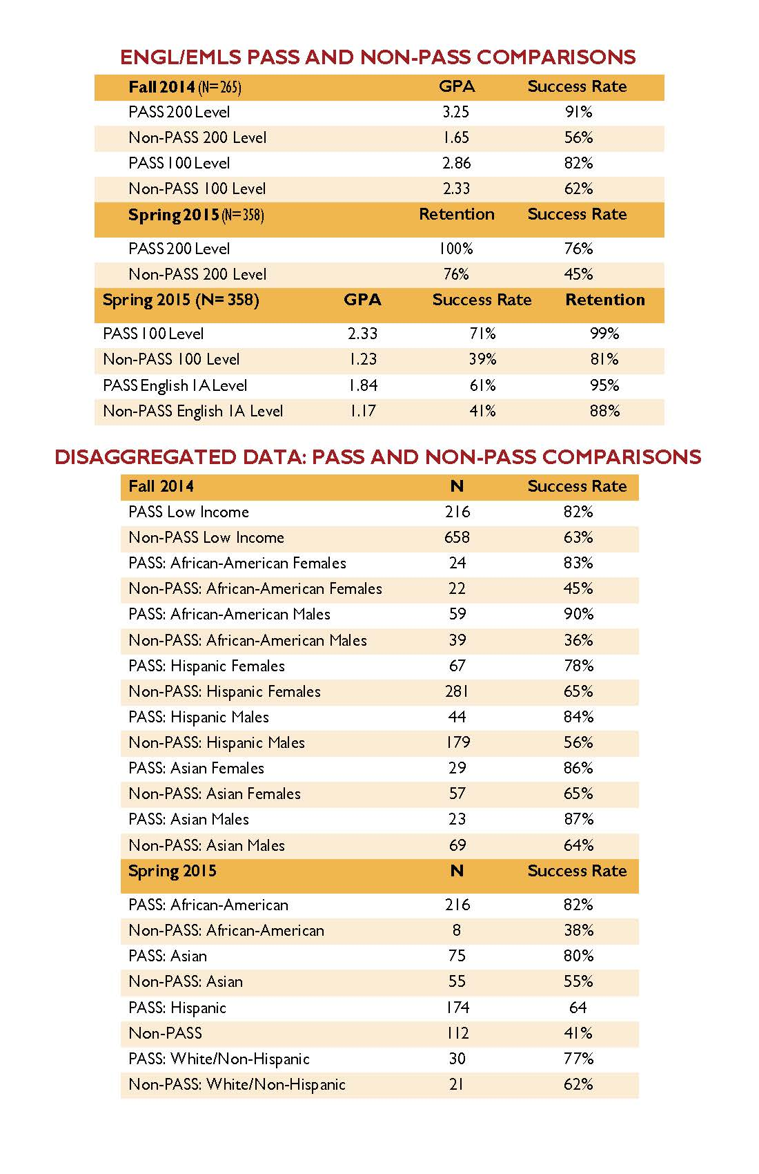

Slide 28
SUCCESS RATES BY STUDENT GROUPS/GENDER
Income:
PASS Low Income 82%
Non-PASS Low Income 63%
Some highlights by gender:
PASS African American Males 90%
Non-PASS African American Males 36%
PASS African American Females 83%
Non-PASS African American Females 45%
PASS Hispanic Males 84%
Non- PASS Hispanic Males 56%

Slide 29
SUCCESS RATES BY STUDENT GROUPS/ NO GENDER
By group not disaggregating for gender:
PASS African American students 82%
Non-PASS African American students 38%
PASS Asian students 80%
Non-PASS Asian students 55%
PASS Hispanic students 64%
Non-PASS Hispanic students 41%
PASS White/non-Hispanic 77%
Non-PASS White/non-Hispanic 62%

Slide 31
Qualifying the “Brain Food Project™” Impact within PASS
Significant Survey Findings (N= 300 roughly for survey responses):
About 50% of students visited PASS 4 or more times a week
A majority (71%) of students believed their grade improved because of PASS
A majority (96%) of students plan to attend PASS again the following semester

Slide 32
Qualifying the “Brain Food Project™” Impact in PASS in their own words…
Emerged theme from recent FOCUS GROUP: Authentic care for students through Brain Food decreases stigma for help-seeking behaviors
Student quotes:
“It was easier for me to let the leader read my paper because I didn’t feel as nervous; I felt like you guys cared because there is food. It’s more social, and I’m writing better.” Special Program Student/Cohort learner
“When I come to school, I can’t think… too hungry. If I leave for Taco Bell, I won’t come back to this, and I don’t have enough cash for the cafeteria. I can eat Brain Food with my leader here. It feels normal, like we’re special.” PASS student
“Without Brain Food and PASS, I wouldn’t be graduating this year.” Graduate
“I never came to PASS before the food because I didn’t think I needed help, ya know. I came for the food but stayed because I like it here.” Freshman student
“I feel embarrassed because I’m hungry a lot; around here, everyone is hungry and everyone eats the food. It’s not like it’s just me. We are a family in here.”

Slide 33
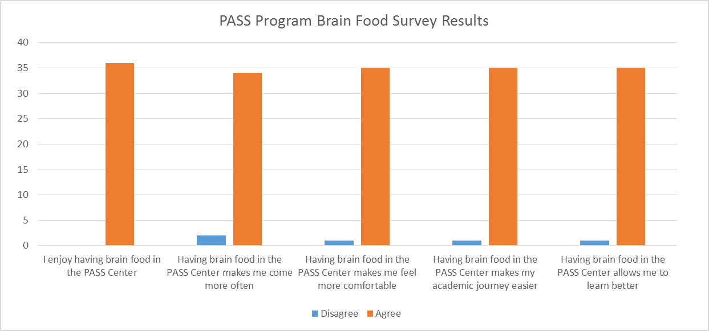
Here’s What Students Think! It’s All About Community

Slide 34
2016 Awards and Publications for “Brain Food Project™” for Student Equity
2016 Golden Award, Georgia Southern University
2016 Stanback-Stroud Diversity Award, Academic Senate for California Community Colleges (ASCCC)
2016 NCWCA Spotlight Center by the Northern California Writing Centers Association (NCWCA): “Brain Food: Breaking Bread during Writing Tutoring Sessions to Increase Engagement, Reduce Food Insecurity, and Improve Outcomes”
2016 forthcoming fall article publication in the Journal of Student Success in Writing (JSSW) “The Brain Food Project™: Providing Food to Reduce Food Insecurity and Increase Attendance and Success in an English and ESL Tutoring Center”
PASS LEADER & STUDENT MORALE AND OWNERSHIP HAS BEEN GREATLY SUPPORTED BY THIS

Slide 35
Become a Certified Brain Food Project™ Institution
Visit brainfoodproject.org for information about certification, professional development, literature, data, research, and much more!
Your challenge is to step up to the challenge
Contact Jennifer.dorian@fresnocitycollege.edu or brain.food@comebackcommunity.com

Slide 36
QUESTIONS???

