Slide 1
Overview of the
Professional Learning Network
Andrea Chatwood, Online Content Curator

Slide 2
What is the Professional Learning Network?
The Professional Learning Network (PLN) is a website funded by a grant from the Chancellor’s Office and the IEPI
Provides FREE resources, video training and more to all CCC employees
Training component includes free access to Lynda.com, Skillsoft and Grovo
Created as a way to facilitate collaboration between colleagues across all 113 campuses

Slide 3
Today’s Agenda
Background on the PLN
Interactive tour of the site
Feedback from you
The future of the PLN
Notes:
Today we are going to go into the history of the PLN and it’s purpose. We will then log in and complete some simple exercises to get to know each area of the site. Afterwards, we would love to hear your feedback- will it be useful, what would you like to see us add and any other comments can be recorded on your feedback form as well as discussed. We will wrap up with a quick look at what the PLN has in store moving forward (website, etc)

Slide 4
Background
Student Success Task Force Recommendation 6.1 (2011):
“Community colleges will create a continuum of strategic professional development opportunities for all faculty, staff, and administrators to be better prepared to respond to evolving student needs and measures of student success.”
“The Chancellor’s Office should explore the use of myriad approaches to providing professional development, including . . . the use of technology.”
Notes:
Bulleted point is from a list of “Requirements for Implementation”.
Task Force Calls for Improvements. In January 2011, the CCC Board of Governors initiated a 12-month strategic planning process to identify a course of action for improving student outcomes. To develop an improvement plan, the Board formed the Student Success Task Force, which consisted of 21 members from inside and outside the CCC system. In December 2011, the task force released a comprehensive report containing 22 recommendations designed to foster greater student success. Key areas of emphasis in the report included strengthening student support services for students and rethinking basic skills (developmental) education.

Slide 5
Background
Chancellor’s Office Student Success Initiative Professional Development Committee (2013).
Thirty-member committee.
Charge: Develop ideas and strategies to “revitalize and re-envision” professional development in the CCC system.
Recommendation: “Establish a virtual professional development resource center.”
Notes:
Best practices, case studies, effective practices, research papers, workshop presentations

Slide 6
2014 Six Summits, 545 Participants
November 3: Orange County
November 5: San Diego
November 7: Marina del Rey
November 12: Pasadena
November 17: Sacramento
November 19: San Francisco
Funded by the Online Education Initiative.
Notes:
[Michelle to add more notes about this slide]

Slide 7
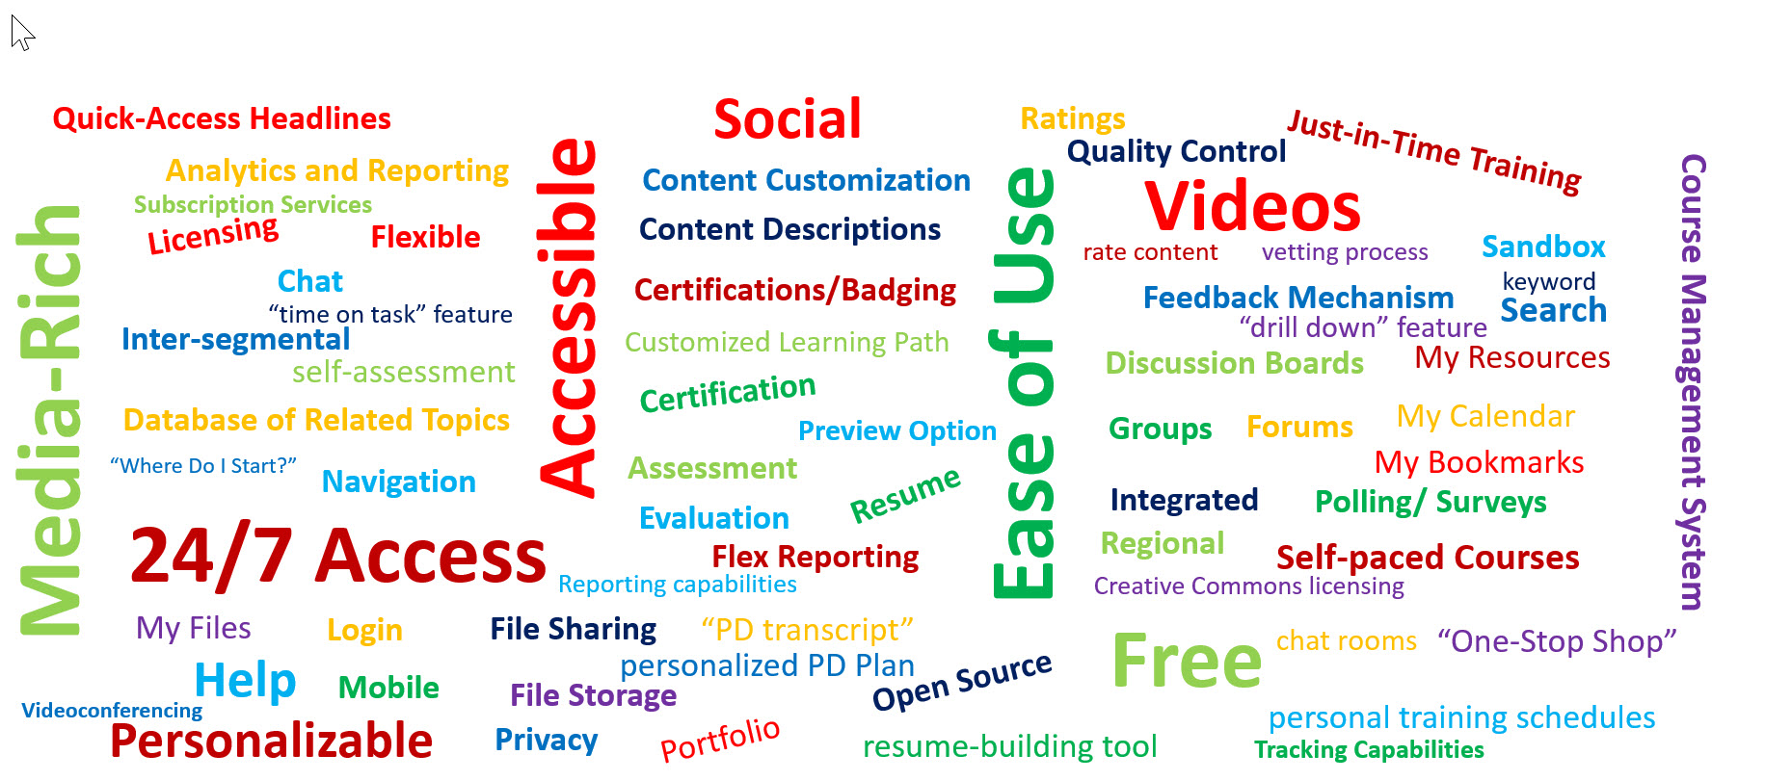
Sample of Features Ideas
Notes:
[Michelle to add notes]

Slide 8
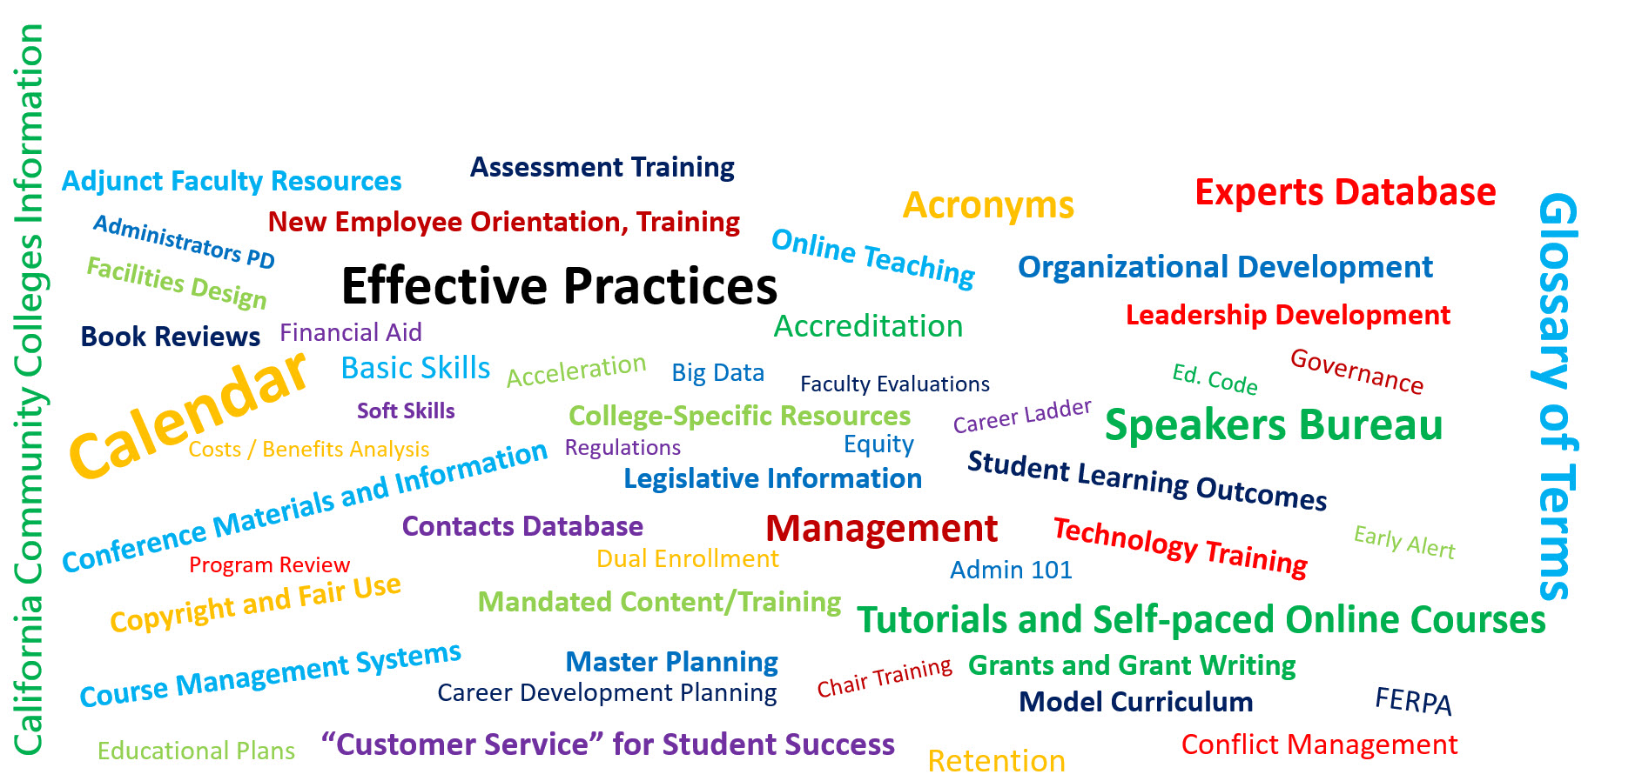
Sample of Content Ideas
Notes:
Here is a sample of the content ideas from summit participants – After this slide, switch to the live website and show sliders, and play this video on the site.

Slide 9
PLN Site Tour
Notes:
If you have internet access just walk through the site a little bit, show MyPD, and then show the video on the site.

Slide 10
PLN Site Tour- Logging In
prolearningnetwork.cccco.edu or pln.cccco.edu
Complete the right side registration
Log into your email to retrieve your email verification link
Click on the link to activate your registration
Complete log in to the site

Slide 11
PLN Site Tour-Resources
Hundreds, soon thousands of resources covering many topics
Search by category, search term and tags
Save resources you like and they’ll appear in MyPD for easy access
Submit resources to be included, all topics welcome
Notes:
Show Save feature – stop to ask for any questions before moving on
Then Do Connect, Speakers Bureau, Calendar, Learn Academy on site, show Lynda Skillsoft integration. Then come back to Slide 16 and show metrics

Slide 12
PLN Site Tour-Connect
Connect with peers across the system
Participate in a thread
Searchable
Active threads show in your MyPD
Notes:
Just a quick overview of our Connect (or Forum) feature of the site. This will be re-vamped with a new design, making it more streamlined.
The forum is designed to speak with your colleagues across the system, for questions or advice.
Any questions on the Connect/forum section?

Slide 13
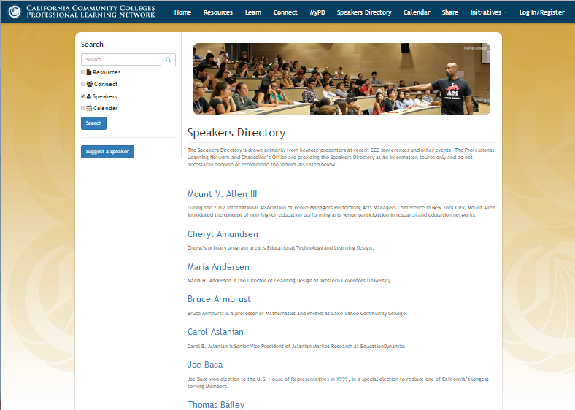
PLN Site Tour-Speakers Bureau

Slide 14
PLN Site Tour-Calendar
Notes:
Show on the site if you have internet access

Slide 15
PLN Site Tour-Learn Academy
Learn Academy
Lynda.com
Grovo (Formal launch anticipated 3rd Quarter 2017)
Skillsoft (February 2017; http://www.skillsoft.com/)
What do you want to learn today?

Slide 16
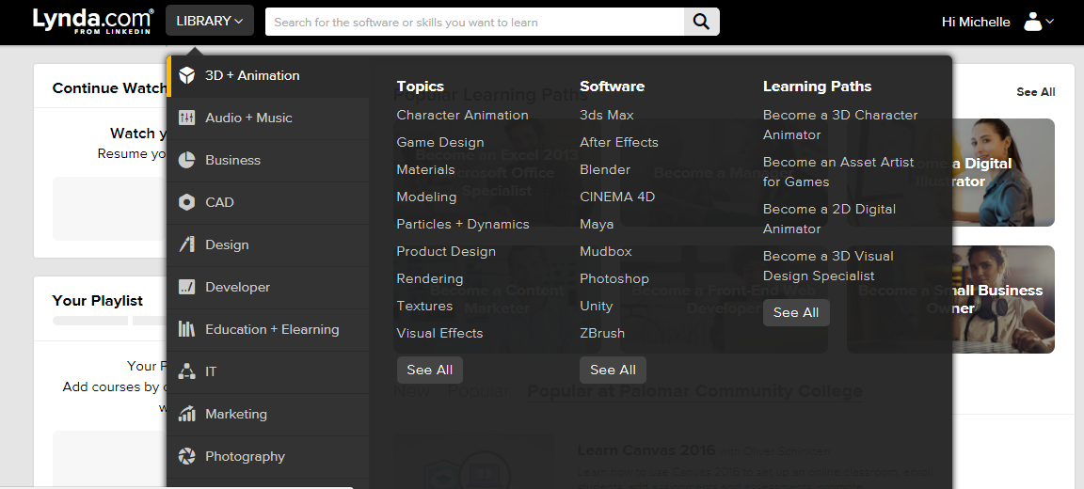
PLN Learn Academy:

Slide 17
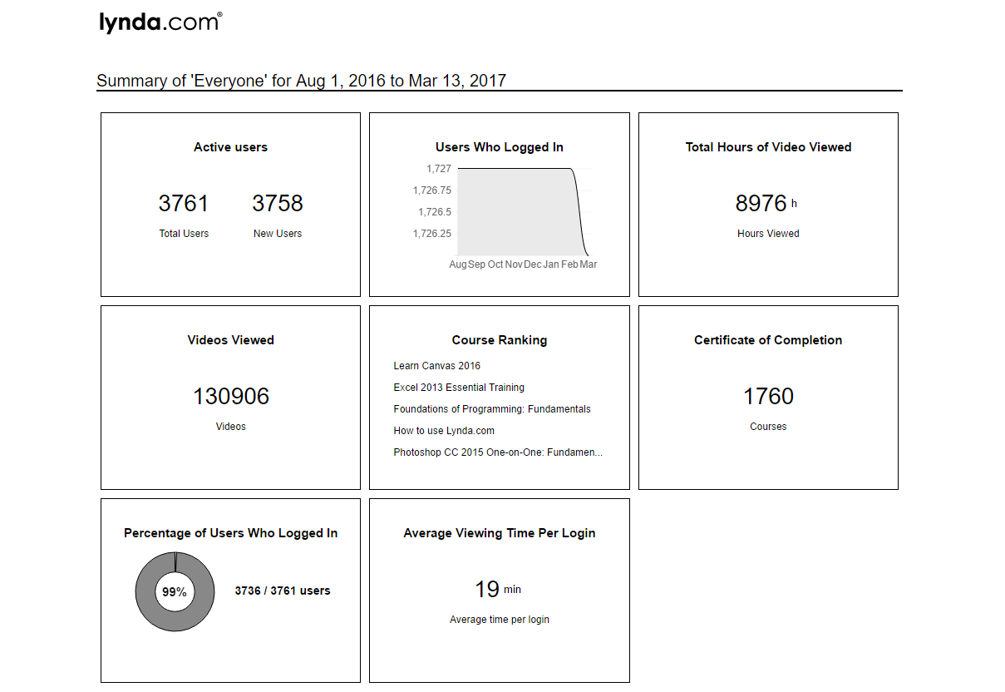
PLN Lynda User Metrics
Notes:
Get new metrics

Slide 18
PLN Learn Academy:
Notes:
[Michelle comment here]

Slide 19
PLN Learn Academy:
“Microlearning”
Awaiting Grovo 2.0
Fully integrated with the PLN
Schedule trainings
Accessible
Notes:
[Michelle comment here]

Slide 20
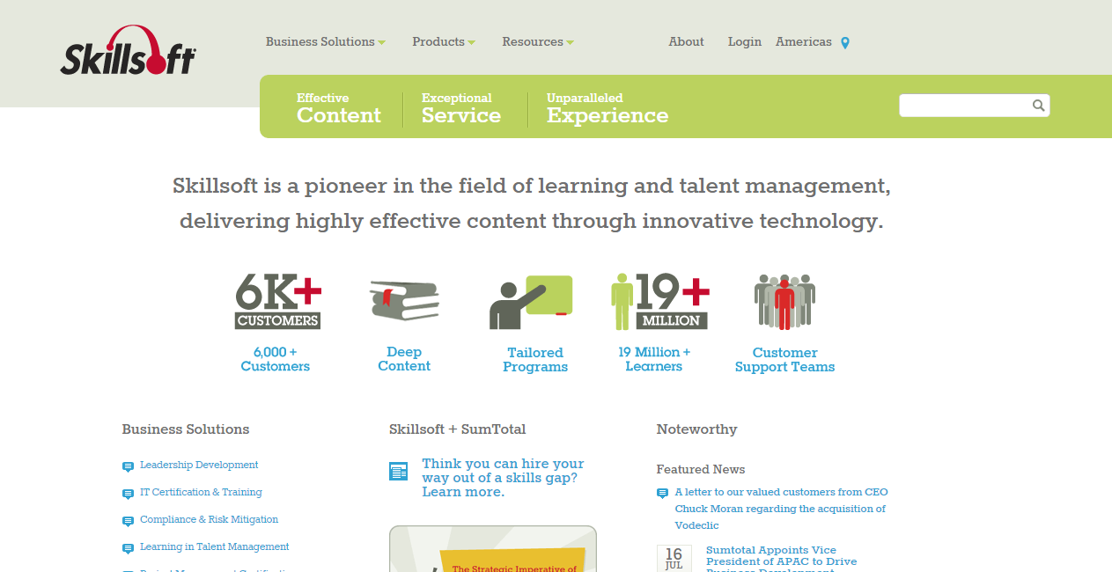
Skillsoft.com
Notes:
Skillsoft has been around since 1989 and today is one of the world's largest corporate training providers, with 60 million users. They are known for IT training, especially those leading to popular IT certifications but they also have a robust offering of Compliance and Risk Management trainings as well as trainings on many other business topics, such as leadership.

Slide 21
PLN Site Tour- MyPD
Bringing it all together:
About
Update your information here by clicking the gear in the top right hand corner
My Connect
Here you will see all threads in the Forum where you are active
Notes:
Now that we have explored the site, and used most of its functions, let’s bring it all together in your MyPD page

Slide 22
PLN Site Tour- MyPD
My Goals
This area allows you to create your own PD plan
Add and edit goals
My Saved Resources
This area banks all of the resources you would like to reference
Notes:
Now that we have explored the site, and used most of its functions, let’s bring it all together in your MyPD page

Slide 23
PLN Site Tour- MyPD
My Trainings
This area shows your completed and in-progress trainings from the Learning Academy platforms
Clicking on in-progress courses will return you to where you left off, without having to enter the platform and search
Notes:
Now that we have explored the site, and used most of its functions, let’s bring it all together in your MyPD page

Slide 24
Applied Solution Kits
Each individual ASK offers a standalone compilation of concrete resources, tools, and effective practices—including case studies and vetted examples currently used on campuses
Integrated Planning
Data Disaggregation
Soon: Strategic Enrollment Management

Slide 25
Other Project Information
PLN resources, including training, are free to all CCC employees
Resource Submissions
Creative Commons licensing
Accessible
Subject to review
PLN’s funds cover content development, resource curation, site administration, and outreach/training.
The PLN is managed out of Palomar College, San Marcos, CA - TTIP South
Notes:
AKA – the stuff I may have forgotten….

Slide 26
On the Horizon
New website look and feel in April - launch to coincide with one-year anniversary of the PLN
Video testimonials
Notes:
Some upcoming additions/features of the PLN are:

Slide 27
Follow Us!
To get up to the minute information on all things PLN, follow us on Facebook and Twitter!
https://www.facebook.com/CCCPLN/
https://twitter.com/CCCProLearn
Notes:
Don’t forget to follow us on social media, to get information in real time

Slide 28
Feedback Forms, Suggestions, Questions
Notes:
Please take a moment to fill out your feedback forms
Are there any questions or suggestions of features your would like to see on the PLN?

Slide 29
Thank You!
Contact us at support@prolearningnetwork.org

