Slide 1
Applying and Interviewing for a Full Time Position
Sam Foster
ASCCC Area D Representative
Part-Time Faculty Committee Chair
Dorene Novotny,
Vice Chancellor, Human Resources
Foothill-De Anza CCD

Slide 2
Applying and Interviewing
Overview…
The application process:
Completing the application
Additional materials
Tailoring your materials
Pitfalls to avoid
The interview process:
Preparing for the interview
Making a good first impression
Maintaining poise
Pitfalls to avoid

Slide 3
Applying and Interviewing
The Application Process…
Typically…
The application
Cover letter
Supporting materials

Slide 4
Applying and Interviewing
The Application…
Fill out completely or risk disqualification .
Even if already in the resume.
Avoid “ See resume”
When in doubt...

Slide 5
Applying and Interviewing
The Cover Letter…
Distinguish yourself.
Tailor the letter.
Something about the college/district.
Address each qualification – minimum and preferred.
Be complete…but not a novel.
But what if I already work there?

Slide 6
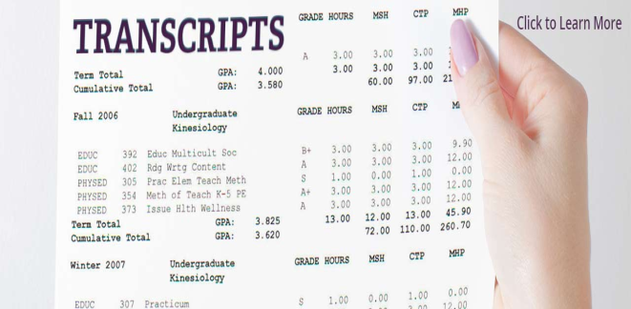
Applying and Interviewing
Additional Materials…
Transcripts
Unofficial transcripts usually acceptable
Check to verify
Show the degree (if any) awarded.
If a masters required
Include graduate AND undergraduate, usually
Other
Teaching philosophy
List of courses taken
Prior courses taught
Other requested paperwork
Materials not requested?
Avoid the urge…☺

Slide 7
Applying and Interviewing
Tips for Success…
Create a digital master file
Resume
List of Courses
Cover Letters
Modify to address the specific job opening
Learn something about the college…
And use that knowledge
Avoid the generic approach
Proofread……!

Slide 8
Applying and Interviewing
Preparing for the Interview…
Learn about the College/District
Learn about the students
Study the website
Summarize your strengths
Prepare your teaching demonstration
Check with college for technical support, what’s allowed, etc.
Practice interview questions!...

Slide 9
Applying and Interviewing
Interview Day…
Dress professionally
Arrive early and relax
No uninvited visitors
Copy of your materials
Be your
authentic self

Slide 10
Applying and Interviewing
Beyond the Degree…
Teaching/CC mission – a calling
Record of volunteerism and service
Team player
Life-long learning mentality
Student equity and cultural competence
Ability to connect
Ability to inspire
Passionate about their discipline
Authentic excitement about teaching
Pedagogical strategies breadth/depth

Slide 11
Applying and Interviewing
Questions…
Sam Foster: sfoster@fullcoll.edu
Dorene Novotny: novotnydorene@fhda.edu

