Slide 1
State of the Academic Senate for California Community Colleges February 10, 2022

Slide 2
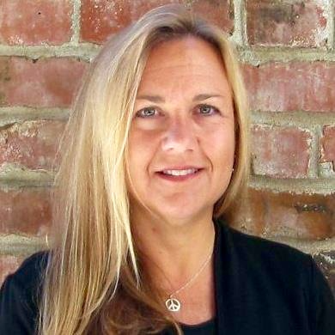
Welcome!
Ginni May, ASCCC Vice President
ASCCC VISION
Faculty leading change, serving students, and embracing inclusion
Notes:
Thank and congratulate Carrie et all for this fabulous program!

Slide 3
About the ASCCC
The faculty voice in regard to academic and professional matters
Formed in 1970, the Academic Senate for California Community Colleges is a 501(c)6 nonprofit organization to strengthen local academic senates and councils of community colleges.
The ASCCC authority in California Code of Regulations Title 5 Section 53206:
community college faculty have a formal and effective procedure for participating in the formation of state policies on academic and professional matters.
Board of Governors recognizes the ASCCC as the representative of local academic senates.

Slide 4
ASCCC Mission
Committed to equity, student learning and student success. The Academic Senate for California Community Colleges acts to:
Empower faculty to engage in local and statewide dialog and take action for continued improvement of teaching, learning, and faculty participation in governance
Lead and advocate proactively for the development of policies, processes, and practices
Include diverse faculty, perspectives, and experiences that represent our student populations
Develop faculty as local and statewide leaders through personal and professional development
Engage faculty and system partners through collegial consultation

Slide 5
A Snapshot of ASCCC Initiatives and Opportunities…
Volunteer for Statewide service: https://www.asccc.org/content/new-faculty-application-statewide-service
ASCCC Elections: yes, part-time faculty may run
Requirements:
A delegate or local academic senate president, or
Within last three years served as local academic senate president or on ASCCC Executive Committee, or
Nominated by resolution from local academic senate endorsing candidacy, meeting minutes need to be submitted with candidacy info

Slide 6
A Snapshot of ASCCC Initiatives and Opportunities…
Open Educational Resources Initiative (OERI): https://asccc-oeri.org
$6M over 5 years in AB 1809 (2017-18) Higher education trailer bill
Opportunities for faculty to create open educational resources
C-ID, Course Identification Numbering System: https://www.c-id.net/about-us
Addresses the need for common course numbers by identifying comparable courses
Course reviewers are always needed for CTE disciplines…
Academic Senate Foundation for California Community Colleges: https://asfccc.com
Support and strengthen professional development for faculty
Scholarships for ASCCC events

Slide 7
Bills that may Impact Part-time Faculty
AB 1505 (Rodriguez) – Community colleges: full-time faculty obligation.
Sponsored by FACCC, CFT, CCCI, supported by ASCCC
Recently introduced:
AB 1602 (McCarty) – Student, faculty, and staff housing: California Student Housing Revolving Loan Fund Act of 2022.
AB 1719 (Ward) – Housing: Teacher Housing Act of 2016: faculty and community college district employees.
AB 1752 (Santiago) – Community colleges: part-time employees
Contact:
The Faculty Association for California Community Colleges (FACCC): https://www.faccc.org
Local Bargaining Agent

Slide 8
Get Involved!
Questions: info@asccc.org
ASCCC Website: https://www.asccc.org
Volunteer for Statewide Service: https://www.asccc.org/content/new-faculty-application-statewide-service
Attend your local academic senate meetings
Attend ASCCC Executive Committee meetings: https://www.asccc.org/executive_committee/meetings
Thank You!

