Slide 1
WELCOME!

Slide 2
Land acknowledgement…
We begin today by acknowledging that we are holding our gathering on the land of the Nisenan Nations, the location of the ASCCC Office on One Capitol Mall, Sacramento, and the Mechoopda Nations, where I am currently located in what is now called Chico. We recognize the sovereign people who have lived and continue to live here. We recognize the Nisenan and Mechoopda Nations and their spiritual connection to the ocean and the land as the first stewards and the traditional caretakers of these areas. As we begin, we thank them for their strength, perseverance, and resistance.
We also wish to acknowledge the other Indigenous Peoples who now call California their home, for their shared struggle to maintain their cultures, languages, worldview, and identities in our diverse cities.
https://native-land.ca/
Notes:
We invite you to research your area and find the Indigneous tribes at the link provided- put in chat!

Slide 3
Part-Time Faculty Committee!
Carrie Roberson
ASCCC Part-Time Committee Chair
Juan Arzola
ASCCC At-Large Representative
Ian Colmer
English @ Santa Monica College, LA Mission
Mussie Okbamichael
Earth Science, Oceanography @ Cerritos, Chaffey, East and West Los Angeles
Anthony Stevens
English @ LA Trade Tech
Anastasia Zavodny
Business Administration, Economics @ Cuyamaca, MiraCosta, Palomar

Slide 4
ASCCC Strategic Plan 2018 - 2023
LEADERSHIP. EMPOWERMENT. VOICE.
Assert the faculty voice and leadership in local, state, and national policy conversations
Engage and empower diverse groups of faculty at all levels of state and local leadership
Assert ASCCC leadership in all faculty professional /learning development for the California Community College system regarding academic and professional matters
Enhance engagement, communication, and partnerships with local academic senates and system partners, + other constituent groups
Secure resources to sustain and support the mission and the work of the ASCCC
Sustain, support, and expand the ASCCC Course Identification Numbering System (C-ID)

Slide 5
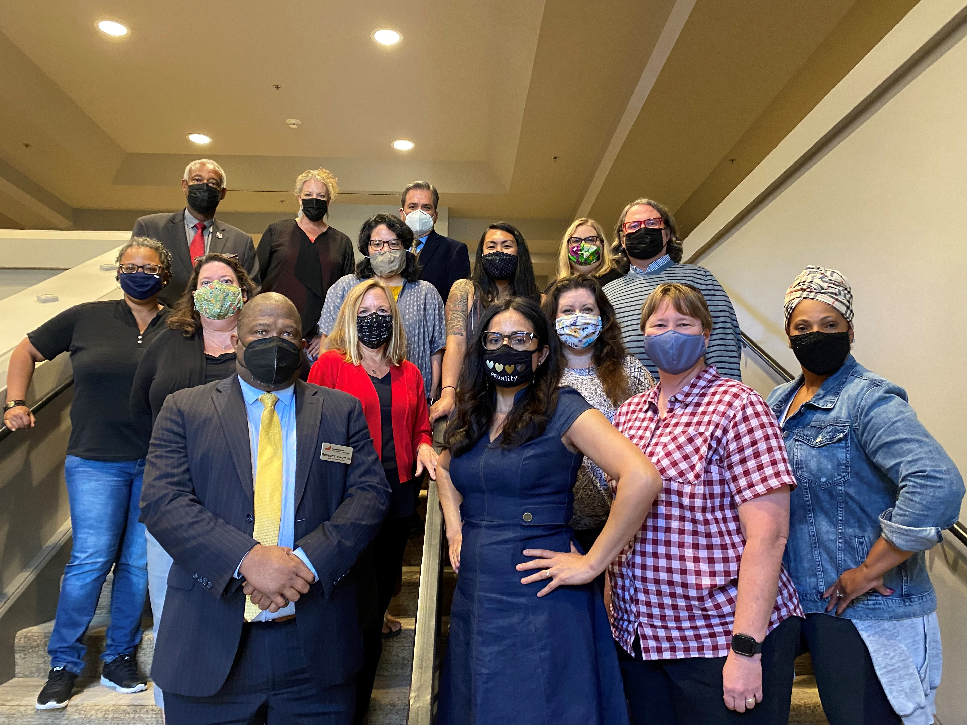
2021-2022 ASCCC Executive Committee

Slide 6
Opportunity awaits!
Learn
Engage
Feedback

Slide 7
ONWARD!

Slide 8
ASCCC.ORG

