Slide 1
I.D.E.A. Practitioners: Considerations for Part-Time Faculty Ian Colmer, Santa Monica College, ASCCC Part-Time Faculty Committee Member Anastasia Zavodny, Palomar College, ASCCC Part-Time Faculty Committee Member Juan Arzola, College of the Sequoias, ASCCC Part-Time Faculty Committee 2nd

Slide 2
Session Outcomes
Understand how DEI work and anti-racism is a journey
Share a common language to support a productive conversation on race
Share experiences, challenges, and successes in combat structural racism from a part-time faculty position
Discuss the approaches Part-time Faculty can use to engage in IDEA
Recognize the importance of professional development and self-care
Notes:
Cheryl (1 min)

Slide 3
This is work of the HEART!
Approach diversity, equity, inclusion, accessibility, and antiracism work with a lens of empathy and humanity
Self-awareness is a skill and involves emotion
We are all responsible for our own growth
Open-mindedness and care are needed–no judgement or blame
Community Agreements:
Stay engaged
Experience discomfort
Speak your truth
Accept non-closure
Notes:
Michelle (3 min)

Slide 4
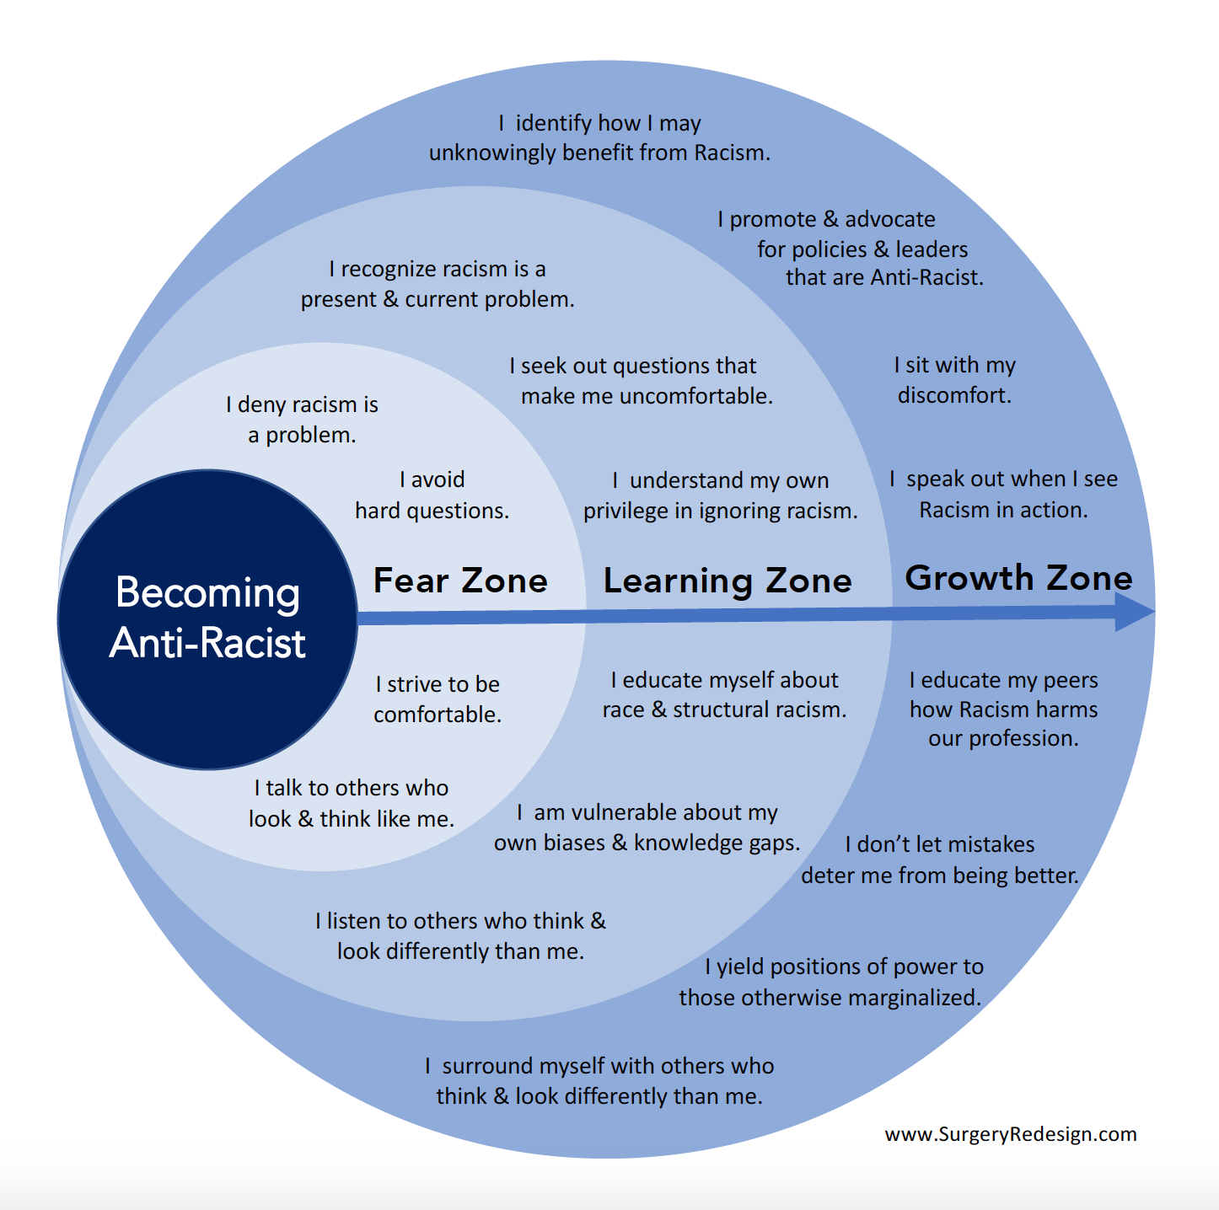
Anti-Racism as a Journey
Notes:
Leslie (2 min)
Image based on one person’s interpretation of Ibram X. Kendi’s How to be Anti-Racist
Journeys also referred to in The Racial Healing Handbook – Anneliese A. Singh, PhD, LPC

Slide 5
What is race?
What is racism?
Forms of racism:
Interpersonal Racism
Internalized Racism
Institutional Racism
Structural Racialization
What is anti-racism?
What does it mean to be anti-racist?
How do we get to racial justice?
The Language of Anti-Racism Education CCC DEI Glossary
Notes:
Juan (3 min)
https://www.cccco.edu/-/media/CCCCO-Website/Files/Communications/vision-for-success/8-dei-glossary-of-terms.pdf?la=en&hash=21FCA99EAE353E6F481025115DC98272EAA36BA9

Slide 6
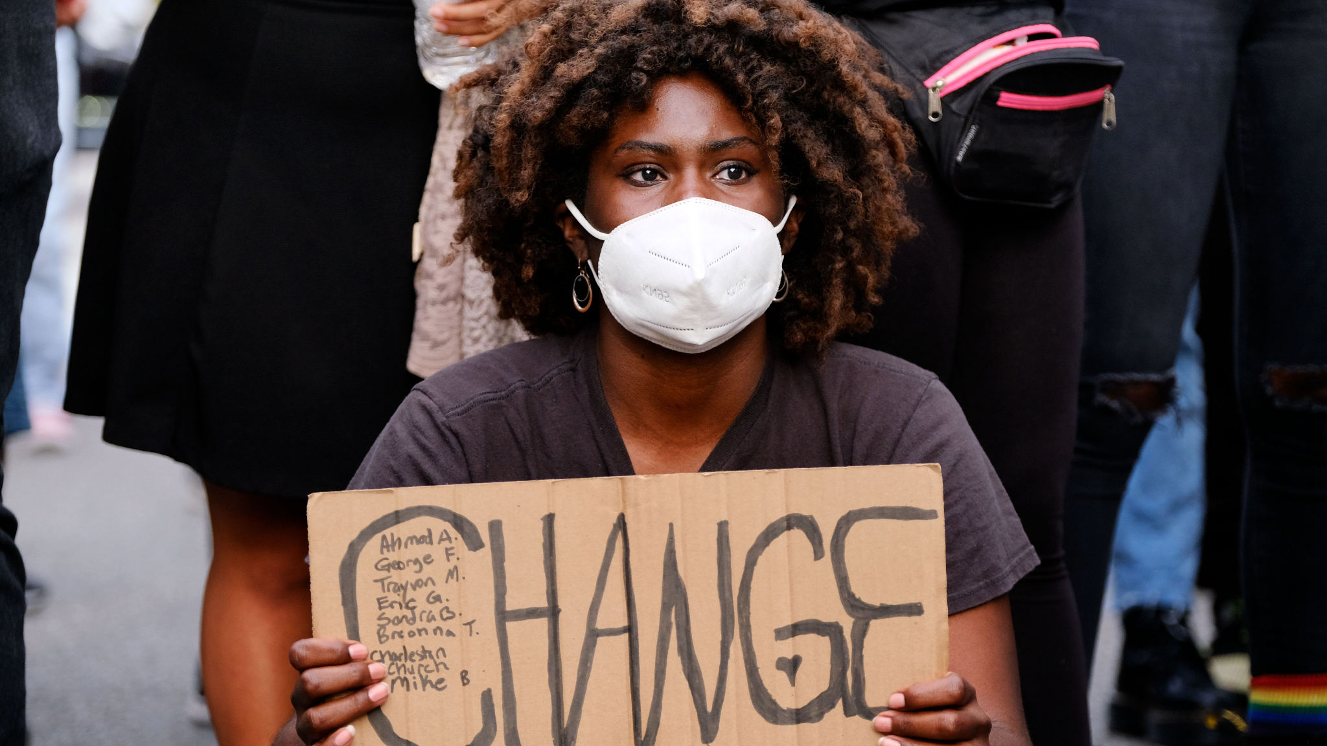
We are not in a post-racial society.
Impacts of racism have not ended.
The harm continues.
How have we perpetuated the harm?
Notes:
Michelle (3 min)
Ingrained in our processes–systemic issues continue.
How have we as a collective faculty perpetuated this?
What radical transformation is needed?
However, we must be REAL and honest:
It will take awhile to dismantle, and we need to actively invest in awareness and training.
Do we have common language to address racism?
Source: https://www.racialequitytools.org/resourcefiles/race_power_policy_workbook.pdf
Racism is dynamic and ever-changing.
Structural racialization is a system of social structures that produces and reproduces cumulative, durable, race-based inequalities.
The critical aspect of racism that we must address today is the accumulation and incorporation of long-standing racialized practices into all of our social, economic, and educational structures.

Slide 7
Implications of and Practical Approaches to Engaging in Anti-racist Work on Your Campus
Implications:
Political Backlash
Societal Ostracization/Isolation
Emotional Trauma
Psychological and Physical Exhaustion
Practical Approaches
Recognize the Colonizer’s Gameplan
Decolonization of Individual and Collective mindset
Find Strength in the Tried-and-Tested Strategies and Tactics of Past Solidarity Movements
Notes:
Juan (5 minutes)

Slide 8
Let’s Talk….break out rooms
Let’s take time to chat and share your anti-racist journey and any struggles or successes in doing anti-racist work.
Person who most recently visited a snowy place goes first.
Notes:
Leslie give directions (2 min)

Slide 9
Main Room Follow-up Question
If you are committed to the type of radical transformation that the system is calling for, it means that you will likely experience setbacks, resistance, disappointment, and apathy from others. What have you learned, as a Part-time Faculty member, from those lessons, and what advice or successes can you offer others engaged in anti-racist work?
Notes:
(15 min)
Brreakout ROOM Question: share your anti-racist journey and any struggles or successes in doing anti-racist work.

Slide 10
What are the
next steps in your personal anti-racism journey?
What are the next steps in your college’s anti-racism journey?
How will you contribute to college efforts?
Notes:
Cheryl give directions and recap as people write (5 min)

Slide 11
Professional Development
and Self Care
Equity work is emotional work
Create safe spaces for honest dialogue that values feelings
Plan a way forward to support our students and colleagues
Notes:
Leslie (3 min)
Finally, friends. Do not mistake this work for Ease and Comfort due to the winding boardwalk. Acknowledgement that Equity work is emotional work is critical.
Some ideas: If you are faculty: creating safe spaces for honest dialogue that value all feelings in your classrooms and create a community. Likewise - creating that same community amongst your staff and on campus.
How do we keep moving forward to support our students and colleagues. This is possible with goals, with acknowledgement of the emotions, asking questions openly, addressing biases within and without, getting uncomfortable and sitting with the discomfort, when we start to seek out others who do not look like us, with the creation of safe spaces that community and trust, with a vision and with teamwork, with a plan, our institutions will slowly see success.

