Slide 1
Part-time Faculty Driving Change by Building Unity, Culture, and Equity-mindedness General Session 1 Thursday, February 18 at 3:00--4:00 p.m.

Slide 2
Land Acknowledgement
We begin today by acknowledging that we are holding our gathering on the land of the Nisenan Nations, the location of the ASCCC Office on One Capitol Mall, Sacramento, who have lived and continue to live here. We recognize the Nisenan Nations and their spiritual connection to the ocean and the land as the first stewards and the traditional caretakers of this area we now call Sacramento. As we begin, we thank them for their strength, perseverance and resistance. We also wish to acknowledge the other Indigenous Peoples who now call Sacramento their home, for their shared struggle to maintain their cultures, languages, worldview and identities in our diverse city.
Notes:
We begin today by acknowledging that we are holding our gathering on the land of the Tongva Nations (where I am currently located)
who have lived and continue to live here.
We recognize the Tongva Nations and their spiritual connection to the ocean and the land as the first stewards and the traditional caretakers of this area we now call Los Angeles.
As we begin, we thank them for their strength, perseverance and resistance.

Slide 3
Session Description
Part-time faculty make up almost seventy percent of the California Community College system. As we think about driving our system to be more equitable, diverse, and inclusive, part-time faculty are integral to this mission. Your dedication to our students is valued and your contributions to the California Community College system cannot be overstated. Building unity and celebrating culture is important to fostering equitable classrooms. This general session will highlight student voices to help faculty frame the equity-driven work that we do daily and provide the much-needed sustenance to continue to do this imperative work on our campuses. We have invited student leaders to share their stories, needs, and encouragement to faculty. Together, we have the opportunity to fundamentally change the experiences of our students as we approach this work with an open mind and empathy for ourselves and others.

Slide 4
Session Agenda
Welcome by Part-time Committee Chair
Introduction of ASCCC Part-time Committee
Introduction of SSCCC Student Panel
Panel Interview
Questions From Attendees

Slide 5
Questions: Use the Pathable platform CHAT box

Slide 6
Institute Theme
Part-time Faculty Driving Change
Building Unity
Honoring Culture
Actualizing Equity-Mindedness
Notes:
Part-time Faculty Driving Change
Building Unity—comradery with each other but also empathy and compassion for students
Supporting Culture—valuing lived experiences and embracing diversity and inclusion
Actualizing Equity-Mindedness—addressing inequities and naming the injustices against BIPOC students and faculty; take up space; know you are a significant percentage of the workforce in CCCs
Driving Change: The work we do is too important, too heavy, too full of value TO DO ALONE!
Building Unity--YOU are a critcal mass. YOU drive change. YOUR voice matters.
Honoring Culture--Be your authentic self. Open your classrooms to others’, your students’, authentic selves. Our beauty is in our diversity, our strenght is in our resiliency, so know you needs and capacity. Thank you for being here today!
Actualizing and Strengthening Equity-mindedness--building our strength is building on and prioritizing equity. Today and tomorrow is about building relationships. As we grow and open up to the possibilities and strength in our voice and in our students’ voices. THAT will change systems. THAT will disrupt the status quo. THAT will be our opportunity.
So join me in introducing two amazing groups of leaders:
ASCCC Part-time Committee: Steven Chang, Grace Chee, Karen Chow, Chelsea Hull, Ted Kagan, Alpha Lewis, Emilie Mitchell,and Luis Zarantu
Student Senate of Ca Community Colleges: Shailah Arreola-Bittner, Joseph Newton-Candelaria, Stefany Perez, Jasmine Prasad, Keziah Thomas

Slide 7
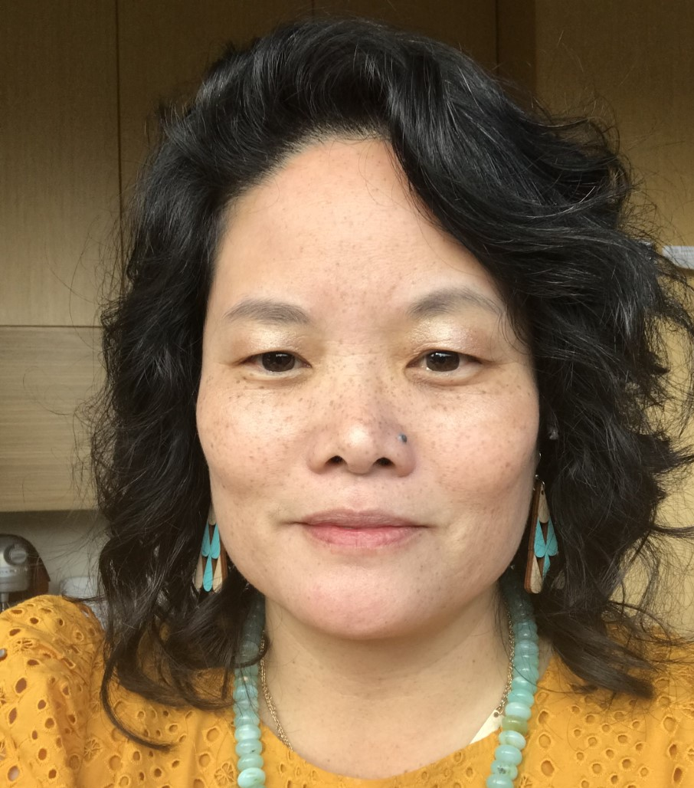
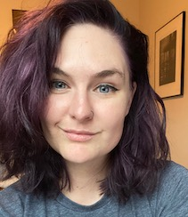
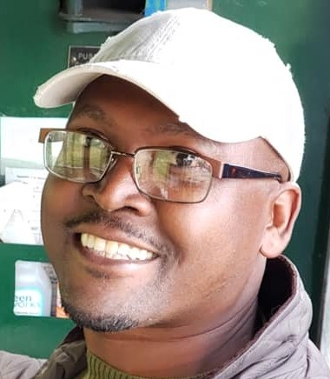
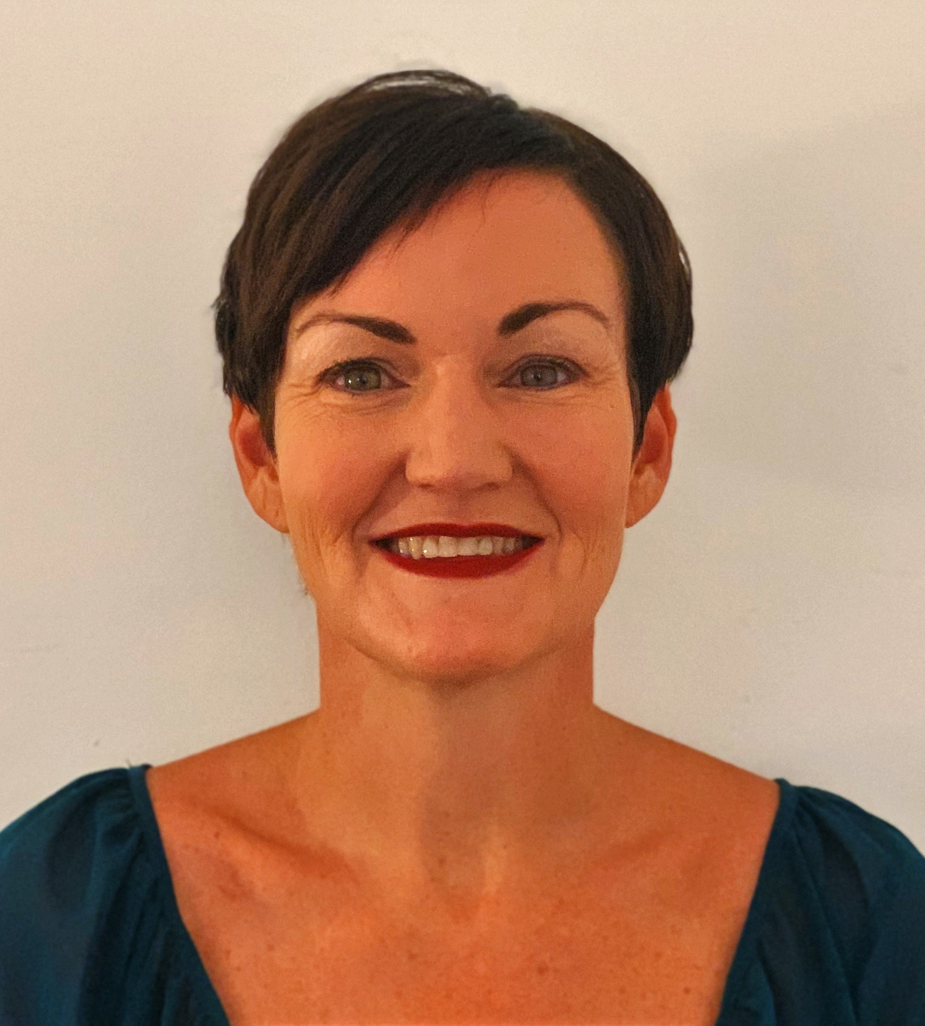
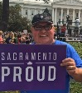
ASCCC Part-time Committee
Michelle Velasquez Bean
Dr. Steven Chang (not pictured)
Grace Chee
Dr. Karen Chow
Chelsea Hull
Ted Kagan
Alpha Lewis
Dr. Emilie Mitchell
Luis Zanartu

Slide 8
Student Senate of California Community Colleges
Shailah Arreola-Bittner, Mt. San Antonio College
Joseph Newton-Candelaria, Copper Mountain College
Stefany Perez, Riverside College
Jasmine Prasad, Folsom College
Keziah Thomas, Chaffey College

Slide 9
Panel Questions
Tell us about yourself. What brings you joy? What is your educational path or life experiences you would like to share?
Share an experience you had with a teacher or college employee who greatly impacted or supported you.
If we can call in and ask for vulnerability, what experience can you share where you felt unsupported?
If you could change one thing in the higher ed system, what would that be and why?
What is the most empowering type of lessons/activities/work you have experienced in a classroom?
What do you want to convey to this Zoom room full of educators?
Notes:
#1: Keziah to speak about culture
#2: Jasmine to speak on “unsupport” needs
#3: Michelle and Emilie--share a story about unsupport first
#6: Use for final minutes after Q&A

Slide 10
Questions: Use Pathable CHAT

Slide 11
Continuing the Conversation
Table Talk at 5:30 p.m.
Acronym Trivia at 6:00 p.m.
Breakout Sessions next at 4:30 p.m.

Slide 12
Further Information
Email ASCCC at info@asccc.org
Visit Student Senate at studentsenateccc.org
Moderator: Michelle Bean mbean@riohondo.edu
Student Contact Info:
Shailah Arreola-Bittner, Mt. San Antonio College, ladregionviii@studentsenateccc.org
Joseph Newton-Candelaria, Copper Mountain College, smoctezuma@student.rccd.edu
Stefany Perez, Riverside College, smoctezuma@student.rccd.edu
Jasmine Prasad, Folsom College, jasmine.isabellaaa@gmail.com
Keziah Thomas, Chaffey College, kthomas7408@panther.chaffey.edu

