Slide 1
Driving Forward: The Adjunct Faculty Life—Navigating Your Needs, Background, and Challenges
Friday, February 19 at 3:30--4:30 p.m.

Slide 2
Session Description
Navigating the challenges of working at multiple colleges and within various campus cultures can feel overwhelming. Join us for this session where members of the ASCCC Part-time Committee will share how they draw from their personal and professional backgrounds to empathize, empower, and affirm students and their voices, while balancing and navigating cultures that are not always mindful of how the complicated life of an adjunct influences their communities and students. Part-time faculty leaders on this panel will highlight their struggles, stories, and perspectives to invigorate and encourage you.

Slide 3
Today, we will
Introduce ASCCC Part-time Committee
Review ASCCC resolutions on part-time faculty topics
Ask questions of panelists
Engage in Q&A from attendees

Slide 4
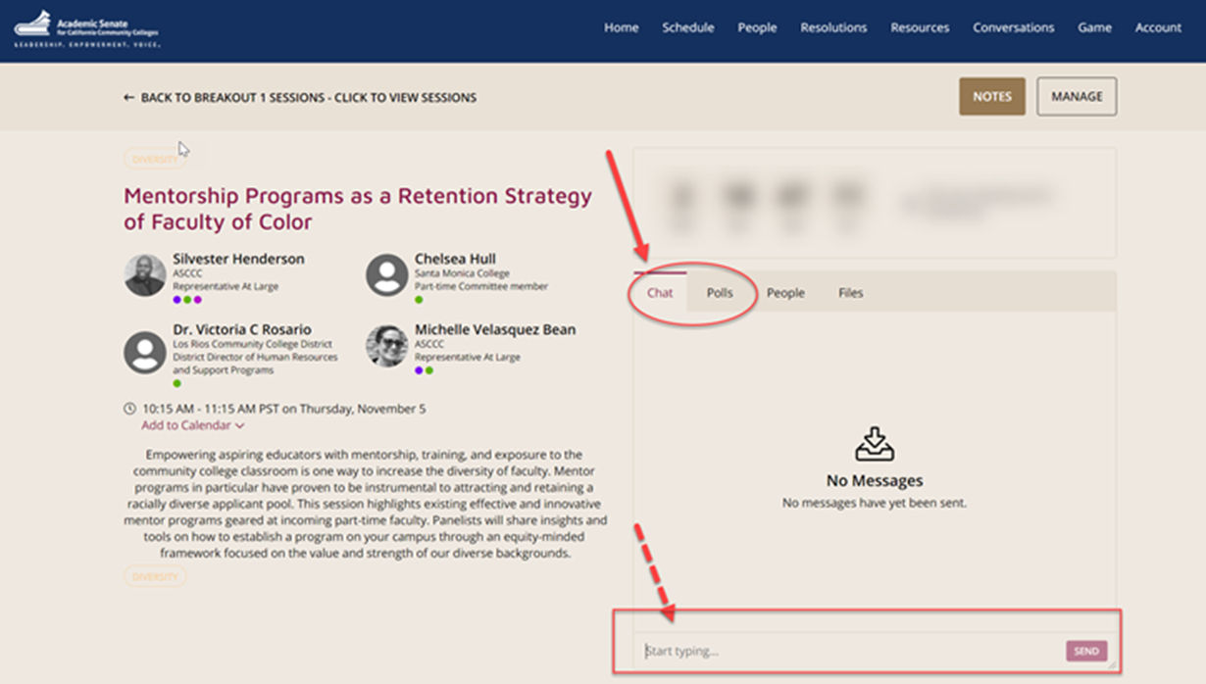
Questions: Use the Pathable platform CHAT box

Slide 5
ASCCC Part-time Committee Faculty
Steven Chang, Los Angeles Harbor College
Grace Chee, West Los Angeles College
Chelsea Hull, Santa Monica College
Ted Kagan, San Diego Community College
Alpha Lewis, Skyline College
Luis Zanartu, Sacramento City College
Notes:
Part-time Committee Self Introductions: 30 seconds each: state your discipline and college(s)

Slide 6
ASCCC Resolutions and Resources
Fall 2020 1.02: Develop a Resource to Communicate and Encourage Part-time Faculty Leadership
Spring 2016 1.01: Mentoring Programs for Part-Time Faculty
Resources
  ASCCC committees: https://asccc.org/content/faculty-application-statewide-service
  Upcoming part-time spring event
  ASCCC events: https://asccc.org/calendar/list/events
Notes:
Steven—3 minutes
Share possible event and resources planned for spring

Slide 7
Panel Questions
How did you get involved in ASCCC?
Are you in other leadership positions and how did you hear about those positions?
What do you do to empower your students and support their lived experiences?
How do you navigate the culture of academia?
How are you making an equitable classroom community exist as part-time faculty who works with additional barriers as well?

Slide 8

Questions: Use Pathable CHAT

Slide 9
Continuing the Conversation
Social networking hour following this session
Sign up for unofficial Part-time Faculty Info Listserv
Notes:
Listserv—not part of ASCCC:
https://forms.gle/tcMiB5y97eBs13uk9

Slide 10
Further Information and Support
Email info@asccc.org
Contact Info:
mbean@riohondo.edu

