Slide 1
Part-Time Faculty Engagement Strategies in Governance Processes
Anna Bruzzese, ASCCC South Representative
Silvester Henderson, ASCCC At Large Representative
ASCCC FALL PLENARY
The Renaissance Newport Beach Hotel November 7-9, 2019

Slide 2
Presentation Overview
Session Description
Basis of Senate Power: Education Code, Title 5 & 10 + 1
What are the key roles of “All” Faculty – Academic Senate
The “10 + 1” Title 5 Section: 53200
Is it Shared Governance, Participatory Governance or “Collegial Consultation”?
Build Relationships & Locate a Faculty Mentor
Become an “Effective Communicator & Leader” via Research & Knowledge?
Practice “Academic Acumen” & “Cultural Diplomacy”
Build Campus Relationships
Effective Strategies for Relational Building
List of Resources
Questions & Comments

Slide 3
Session Description
Title 5 Regulations grant academic senates and all faculty the right to be the primary voice in college decision-making with regard to academic and professional matters. However, do you really feel like it applies to you? The right to engage in “Participatory Governance” applies to all faculty, but many part-time faculty may wonder what could happen if they were ever to exercise their legal right. Please join us as we explore methods and approaches for Part Time Faculty to actively become part of their local campus collegial processes and procedures.

Slide 4
BASIS FOR SENATE POWERS
Education Code
Title 5 Regulations
Faculty Member: Any employee of a community college district who is employed in an academic position that is not designated as supervisory or management.
https://www.asccc.org/about/bylaws

Slide 5
BASIS FOR SENATE POWERS
Faculty Member: Any employee of a community college district who is employed in an academic position that is not designated as supervisory or management.
What is the difference between Education Code and Title 5?

Slide 6
TITLE 5
California Code of Regulations
Derived by the Board of Governors from Ed. Code
Division 6 - applies to California Community Colleges
Regulation with the force of law
Notes:
Title 5 can be changed by the Board of Governors; e.g. math/English requirements – began
with the Academic Senate, then through Consultation Council, then to the Board of
Governors

Slide 7
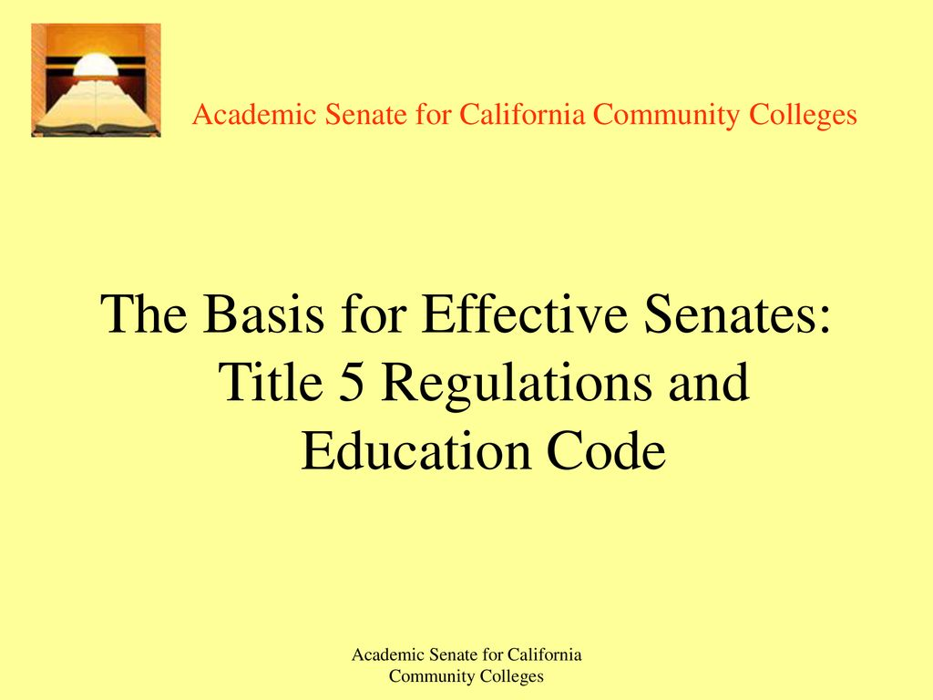
California Code of Regulations
Derived by the Board of Governors from Education Code
California Code of Regulations
Division 6 – applies to the California Community Colleges
Regulations with the force of Law

Slide 8
EDUCATION CODE §70902 (B)(7)
“ The Governing Board shall … ensure … the right of academic senates to assume primary responsibility for making recommendation in the areas of curriculum and academic standards.”

Slide 9
TITLE 5 § 53203 - POWERS
TITLE 5 § 53203 - POWERS
(A) Governing Board shall adopt policies delegating authority and responsibility to its Academic Senate.
(B) Policies in (A) shall be adopted through collegial consultation with the Academic Senate.
(C) Guarantees the Academic Senate the right to meet with or appear before the board.

Slide 10
TITLE 5 § 53200 - DEFINITIONS
(B) Academic Senate means an organization whose primary function is to make recommendations with respect to academic and professional matters.
(C) Academic and Professional matters means the following policy development and implementation matters:
Notes:
Defined in Title 5 but not Education Code; note that the 2005 appellate court decision
recognized local senates as having legal standing

Slide 11
The “10 + 1” Title 5 §53200 (c)
Curriculum, including establishing prerequisites
Degree & Certificate Requirements
Grading Policies
Educational Program Development
Standards & Polices regarding Student Preparation and Success

Slide 12
The “10 + 1” Title 5 §53200 (c)
College governance structures, as related to faculty roles
Faculty roles and involvement in accreditation process
Policies for faculty professional development activities
Processes for program review
Processes for institutional planning and budget development

Slide 13
THE “PLUS 1” Title 5 §53200 (c)
Other academic and professional matters as mutually agreed upon
Notes:
Examples may include: Faculty office reorganization; reorganization; classroom usage; marketing plan; efforts
of the college foundation

Slide 14
What is the difference between shared/participatory governance and collegial consultation?

Slide 15
Shared Governance vs. Collegial Consultation
“Shared governance” is not a term that appears in law or regulation. Education Code §70902(b)(7) calls on the Board of Governors to enact regulations to “ensure faculty, staff, and students...the right to participate effectively in district and college governance” and, further, to ensure “the right of academic senates to assume primary responsibility for making recommendations in the areas of curriculum and academic standards.”*
Consequently, the more precise terms call for the governing board to assure effective participation of staff and students** and to consult collegially with academic senates.
* From Participating Effectively in District and College Governance, ASCCC/CCLC, Fall 1998
** See Title 5 sections 51023.5 and 51023.7, respectively

Slide 16
Build Relationships & Locate/Become a Faculty “Mentor”
“Faculty members have endless opportunities to experiment with new teaching methods, take on new administrative roles and venture into entirely new research directions, yet they have few structures that provide training to do so. Academe operates within one of the few remaining apprenticeship models in today’s society. Mentorship is basic to that structure”.
“What sustains faculty members are relationships with others, write Jennifer Lundquist and Joya Misra, who outline how to identify mentors and how to be a better one yourself”.

Slide 17
Remember it’s all about RELATIONSHIPS!
How do these roles and responsibilities -with authority- impact the relationships on campus or within a district? Beyond?
Notes:
AUTHORITY?!

Slide 18
Understand Relationship Dynamics…
Power and/or authority implications
Institutional organization
Context
Situation
What else?
Notes:
Go round and round with dynamics at play… hard to figure out just what dynamic most influences the constructive or destructuve components of relationship building

Slide 19
Effective Relationships are CRUCIAL!
Notes:
Sometimes is cordial, collegial, or just on an as needed basis!
Easier said, than done- right?
If relationships were easy, we wouldn’t have 10000x resources (and everyone would have the answers)
Relationships with yourself!

Slide 20
Become an “Effective Communicator & Leader” via Research & Knowledge
Four Basic Communication Styles:
1). Passive: Individuals who use the passive communication style often act indifferently, yielding to others. Passive communicators usually fail to express their feelings or needs, allowing others to express themselves.
3). Passive-Aggressive: Passive-aggressive communication style users appear passive on the surface, but within he or she may feel powerless or stuck, building up a resentment that leads to seething or acting out in subtle, indirect or secret ways.
2). Aggressive: The aggressive communication style is emphasized by speaking in a loud and demanding voice, maintaining intense eye contact and dominating or controlling others by blaming, intimidating, criticizing, threatening or attacking them, among other traits.
4). Assertive: Thought to be the most effective form of communication, the assertive communication style features an open communication link while not being overbearing.

Slide 21
Practice “Academic Acumen” – High Level Communication Skills & “ Cultural Diplomacy”
Cultural Diplomacy:
“The Institute for Cultural Diplomacy, ICD, has declared that the ultimate goal of cultural diplomacy is promoting peace and stability through intercultural relations”.

Slide 22
Build Department & Campus Professional Relationships

Slide 23
EFFECTIVE STRATEGIES for RELATIONSHIP BUILDING
Mutual understanding of roles/responsibilities and genuine respect
Inclusivity, transparency, diplomacy
Direction from local board policies, administrative procedures, and contract
Written agreements!
**Generate when not stressed by conflict or other major concerns

Slide 24
RESOURCES
https://online.alvernia.edu/articles/4-types-communication-styles/ (2018)
ASCCC Website - http://asccc.org
Ed Code, California Code of Regulations - http://oal.ca.gov
Chancellor’s Office - http://www.cccco.edu
Local Senates Handbook, ASCCC, 2015 Edition
Scenarios to Illustrate Effective Participation in District and College Governance (Joint ASCCC/CCLC publication. Useful for orienting your senate)
Participating Effectively in District and College Governance, ASCCC/CCLC, adopted Fall 1998
https://www.insidehighered.com/advice/2017/07/13/how-find-mentors-and-be-good-one-yourself-essay

Slide 26
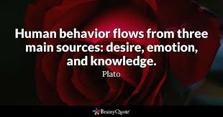
Thank You for coming
Please feel free to contact each of us for more information:
Anna Bruzzese, ASCCC South Representative - bruzzeaa@piercecollege.edu
Silvester Henderson, ASCCC At-Large Representative – shenderson@losmedanos.edu

