Slide 1
Pathways from Noncredit to Credit Instruction
Raine Hambly, North Orange Continuing Education Tina McClurkin, North Orange Continuing Education
Thais Winsome, Mission College

Slide 2
Overview
Noncredit Review
Pathways
Examples

Slide 3
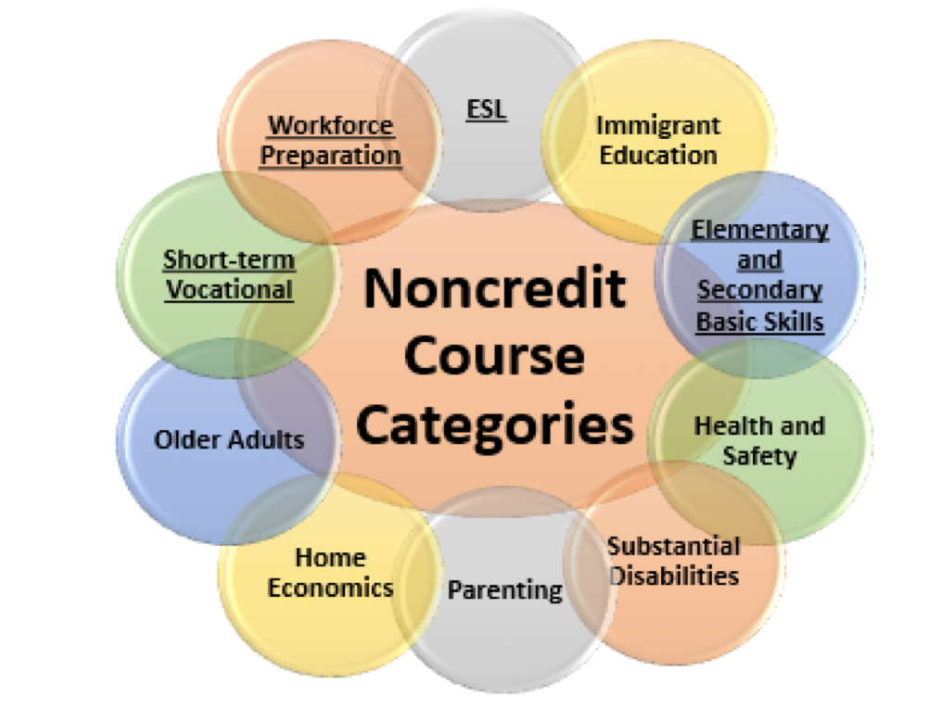
Eligible Noncredit Courses: Ten Categories
English as a Second Language (ESL)*
Immigrant Education
Elementary and Secondary Basic Skills*
Health and Safety
Substantial Disabilities
Parenting
Home Economics
Courses for Older Adults
Short-term Vocational*
Workforce Preparation*
*Areas (1), (3), (9), (10) are eligible for Enhanced Funding if associated with an approved noncredit program.

Slide 4
Benefits of Noncredit as an Entry Point
Tuition Free – State Sponsored Classes and Program
May be open-entry, open-exit or offered at set times and days for a term
Learning environment created for adult learners and incumbent workers
Greater opportunity for career exploration
Workforce Training
Focus on skills
Repeatability
Student support
Notes:
Source: AACC (https://www.aacc.nche.edu/wp-content/uploads/2017/09/PathwaysGraphic462017.pdf)

Slide 5
Setting up the Pathway
Identifying program areas that benefit students moving from noncredit to credit and/or areas where we see a desire from our students to move to credit programs.
Executive-level support
Alignment
Engagement of credit and noncredit faculty
How many levels before credit
Professional development
Notes:
Source: AACC (https://www.aacc.nche.edu/wp-content/uploads/2017/09/PathwaysGraphic462017.pdf)

Slide 6
Noncredit to Credit Pathway Opportunities
AB 705
Guided Pathways
Strong Workforce
California Adult Education Program (CAEP)
Secondary Basic Skills
English as a Second Language
Career Technical Education
Computer Applications
Workforce Preparation
Career Skills/Exploration
Notes:
Source: AACC (https://www.aacc.nche.edu/wp-content/uploads/2017/09/PathwaysGraphic462017.pdf)

Slide 7
Career Development and College Preparation (CDCP)
Education Code 84760.65
Noncredit courses
Offered in a sequence (must include two (2) or more courses)
In an eligible CDCP category
Lead to a certificate of completion
Lead to a certificate of competency
Notes:
Source: AACC (https://www.aacc.nche.edu/wp-content/uploads/2017/09/PathwaysGraphic462017.pdf)

Slide 8
Career Development and College Preparation (CDCP) - continued
Four (4) Categories of Instruction:
English as a Second Language (ESL)
Elementary and Secondary Basic Skills
Short-Term Vocational
Workforce Preparation
Notes:
Source: AACC (https://www.aacc.nche.edu/wp-content/uploads/2017/09/PathwaysGraphic462017.pdf)

Slide 9
Examples of Current Pathways
Basic Skills Math
Cypress College/NOCE Math Co-Lab
Career Technical Education
Funeral Service Assistant to Mortuary Science
Medical Assisting to Health Information Technology
Notes:
Source: AACC (https://www.aacc.nche.edu/wp-content/uploads/2017/09/PathwaysGraphic462017.pdf)

Slide 10
Pathways Currently Under Construction
English as a Second Language
Basic Skills Math
Offering lower level Math classes (AB705)
Career Technical Education
Business Information Worker I and/or II to Business Information Worker II and/or III as well as other related credit programs
Bookkeeping to Accounting
Noncredit Management to Credit Management
Noncredit Early Childhood Education to Credit Early Childhood Education
Notes:
Source: AACC (https://www.aacc.nche.edu/wp-content/uploads/2017/09/PathwaysGraphic462017.pdf)

Slide 11
Noncredit to Credit Pathway Obstacles
Buy-In from credit faculty
Understanding the benefits of a pathway
Articulation
Challenge Exams
Executive-level support for pathways and removing barriers
Transition - Warm hand-offs between noncredit and credit (helping students feel comfortable and successful about moving over to credit)
Notes:
Source: AACC (https://www.aacc.nche.edu/wp-content/uploads/2017/09/PathwaysGraphic462017.pdf)

Slide 13
Thank you!
Raine Hambly; rhambly@NOCE.edu
Tina McClurkin; tmclurkin@NOCE.edu
Thais Winsome; thais.winsome@missioncollege.edu
info@asccc.org

