Slide 1
Personal Professional Development: Other Opportunities Available for Part-time Faculty
Ginni May,
ASCCC Area A Representative, Sacramento City College
Madelyn Rios,
Part-time Faculty Committee, Lake Tahoe Community College
2017 Summer Part-time Faculty Leadership Institute
August 5, Double Tree Anaheim, CA

Slide 2
Overview
Requirements regarding professional development
Where to find professional development opportunities
Recommendations on how to seek support to participate
Discussion and questions

Slide 3
Professional Development - Requirements
Flexible Calendar
Student Success Task Force Recommendation 6.1 (2011):
“Community colleges will create a continuum of strategic professional development opportunities for all faculty, staff, and administrators to be better prepared to respond to evolving student needs and measures of student success.”
“The Chancellor’s Office should explore the use of myriad approaches to providing professional development, including . . . the use of technology.”
Chancellor’s Office Student Success Initiative Professional Development Committee (2013):
Thirty-member committee
Charge—Develop ideas and strategies to “revitalize and re-envision” professional development in the CCC system.
Recommendation: “Establish a virtual professional development resource center.”
AB 2558 (Williams, 2014)

Slide 4
Professional Development - Requirements
Flexible Calendar
The Board of Governors through the Chancellor’s Office is required by California Code of Regulations to oversee the Flexible Calendar program for the California Community Colleges. The Flexible (Flex) program consists of staff development activities “in-lieu-of” regular instruction.
Flex activities (CCR, title 5, division 6, chapter 6, subchapter 8, article 2, section 55724, item a-4) can be, but are not limited to, training programs, group retreats, field experiences, and workshops in activities such as course and program development and revision, staff development activities, development of new instructional materials, and other instruction-related activities.
http://extranet.cccco.edu/Portals/1/AA/FlexCalendar/Flex_Calendar_Guidelines_04-07.docx.pdf

Slide 5
Professional Development - Requirements
Flexible Calendar
The flexible calendar program allows faculty (full-time, part-time, instructional and non-instructional) the time to work individually or with groups to achieve improvement in three distinct areas,
Staff improvement
Student improvement
Instructional improvement

Slide 6
Professional Development - Requirements
Student Success Task Force Recommendation 6.1 (2011)
“Community colleges will create a continuum of strategic professional development opportunities for all faculty, staff, and administrators to be better prepared to respond to evolving student needs and measures of student success.”
“The Chancellor’s Office should explore the use of myriad approaches to providing professional development, including . . . the use of technology.”

Slide 7
Professional Development - Requirements
Chancellor’s Office Student Success Initiative Professional Development Committee (2013)
Thirty-member committee
Charge—Develop ideas and strategies to “revitalize and re-envision” professional development in the CCC system.
Recommendation: “Establish a virtual professional development resource center.”

Slide 8
Professional Development - Requirements
AB 2558 (Williams, 2014)
Ed Code §87150
There is hereby established the Community College Professional Development Program, to be administered by the board of governors, the purpose of which is to provide state general funds to community colleges for supporting locally developed and implemented faculty and staff development programs.
Advisory Committee: faculty, staff, admin representatives
Plan
Expenditure Report

Slide 9
Finding Professional Development Opportunities
ASCCC Website
ASCCC Professional Development College (PDC)
Professional Learning Network (PLN)
College Professional Development Committee (may have other names for this committee)
RP Group
3CSN
ACCCA
ACCJC
Other professional organizations

Slide 10
Finding Professional Development Opportunities
ASCCC Website
ASCCC Professional Development College (PDC)

Slide 11
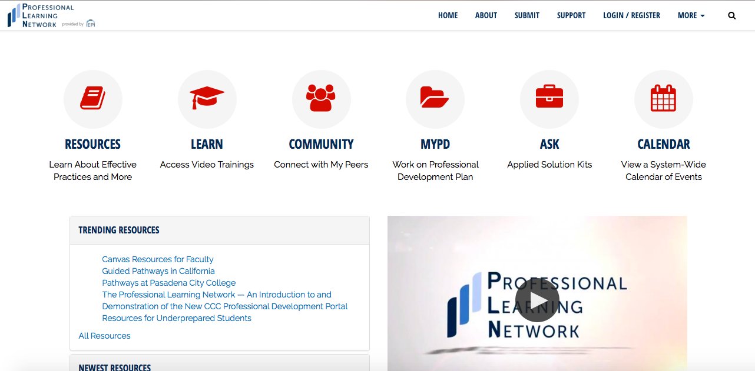
Finding Professional Development Opportunities
Professional Learning Network (PLN)
Online Learning Consortium (OLC)

Slide 12
Finding Professional Development Opportunities
College Professional Development Committee (may have other names for this committee)
Required for colleges using the Flexible Calendar
Must have faculty, staff, and administrative representatives
Some names:
Staff Development Committee
Professional Development Committee
Professional Development Coordinating Committee

Slide 13
Finding Professional Development Opportunities
RP Group – Research and Planning Group
Professional Development:
A significant part of our organization is dedicated to empowering leaders of all types and levels in our California Community Colleges. We offer professional development programs, knowledge sharing, and other resources to help just about every type of practitioner in the field — from institutional researchers and planners to college educators to funders and policy makers.
3CSN – California Community Colleges Success Network: An initiative of the California Community Colleges Chancellor’s Office
Mission:
Develop leaders in California community colleges who have the capacity to facilitate networks of faculty, staff, and students for curricular and institutional redesigns in support of increased student access, success, equity, and completion.

Slide 14
Finding Professional Development Opportunities
ACCCA – Association of California Community College Administrators
ACCJC – Accrediting Commission for Community and Junior Colleges
Other professional organizations

Slide 15
Disseminating what you Learn!
Your institution may require you to report on or share what you learned during your experience as a requirement for funding. Here are some ways to do that:
Email pertinent faculty links to the abstracts or materials you acquired with a brief summary of them
Lead a brown-bag lunch on a topic from your training
Share physical materials (i.e. books, journals, etc.) either through the library or department office
Other ideas?

Slide 16
Support for Professional Development
Resources for Support:
Local Academic Senate President
Department Chair
Dean/other Administrator
ASCCC:
Faculty Development Committee
Resolutions
Rostrum Articles
Types of Support:
Monetary
Time
Professional courtesy

Slide 17
Logistics
Maximizing Support Opportunities:
Find out the particular deadlines for proposals, professional development applications, or timeline your institution follows to ensure you get all required documents submitted on time!
Make sure you understand the procedure and amount for reimbursements!
If you have never received information about professional development opportunities at your instruction, check with your instruction office to make sure you are on the correct email distribution list!

Slide 18
Discussion
What challenges have you experienced in finding and participating in professional development activities?
What tips do you have to offer others to improve their ability to participate in professional development opportunities?
How has participating in professional development improved your work inside and/or outside of the classroom?

Slide 19
Thank you!

Slide 20
References
ASCCC: http://asccc.org
CCC Professional Learning Network: https://prolearningnetwork.cccco.edu
CCCCO Professional Development: http://extranet.cccco.edu/Divisions/AcademicAffairs/EducationalProgramsandProfessionalDevelopment.aspx
AB 2558 (Williams, 2014): https://leginfo.legislature.ca.gov/faces/billNavClient.xhtml?bill_id=201320140AB2558
Guidelines for the Implementation of the Flexible Calendar: http://extranet.cccco.edu/Portals/1/AA/FlexCalendar/Flex_Calendar_Guidelines_04-07.docx.pdf
ASCCC Support to use Professional Learning Network materials to Satisfy Flex Requirements: http://asccc.org/resolutions/include-professional-learning-network-pln-resources-satisfy-flex-requirements

