Slide 1
PRE-SESSION: NEW/NEWER CURRICULUM SPECIALISTS Wednesday, July 6, 2022 at 1:00 p.m.- 4:00 p.m.

Slide 2
Today’s Presenters
Lesley Agostino, Program Coordinator, Senior (Curriculum), Diablo Valley College
Daniel Alvarado, Academic Resources Specialist/Curriculum, College of the Sequoias
Raul Arambula, CCCCO Dean Educational Services and Support
Shireen Awad, Curriculum Specialist Chaffey College
Michelle Bean, ASCCC Treasurer
David Garcia, CCCCO Associate Governmental Program Analyst

Slide 3
Breakout Description
Curriculum specialists play an essential role in the college curriculum process, and the work can be daunting for those new to this role. This workshop is intended for new or newer curriculum specialists and provides the basics of the roles and responsibilities of curriculum specialists, designing your personal tracking system, promising and effective practices for submitting curriculum, and building relationships with faculty and the curriculum chair.

Slide 4
Today’s Overview
Roles and Responsibilities
Designing a Personal Tracking System for Courses and Programs
Effective Practices for Submitting Curriculum
Serving as a Liaison to the Chancellor’s Office
Building Relationships with Faculty and Curriculum Chairs
Collaborating with Faculty and Supporting 10+1
Supporting IDEAA work—facilitating conversations
Keeping Up with Curriculum Developments
IDEAA courageous conversations and frameworks
Finding the balance in your role
Sharing Resources
Notes:
Michelle (4 min)

Slide 5
Curriculum Speak: What is . . . ?
BURNING QUESTIONS
Use 3x5 Card/Pathable Chat:
READING THE ROOM
Fingers/Pathable Poll:
ACRONYMS List: The Nuts and Bolts Curriculum Acronyms (7th Ed., PCAH)
TOP
CIP
Other terms?
How many years have you been in your role as curriculum specialist?
What do you want to know?
Notes:
Lesley and Shireen (10 minutes)
(Michelle support and use poll into Pathable for online participants–question 2)

Slide 6
Roles and Responsibilities: General
USUALLY, under the general supervision of the vice president of instruction, Curriculum Specialists:
Coordinate the curriculum approval process from the course and program proposal level through local and state approval, including ACCJC (if appropriate)
Oversee/manage the local curriculum management system of record and submit curriculum to the state inventory (COCI)
Validate that codes are aligned/consistent across various curriculum systems - local curriculum management system, scheduling system, COCI, etc.
Notes:
Lesley (slides 5-10: 20 min)

Slide 7
Roles and Responsibilities: CCCCO
Assure that new and revised curriculum is documented and approved by the district and chaptered with the CCCCO in a timely manner prior to offering
Coordinate with the CCCCO in assuring compliance for program and course approval
Notes:
Lesley

Slide 8
Roles and Responsibilities: Curriculum Committee
Participate in Curriculum Committee meetings and record proceedings (agendas/minutes)
Attend technical review committee meetings to provide technical and resource support, especially in the area of coding
Work with faculty to clarify comments and resolve issues prior to local approval
Notes:
Lesley

Slide 9
Roles and Responsibilities: College
Prepare and maintain documentation related to curriculum approval (the official “historian/archivist”)
Coordinate, edit, and produce content for the college catalog/addenda and schedule of classes
Track completion of new and revised curriculum for publication
Notes:
Lesley

Slide 10
Roles and Responsibilities: Other Departments
Coordinate with the Financial Aid office to update the Eligibility and Certification Approval Report (ECAR) and Program Participation Agreement (PPA)
Assist the district in reconciling any course-level referential (misalignment between what is reported and what is in the MIS master course file) or syntactical (rules based) MIS errors for the college during end-of-term reporting
Notes:
Lesley

Slide 11
Specialists Sometimes…
Assure compliance of the curriculum with Student Services in the areas of Articulation, Matriculation, and Admissions and Records
Perform a variety of technical duties relative to assigned area
Notes:
Lesley

Slide 12
Tasks of Others
Faculty or administrative responsibilities include
Creating the Course Outline of Record (COR) and Program Narratives
How to use your CMS to help with this
Determining Course Design, including:
Methods of instruction (lecture/lab/studio)
Number of course hours and units
Academic discipline
Assigning the TOP Code (CB03), CIP Code, SAM code (CB09), Basic Skills Status (CB08), Special Class Status (CB13), Levels Below Transfer (CB21), and other coding*
Determining the Minimum Qualifications for a course
These elements should be established through collegial consultation with faculty and administration
Notes:
Shireen: Guide (e.g. TOP CODE) (5 min)

Slide 13
What is Not Part of the Specialists’ Role?
Writing/revising curriculum for the faculty
The 10+1 (Title 5, §53200) gives faculty primary authority over and responsibility for curriculum
Approving curriculum
This is the purview of faculty and administrators
Voting member on Curriculum Committee?
Submitting to ASSIST or C-ID
This is the role of the articulation officer
Notes:
Shireen

Slide 14
Designing a Personal Tracking System: Courses
What information is important to track regarding courses?
Approval dates - Curriculum Committee, Board, and State approval dates
Catalog and scheduling deadlines
Currency - Courses are reviewed every 5 years
CB code changes - Codes entered in COCI
C-ID descriptors
Effective term - Fall, Spring, Summer
GE codes - local, CSU-Breadth, IGETC
Potential impact of course changes on programs
Substantial changes (resulting in the issuance of a new control number)
Notes:
Daniel (slide 13-17: 10 min)

Slide 15
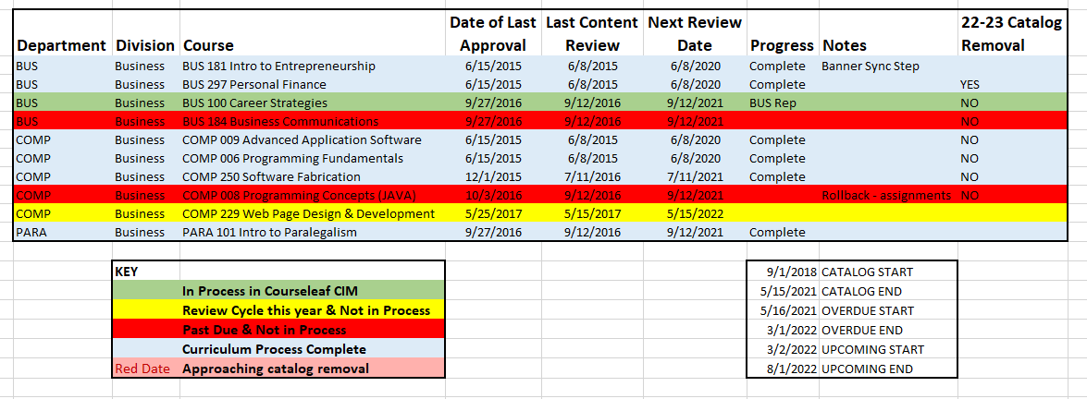
Designing a Personal Tracking System - Courses
Spreadsheet tracks approval dates, currency, and catalog/scheduling deadlines
Extract “Date of Last Approval” from curriculum management software.
Other dates entered manually.
Colors automatically display via conditional formatting.
Spreadsheet is presented/discussed at every Curriculum Committee meeting.
Notes:
Daniel

Slide 16
Designing a Personal Tracking System: Courses
Curriculum management software keeps track of programs referencing a course, C-ID, CB/GE code changes, effective term, and substantial changes.
If course has a substantial change (unit change, SAM code change, deleted, etc.), associated Division Chairs and Deans are automatically notified to potentially update their programs.
Notes:
Daniel

Slide 17
Designing a Personal Tracking System: Programs
What information is important to track regarding programs?
Currency - Programs are updated every 2 years (CTE) or 5 years (non-CTE)
Substantial changes to courses
Course list - Changes to required and elective courses
Narrative updates
TOP and CIP code alignment
Status of supporting documentation
CTE: Advisory committee minutes, LMI & analysis, Regional Consortia recommendation, transfer documentation (if applicable)
Apprenticeship: LMI & analysis, California Division of Apprenticeship Standards approval letter
ADTs: TMC, required transfer documentation (AAM, BCT, GECC), C-ID submission status for courses pending approval
Non-CTE: Transfer documentation, if applicable
Notes:
Daniel

Slide 18
Designing a Personal Tracking System: Programs
What information is important to track regarding programs?
Approval dates - Curriculum, Board, and State
Catalog and Scheduling deadlines
Effective term
New and deleted programs
State and Federal licensing requirements
Spreadsheet is similar to the one we use for courses…
Notes:
Daniel

Slide 19
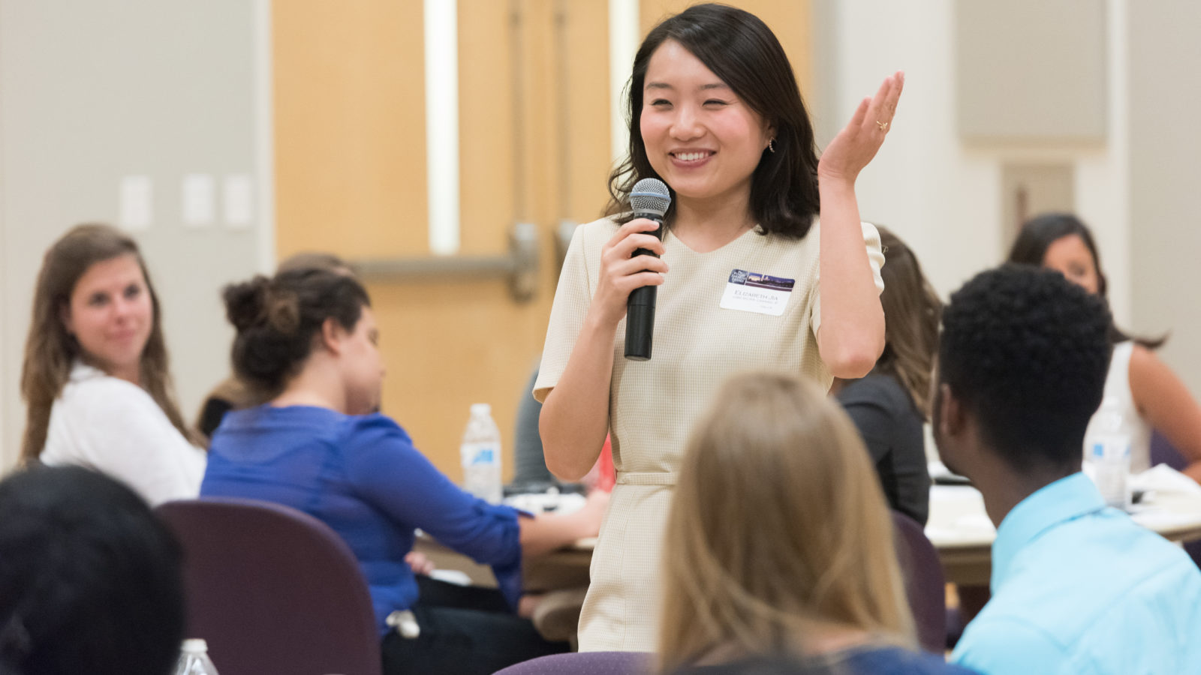
How do you use Curriculum Management Systems to track your work?
OPEN DISCUSSION: VOLUNTEERS?
Notes:
Daniel and Michelle w/support (10 min)

Slide 20
5 Minute Break
Notes:
5-10 min

Slide 21
Effective Practices for Submitting Curriculum
California Education Code
Statute, determined by legislation
Title 5
Interprets Ed Code into regulations
Defines required elements of the COR
CCCCO Program and Course Approval Handbook (PCAH)
Establishes specific guidelines for implementing Title 5
MIS Data Element Dictionary (DED)
Provides coding rules for individual Course Basic (CB) codes as well as codes that intersect (such as CB03 - TOP code and CB09 - SAM code)
Validate CB codes prior to submitting courses to the state inventory
Notes:
Raul, David, Daniel (slides 19-25: 20 min)

Slide 22
Effective Practices for Submitting Curriculum: Courses
Confirm proposal fields completed in COCI match those in the COR
CB Codes
Catalog description
Minimum/maximum contact hours (credit courses), Minimum/maximum course contact hours (noncredit courses)
Minimum/maximum outside of class hours (credit courses)
Confirm only one COR is attached
Notes:
Raul, David, Daniel

Slide 23
Effective Practices for Submitting Curriculum: All Program Types
Confirm proposal fields are accurate and complete in COCI and match the narrative
Program title
Program goal
Program award type
Catalog description
TOP & CIP codes - validate against crosswalk
Minimum/maximum units (or hours for noncredit CDCP)
Verify that all courses in narrative item 3 have been included in the Associated Courses section
For legacy programs confirm that old/outdated attachments (including CORs) and regenerated/duplicate attachments have been removed
Notes:
Raul, David, Daniel

Slide 24
Effective Practices for Submitting Curriculum: Certificates and Associate Degrees
Confirm all required elements and supporting documentation (if applicable) is attached:
Narrative
Validate double counted values in narrative item 3 for associate degrees are accurate
LMI and analysis (for CTE programs & apprenticeships) - must be current (within 2 years) and focus on local region
Advisory committee minutes (for CTE programs) - including date and location of meeting, list of attendees and job titles, and program recommendations)
If certificate or degree is new confirm the approval action for the new program is highlighted
Regional consortia recommendation (for new CTE programs)
California Division of Apprenticeship Standards Approval Letter (for apprenticeships)
Transfer documentation (if applicable)
Notes:
Raul, David, Daniel

Slide 25
Effective Practices for Submitting Curriculum: ADTs
Utilize the Chancellor’s Office AA-T/AS-T Review Checklist [link]
Confirm current TMC was used, the college name is included, and the total min/max units are 60
Confirm narrative items 1-2 are attached and that the graduation requirements (completion of 60 semester or 90 quarter units, minimum overall GPA of 2.0, minimum grade of “C” or “P” for each course in the major, completion of the CSU-GE Breadth or IGETC pattern) have been included
Confirm the program goal is “Transfer” and that apprenticeship is coded as “False”
Confirm all CORs are attached and that the course prefix, number, and title for C-ID approved courses matches in both COCI and C-ID’s system
Confirm all supporting documentation (AAM, GECC, BCT) required by the TMC is attached
If a course matched to a C-ID descriptor is pending C-ID approval beyond 45 days attach documentation
Notes:
Raul, David, Daniel

Slide 26
Effective Practices for Submitting Curriculum: ADTs (continued)
Double counting
Develop a basic understanding of the rules for each GE area
Refer to the Chancellor’s Office Double Count for CSU-GE, IGETC, and IGETC for STEM document [link]
Have someone from your campus experienced at double counting (such as an evaluator, counselor, or articulation officer) confirm the values provided in the TMC
Notes:
Raul, David, Daniel

Slide 27
Effective Practices for Submitting Curriculum: Noncredit Certificates (CDCP)
Confirm proposal fields specific to noncredit programs are accurate and complete in COCI
Noncredit program type
CDCP eligibility criteria
Employment potential
Total core courses/hours and total elective courses/hours
Confirm all required elements and supporting documentation (if applicable) is attached
Narrative (only items 1-4 are required for noncredit programs)
LMI and analysis (only required for Short-Term Vocational programs)
Notes:
Raul, David, Daniel

Slide 28
Serving as a Liaison to the Chancellor’s Office
Due to your submissions in COCI, reviewers may contact you, or you may contact them regarding revisions requested and general questions.
What happens when you have revisions requested?
What if you have questions?
Disagree?
Care and Empathy for Reviewers
How many reviewers?
Open to suggestions and dialogue
They truly want to help and not punish
Care and Empathy for Yourself
Submissions can be tiring and there is a lot to track!
Revisions are a normal part of the process
Notes:
Shireen/Raul/David (3 min)
set up zoom, be polite
Empathy for AO when revisions to ADTs come

Slide 29
Building Relationships with Curriculum Chairs
Teaming Up with the Faculty Curriculum Chair
You are each others’ partners!
What are your goals together?
In-office goals
Faculty related goals
Campus related goals (e.g. how does the campus view your partnership)
Thought partners
Promote a team approach that sets aside perceived hierarchies
Formulate a clear understanding of respective responsibilities within the team structure
Develop and maintain regular and open communication with the chair(s)
Collaborate to develop annual curriculum timelines, calendars, goals, and objectives: 10+1
Be open to ideas for process improvement and innovation wherever they come from
Attend training opportunities together and plan professional development together
Support IDEAA conversations and inclusion of culturally responsive practices in curriculum
Member of Curriculum Committee (your role isn’t transactional, you can bring your voice here)
Notes:
Shireen (slides 28-31: 15 min)
IDEAA conversations especially as member of Curriculum Committee so your voice matter as a member. What trainings can you bring to the table in regards to IDEAA. Example, I am a facilitator for social justice training so my voice is valued in where DEI opportunities can apply in the COR as well as decolonizing curriculum.

Slide 30
Building Relationships with Faculty
Building Relationships with Faculty
Help with the technical development of curriculum
Try being a main communicator with faculty
Sending the emails for revisions
Offering to meet with them (and the Chair if needed)
Give grace to all of the nuances of the technical development of curriculum (e.g. tutorials)
It’s okay to say, “No” and offer a solution:
“No, I cannot select the TOP Code, but I can guide you on how to select one”.
“Thank you for trusting me with ‘xyz’, but since this is faculty purview, you will need to complete ‘xyz’ on your end.”
When the opportunity is present, make your role clear to them.
For example, presenting during FLEX with the Chair, attending New Faculty Orientation, hosting workshops
Notes:
Shireen

Slide 31
Building Relationships and Goals with Curriculum Chairs
New Chairs
Often chairs are on FOSAs (Faculty on Special Assignments) which means the chair may be different every couple years.
What is their release time?
How to work with them on their release time?
Recommended Practices if You Have a New Chair
Have initial meeting with them explaining your specific roles as a specialist.
You are the permanent position, 100 percent position
Ask them to support you in faculty based conversations
Discuss your role as a classified professional in general.
e.g., work schedule
Set goals for your partnership together
Will you be thought partners?
What is strictly the chair’s role vs yours?
Be open to helping train them
Notes:
Shireen

Slide 32
Building Relationships and Resilience
Care and Empathy for the Faculty
Sympathize and empathize whenever possible; expect the same in return
Expect technology challenges and distracted faculty (“I never got your email!”)
Reference local documents (e.g., curriculum handbooks, local policies, etc.), Title 5, and Education Code
Communicate timelines, technology updates, support hours, etc. frequently
Provide visual representations of complex submission and approval processes, especially related to technology
Video tutorials
Partner with the Curriculum Chair in the stickier situations (or in all situations) that may be challenging
Care and Empathy for Yourself
Find the balance, rest, and keep going
Remember you are equipped
Give yourself grace to make mistakes
Notes:
Shireen: video tutorials, made myself available to them in unique way

Slide 33
Keeping Up With Curriculum Developments
IDEAA as a framework in all things curriculum–see Memo ESS 22-300-007 introducing the Diversity, Equity, and Inclusion in Curriculum Model Principles and Practices framework created by the California Community Colleges Curriculum Committee (5C)
Academic Senate for California Community Colleges Papers (link)
Academic Senate for California Community Colleges Rostrum (link)
California Community Colleges Board of Governors (link)
California Community Colleges Curriculum & Instruction Unit (link)
California Community Colleges Curriculum Committee (5C) (link)
Chancellor’s Office Curriculum Assistance Listserv (link)
Curriculum Specialists Listserv (send email request to join to cacurriculumstaff+owner@groups.io)
Curriculum Institute and Regional Meetings (link)
Notes:
Lesley and Shireen (5 min)

Slide 34
Resources
CCCCO MIS Data Mart (link)
Course Data Elements (link)
Credit Course Repetition Guidelines (link)
Common Concerns and Questions for Community Services Offerings (link)
Guidelines for Required Instructional Materials in the California Community Colleges (link)
Noncredit at a Glance (link)

Slide 35
More Resources
Policies for Prerequisites, Corequisites, and Advisories on Recommended Preparation (link)
Program and Course Approval Handbook - 7th edition (link)
Taxonomy of Programs (6th edition) (link)
TOP-CIP Crosswalk (2020)
Located Under “Regulations” (link)
The Course Outline of Record: A Curriculum Reference Guide Revisited (Spring 2017) (link)
Supplemental Learning Assistance and Tutoring Regulations and Guidelines (link)

Slide 36
You are valued and appreciated!
Thank you for joining us today!
Any unanswered questions?
info@asccc.org
Notes:
Michelle and all (15 min)

Slide 37
Presenters’ Contact Information
Lesley Agostino: LAgostino@dvc.edu
Daniel Alvarado: danielal@cos.edu
Raul Arambula: rarambula@CCCCO.edu
Shireen Awad: sharon.awad@chaffey.edu
Michelle Bean: mbean@riohondo.edu
David Garcia: dgarcia@CCCCO.edu

