Slide 1
Pre-requisite Content Review and Disproportionate Impact
Jennifer Vega La Serna, College of the Sequoias
Daylene Meuschke, College of the Canyons
Brianna Hays, San Diego Mesa College
Cleavon Smith, ASCCC Executive Committee
Berkeley City College

Slide 2
Session Learning Outcomes:
Participants will be able to…
Describe how the process is working in different settings
Identify the critical steps necessary for local implementation
Leverage tools and resources from panel colleges that may be taken back to their campuses to begin the discussion locally

Slide 3
History and Context
1980s – Many cases of students completing pre-requisites then being required to re-take assessment tests; if they didn’t pass, they were in matriculation limbo.
Early 1990s – Mexican American Legal Defense Fund (MALDEF) filed suit against the above mentioned practices
  Filed dropped by MALDEF based on a list of assurances to draft regulatory changes to include policy on multiple measures, prohibition of exit tests, and validation of prerequisites.
Issues raised with Statistical Analysis for determining Pre-reqs
  Statistical analysis unique to California
  Difficulty of acquiring sufficient data for infrequently delivered courses
  Length of time for gathering data for statistical analysis

Slide 4
History and Context (cont.)
2000s - ASCCC Responds to studies conducted by external scholars and policymakers with resolutions
  Spr09 9.02 “Communication and Computation Prerequisite Validation through Content Review”
    Resolved, That the Academic Senate for California Community Colleges recommend changes needed to Title 5 language on prerequisites that, instead of relying on statistical analysis, allow local faculty to base their determination for prerequisites of English, reading, or mathematics for collegiate level courses on content review;
  Fall09 9.05 “Ensuring Rigorous Content Review to Establish Prerequisites”
    Resolved, That the Academic Senate for California Community Colleges revisit the content review process as described in the The Model District Policy on Prerequisites, Corequisites, and Advisories on Recommended Preparation for possible modifications, in an effort to consistently implement rigorous content review standards at such time as content review becomes the primary method of validating prerequisites.

Slide 5
History and Context (cont.)
2010s – ASCCC adopts papers
  “Student Success: The Case for Establishing Prerequisites through Content Review” (Fall10)
  “Implementing Content Review for Communication and Computation Prerequisites” (Spr11)
  Spr09 9.02 “Communication and Computation Prerequisite Validation through Content Review” REVISITED
    Resolved, That the Academic Senate for California Community Colleges recommend that once new prerequisites are implemented, colleges conduct research on the effect(s) of the prerequisites.

Slide 6
Title 5 Regulations
Title 5 regulations state:
5 CCR § 55003 (d) (2) the prerequisite will assure, consistent with section 55002, that a student has the skills, concepts, and/or information that is presupposed in terms of the course or program for which it is being established, such that a student who has not met the prerequisite is highly unlikely to receive a satisfactory grade in the course (or at least one course within the program) for which the prerequisite is being established;

Slide 7
Establishing Out-of-Sequence Prerequisites: Then and Now…
Pre-Title 5 Changes
Title 5 Change (2011)
Content Analysis
Statistical Validity
BOG amends Title 5
Districts have the option of establishing out-of-sequence pre-requisites using content review alone

Slide 8
Audience Reflection
What fears do you have (or have you had) with regard to the change in policy to permit districts to establish out-of-sequence pre-requisites using content review alone?

Slide 9

College of the Canyons:
Prerequisite Validation Process
Daylene Meuschke, Ed.D.
Dean, Institutional Research, Planning and Institutional Effectiveness

Slide 10



Pre-Req Validation Doesn’t Require Data?!?!?!
Take a deep breath, count to ten
Whew! All is right with the world. We need each other.

Slide 11
Collaborative Model
Keeping the Focus on Students
Students
Researchers
SSSP Directors
Curriculum Committee
Academic Senate
Faculty

Slide 12
Jointly Developing Prerequisite
Validation Procedures: Our Story
Disclaimer: This is College of the Canyons’ story. Context and culture matters when applying the policy and procedures at your college/ district.
Academic Senate
Curriculum Committee
Policy Committee
Research and Planning
Faculty
Policy Committee Chair invited the Research Office to participate in the development of the new administrative procedures
College of the Canyons’ culture for using data to inform decisions was still in play with the Title 5 revisions allowing content review alone
Sample prerequisite validation form and guidelines are provided
College of the Canyons’ Prerequisite Team

Slide 13
Content Review Sample

Slide 14
Sample Content Review Template: SLOs

Slide 15
Sample Content Review Template: Objectives

Slide 16
Sample Content Review Template: Assignments
Assignments from Syllabi

Slide 17
Quantitative Data Sample

Slide 18

What are the success rates for students enrolled in SOCI-101H, SOCI-103H, and SOCI-200H who completed ENGL-101 prior to taking the honors course in Sociology?
What are the success rates for students in these three courses who had not yet completed ENGL-101 before taking the honors course in Sociology?
Student Success Rates with ENGL-101 Completion, 2011-2015
 |  | Completed ENG101, 101H or Higher* prior to SOCI honors course (YES) |  |  | Did NOT complete English-101/101H or Higher prior to SOCI Honors course (NO)
 | Enrollments (n) | Total in Group (n) | Success (n) | Success (%) | Total in Group (n) | Success (n) | Success (%)
SOCI-101H | 282 | 216 | 207 | 96% | 66 | 45 | 68%
SOCI-103H | 93 | 66 | 59 | 89% | 27 | 19 | 70%
SOCI-200H | 114 | 64 | 61 | 95% | 50 | 38 | 76%
Average success rates for all Sociology courses over the past five years ranged from 70% (in 2013-14) to 75% (in 2010-2011 and 2011-2012).
*Includes students who had credit for the course through transcripts from another institution

Slide 19
What are the success rates by English composition course eligibility level for students who enrolled in SOCI-101H, SOCI-103H, and SOCI-200H?
Success Rates by English Level, 2011-2015
 | SOCI-101H |  |  | SOCI-103H |  |  | SOCI-200H
 | Total in Group (N) | Success (n) | Success (%) | Total in Group (N) | Success (n) | Success (%) | Total in Group (N) | Success (n) | Success (%)
Passed English-101/101H or Higher | 216 | 207 | 96% | 66 | 59 | 89% | 64 | 61 | 95%
Eligible for English-101¹ | 9 | -- | -- | 8 | -- | -- | 14 | 9 | 64%
Eligible for English-091/094/096 or lower² | 35 | 20 | 57% | 17 | 10 | 59% | 25 | 20 | 80%
No record of prior English course or placement | 22 | 17 | 77% | 2 | -- | -- | 11 | 9 | 82%
Total Number of students in course | 282 | 252 | 89% | 93 | 78 | 84% | 114 | 99 | 87%
^{1.} Eligibility is determined by either prerequisite course completion or placement into level through the English assessment process.
² This level includes two groups. Group 1’s eligibility is determined by either completion of English-081 or placement into English-091/094 and the second group’s eligibility is determined by either completion of 071 or placement into 081/096 or placement into 089. No students were identified as being in a lower level than these two groups and taking honors sociology courses.

Slide 20

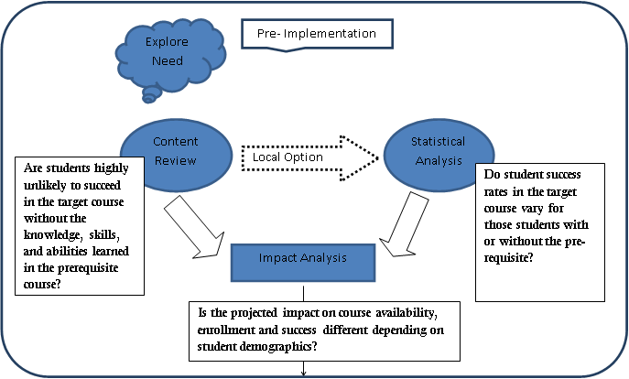
Pre-Implementation
RP Group's Suggestions for California Community College Institutional Researchers Conducting Prerequisite Research

Slide 21
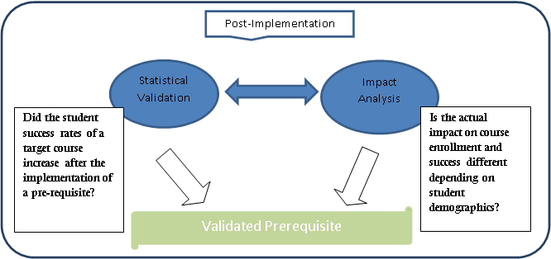
Post-Implementation
RP Group's Suggestions for California Community College Institutional Researchers Conducting Prerequisite Research

Slide 22
Pre-requisites at College of the Sequoias
English 1 pre-requisite implementation for Social Science courses

Slide 23
Implementation Process
Administrative Procedure – Prerequisites and Corequisites
Step 1: Define entrance expectations in the target course and exit skills obtained in the prerequisite course.
Step 2: Identify means of obtaining abilities, skills and knowledge.
Step 3: Compare the exit skills for the prerequisite course and the entrance skills for the target course.

Slide 24
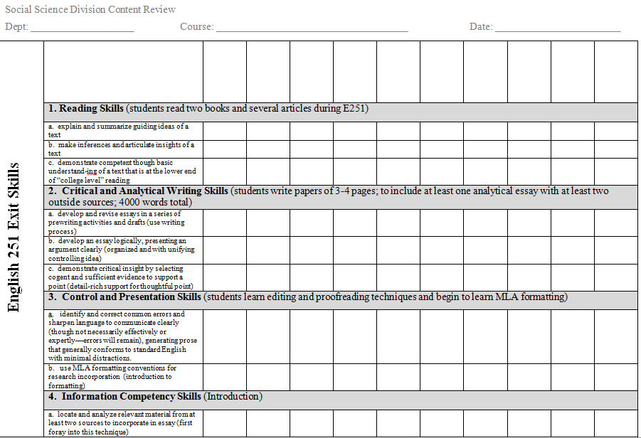
Entry and exit skills comparison

Slide 25
Timeline for English pre-requisites for Social Science courses
2010: Statistical validation study completed by the research office
2011: Content review process completed by English and Social Science faculty
Spring 2012: pre-requisites implemented
Spring 2014: Establishing a basic skills pre-requisite study completed
Spring 2015: Success rates and cost-analysis study completed

Slide 26
Impact
Board of Trustees presentation and discussion
District Objective developed to assess course success in social science transfer courses and a cost/benefit analysis:
District Objective #8: Assess the effectiveness of the pilot program of requiring successful completion of English 251 as a prerequisite for social science transfer courses.
Updated Board of Trustees in the Annual Report on the Strategic Plan 2014
Revised assessment and updated Board of Trustees in the Annual Report on the Strategic Plan 2015

Slide 27
Assessment of District Objective #8: 2014
Compare the successful course completion rate of students in social science transfer courses in 2012-2013 (when the prerequisite was enforced) with the successful course completion rate of students in social science transfer courses prior to the enforcement of this prerequisite who did not successfully complete English 251 prior to enrolling in the social science transfer courses
Measure
A study was completed by faculty and the research office. The data for the program group amounted to 5,602 student grades prior to the establishment of the prerequisite and 4,515 student grades after. For the comparison group the number of observations totaled 17,677 ‘prior’ student grades and 16,207 ‘after’ student grades.
In summary, with respect to the program group, the test revealed a significant increase in success rates, from 64.2% to 68.0%, z = 3.98, p < .05. However, with respect to the comparison group, the change from 71.2% to 71.6% from one semester to the next was not found to be significant, z = 0.94. Success rate for Hispanic students was significantly increased from 61.5% to 66.9% (z=4.09, p< .001). It is important to note that Black/African American student success rate was decreased from 53.1% to 49.5% (z=-0.57; no statistical significance). In addition, changes in enrollment patterns among the affected courses were found to be statistically significant among several demographic groups. Effect sizes for these demographic variations, however, ranged from trivial to small in their magnitude.

Slide 28
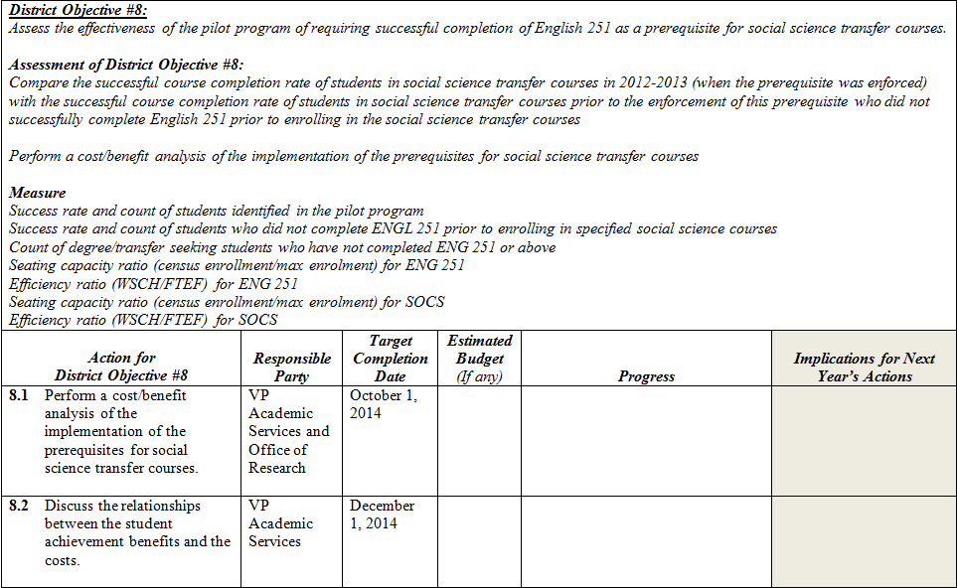

Slide 29
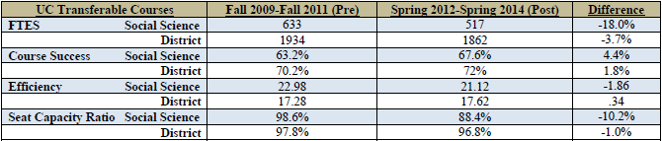

District Objective 8 analysis-- 2015

Slide 30
Implementation of the Prerequisites for
Social Science Transfer Courses
In order to gain a better understanding of the implementation of the prerequisites for social science transfer courses, a series of additional data analyses/review have been performed.
For the Social Sciences UC Transferable Courses:
FTES, Efficiency and Seating Capacity Ratio have decreased.
Since spring 2013, no major differences in the percentage change of FTES were observed, as compared to the rest of the District.
Success rates have increased (at a higher rate than the rest of the District.)
For English 251 Courses:
Efficiency and Seating Capacity Ratio have remained unchanged.
FTES increased slightly.
Success rates have decreased slightly.

Slide 31
Where are we now?
Progress Update
Pre-requisites remain in place for most social science courses
Additional social science courses added pre-requisites (2013: Western Civilization, US History, World History; 2015: California government; 2016: Cultural Anthropology, Intro to sociology)
2016: Nutrition completed content review and implemented English 251 pre-requisite

Slide 32

Prerequisite Validation
and Disproportionate Impact Analysis:
Examples from a Multi-College District
Bri Hays
Campus-Based Researcher
San Diego Mesa College

Slide 33
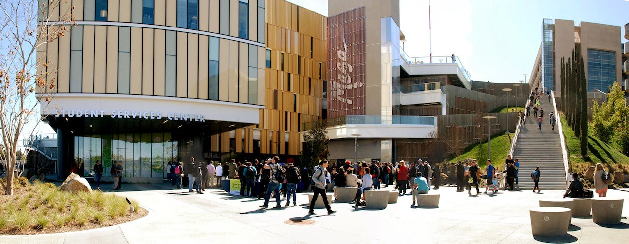
But First, Some Context
Mesa College: largest credit college in the San Diego CCD
San Diego CCD: one of the largest districts in the state
District-wide, shared curriculum
Discipline deans work with faculty across the credit colleges

Slide 34
Prerequisites:
A Collaborative Effort
Campus Curriculum Committee
District Curriculum Committee
District Instructional Services
District Student Services
Department Chairs
Cross-Disciplinary Prerequisite Establishment Process Key Players
District IR Office
Math or English Department
Discipline Dean
Campus IR Office

Slide 35
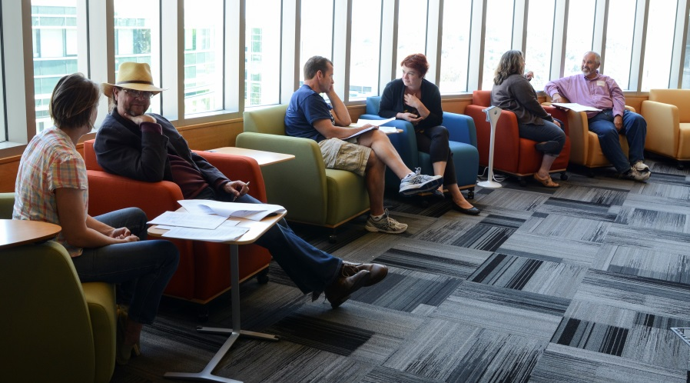
Starting with Inquiry: How It Works In Practice
Department faculty (often at the college level) review course content and consider appropriateness of a math or English prerequisite
Faculty collaborate with the campus IR office to examine preliminary data on success by prerequisite skill level attainment
Faculty review success data and other data, including a preliminary analysis of potential disproportionate impact and enrollment implications
If data support moving forward, the conversation proceeds to the district-level

Slide 36
A Data-Informed Process

Slide 37
What About Disproportionate Impact?
Prerequisites aim to foster successful movement through a sequence of courses
Major Caveat: Instituting prerequisites may inadvertently keep certain students from advancing toward their educational goals
Issues of concern: access and success

Slide 38

Questions for Consideration
Pre-Implementation
Will any student group’s access to the target course be adversely impacted by the proposed prerequisite?
Which students are enrolling in and successfully completing the proposed prerequisite course?
Adapted from Ensuring Equitable Access and Success: A Guide to Assessing and Mitigating Disproportionate Impact in Student Success and Support Programs (CCCCO, 2013)

Slide 39
Disproportionate Impact Analysis: Pre-Implementation
Hypothetical:
If the prereq were to be implemented, would it create barriers for specific subpopulations of students?
Reference group
And it would disproportionally limit access for five subpopulations of students
If implemented, this prerequisite would potentially decrease enrollment in PSYC 101 by 80%

Slide 40
What if There is Evidence of Disproportionate Impact?
Should the institution proceed with the prerequisite implementation?
If so, what steps will the institution take to mitigate disproportionate impact?

Slide 41
Questions for Consideration
Post-Implementation
Has any student group’s access to the target course be adversely impacted by the proposed prerequisite?
Among students who meet the prerequisite skill level, are any groups less likely to succeed in the course?
Adapted from Ensuring Equitable Access and Success: A Guide to Assessing and Mitigating Disproportionate Impact in Student Success and Support Programs (CCCCO, 2013)

Slide 42
Looking Forward
What impact will the move toward a common assessment and multiple measures have on prerequisite validation?
What factors will we need to consider to move forward?

Slide 43
Quick Poll:
How many institutions are using content review alone for prerequisite analysis?

Slide 44
Discussion Questions
When the decision to shift to content review alone for out-of-sequence prerequisites came through, how did your institution react?
Has your college revised its procedures for prerequisite validation?
How did the change progress on your campus?

Slide 45
More Discussion Questions
Is your college part of a multi-college district? If so, is curriculum aligned across all credit colleges?
How has the shift to content review impacted your district processes?

Slide 46
More Discussion Questions
What questions might your campus practitioners have about prerequisite validation? What about your Board of Trustees?
How might the College of the Canyons or College of the Sequoias content review templates be modified and used at your institution?
How might you develop a disproportionate impact study for your institution’s prerequisites?

Slide 47
“
Questions?

