Slide 1
Decolonization & Equity in Remote Learning and Distance Education Spring 2021 ASCCC Plenary

Slide 2
Session Description
Through the pandemic we have learned about digital inequities for our students and faculty. Come to this session to discuss what we have learned and what innovations we should keep. Learn about ways to decolonize your online classes in both content and processes. Examine what types of student support needs to be available to support student success. Let’s discuss how to review our remote and distance education opportunities with equity-mindedness.
Notes:
Stephanie

Slide 3
Who are we?
Stephanie Curry, ASCCC North Representative
Cheryl Aschenbach, ASCCC Secretary
Hossna Sadat Ahadi, Palomar College
Notes:
Stephanie

Slide 4
Impact of COVID: What We Learned

Slide 5
Students Face Many Barriers in Online Environment
Digital Equity
Environment
Cameras
Bandwidth (literal and figurative)
Eradicate equity deficits within your sphere of influence; advocate for change in areas where students are being marginalized and oppressed.
We cannot make assumptions about students’ lived experiences!
Notes:
Cheryl

Slide 6
RP Group Findings
TOP Strategies to Support Students
Flexibility in deadlines and requirements
Regular student check ins
Increased availability and accessibility
Leveraging technology
Notes:
Stephanie

Slide 7
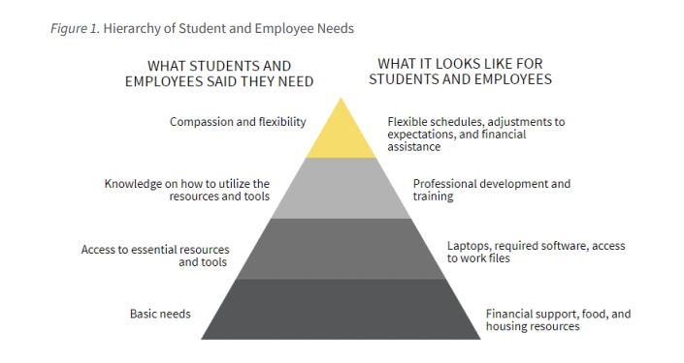
RP Data on Student Needs
Notes:
Stephanie

Slide 8
Acknowledge Challenges Students Experience
Basic needs
Technology
Pandemic pressures
Racial reckoning
Home obligations
Mental health and well-being
We cannot make assumptions about students’ lived experiences and we need to consider students holistically.
Notes:
Hossna

Slide 9
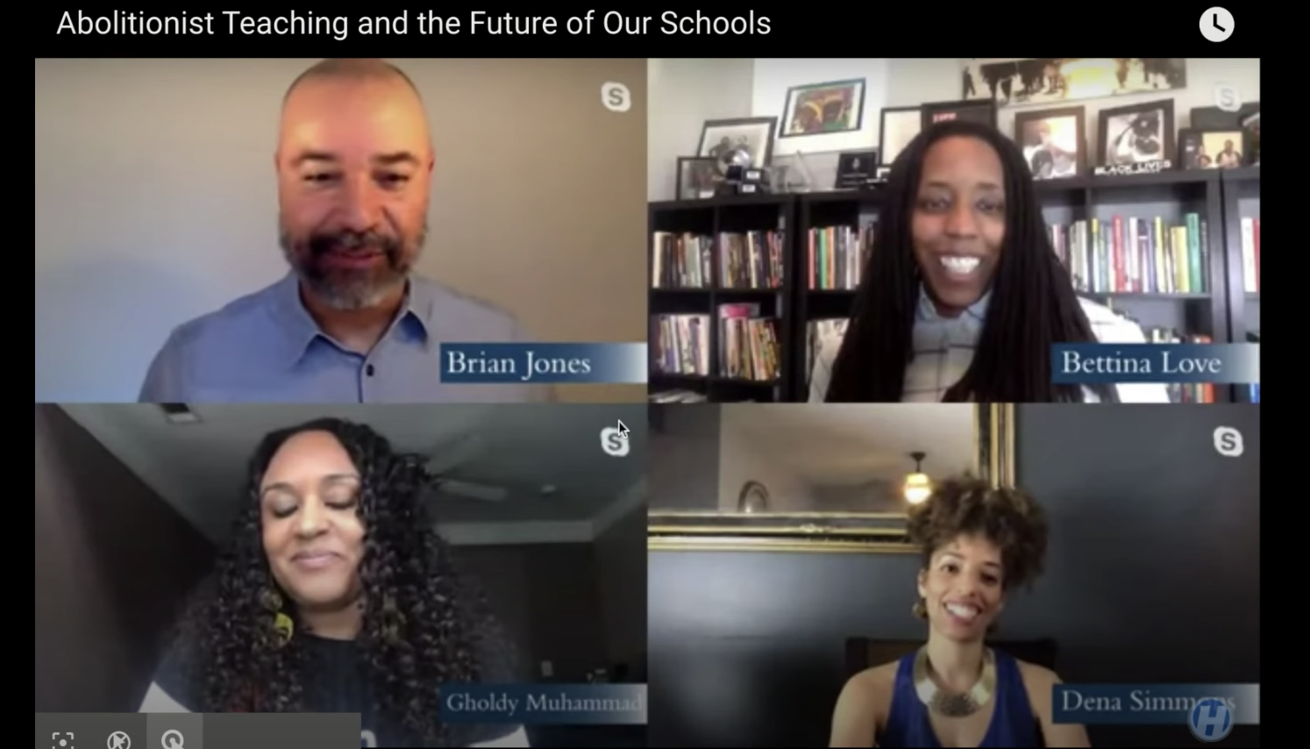
Notes:
Hossna

Slide 10
Interactive Activity—Padlet
Notes:
Hossna
What are some equity-focused teaching praxis you applied remotely for students?
What were some important resources you shared to support students?
What is the biggest reflective takeaway you learned during this pandemic about your teaching?

Slide 11
Decolonize the Traditional Instruction Model— Deploy Proactive & Intrusive Support
Notes:
CHeryl

Slide 12
Collaboration between Student Services & Instruction
Take a holistic approach to instruction and student support in the classroom
Partner with counseling and student support services
Encourage communication with students; be responsive
Ask why. Don’t just assume you know what students are experiencing
Provide support with housing, food, and classroom resources
Build student’s trust
Come from a place of unconditional regard & care
Avoid punitive teaching
Validate the agency our students bring in the classroom and on our campus
Vision for Success commitment: pair high expectations with high support
Notes:
Cheryl

Slide 13
Decolonizing Your Syllabus— an Anti-Racist Guide for Your College
Notes:
Hossna

Slide 14
Decolonizing Curriculum and Pedagogy
The power of counterstories and counternarratives
Culturally responsive teaching
The importance of engagement and validation
Dismantling coloniality and decolonize teaching
Creating Brave Spaces
Notes:
Hossna

Slide 15
Community Agreements/Environmental Learning Agreements
Notes:
Hossna

Slide 16
Addressing Structures of Online Learning
What role does your local senate play in discussions and making recommendations on professional development (#8 in the 10+1) and student preparation and success (#5)
Processes
Flexibility
Scheduling: Synchronous vs Asynchronous
Data
Addressing artificial barriers
Institutionalizing racial equity
Notes:
Stephanie

Slide 17
Recommendations
Notes:
Stephanie

Slide 18
Self-Assessment
Review your student outcomes data without bias - what is it telling you?
Review course syllabus, materials, assignments, and instructional approaches
Open courses - on campus & online - and ask for feedback from colleagues
What are your areas for growth?
Notes:
Stephanie

Slide 19
Ask Students
Get feedback from students on a regular basis
Course feedback (delivery, content, materials, assignments, etc)
Content feedback (formative assessment)
You can use Mentimeter, Padlet, or Google Form to get your student’s feedback
Notes:
Cheryl

Slide 20
Professional Development—Beyond Canvas Basics
DE training supporting pedagogy and andragogy
Understanding students holistically
Sharing best practice with breaking down barriers
The inclusivity of Online PD
Decolonization
Notes:
Hossna

Slide 21
Creating a culture of authentic trust with our students and our colleagues
Be honest about your own struggles & Understand students and colleagues have complex lives outside the classroom
Notes:
Stephanie
Be honest about your own struggles
Understand students and colleagues have complex lives outside the classroom
Genuinely ask students and colleagues how they are doing; follow up and help
Allow spaces and time for questions and conversations
Be consistent in communication
Let students be part of creating the class- liquid syllabus, community agreements

Slide 22
Create a Culture of Care
Very important for those online who are distant from college and on campus services!
Notes:
Cheryl
Online education can be isolating
Need to create the feeling of a classroom, online
Encourage connections between students, projects, ice breakers so they can create a sense of community
Proactively share resources with students multiple times in the semester, not just one and done
Use early alerts/kudos to reach out to students
Personally reach out to “missing” students- show that you care
Embed resources and services in your online class (library, counseling, tutorial, behavioral health, DSPS, basic needs)

Slide 23
Recommended Resources
Decolonizing Your Syllabus, an Anti-Racist Guide for Your College
RP Group Equity Survey 2020
Webinar- Strategies and Effective Practices for Conducting Labs and Activities Online
Active Learning in the Online Environment and Motivating your Students
Curricular Trauma and Decolonizing your Syllabus
Decolonization is not a metaphor
From Safe Space to Brave Space

