Slide 1
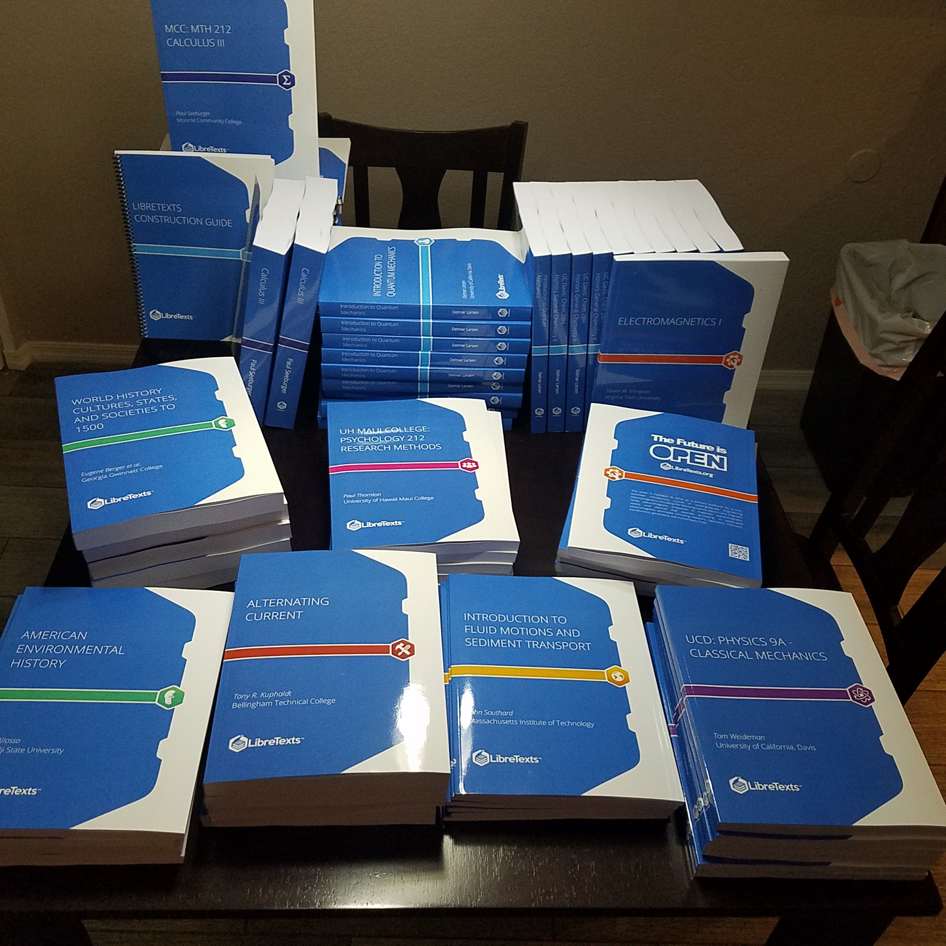
Unleashing the Power of Open: Hands-on Workshop on Adopting and Adapting LibreTexts for Use in Your Classroom
Delmar Larsen
Executive Director, LibreTexts
Professor, Department of Chemistry,
University of California, Davis
http://Libretexts.org
https://www.youtube.com/LibreTexts
Notes:
When it comes to SOLT research, Mount Royal University comes immediately to my mind. I would like to thank Brett and the other organizers of the meeting for the giving me the opportunity to meet with SOTL researchers both at MRU and abroad, that are presenting your excellent results here. I am also thankful for giving me the opportunity to present our Libretexts project centered out of the University of California, Davis, but used internationally as you will learn.
How do we know that students are using the Wiki? In contrast, how do we know they are using print textbooks?
What evidence is there for a digital textbook being a viable replacement to a print textbook?
Are there best practices for adopting a digital textbook?
What peer-review processes does the Wiki undergo?
Are faculty recognized for contributions to the Wiki in a similar manner to writing a commercial textbook, and should they be?
How does LibreText compare to Wikipedia? Can students trust LibreTexts?

Slide 2
Workshop Overview
Project Overview, Scope, Impact and Power (50 minutes)
10 min break
Hands on Activities (Taming the Platform for your purposes) (90 minutes)

Slide 3
Workshop Overview
Short Introduction to the LibreTexts
Brief Overview of Open Education Resources (OER)
Philosophy of the LibreTexts Project
LibreTexts Features
Works in Progress

Slide 4
Support and Acknowledgement

Slide 5
The LibreTexts Mission
This means Free
This means you
Implementing a Community built OER resource/platform/portal that is Comprehensive and can be Curated at multiple levels.
“No gap Left Behind”
This means a Living Library
“No tech Left Behind”

Slide 6
The LibreVerse is an centralized ecosystem of interconnected applications focusing on the construction, customization, distribution and usage of OER. All for you to use for your classes.
query.libretexts.org
Query
(Homework)
jupyter.libretexts.org
ADAPT (homework)
Jupyter Notebook
(code)
LibreTexts Libraries
Forums
Javascript Server
TSUGI
LT LMS
Learning Analytics
Bot
Server

Slide 7
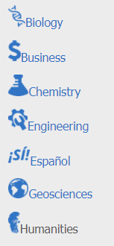

Slide 8
What is OER?
Open educational resources (OER) are free and openly licensed educational materials that can be used for teaching, learning, research, and other purposes.
- The William and Flora Hewlett Foundation
Open Educational Resources (OER) are teaching, learning or research materials that are in the public domain or released with intellectual property licenses that facilitate the free use, adaptation and distribution of resources.
- UNESCO Definition

Slide 9
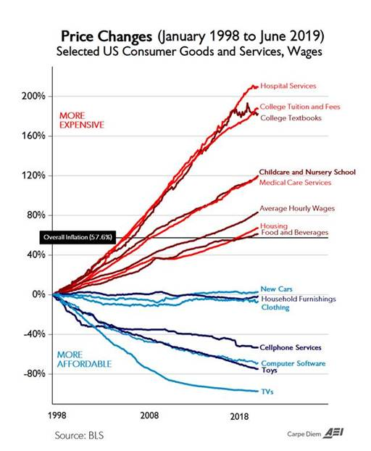
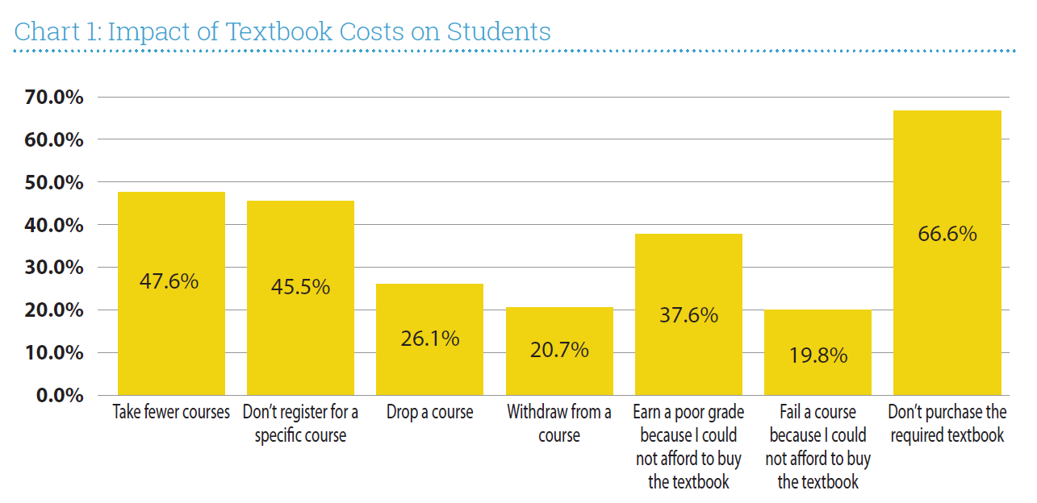
The Textbook Problem #1: Costs
Cost is only a problem because it negatively impacts our Educational Mission
Source: https://www.aei.org/publication/chart-of-the-day-or-century-2/ and Florida Virtual Campus. (2016). 2016 Florida Student Textbook & Course Materials Survey. Tallahassee, FL. Image curtesy of Michigan Tech (CCBY-SA 4.0)

Slide 10
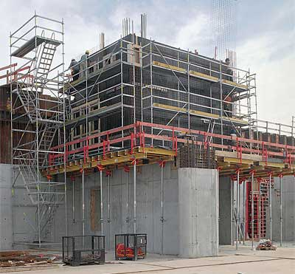
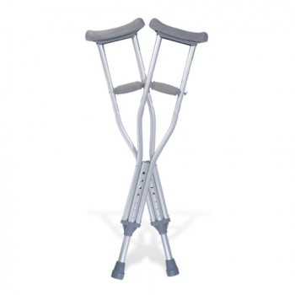
The Textbook Problem #2: Freedom
Textbooks should be tool to aid in the building of a robust knowledge base in students
Textbooks should not be a crutch to limit content development, pedagogy, assessment and advancement

Slide 11
Why are Open Textbooks is the Solution?
OER is the free (or should be)
OER provides the ability for anyone to remix, reuse, and revise the material to better fit their course objectives.
For example, do the materials you currently use provide examples that are inclusive of race, sex, age, and ability? Are they representative of the students taking your course?
Angelique M. Carson

Slide 12
Why don’t faculty use OER?
Not enough OER resources for my subject (49%),
Too hard to find what I need (48%)
There is no comprehensive catalog of OER resources (45%)
Need an online homework systems and other support
Has been designed by faculty to answer these needs
Opening the Textbook: Educational Resources in U.S. Higher Education- Babson Survey Research Group 2016
https://www.onlinelearningsurvey.com/reports/freeingthetextbook2016.pdf

Slide 13
OER Terminology – A Common Tongue
“provides information such as the name and description, reviews, and hyperlinks (metadata) to resources or learning objects …”
Referatory
Benefits: Easy to set up (basically an extended library guide)
Detractions: At the mercy of external projects (e.g., link farming and hot-linking)
is "a central place in which an aggregation of data is kept and maintained in an organized way, usually in computer storage.“ Repositories can be “dead” (e.g., PDF) or “living” based on curation
Repository
Benefits: Stable
Detractions: Dead repositories age rapidly
Authoring
Platform
is an infrastructure that facilitates the creation of OER content. This is typically connected to a repository.

Slide 14
Repositories and Referatories Alone
Will Not Solve the Textbook Problem
OER Libraries
They don’t provide what faculty & students need
High operating costs or network fees
Referatories suffer from linkrot

Slide 15
The Constitution of OER - The Five 5Rs
The LibreTexts is committed to maximizing the impact of the 5R for the community, by building a centralized repository, authoring, and distribution infrastructure designed for unparalleled remixing capability that is freely available to all.
Notes:
Define all the terms quickly… focus on remixing if time permits

Slide 16
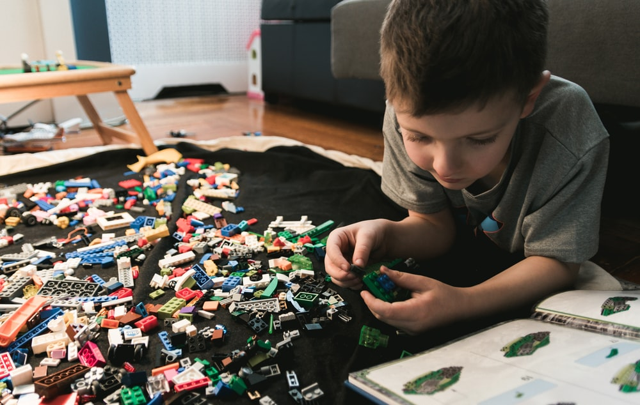
Building an OER Text is a Construction Project
Just with any construction project, there are many options and many formats available for constructing a OER textbook.
Notes:
https://unsplash.com/photos/US9Tc9pKNBU

Slide 17
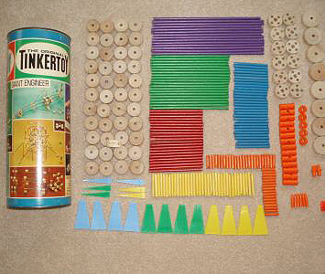
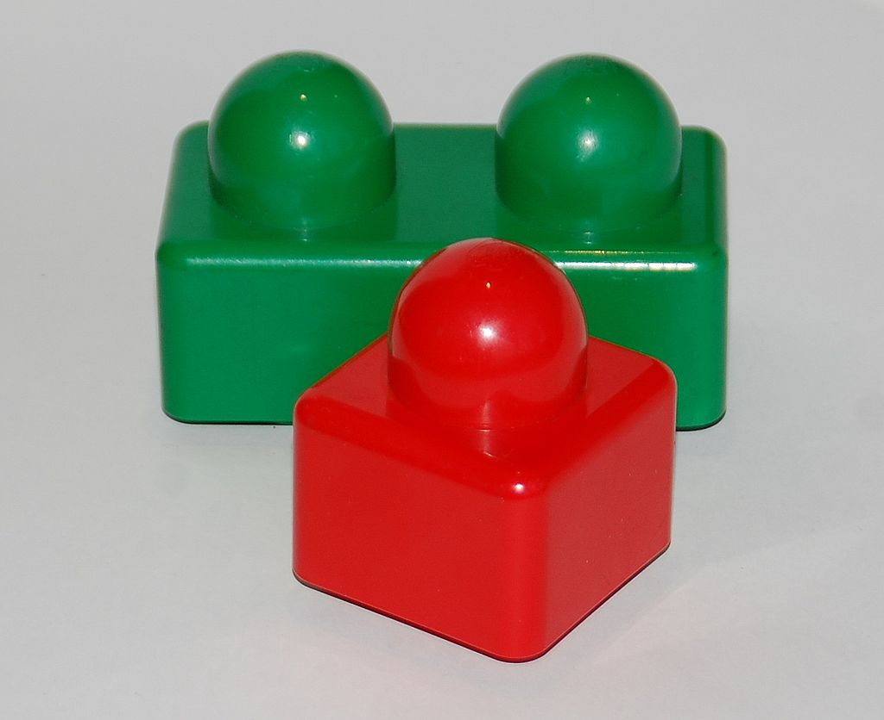
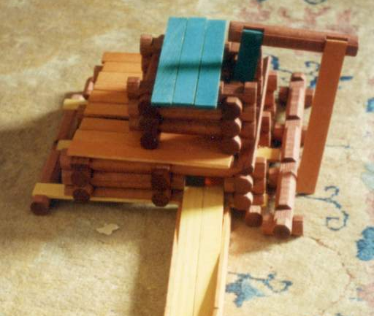
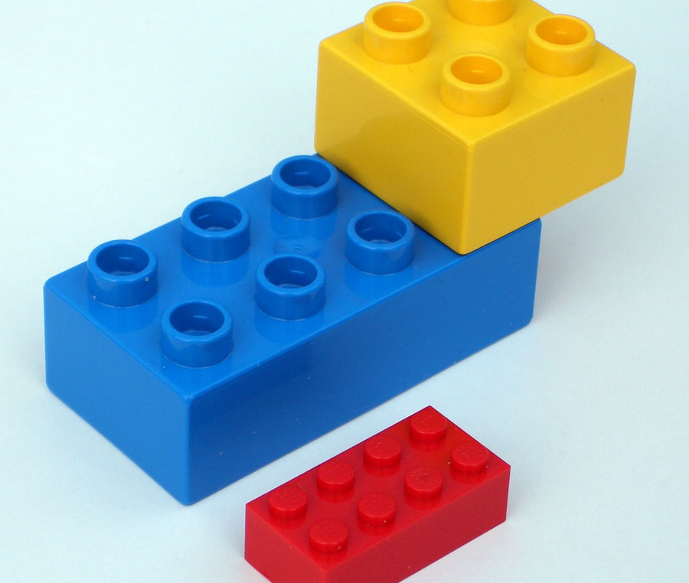
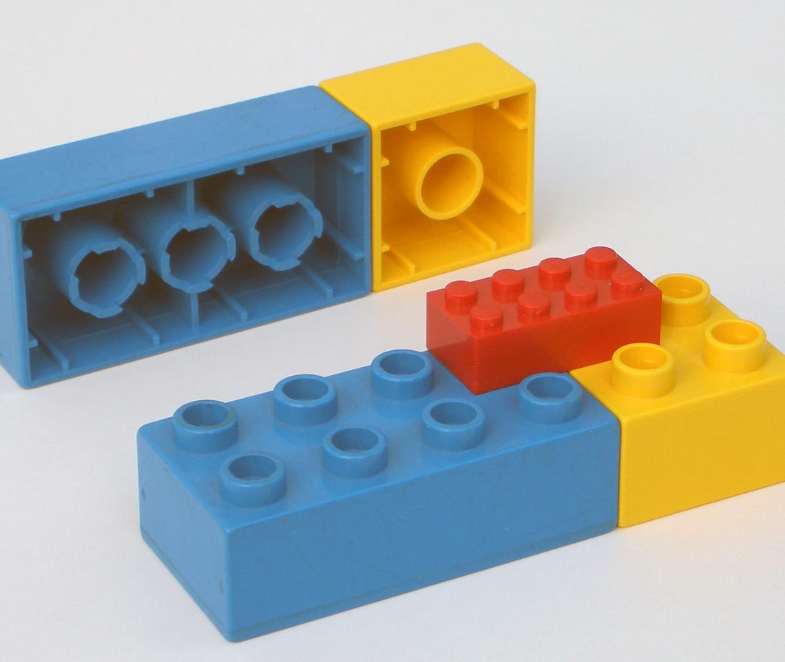
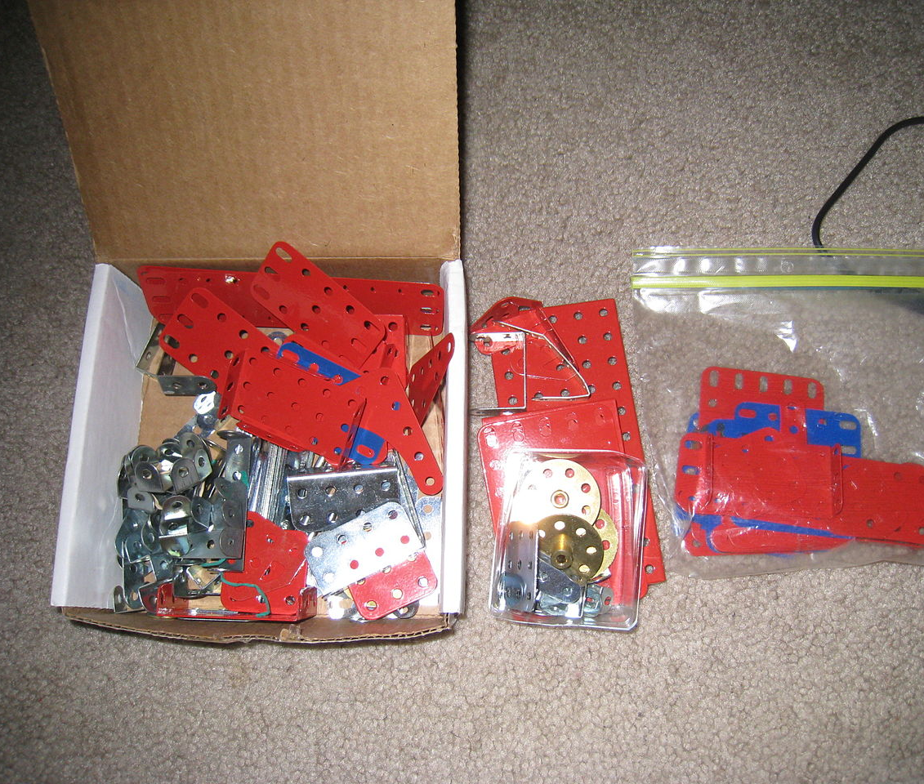
Tinkertoy
Lego Baby
Lincoln Logs
Duplos
Legos
Erector set
Notes:
Duplos: https://en.wikipedia.org/wiki/Lego_Duplo#/media/File:2_duplo_lego_bricks.jpg
https://en.wikipedia.org/wiki/Lincoln_Logs#/media/File:Lincoln_Logs_sawmill.jpg
Toy bricks by LEGO Duplo Primo: https://en.wikipedia.org/wiki/Lego_Baby#/media/File:12-11-03_Duplo_Primo.JPG
https://en.wikipedia.org/wiki/Lego#/media/File:2_duplo_lego_bricks.jpg
https://en.wikipedia.org/wiki/Tinkertoy#/media/File:Tinkertoy_300126232168.JPG
Duplo and regular-sized Lego compatibility demonstrated
https://en.wikipedia.org/wiki/Lego_Duplo#/media/File:Old_duplo_bricks.jpg

Slide 18
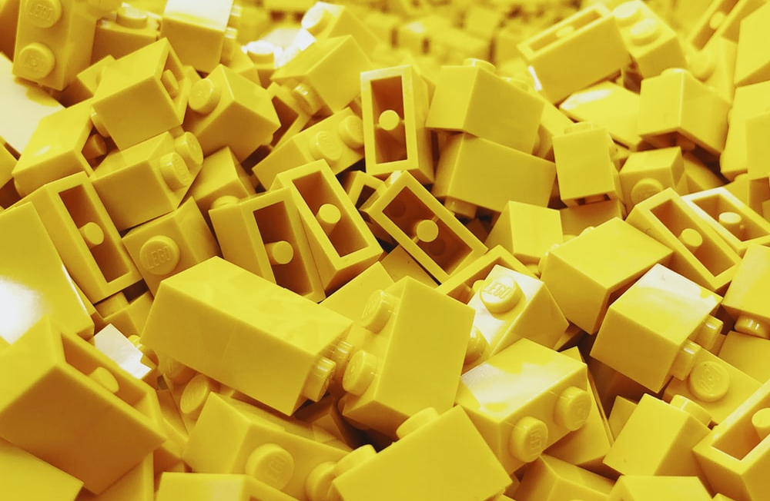
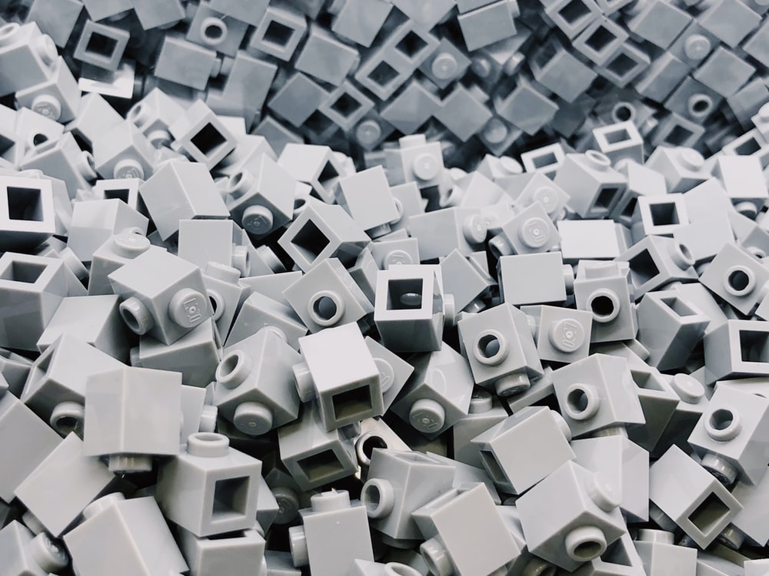
Harvesting Effort Facilitates effective Remixing
Dissect existing OER
Integrate OER into libraries
Standardize existing formatting
Notes:
Yellow: https://unsplash.com/photos/G-HRuwCTR7c
Grey: https://images.unsplash.com/photo-1560961911-dd5c0bdd004a?ixlib=rb-1.2.1&ixid=eyJhcHBfaWQiOjEyMDd9&auto=format&fit=crop&w=500&q=60
https://images.unsplash.com/photo-1560961911-0ac252fecc71?ixlib=rb-1.2.1&ixid=eyJhcHBfaWQiOjEyMDd9&auto=format&fit=crop&w=967&q=80
https://unsplash.com/photos/PzRuJU9v-ochttps://unsplash.com/photos/PzRuJU9v-oc

Slide 19
Conflict Theory Perspective of OER

Slide 20
100 million pageviews last in 2019
Almost ½ billion accumulated pageviews
>1.5 millennia of confirmed Student Reading
Most visited OER project on the net (outside of Wikipedia)
As many Customized Texts (Remixes) as Harvested

Slide 21
Accessing the LibreVerse
query.libretexts.org
adapt.libretexts.org
Query
(Homework)
jupyter.libretexts.org
ADAPT (homework)
Jupyter Notebook
(code)
LMS
LibreTexts Libraries
Forums
Javascript Server
TSUGI
LT LMS
Learning Analytics
Bot
Server

Slide 22
Unique Aspects of the LibreTexts (empowered by Mindtouch’s platform)
Content is Living (defragmented ecosystem)
Content is Modular (at page or Learning Objective level)
Content is Connected (at page to page or meta-connections)
Greater Technology-Enabled Ecosystem (Textbook of the Future)

Slide 23
EFFECTIVE USAGE OF 21ST CENTURY TECH REQUIRES 21ST CENTURY THINKING
The Textbook of the Future is not the Textbook of the past
We need to stop thinking about building OER individual textbooks…
We need to start thinking about building Interconnected OER “textlibraries”…
CC BY 2.0; Stewart Butterfield - flickr

Slide 24
Our Textbook should reflect how we want students to see the world
Silos Compartmentalize Knowledge & Hinder Synergy
Notes:
Silos:
Reduce the identification and usage of the synergy of knowledge/expertise
Concepts are unnecessarily introduced (in different fields).
The underlying concepts are not reinforced with different nomenclature of different fields
Reduces the ability of students to be flexible in their thinking of the utility of their education

Slide 25
The LibreTexts Balancing Act: Centralized vs. Decentralized Approaches
Decentralized
Platform
Centralized
Platform
PROS
Flexibility
CONS
Fragmented Ecosystem
Independent Resources
Inefficient
FOSS is not Free to implement
PROS
High Stability/fidelity
Effective Sharing
Pooled Resources
Efficient
CONS
Lack of Local Control

Slide 27
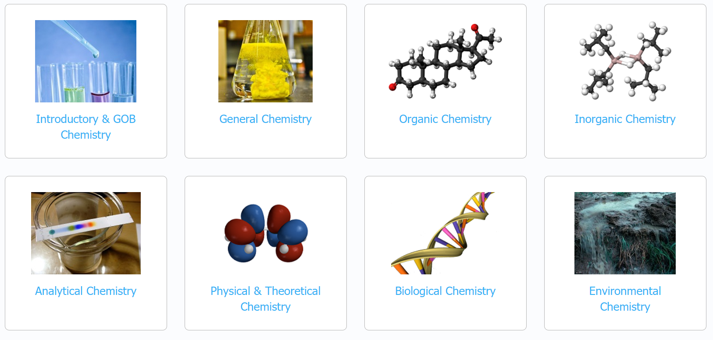
Bookshelves (Centrally Curated OER)

Slide 28
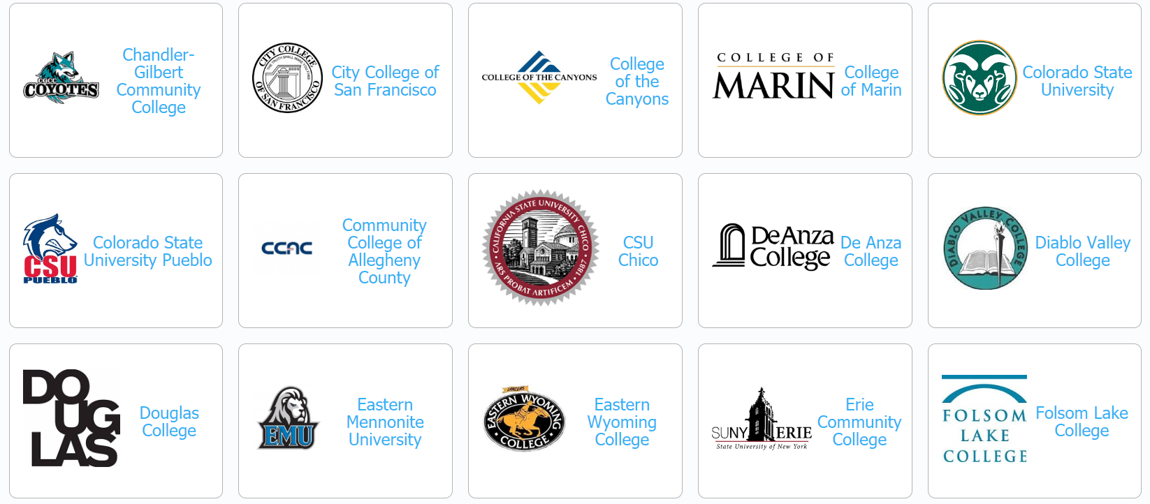
Courses (Customized / Locally Curated)

Slide 29
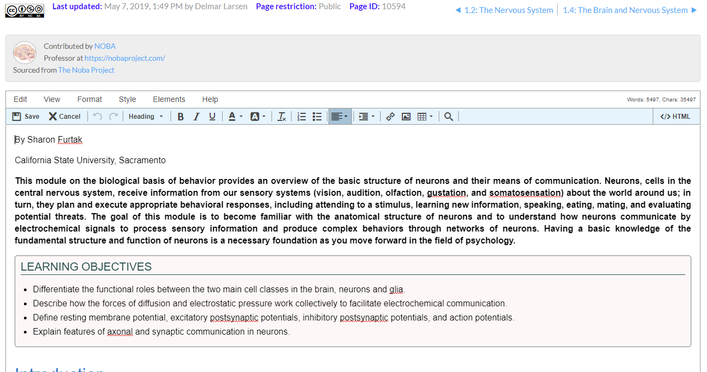
Easy Editing/Construction

Slide 30
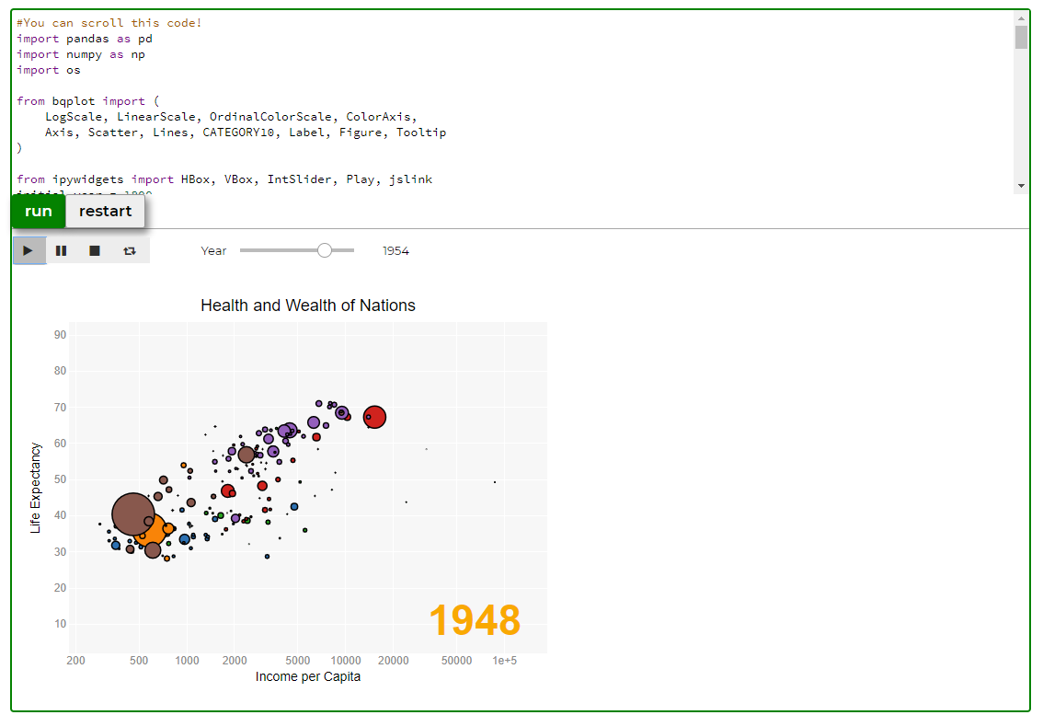
Add Advanced Features
https://libretexts.org/advanced.html

Slide 31
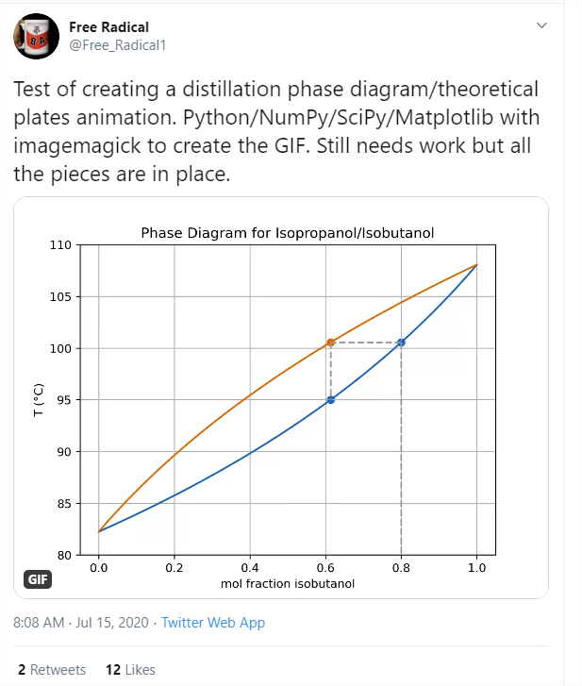
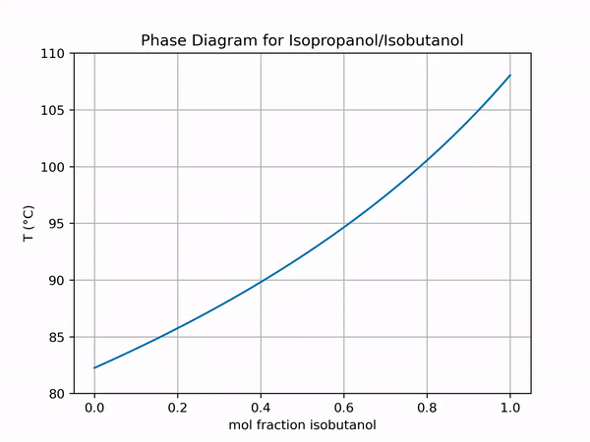
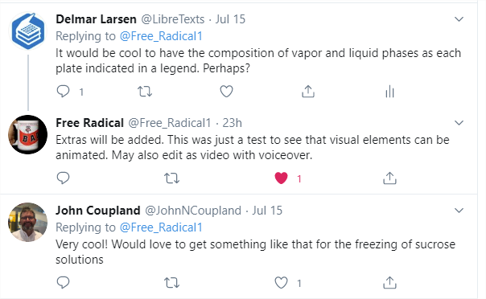
Flexibility + Community = Power
https://twitter.com/Free_Radical1/status/1283418265432272896

Slide 32
The OER Universe
Notes:
https://www.insidehighered.com/digital-learning/article/2018/01/10/finding-oer-remains-challenging-solutions-abound
https://sparcopen.org/our-work/list-of-oer-policies-projects/

Slide 33
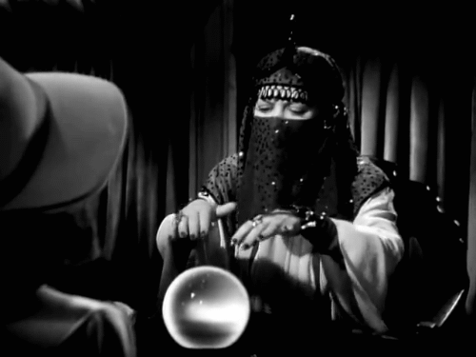
Remixing: Enter The Oracles
OER content is heavily fragmented
Oracles help faculty traverse this fragmented landscape
There are many more important things to do…

Slide 34
Harvesting the OER Universe
Integrate existing OER
Depository/Referatories into LibreTexts
Create Remixing Map
Edit and Typeset to Central Standard
Create New text/course (Remixer)
Cross reference and add Meta-tags for content curations
Reremixing exiting text/course (ReRemixer)
Build an OER Remixer to let faculty rapidly construct customizable texts

Slide 35
Step 1: Prepare a Remixing Map

Slide 36
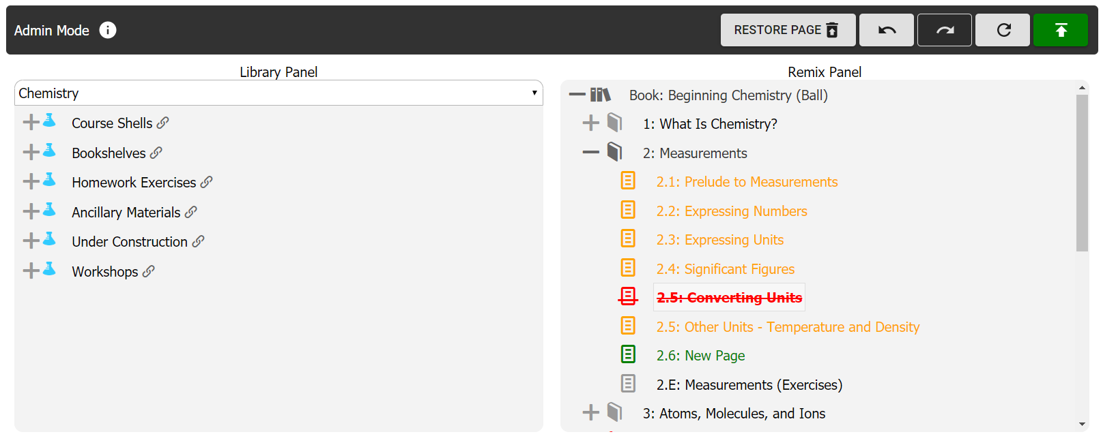
Step 2: Remixer 2.0
The OER Remixer is a self-service tool to rapidly assemble a LibreText from existing sources. This tutorial will include both an explanation of the User Interface as well as a walkthrough of how to do basic tasks.

Slide 37
More than a Textbook: QUERY
https://Query.libretexts.org
Independent
Instructor-led
Course
LMS / Classroom
Grade Book
Modules
Due Dates
LMS Tools
Instructors
Roster/Students
Independent Student
Student 1
Common Cartridge /
Deep Linking
Student 2
Student 3
Tsugi / LOR
LT Content Interactive Tools
Tsugi / MOOC
LT Content
Grade Book
LMS Tools
Interactive Tools
Community
Tsugi / LMS
LT Content
Grade Book
LMS Tools
Interactive Tools
Roster
Student 4
Student 5
LTI Advantage with Grade Return
Campus Analytics
Activity Data
Caliper /
xAPI
LTI Advantage with Grade Return
Caliper / xAPI
LibreTexts Learning Activity Data
Anonymous
Students
MyOpenMath
WeBWork
BeSocratic
Open OChem
Exercise Delivery Applications
Machine Learning/AI
Adaptive Feedback

Slide 38
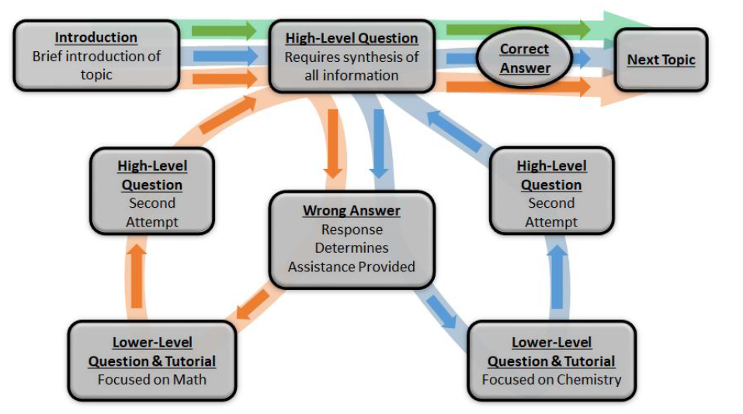
The Next Phase of Homework: QUERY^{AL}
California Education Learning Lab Award 3/20 UCDavis, CSU System, CSU San Bernadino, California CCS, Mendocino College
Design and distribute a free adaptive learning system coupled to LibreTexts books with an open architecture
Linear model with pre-established static decision trees.
Simpler, more intuitive and robust than AI/ML approaches
Easy for faculty to edit to meet the needs of their students and courses.
Comparative studies to quantify the learning outcomes providing feedback for the design and implementations

Slide 39
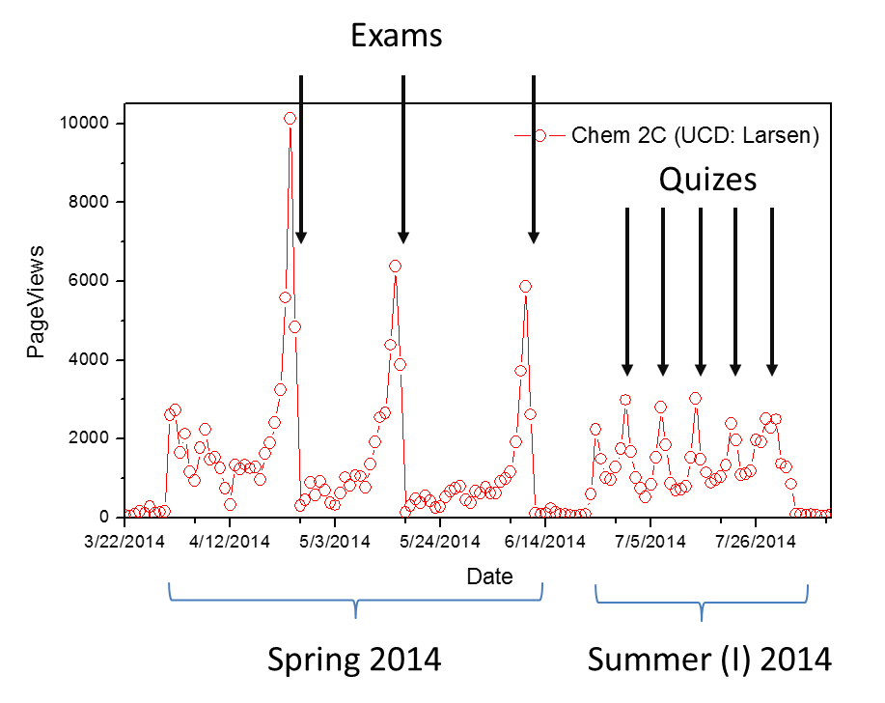
Learning Analytics
Can extract information regarding student study habits.
Clear Cramming
Chemistry Education Research and Practice, 16, 939-948 (2015).

Slide 40
Active Accessibility
Brad Bot
A11Y Bot
Centralized Code and Presentation
Currently 160 Checks per page
Implement accessibility changes (not just a checker, but a “doer”)
ETA: Summer

Slide 41
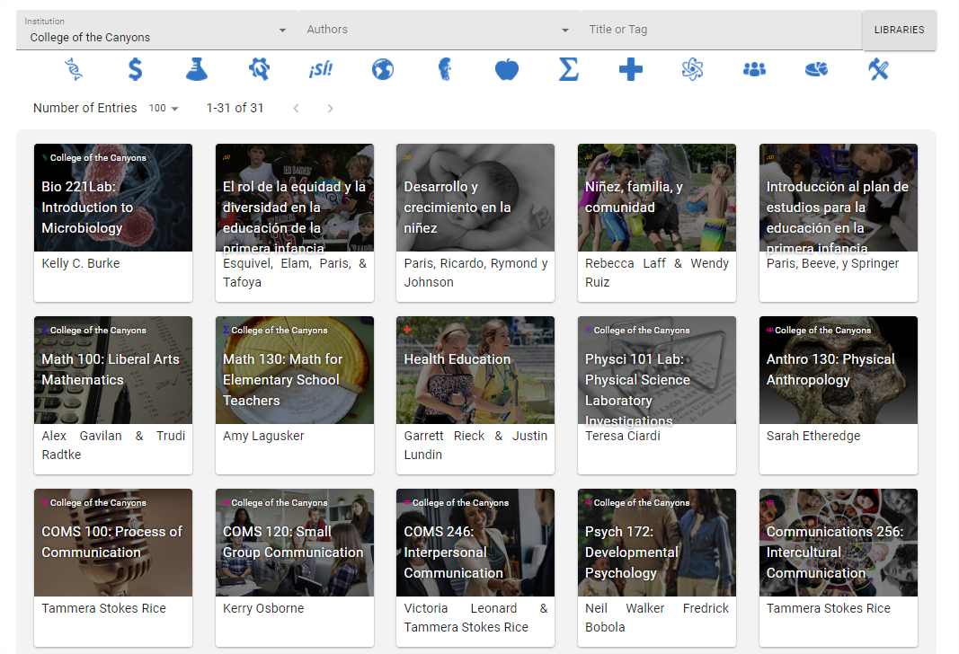
Notes:
Distribution of your books

Slide 42
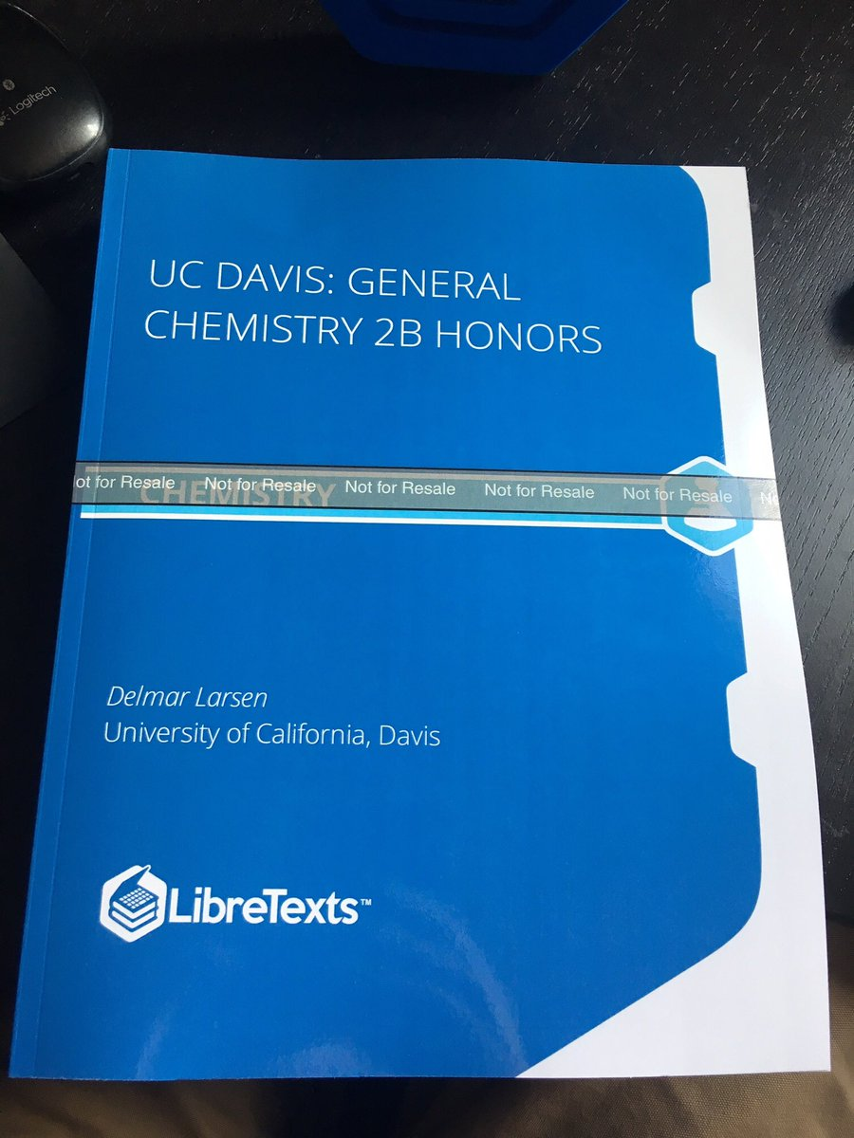
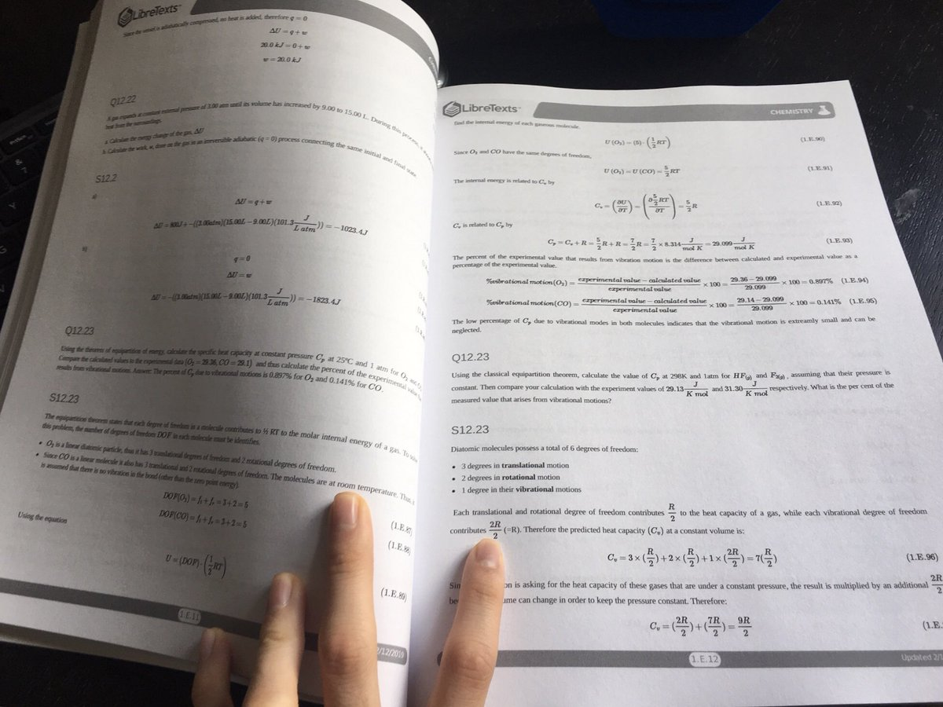
Physical Textbooks
Dissemination: Physical Texts

Slide 43
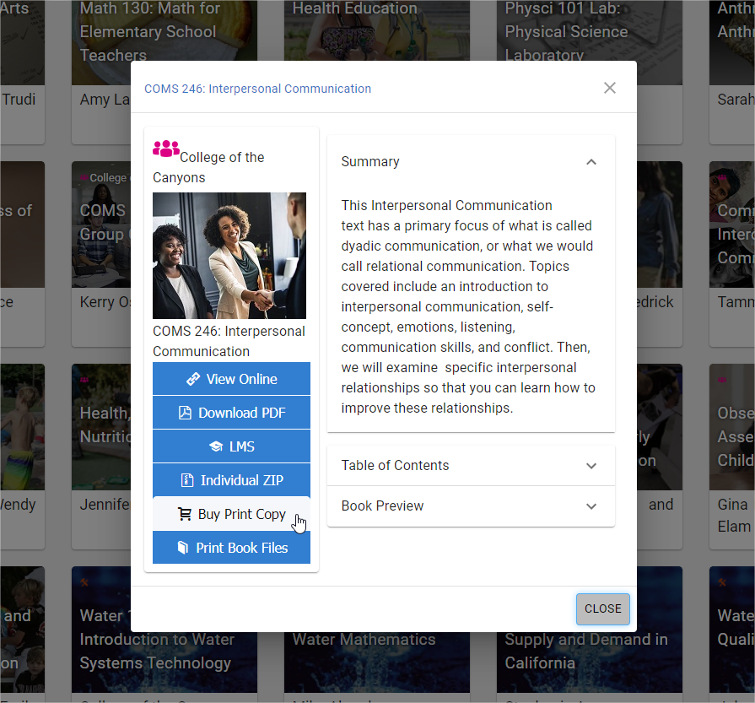
Dissemination: Online Campus Stores
Centrally located Collection of Campus branded OER texts
Available for rapid print-on-demand for students/faculty
At cost – pay only printer and shipping
Branded and Dynamic for Faculty and Campus
Notes:
https://Books.Libretexts.org

Slide 44
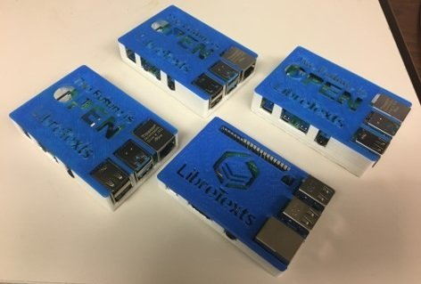
Dissemination: LibreTexts in a Box
The internet is only available to a little over half of the world’s population. The people who typically need these online resources the most, are the very people most likely to lack access to the internet.
Internet-Free LibreTexts
Notes:
We are making slow progress in building the "LibreTexts in a Box" raspberry PI system. Get the box and get access to 100,000 LibreTexts textbook pages offline. Ideal for students in rural area with no high speed access and especially including developing countries = equity.

Slide 45
The LibreTexts Mission
This means Free
This means you
Implementing a Community built OER resource/platform/portal that is Comprehensive and can be Curated at multiple levels.
“No gap Left Behind”
This means a Living Library
“No tech Left Behind”

Slide 46
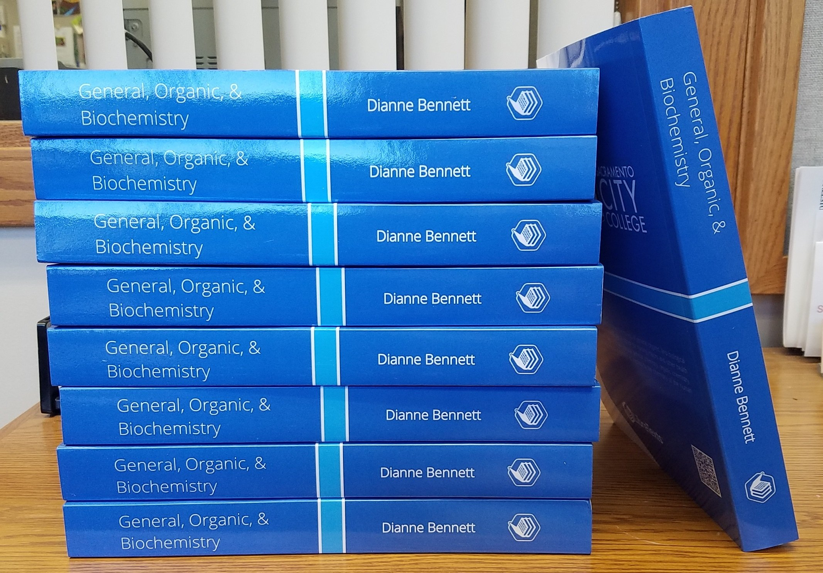
fin

Slide 47
Next LibreFest Scheduled for November 4-6, 2020
https://tinyurl.com/2020LibreFest

Slide 48
Workshop Activity: Remixing a Text
Open the Remixer (in New Text mode)
Type in name of book you are making
Add two chapters (plus button)
Change name of the chapters (double click on new green chapters)
Drag & Drop existing pages into newly created chapters

Slide 49
Scaling LibreTexts
Faculty Feedback
Student Feedback
Gap Analysis
Updating
Curation
Faculty
“Course Reports”
LibreMaps
Remixing
Maps
OER
Remixer
Published
LibreTexts
Classrooms
Team
(Hack-a-thons
& Sprints)
Bookstore
Accessibility
Analytics
Development
Team
Priority
Course Shells Printed Books
Training
Support
Dissemination
LibreNet Consortium

Slide 50
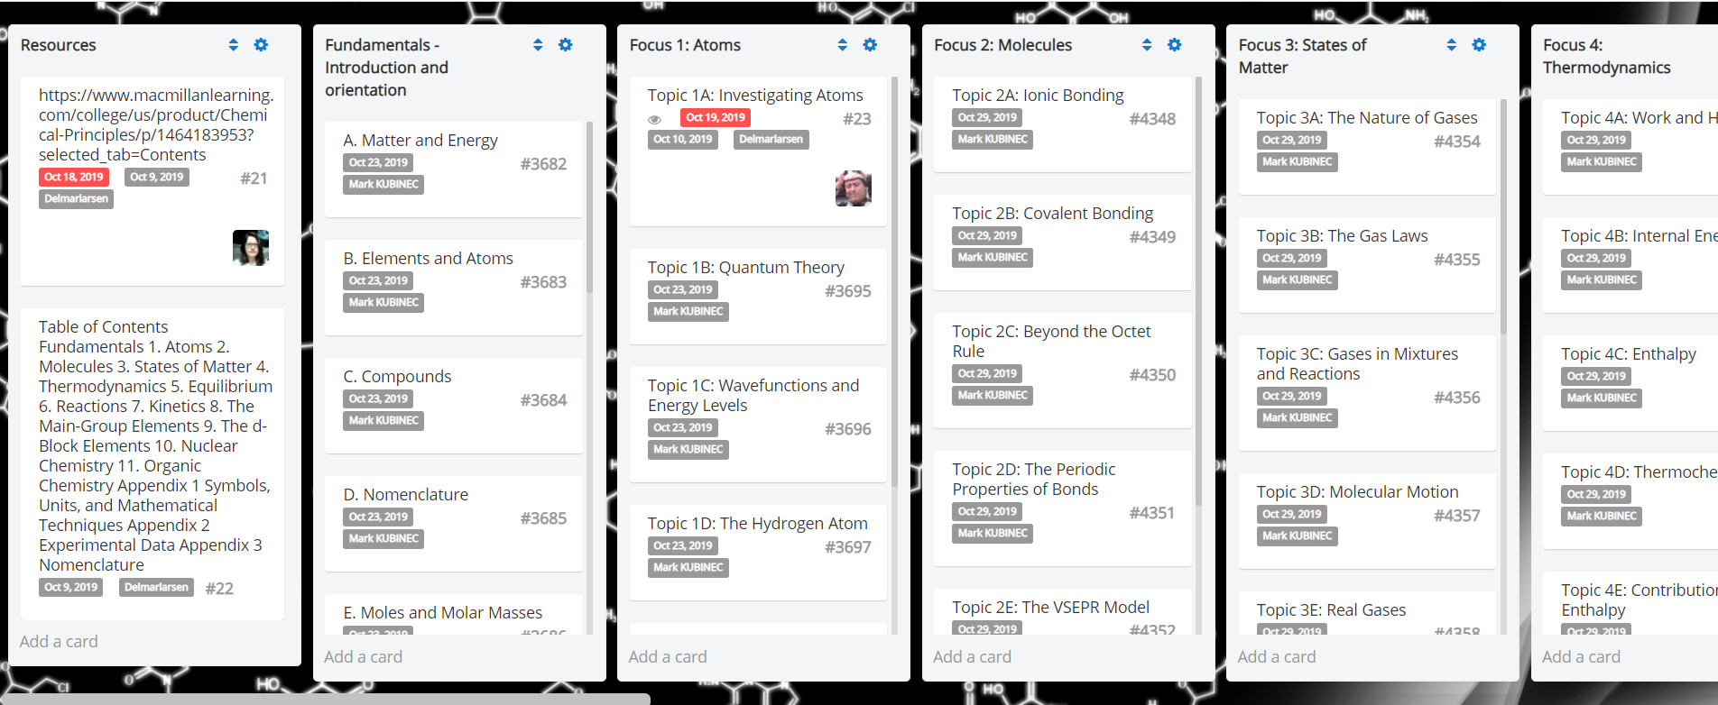
LibreMaps: An organization tool for Content Construction

Slide 51
Sustaining the LibreNET Consortium
On Campus Training
Accessibility review
Support for OER construction
Ancillary materials (Homework systems, test banks, etc.)
Priority access to Development, Technology & Assessment Teams
Advanced Membership
Single Sign On
Institutional Portals
Branding of Physical Texts
More than 10 Course Shells
One click ordering from LibreTexts Print Bookstore
Access to Development, Technology & Assessment Teams
Closed course annotation (hypothesis and note bene)
Base Membership
OER Remixer access
Hosting of OER materials
Up to 10 course shells in a Campus Hub
Printing-on-demand Files for physical texts
Individual Annotations (hypothesis and note bene)
Public Access

Slide 52
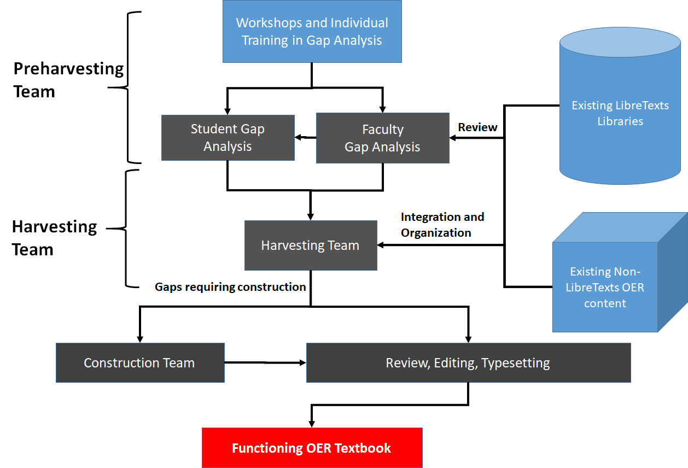
Harvesting Team
Common format allows simple integration and modification

Slide 53
Consortium Membership
Membership has its Privileges
Preservation and Curation of local content
Dissemination of local content
Facilitate/Guide the construction of new content
Reviewing, Adapting, Remixing, Adopting
IT: Costs for setting up a local platform
Access to the LibreTexts development team
Access to studies to confirm efficacy and SOLT studies
Co-Branding/PR
Aid in proposal construction (external and internal)

Slide 54
Three Quarter Evaluation Pilot
Stage 1 (Spring 2014 ): Compare ChemWiki to Conventional Textbook in same Class (Chem 2C at UCD) with same instructor.
Stage 2 (Summer 2014): Assess ChemWiki in same class (Chem 2C), but taught under different conditions (faster pace).
Stage 3 (Fall 2014): Assess ChemWiki in same class (Chem 2A), but with two different instructors.
Independent Evaluation team: iAMSTEM Hub at UC Davis (http://iamstem.ucdavis.edu)
Marco Molinaro
Greg Allen (head TA)
Educause Learning Initiative Brief, Feb. (2015).
Chemistry Education Research and Practice, 16, 939-948 (2015).
Notes:
this is the first large scale (>1000 students), open-access-resource (OER) pilot in the nation and is formulated with Larsen (UCD) teaching two classes back-to-back, with one class (500 students) using the commercial textbook (Petrucci et al.) and the second class (500 students) using the ChemWiki. Assessment protocols include the use of pre/post exams, weekly surveys, paired exam performances, and student-specific correlations between ChemWiki use and performance

Slide 55
Stage 1: Evaluation Protocols
ChemWiki
(class of 550 students)
Petrucci et al.
(class of 550 students)
Pre/post Exams Questions
Pre/post “Notice to Expert Thinking” or “Thinking like a Chemist”
COPUS classroom observations
“The Classroom Observation Protocol for Undergraduate STEM”
Student level Weekly Reading Surveys
Final Pilot Impression Survey
Course Evaluation (at student level via Qualtrics)
Student level ChemWiki usage statistics (who, what, where, when)
Midterm and Final Exam Grades (identical tests)
Course Grades
Future Grades
CBE Life Sci Educ. 2013 Winter; 12(4): 618–627.
Notes:
http://www.ncbi.nlm.nih.gov/pmc/articles/PMC3846513/
The Classroom Observation Protocol for Undergraduate STEM (COPUS): A New Instrument to Characterize University STEM Classroom Practices
Michelle K. Smith,* Francis H. M. Jones,† Sarah L. Gilbert,‡ and Carl E. Wieman‡
Erin L. Dolan, Monitoring Editor
Author information ► Article notes ► Copyright and License information ►

Slide 56
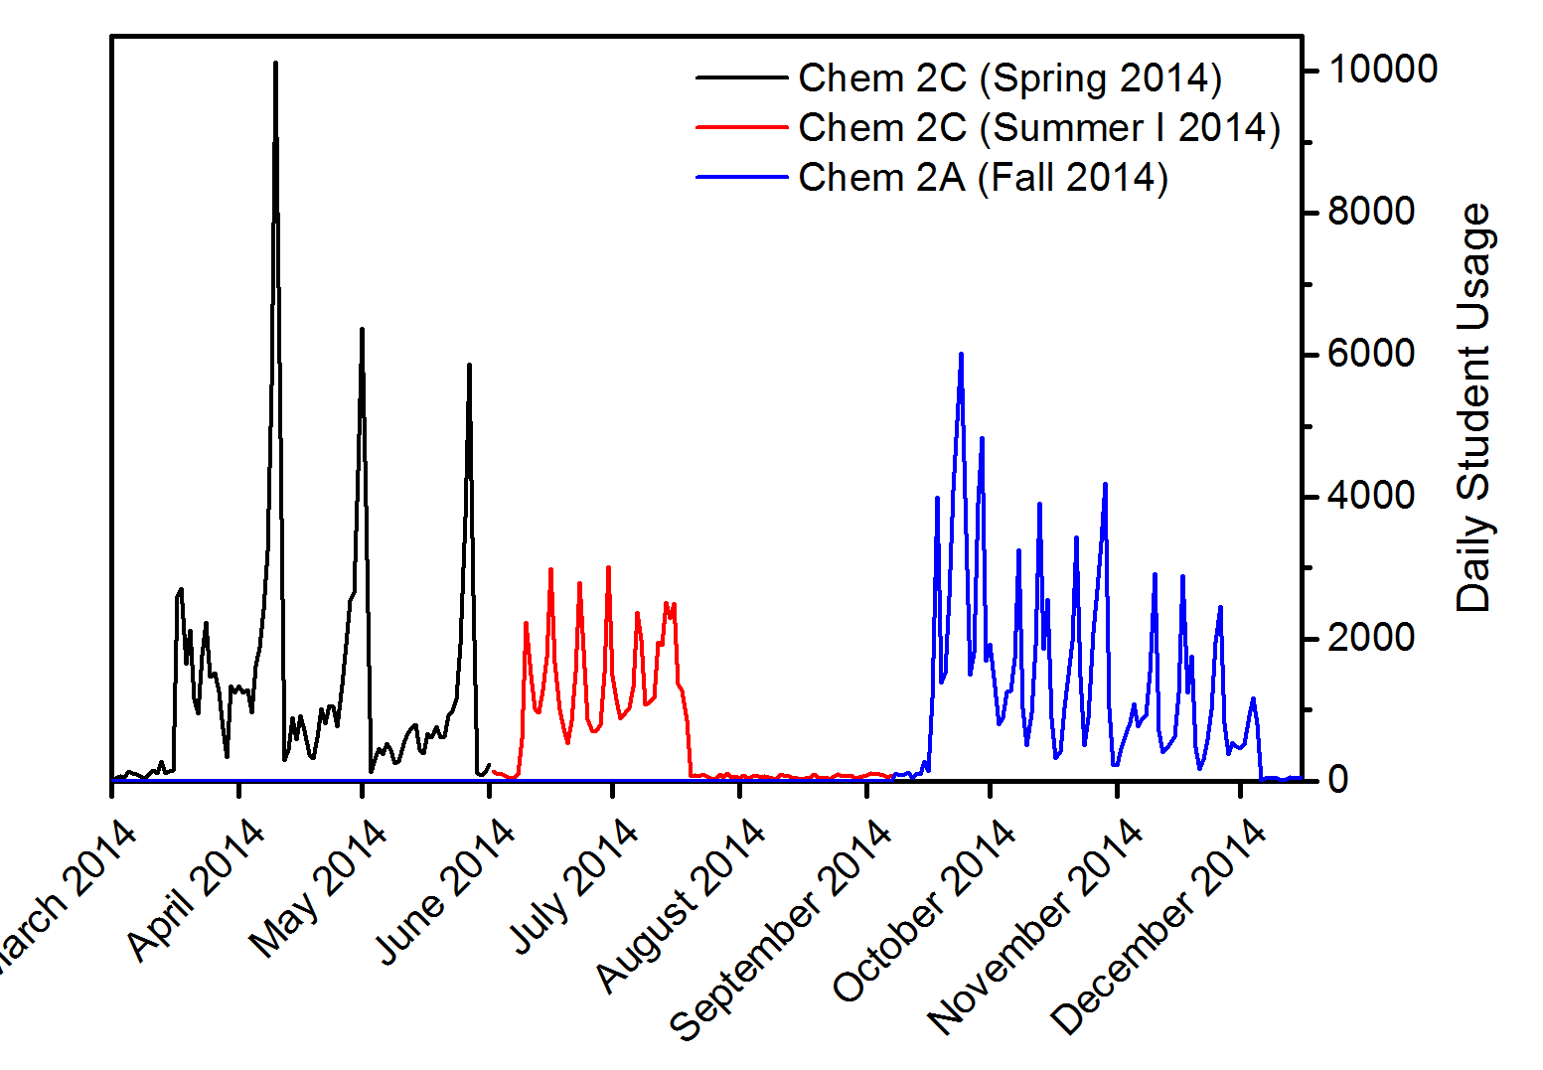
Stage 1: Evaluation Protocols
Daily traffic for student usage of Libretexts for the LibreTexts pilot. Spikes originate from students “cramming” before exams and quizzes.

Slide 57
Exam Performance
Daily Wikitext usage (only ChemWiki class students)
Exam #1
Exam #2
Mean: 61.3%
Std: 14.6%
Mean: 73.65%
Std: 11.9%
The exam performances are statistically identical for both classes
Mean: 60.8%
Std: 14.9%
Mean: 72.9%
Std: 12.4%

Slide 58
Many Variables are Measured (Propensity-Score Matching)
Ordinary Least Squares Regression Model Estimating Effects of ChemWiki on the Post Score Utilizing a Non-Inferiority Framework (Chemistry Education Research and Practice, 16, 939-948 (2015))
Variable | Post-test | Midterm 1 | Midterm 2 | Final Exam | Total Exam Points | Course Grade
Constant | 70.37*** | 63.89*** | 75.84*** | 38.39*** | 69.80*** | 75.05***
ChemWiki (90% CI) | 0.09 (-1.22, 1.39) | -1.45 (-3.12, .22) | 0.34 (-1.05, 1.73) | -0.01 (-.72, .71) | -0.33 (-1.53, .87) | -0.48 (-1.66, .69)
Pre Assessment | 0.43*** | 0.53*** | 0.35*** | 0.25*** | 0.45*** | 0.42***
First Generation | -1.75 | -1.97 | -2.04 | -0.43 | -1.47 | -1.61
Low Income | 1.40 | -0.16 | 0.88 | -0.09 | 0.13 | 0.41
URM | -0.65 | -1.83 | -0.39 | -0.66 | -1.16 | -0.63
Male | 2.59** | -1.24 | 1.67 | 1.11* | 0.98 | 0.53
Previous Units | -0.05** | -0.12*** | -0.03 | -0.05*** | -0.08*** | -0.09***
SAT Total | 0.01*** | 0.01 | 0.01* | 0.01** | 0.01** | 0.01**
STEM Major | 0.92 | 2.56 | 0.55 | 1.00 | 1.68 | 1.52
Transfer | -0.90 | -6.54* | -4.29 | -2.47* | -5.03* | -4.20*
R² | .26 | .24 | .16 | .30 | .30 | .28
* p < .05 ** p < .01 *** p < .001 NOTE: All dependent variables are in percentage points; The equivalency margin for non-inferiority is ±2%

Slide 59
Stage 1: Evaluation Protocols
Daily traffic for student usage of Libretexts for the LibreTexts pilot. Spikes originate from students “cramming” before exams and quizzes.

Slide 60
Exam Performance
Daily Wikitext usage (only ChemWiki class students)
Exam #1
Exam #2
Mean: 61.3%
Std: 14.6%
Mean: 73.65%
Std: 11.9%
The exam performances are statistically identical for both classes
Mean: 60.8%
Std: 14.9%
Mean: 72.9%
Std: 12.4%

Slide 61
Many Variables are Measured (Propensity-Score Matching)
Ordinary Least Squares Regression Model Estimating Effects of ChemWiki on the Post Score Utilizing a Non-Inferiority Framework (Chemistry Education Research and Practice, 16, 939-948 (2015))
Variable | Post-test | Midterm 1 | Midterm 2 | Final Exam | Total Exam Points | Course Grade
Constant | 70.37*** | 63.89*** | 75.84*** | 38.39*** | 69.80*** | 75.05***
ChemWiki (90% CI) | 0.09 (-1.22, 1.39) | -1.45 (-3.12, .22) | 0.34 (-1.05, 1.73) | -0.01 (-.72, .71) | -0.33 (-1.53, .87) | -0.48 (-1.66, .69)
Pre Assessment | 0.43*** | 0.53*** | 0.35*** | 0.25*** | 0.45*** | 0.42***
First Generation | -1.75 | -1.97 | -2.04 | -0.43 | -1.47 | -1.61
Low Income | 1.40 | -0.16 | 0.88 | -0.09 | 0.13 | 0.41
URM | -0.65 | -1.83 | -0.39 | -0.66 | -1.16 | -0.63
Male | 2.59** | -1.24 | 1.67 | 1.11* | 0.98 | 0.53
Previous Units | -0.05** | -0.12*** | -0.03 | -0.05*** | -0.08*** | -0.09***
SAT Total | 0.01*** | 0.01 | 0.01* | 0.01** | 0.01** | 0.01**
STEM Major | 0.92 | 2.56 | 0.55 | 1.00 | 1.68 | 1.52
Transfer | -0.90 | -6.54* | -4.29 | -2.47* | -5.03* | -4.20*
R² | .26 | .24 | .16 | .30 | .30 | .28
* p < .05 ** p < .01 *** p < .001 NOTE: All dependent variables are in percentage points; The equivalency margin for non-inferiority is ±2%

