Slide 1
Program Review Driving Curricular Revisions
ASCCC Curriculum Institute 2018
July 13, 2:15-3:30pm, Riverside, CA
Dr. Kim Harrell, Dean of Careers & Technology, Cosumnes River College
Dr. Daniel Keller, Dean of Curriculum and Instructional Support Services, Los Angeles Community College District
Dr. Leandra Powell Martin, Vice President of Instruction, Mission College
Notes:
Dan

Slide 2
Why program review?
Notes:
Dan

Slide 3
The carrot
How aligned are our academic programs in achieving the mission of the college?
What are the educational needs of students in our region?
What are the workforce needs in our region?
What programs do we have?
Are they thriving (high enrollment & completers)?
Are they struggling? If so why?
Can a curricular fix rejuvenate the program?
Is the program still relevant?
Notes:
Dan

Slide 4
The stick
Accreditation
I.B.5: The institution assesses accomplishment of its mission through program review and evaluation of goals and objectives, student learning outcomes, and student achievement. Quantitative and qualitative data are disaggregated for analysis by program type and mode of delivery.
II.A.16: The institution regularly evaluates the quality and currency of all instructional programs offered in the name of the institution, including collegiate, pre-collegiate, career-technical, and continuing and community education courses and programs regardless of delivery mode or location. The institution systematically strives to improve programs and courses to enhance learning outcomes and achievement for students.
Notes:
Dan

Slide 5
The stick
§ 78016 (a) Every vocational or occupational training program offered by a community college district shall be reviewed every two years by the governing board of the district to ensure that each program, as demonstrated by the California Occupational Information System, including the State-Local Cooperative Labor Market Information Program established in Section 10533 of the Unemployment Insurance Code, or if this program is not available in the labor market area, other available sources of labor market information, does all of the following:
(1) Meets a documented labor market demand.
(2) Does not represent unnecessary duplication of other manpower training programs in the area.
(3) Is of demonstrated effectiveness as measured by the employment and completion success of its students.
(b) Any program that does not meet the requirements of subdivision (a) and the standards promulgated by the governing board shall be terminated within one year.
Notes:
Dan

Slide 6
Translating needs into curriculum
Needs
Advisory committee recommendations
Lower-division transfer patterns
Contract, AB288, community interest, etc.
Objectives, learning outcomes
Programs and courses
Notes:
Kim

Slide 7
Data
Completer trends
Factors that affect them
Convenience of registration
Availability of courses (open sections, scheduling)
Financial aid
Support services
Other
Doing it better
Notes:
Kim

Slide 8
Required Coursework
Credit vs. noncredit
Core vs. elective
Units, hours, and program length
Are there some courses that should be added?
Are there courses that are unnecessary?
How do the required courses map to the program learning outcomes?
Notes:
Kim

Slide 9
Limitations on Admission
Mandated vs. self-imposed
Clinical hours
Prerequisite coursework
Corequisites
Certifications and clearances
Notes:
Kim

Slide 10
Course Sequencing
Pre/Corequisite structure
SAM coding (of CTE courses)
Pathways
Notes:
Kim

Slide 11
Hours and Units
More time or better time?
Class time vs. number of classes
Out-of-class expectations
Cost
Per-unit tuition, fees
Opportunity cost (time away from work)
Full vs. part-time students
Length of program
Notes:
Leandra

Slide 12
Suitability
Student success
Convenience vs. attrition
Support services
Notes:
Leandra

Slide 13
Support
Courses Services
Noncredit vs. credit Mentoring
Pre- vs. Corequisite Tutoring
Other
Notes:
Leandra

Slide 14
What are some best practices at your college?
Notes:
Leandra

Slide 15
I don’t think my program is relevant any longer…
Now what?
How can I best utilize this FTE for students?
What is the difference between a viability study and program discontinuance?
Why is “why” so important?
Notes:
Dan

Slide 16
Why?
Enrollment is down, completers are down—why?
Causes
Solutions
Committing resources for the right amount of time
Notes:
Dan

Slide 17
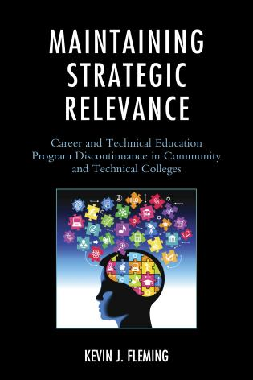
If discontinuance is the right choice…
How do you make it benefit your students?
“Teach-out” process
Course substitution
Strengthening other programs
Notes:
Kim

Slide 18
What have you done in this situation?
Notes:
Leandra

Slide 19
References
ACCJC Eligibility Requirements for Accreditation
Adopt "Program Review: Setting a Standard"
Adoption of "Program Review: Developing a Faculty Driven Process"
Doing What Matters Program Viability Tool Kit
Notes:
Leandra

