Slide 1
What is our why? 10+1…and other numbers
Ginni May, Area A Representative, ASCCC Guided Pathways Task Force
Michelle Pilati, Rio Hondo College, ASCCC Lead, Guided Pathways Tool Development
ASCCC Guide Pathways Regional Meetings 2018
May 11 (Pasadena City College) and May 12 (Evergreen Valley College)

Slide 2
Overview
Why Guided Pathways?
ASCCC and Guided Pathways – By the Numbers..
KPIs
Making the Case
What is your why?

Slide 3
Governance – The 10+1: Title 5 §53200
(c) “Academic and professional matters” means the following policy development and implementation matters:
curriculum, including establishing prerequisites and placing courses within disciplines;
degree and certificate requirements;
grading policies;
educational program development;
standards or policies regarding student preparation and success;
district and college governance structures, as related to faculty roles;
faculty roles and involvement in accreditation processes, including self-study and annual reports;
policies for faculty professional development activities;
processes for program review;
processes for institutional planning and budget development; and
other academic and professional matters as are mutually agreed upon between the governing board and the academic senate.

Slide 4
4.o

Slide 5
Four Pillars of Guided Pathways
Notes:
.

Slide 6
The Four “Pillars”
Four Pillars of Guided Pathways
Clarify the Path
Enter
the Path
Stay on the Path
Ensure Learning
Create Clear
Curricular
Pathways to
Employment
and Further
Education
Help Students
Choose and Enter Their
Pathway
Help Students
Stay on
Their Path
Follow Through, and Ensure that Better Practices are Providing Improved Student Results.

Slide 7
The 10+1 and Guided Pathways
CLARIFY -Clear pathways and programs
Curriculum
ENTER-Guided Exploration and Progress
Curriculum
ENSURE - Academic and Student Support
Curriculum
STAY-Teaching and Learning
Educational Programs
Degree and Certificate Requirements
Student Preparation and Success
Student Preparation and Success
Educational Programs
Student Preparation and Success
Educational Programs
Student Preparation and Success
Curriculum
Grading Policies

Slide 8
The Student 9+1 and Guided Pathways
Clear pathways and programs
Curriculum Development
Guided Exploration and Progress
Curriculum Development
Academic and Student Support
Curriculum Development
Teaching and Learning
Course/Program Initiation or Discontinuance
Student Preparation and Success
Student Preparation and Success
Course/Program Initiation or Discontinuance
Student Preparation and Success
Course/Program Initiation or Discontinuance
Student Preparation and Success
Curriculum Development
Grading Policies
Notes:
Title 5 § 51023.7 Students.

Slide 9
Guided Pathways in CA – By the numbers
AACC Pathways Project - 3 + 1
“Homegrown” Pathways - 2
California Guided Pathways Project – 20
California Guided Pathways Award Program - 114
Legislation…

Slide 10
Legislation
AB 705
Speed up remediation
AB 19
College Promise (formerly known as BOG Fee Waiver) funding is only available to colleges that are part of the Guided Pathways Award Program

Slide 11
Looking at the Numbers
What do the legislators see?
Do you know the numbers at your college?
Anecdotal stories
What are you hearing?
Are you listening?
Should you listen?
Do the numbers tell you the “why”?

Slide 12
From CCCCO Data Mart
Student Unit Load | Fall 2015 | Fall 2016 | Fall 2017 | Fall 2018
Less than 6 units | 28.04% | 29.09% | 29.04% | ?
6 units to less than 12 units | 33.27% | 33.06% | 32.75% | ?
12 or more units | 29.56% | 28.85% | 28.96% | ?
Enrollment Status | Fall 2015 | Fall 2016 | Fall 2017 | Fall 2018
First-time | 17.10%% | 17.27% | 17.09% | ?
First-time transfer | 8.07% | 7.75% | 8.23% | ?
Returning | 11.13% | 10.99% | 11.69% | ?
Continuing | 57.01% | 57.20% | 55.62% | ?
Notes:
Sample data

Slide 13
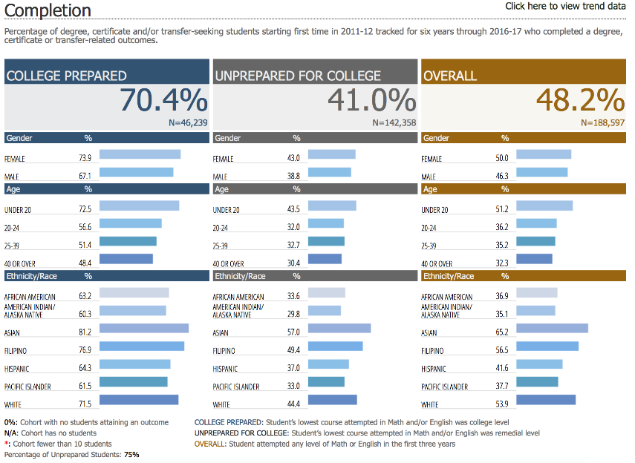
Notes:
Sample data

Slide 14
Key Performance Indicators (KPI’s)
Available at the LaunchBoard Guided Pathways tab for all colleges
www.calpassplus.org/LaunchBoard/guidedpathways.aspx
Cal-PASS Plus password needed
Have you considered your KPIs?

Slide 15
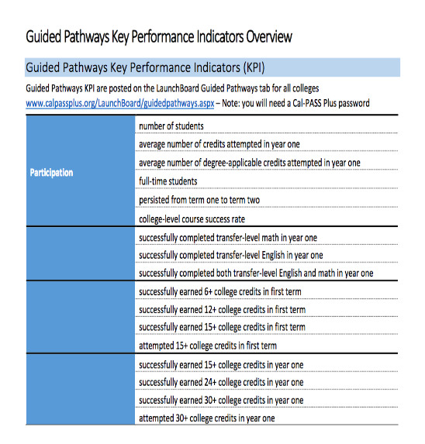
KPIs

Slide 16
Completion & Momentum Metrics
CCRC, NCII, & others help identify shorter, more predictive set of “momentum” metrics
(*) College-level credit thresholds (15+, 24+, 30+ units in 1st year; 6+ and 12+ units in 1st term)
(*) Gateway Math & English Completion in 1st Year
Fall-to-Spring Persistence
College level Course Pass Rate
Units Attempted in 1st Term / 1st Year
All data that follows are for the Fall 2016 cohort from an unidentified CCC

Slide 17
FTEIC Credit Threshold Attainment in 1st Year
Notes:
“First time ever in college”/CL – college level

Slide 18
FTEIC Credit Threshold Attainment in 1st Term

Slide 19
FTEIC Passing College Level Math & English in Year One

Slide 20
College Level Persistence & Course Pass Rate

Slide 21
Fall 2016 Demographics for FTEIC
Note – provided comparison data point is the “median”, ½ of our colleges are higher and ½ are lower.
Is our sample college “typical”?
As a backdrop to the previous slides, here are some key demographics for the Fall 2016 FTEIC cohort:
55% male, 45% female
88% traditional college age
32% full-time
95% college ready
What questions do you need answered to fully understand these data?
What conclusions can we make about the causal factors behind student success?

Slide 22
What’s acceptable?
Considering the course-taking patterns of your students, are you serving your students well?
Is there room for improvement?
Do your students believe they are well-served?
Could guided pathways be the answer?

Slide 23
Determining your “why”
Improve student experience?
Optimize student success?
Required?
The 10+1…

Slide 24
How do we start?
Governance
Curriculum
Student Services

Slide 25
Questions and Comments

