Slide 1
Racial Justice Through Culturally Responsive Teaching & Learning in STEM

Slide 2
PRESENTERS
Angela Echeverri, Los Angeles Mission College
Karla Kirk, ASCCC North Representative
Roberto Rubalcaba, San Diego City College
Robert L Stewart Jr, ASCCC Area C Representative
Eric Wada, Folsom Lake College

Slide 3
Breakout Session Description
STEM (Science, Technology, Engineering and Math) is an interdisciplinary approach to learning where rigorous academic concepts are coupled with real-world lessons as students apply science, technology, engineering, and mathematics in contexts that make connections between school, community, work, and the global enterprise. This enables the development of STEM literacy and with it the ability to compete in the international STEM economy. It is important that the instruction and interaction in our classrooms allow students to maintain the integrity of their cultural identity, while succeeding academically and socially-emotionally. Culturally responsive STEM teaching and learning allows faculty to use aspects of students’ cultures in an asset-based approach as opposed to deficit-based to make STEM concepts relevant to them, and increase their skill acquisition, engagement, and learning outcomes. Please join us in this very important conversation about decreasing the racial divide and increasing racial justice in STEM teaching and learning.

Slide 4
Session Outcomes
Understand what STEM means and some examples of areas of study
Understand that there are disproportionate numbers of Black, Brown and Indigenous student representation in STEM majors, STEM postsecondary and graduate degrees, and subsequently STEM faculty and STEM jobs, relative to their white counterparts
Understand Racial Justice and how it applies to the Racial Equity gaps in STEM
Contemplate and Discuss potential reasons for the racial equity gap in STEM students in higher education, STEM faculty at any level of education, and non-faculty STEM jobs?
Define Culturally Responsive Teaching and Learning and understand why Culturally Responsive Teaching and Learning in STEM is important for Black, Brown and Indigenous students?
View demonstrations of Culturally Responsive Teaching in STEM
Gain some historical context for Black, Brown and Indigenous peoples and STEM to counter the narrative that underrepresented students of color cannot do STEM.

Slide 5
What In The World Is STEM?
STEM (Science, Technology, Engineering and Math) is an interdisciplinary approach to learning where rigorous academic concepts are coupled with real-world lessons as students apply science, technology, engineering, and mathematics in contexts that make connections between school, community, work, and the global enterprise.
Some areas of discipline that fall under STEM would be: Biology, Chemistry, Mathematics, Computer Science, Computer Technology, Civil Engineering, Biomechanical-engineering, Chemical Engineering, Electrical Engineering, Mechanical Engineering, Aerospace Engineering, Physics, Astronomy, Geology, Information Technology, Biotechnology, Nuclear Technology, Communication Technology, Medical Technology, Electronics Technology, Health Sciences, etc.

Slide 6
What is Racial Justice?
Williams Colleges’ Diversity, Inclusion and Equity statement says that “Racial justice is the systematic fair treatment of people of all races, resulting in equitable opportunities and outcomes for all. Racial justice initiatives address structural and systemic changes to ensure equal access to opportunities, eliminate disparities, and advance racial equity—thus ensuring that all people, regardless of their race, can prosper and reach their full potential”.
What then does Racial Justice have to do with STEM education, or education in general?
https://diversity.williams.edu/racial-justice/

Slide 7
Equity Is Rooted In Racial Justice
Estela M. Bensimon at USC’s Center for Urban Education calls for Racial Equity and Racial Justice in Education
What should colleges be doing:
Acknowledge that equity is rooted in racial justice
Value work by faculty done on behalf of racial equity
Hire more faculty of color and faculty who are equity-minded
Prioritize hiring first-generation faculty who are also people of color
https://rossier.usc.edu/racial-equity-in-education-seven-key-points/

Slide 8
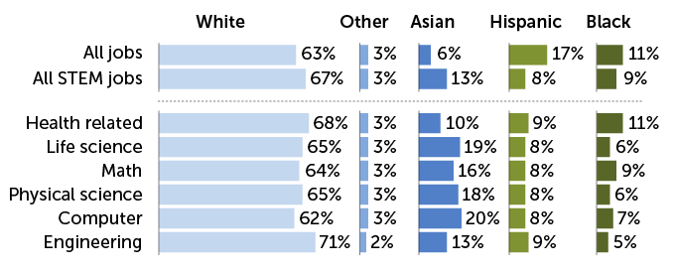
STEM DATA
Employment data from 2017-2019 show that Black and Hispanic professionals are underrepresented in STEM, compared with their share of the overall U.S. workforce. Asian and white workers, on the other hand, are overrepresented in STEM.
PEW RESEARCH CENTER, E. OTWELL/SCIENCE NEWS

Slide 9
STEM Education Diversity
Current diversity in STEM education mirrors gaps in workforce representation
Black and Hispanic students are less likely to earn degrees in STEM than in other fields. For instance, Black students earned 7 percent of bachelor’s degrees in STEM in 2018 (the most recent year with available data) — lower than their 10 percent share of all bachelor’s degrees that year. White and Asian students, on the other hand, are overrepresented among STEM college graduates.
Black and Hispanic students are also underrepresented among those earning advanced STEM degrees.

Slide 10
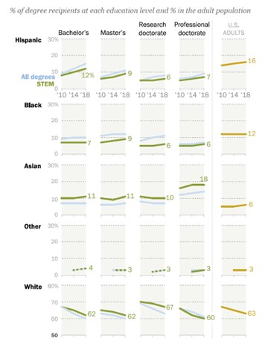
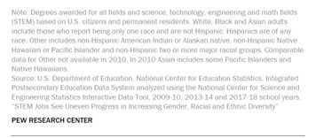

Slide 11
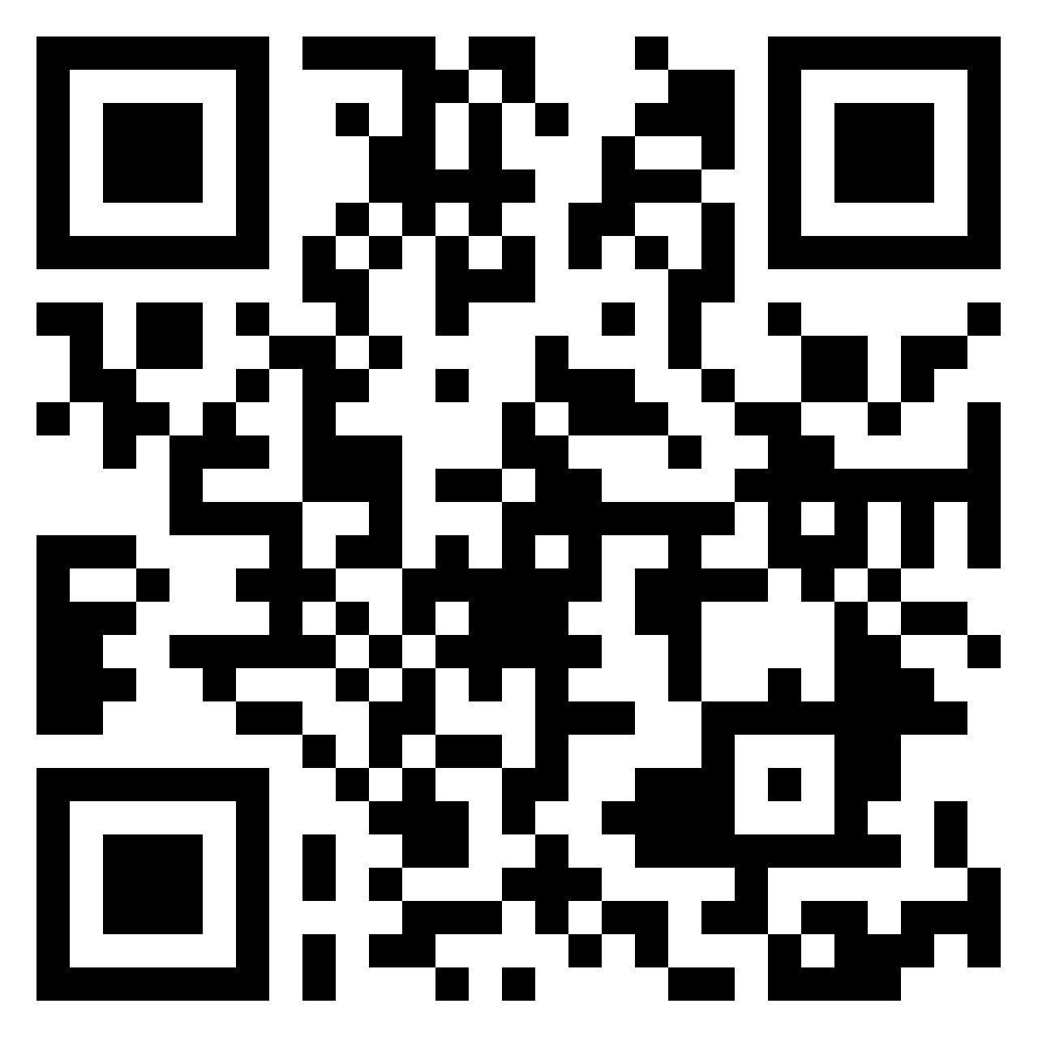
Why Are These Racial Gaps Present in STEM?
Padlet Activity: Why do you think there is a racial disparity in STEM Education and the STEM Workforce? What do you think motivates Black, Brown and Indigenous students to choose a STEM pathway or discourages them from a STEM pathway? (5 minute activity)
https://padlet.com/stewarrl/r2itbpqx4bj5699i
For those in person, if you have your phone, table or laptop, please use the padlet link or QR Code. If you do not have access to the internet, please use the provided index cards and go old school
Please raise your hand to participate in the discussion

Slide 12
What is Culturally Responsive/Relevant Teaching & Learning?
Instruction and interaction that allow students to maintain the
integrity of their cultural identity, while succeeding academically and
socially-emotionally. In culturally responsive pedagogy, faculty use
aspects of students’ cultures in an asset-based approach as
opposed to deficit-based to make academic and student life
relevant to them, and increase their skill acquisition,
engagement, and learning outcomes
National Institute for Learning Outcomes Assessment

Slide 13
Why is Culturally Responsive/Relevant Teaching and Learning Important in STEM?
IDENTITY
RESPONSIVENESS
AGENCY
RELEVANCE
Students need to be able to identify themselves personally and culturally as competent learners in STEM classroom activities. So Historical context of contributions of Black, Brown and Indigenous people to STEM becomes a necessary part of the curriculum.
STEM instructors should use various methods in order to maximize the opportunities the students have to learn the sometimes complex STEM concepts and literacies
Instructors should empower students to use STEM as a tool to understand the world as they see it, and also to solve community as well as global problems
Instructors should connect STEM concepts to their students’ lived experiences, thus connecting the students’ prior knowledge of their world to their new STEM learning experiences
https://digitalcommons.imsa.edu/cgi/viewcontent.cgi?article=1057&context=pres_pr

Slide 14
Example of Culturally Responsive/Relevant Teaching and Learning in STEM
HESABU Circle
Hesabu Circle, named for the Kiswahili/Swahili word for mathematics, consists of virtual monthly meetings for Black math educators and professionals to connect with young African Americans of all ages. During the meetings, participants discuss a variety of topics that highlight how math is used beyond the classroom.

Slide 15
Example of Culturally Responsive/Relevant Teaching and Learning in STEM
Dr. Rob and Umoja Math Jams at San Diego City College:
https://www.youtube.com/watch?v=J6W7vDSOXmI

Slide 16
Example of Culturally Responsive/Relevant Teaching and Learning in STEM
Culturally Relevant Pedagogy in STEM - Teaching STEM Concepts through hip hop - Dr. Christopher Emdin
https://youtu.be/BoHjXIWrBvQ

Slide 17
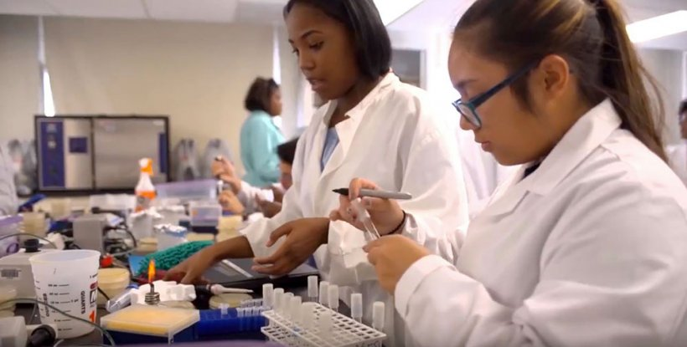
Black, Brown & Indeginous People Cannot Do STEM?
To the contrary, there are rich examples of Black, Brown and Indigenous cultures who have contributed historically (and more recently) to the progress of STEM.

Slide 18
STEM in Classical Societies

Slide 19
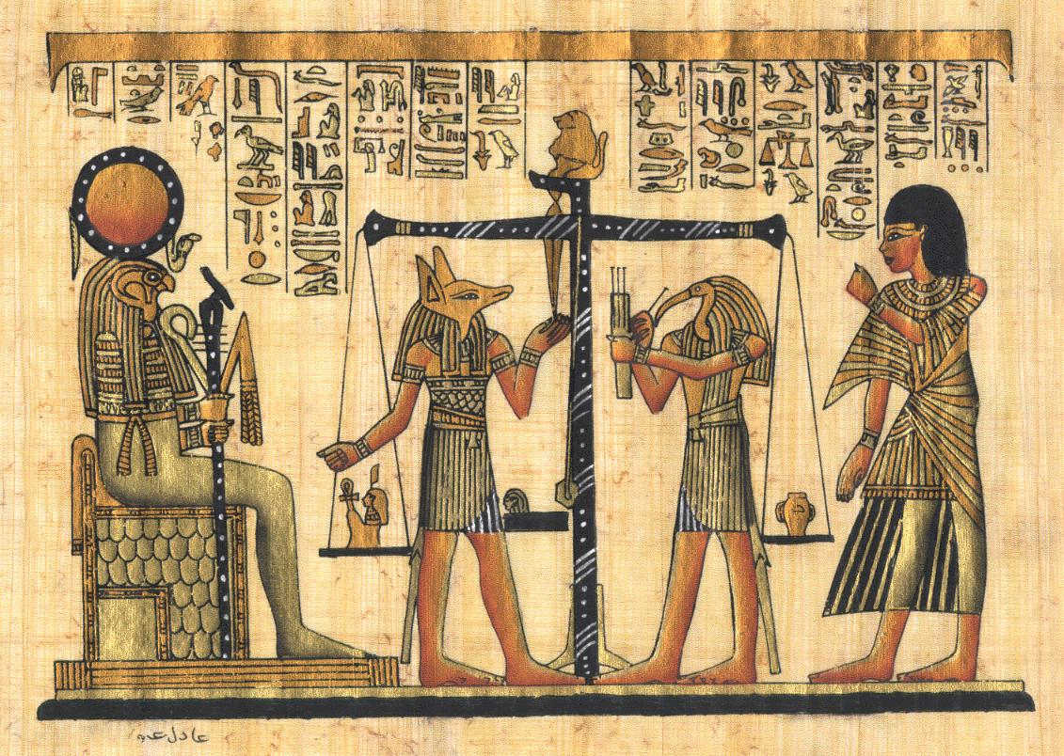
What is Justice?

Slide 20
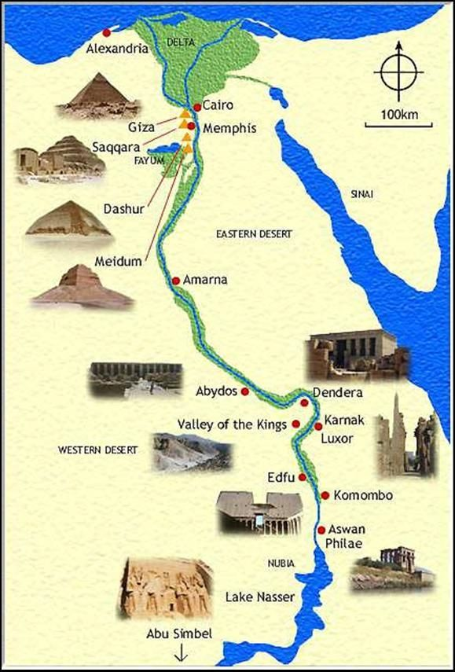
The Nile Valley Complex of Civilizations
Kush/Nubia: 3900 BCE
Kemet/Egypt: 3100 BCE
Axum/Ethiopia: 500 BCE

Slide 21
STEM in the Nile Valley Complex
Agriculture: irrigation, crop rotation, surplus storage, 365 day calendar system
Institutions: Education, Science, Social Structure
Technology: Architecture, Astronomy, Geology, Human Anatomy, Civil Engineering
Institutions: Religion, Health and Human Services, Governance
Metal Work (iron, gold, silver), skilled artisans (glasswork, pottery, jewelry, sculpture)
Institutions: Creative Arts, Commerce, Industry

Slide 22
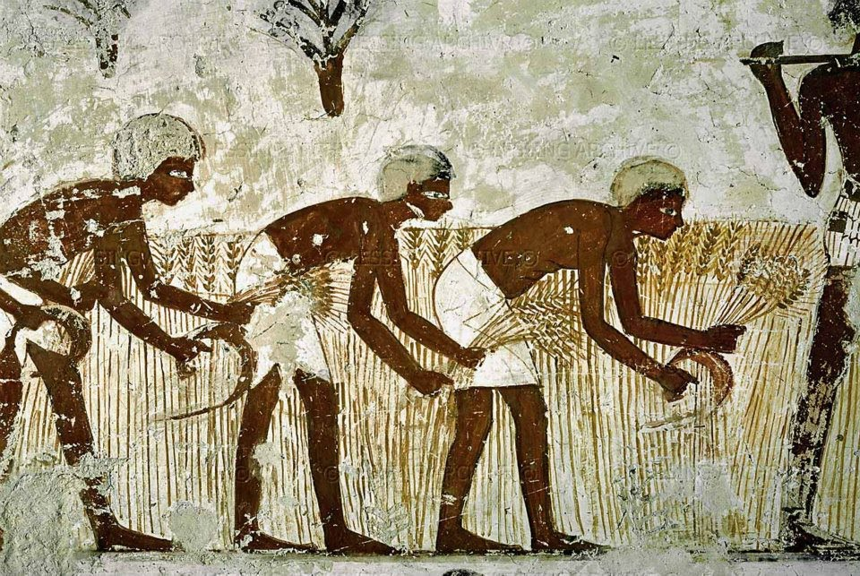
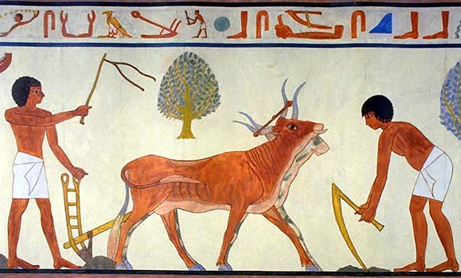
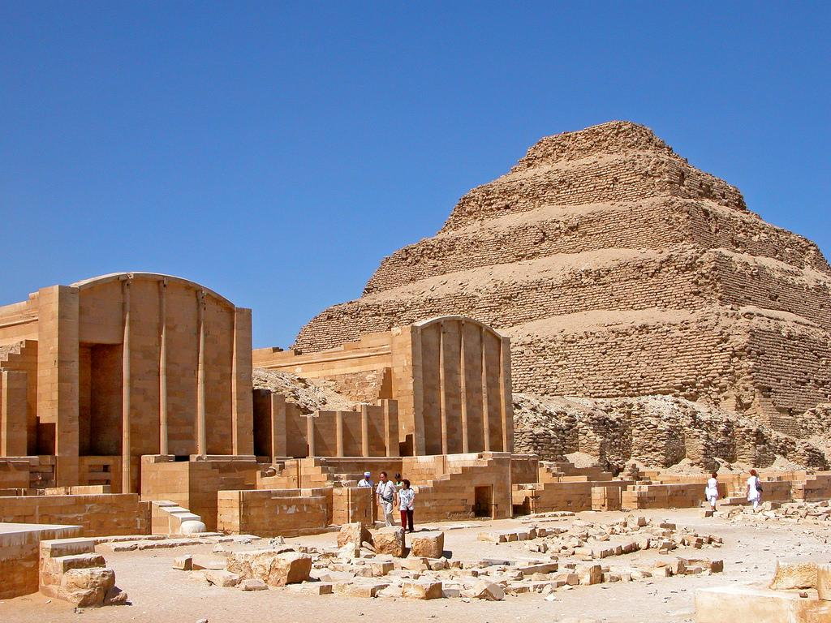
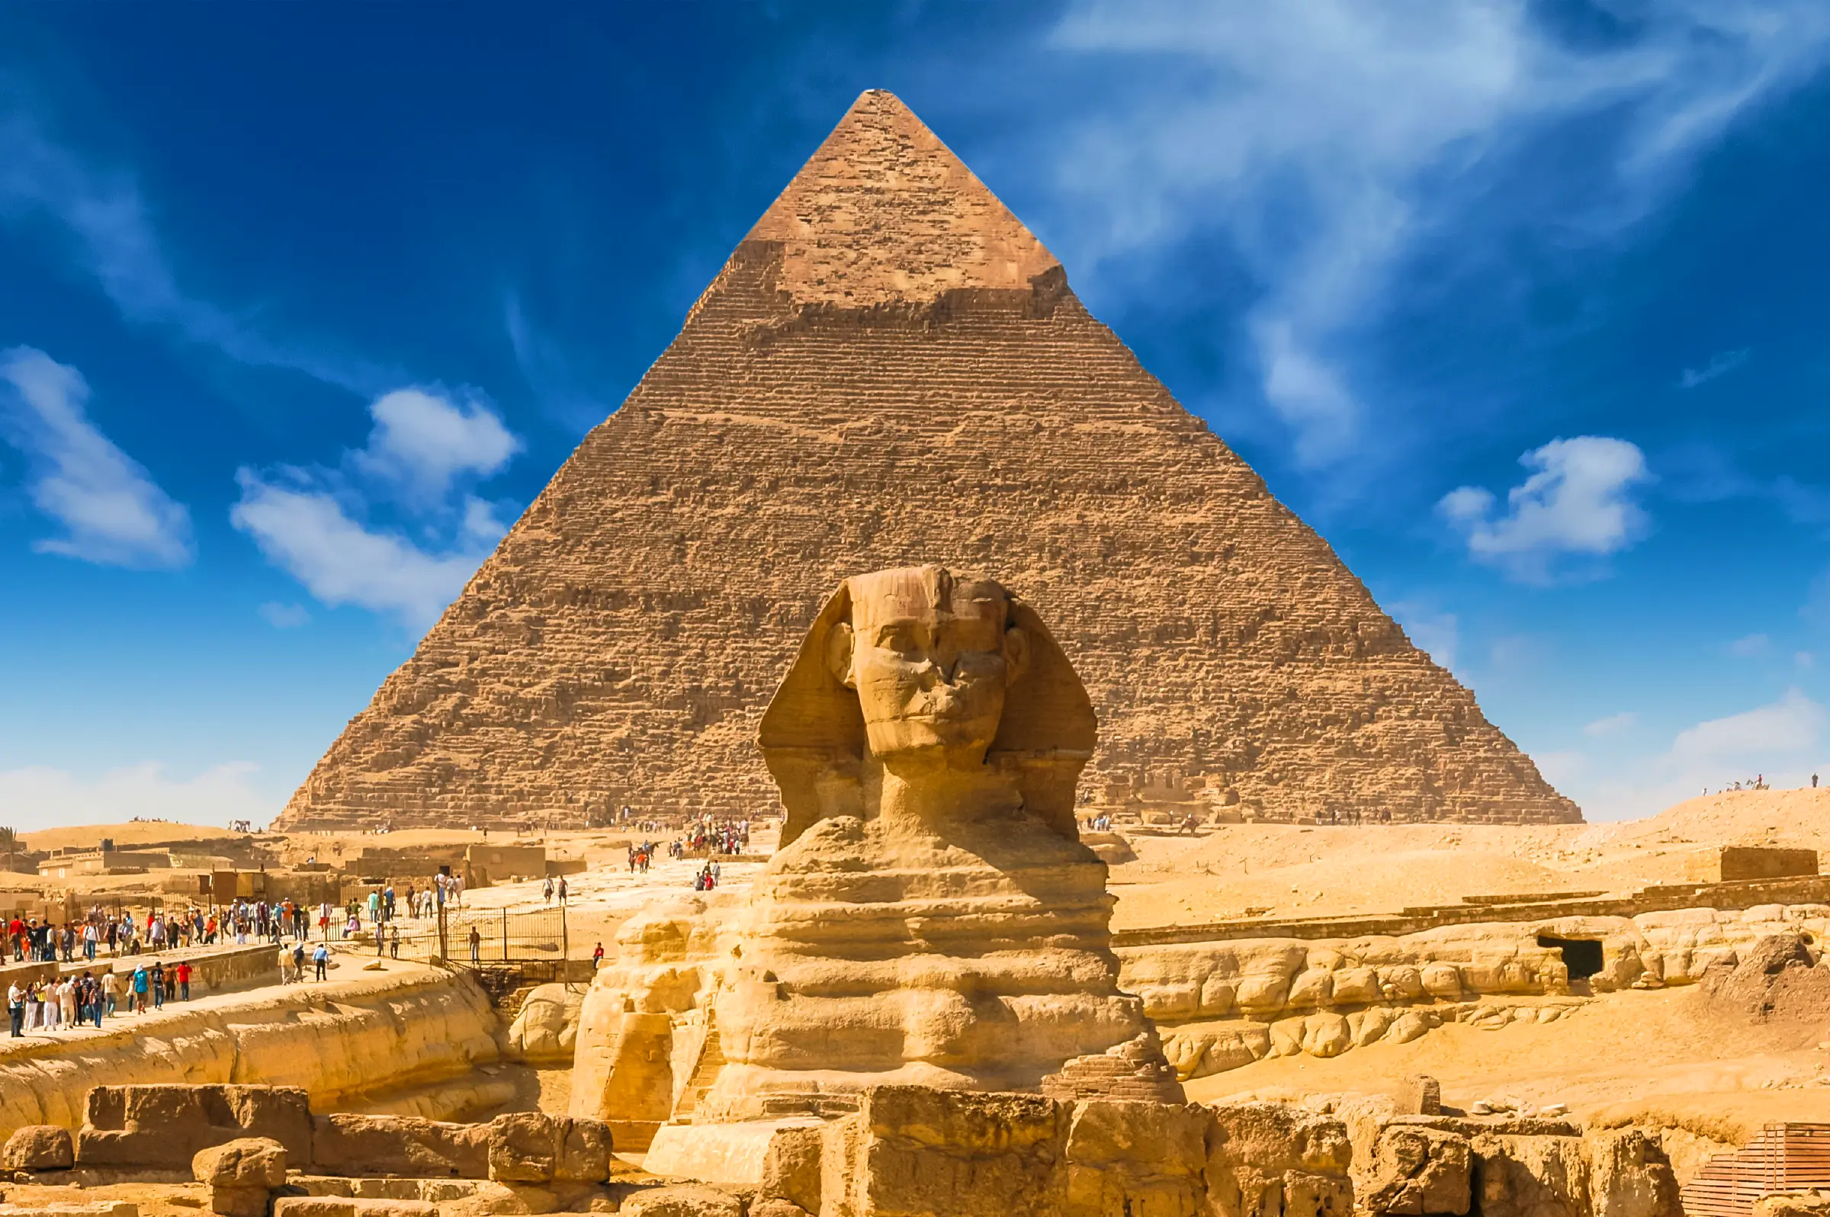
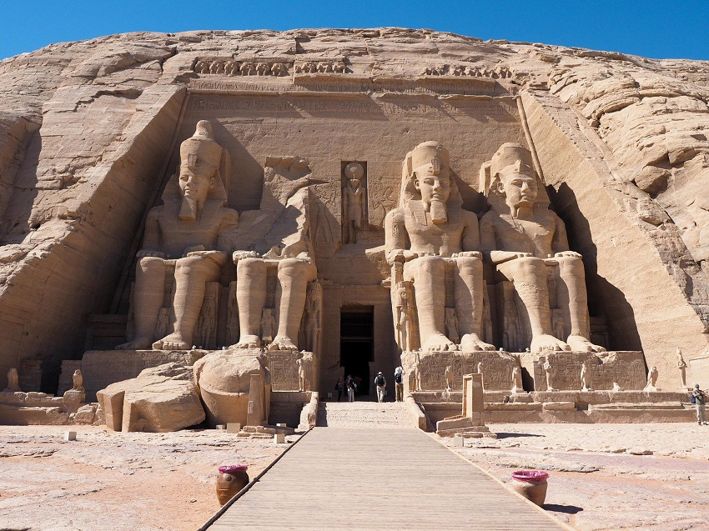
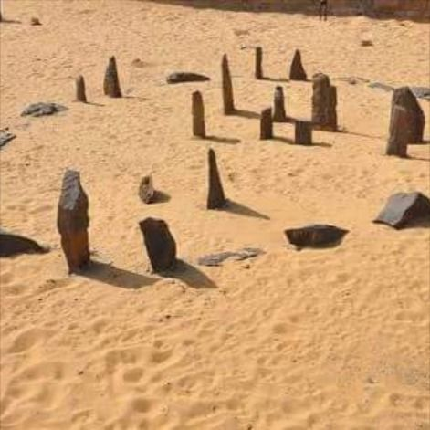
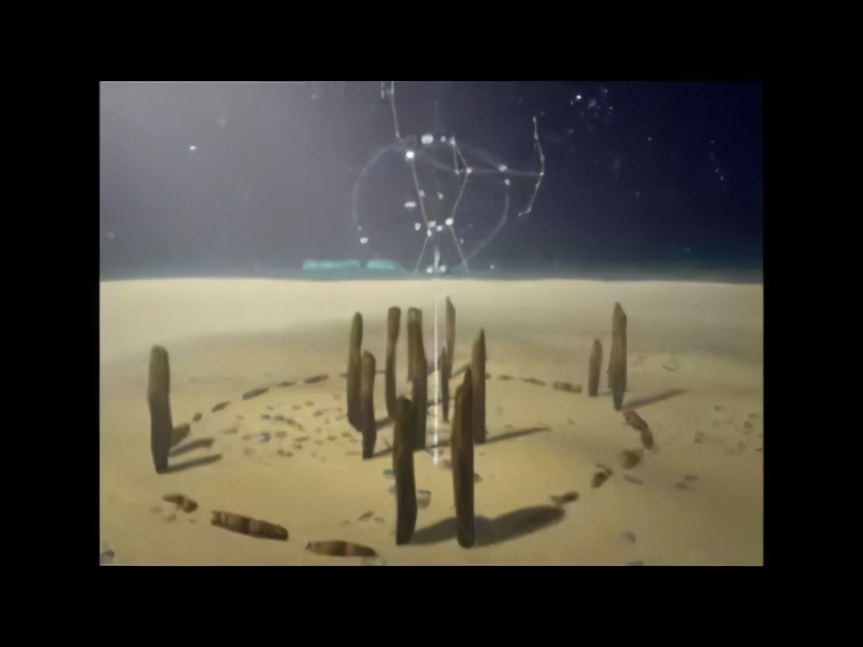

Slide 23
Teaching STEM in Classical Africa: The Mystery System
Model for Education
Grade Levels of the Mystery System
A model for the modern university system, the Mystery System was the center of organized culture. Candidates within the Mystery System underwent years of disciplinary intellectual exercises and bodily asceticism with intervals of tests and ordeals to determine their fitness to proceed to more serious, solemn process of initiation.
The Mortals (Initiation)
Probationary students who were being instructed, but had not yet experienced an inner vision.
The Intelligences (Illumination)
Those who had attained the inner vision.
The Creators (Perfection)
Those who had become identified with or united with the light.

Slide 24
STEM Study in Classical Africa
Quadrum:
Grammar
Arithmetic
Rhetoric
Logic
Disciplines of moral nature to purge away irrational tendencies of human beings
Tribum:
Geometry
Astronomy
Music
Science of transcendental space and numeration. They addressed knowledge on earth, in space, and the vibrations that connect the spiritual realm.

Slide 25
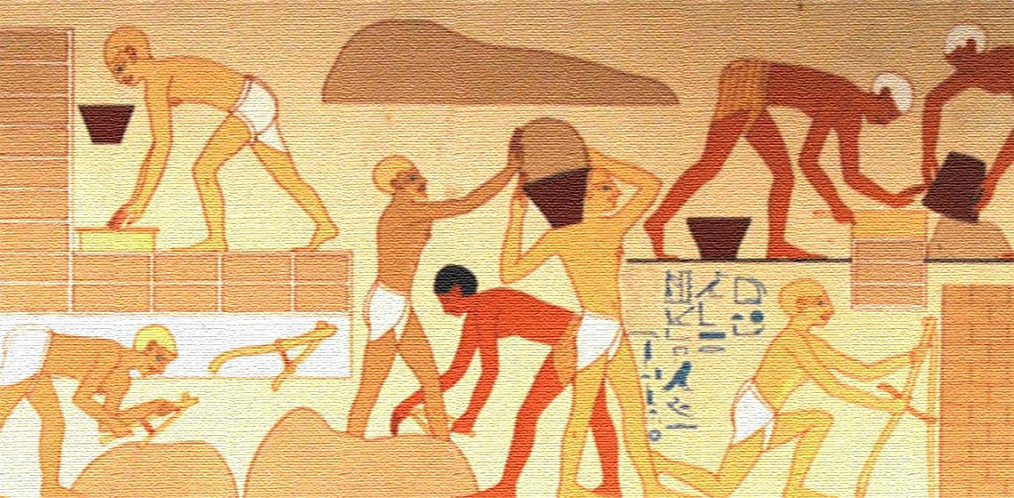
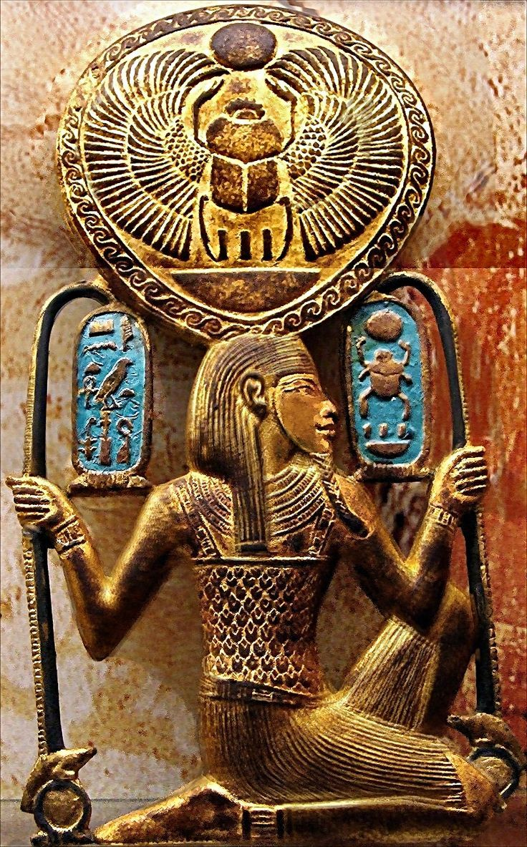
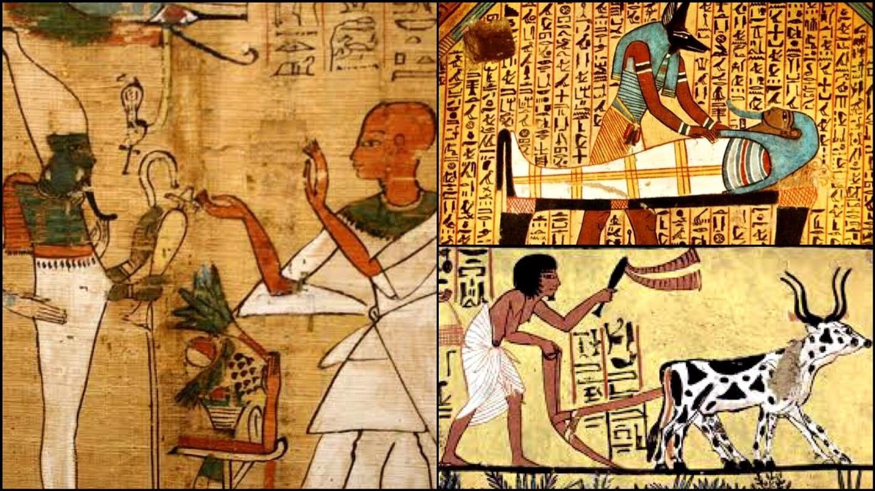
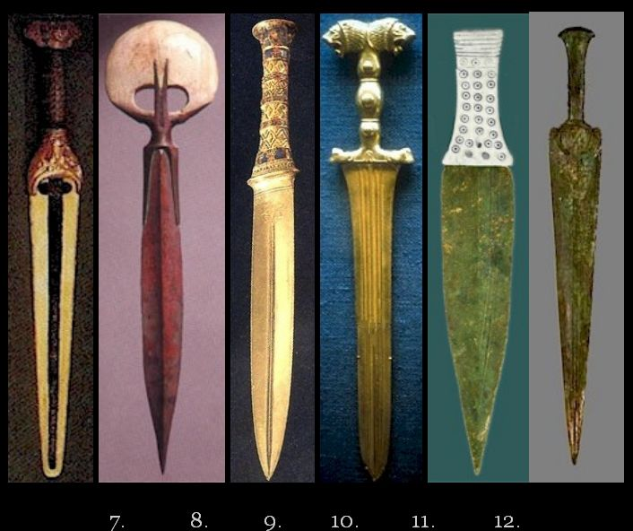
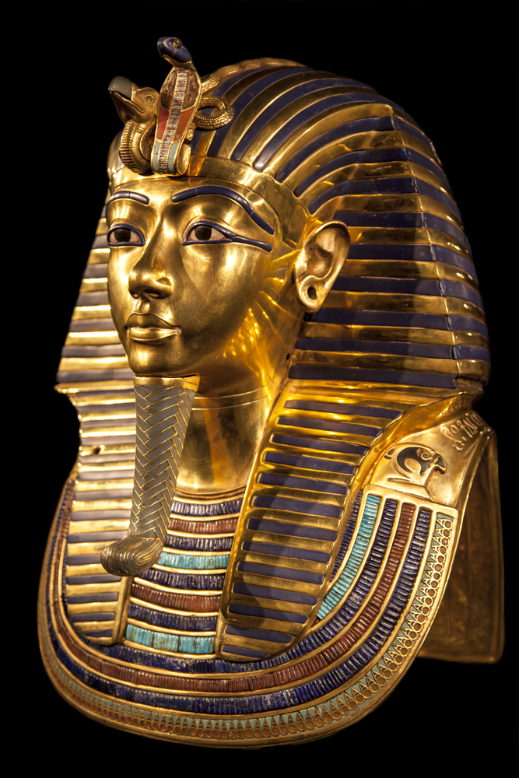
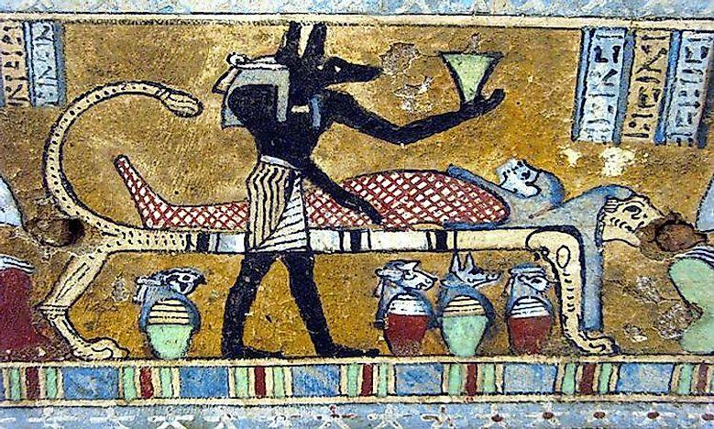
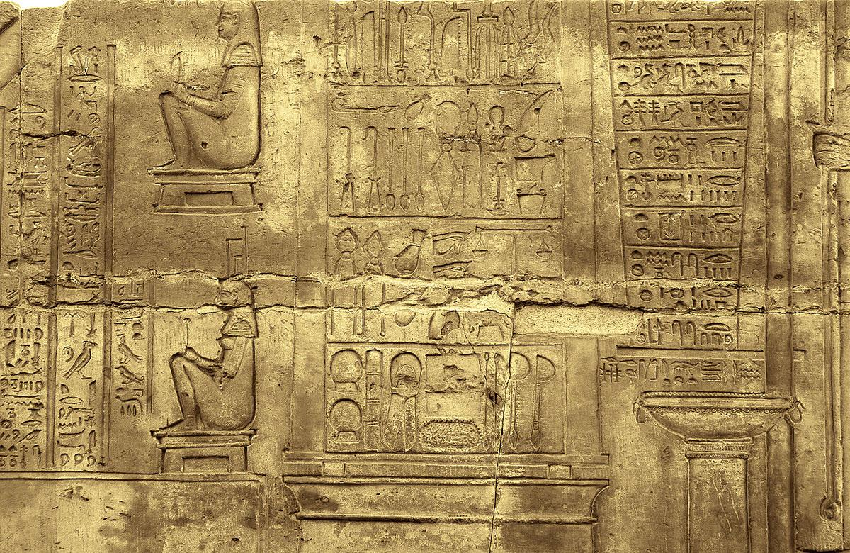

Slide 26
StudeClant Learning Outcomes of Classical Student Learning Outcomes from Classical Societies
Control of thought.
Control of Action.
Steadfastness of purpose.
Identity with spiritual life or higher ideals.
Evidence of having a mission in life.
Evidence of a call to spiritual orders.
Freedom from resentment.
Confidence in the power of the master (teacher).
Confidence in ones ability to learn.
Readiness or preparedness for initiation.

Slide 27
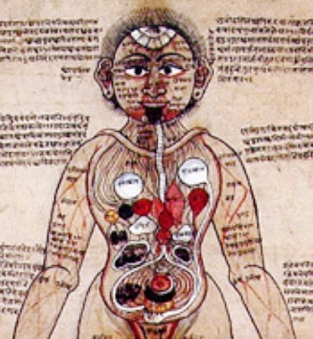
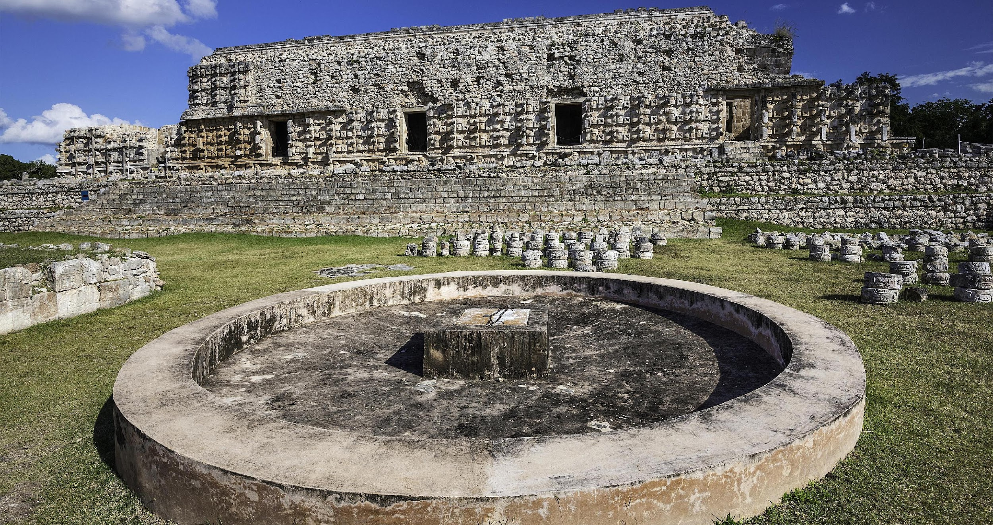
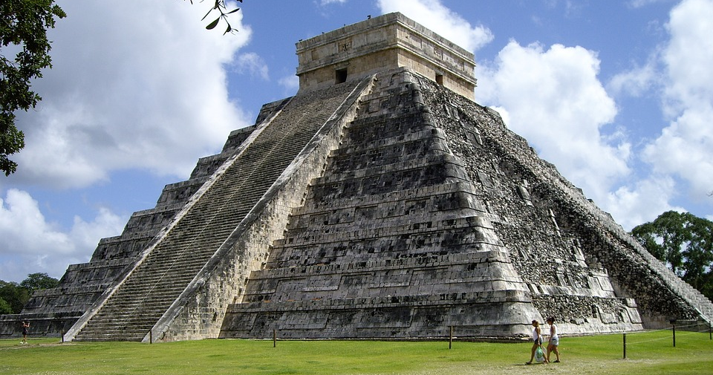
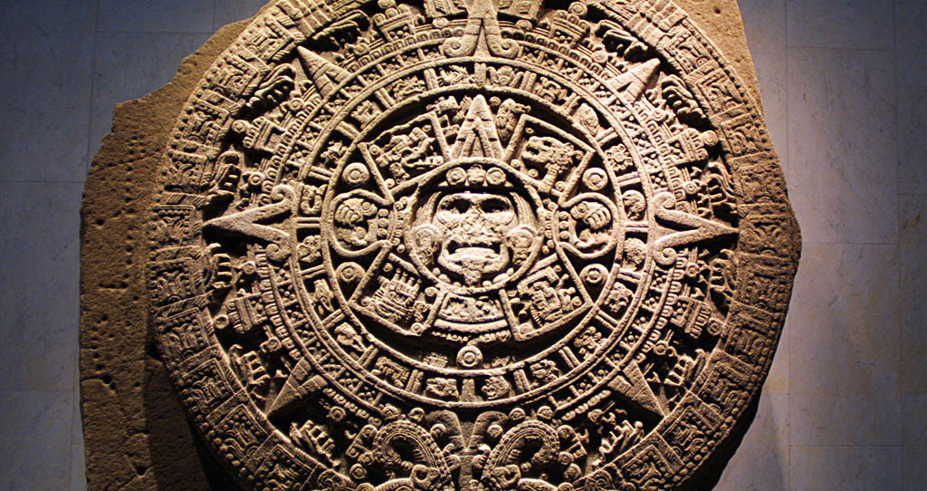
STEM in Classical Societies

Slide 28
Wrap-Up/Questions?

Slide 29
References & Resources
https://diversity.williams.edu/racial-justice/
https://www.sciencenews.org/article/science-technology-math-race-ethnicity-gender-diversity-gap
https://www.pewresearch.org/science/2021/04/01/stem-jobs-see-uneven-progress-in-increasing-gender-racial-and-ethnic-diversity/
https://www.pewresearch.org/science/2021/04/01/stem-jobs-see-uneven-progress-in-increasing-gender-racial-and-ethnic-diversity/ps_2021-04-01_diversity-in-stem_00-010/
https://digitalcommons.imsa.edu/cgi/viewcontent.cgi?article=1057&context=pres_pr

Slide 30
References & Resources
https://jobs.newscientist.com/article/african-americans-and-stem-a-rich-past-a-bleak-present-and-a-bright-future-/
https://www.asbmb.org/asbmb-today/science/020113/great-achievements-in-stem-in-ancient-africa
https://www.smithsonianmag.com/history/earliest-and-greatest-engineers-were-incans-180947976/
https://thestempedia.com/blog/stem-education-in-africa-the-past-present-and-future/
https://blog.flocabulary.com/racial-justice-classroom-resource-guide/

Slide 31
References & Resources
https://rossier.usc.edu/racial-equity-in-education-seven-key-points/
https://meyerhoff.umbc.edu/
https://www.theatlantic.com/ideas/archive/2019/11/how-umbc-got-minority-students-stick-stem/602635/
https://www.insightintodiversity.com/hesabu-circle-connects-black-mathematicians-and-students/
Historical Resources
Classical African Civilizations Archives - KNC (kushitenubian.org)
MexicanHistory.org Mexican history from ancient times to today
Top 18 Ancient Chinese Inventions and Discoveries (ancienthistorylists.com)
Ancient India- Ancient India History, History of Ancient India, Ancient India Culture, Ancient Indian Civilization (culturalindia.net)

Slide 32
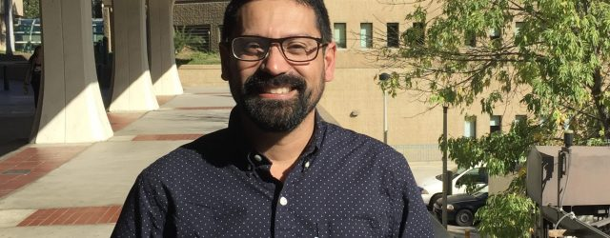
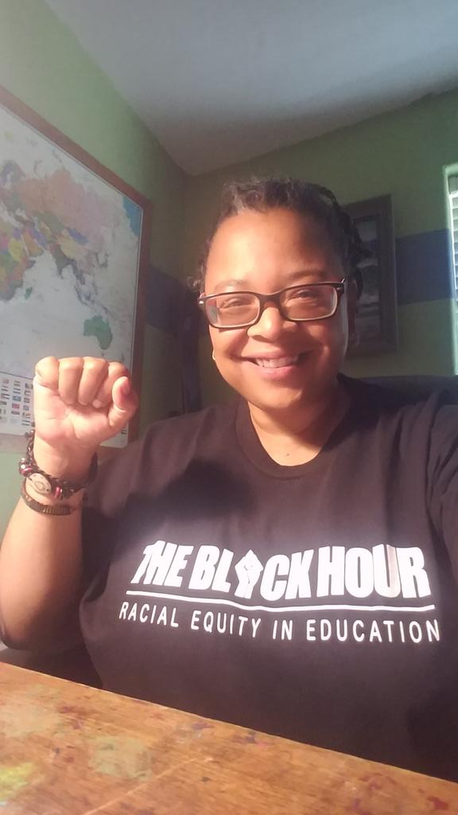
Thank You!

