Slide 1
Orienting and Training Your Faculty for Leadership
Dolores Davison, Foothill College
Wheeler North, San Diego Miramar College

Slide 2
Introductions:
Who are you?
Why are you here?
What would you like to get from this breakout?

Slide 3
Are your faculty M.I.A.?
Reasons faculty are reluctant to get involved in participatory governance?
Nothing ever changes – apathy
No sense of accomplishment
Too much to do already
Burn out
Feeling beat up/morale
Personality conflicts
Other?

Slide 4
Are your faculty M.I.A.?
Are there institutional barriers to getting faculty involved?
Additional “other duties as assigned”
Fewer faculty to serve students
Scheduling issues (M-Th classes, lecture/lab)
Lack of reassigned time
Meetings scheduled during “prime time”
Boring or poorly facilitated meetings
Other?

Slide 5
What About Faculty That May Not Normally Participate?
CTE Faculty
Schedules
Accreditation Requirements
Other duties off campus
Part-time Faculty
Freeway flyers
Not invited or welcomed
Nothing to motivate participation

Slide 6
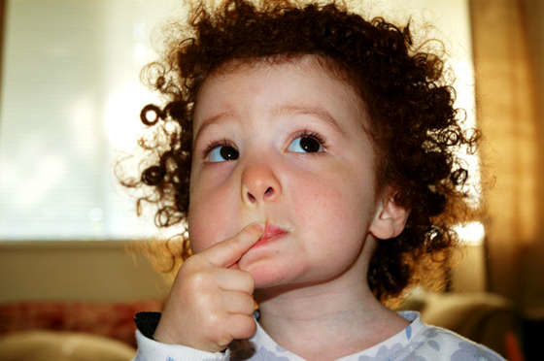
Considerations When Looking at Work
Is it in the 10+1?
Do you want it to be a +1?
Is it worth the senate’s time to appoint faculty?
Will the committee actually accomplish something?
Timeline? Urgent or long term?

Slide 7
Brainstorming: You’re Here. So…
Why did you get involved?
What captured your attention?
How do you get faculty involved?

Slide 8
Strategies

Slide 9
Strategies
Engage new faculty immediately – set expectation of participatory governance as professional responsibility
Involve the Senate in new faculty orientations
Assign mentors
Match people with skills and interest
Identify “wonkish” faculty and use them
Identify reasons for outliers’ behavior and address, if possible
Recognize that there will always be those few faculty…

Slide 10
Strategies
Publicize committees’ accomplishment
Don’t be afraid to ask faculty to rethink their committee participation and reassign as appropriate
Provide faculty with new opportunities to learn
Schedule meetings at faculty friendly times
Shared seats and split responsibilities

Slide 11
Strategies
Create a system to track interaction with faculty
Keep a running list of faculty interests to use later when recruiting
Use referrals
Ask in person
Ensure meetings are as effective and enjoyable as possible

Slide 12
Strategies
Get faculty involved at the state-level
Send faculty to workshops and Institutes
Send out updates from listserv to faculty who may be interested with a personal note
Visit asccc.org frequently
Urge faculty to investigate “Service at the State Level” in the “Get Involved” section

Slide 13
Questions?

Slide 14
Thank you!

