Slide 1
Reimagining the ASCCC: 2023-2026 Strategic Directions
Friday, June 16, 2023 11:00 a.m. to 12:00 p.m.
Laurel Room

Slide 2
2023 Faculty Leadership Institute Your Presenters!
Christopher J. Howerton, ASCCC At-Large Representative
LaTonya Parker Ed.D., ASCCC Secretary
Robert L. Stewart Jr., ASCCC Treasurer

Slide 3
SESSION DESCRIPTION:
On April 22, 2023, during the spring plenary the delegates approved the Reimagining with Purpose 2023-2026 Strategic Plan developed December 2022-February 2023 by the Executive Committee. The overarching goals and strategies in the plan offer guidance for the Executive Board for the next three years' planning. During this session, ASCCC leadership will discuss activity alignment areas of innovative, substantial actions dealing with the strategic blocks in our way and movement toward our envisioned future. Come join us in an open, transparent, and inclusive session on the three-year plan.

Slide 4
By the End of Our Time Together Today:
You will know our ASCCC’s Mission and Vision Statements
The four strategic directions and goals of ASCCC recently adopted Strategic Planning Document
The process and considerations that went into developing this document
Have access to the new 2023-2026 Strategic Document and the completed comprehensive review of the ASCCC 2018-2023 Strategic Plan.
You will have an opportunity to ask questions

Slide 5
ASCCC’s MISSION (adopted 1.01.F22): :
As the official voice of California community college faculty in academic and professional matters, the Academic Senate for California Community Colleges (ASCCC) is committed to advancing inclusion, diversity, equity, anti-racism, accessibility, student learning, and student success.
Notes:
Adopted by Resolution (Acclamation) Fall 2022 to add “IDEAA” into our mission

Slide 6
ASCCC ‘s MISSION acts to:
Empower faculty to engage in local and statewide dialogue and take action for continued improvement of teaching, learning, and faculty participation in governance
Lead and advocate proactively for the development of policies, processes, and practices
Include diverse faculty, perspectives, and experiences that represent our student populations
Develop faculty as local and statewide leaders through personal and professional development
Engage faculty and system partners through collegial consultation
Notes:
Adopted by Resolution (Acclamation) Fall 2022

Slide 7
ASCCC VISION:
Faculty leading change, serving students, and advancing inclusion, diversity, equity, anti-racism, and accessibility.

Slide 8
Adopted 2023–2026 ASCCC Strategic Directions Resolution
Spring 2023 Resolution Number 01.02
Resolved, That the Academic Senate for California Community Colleges adopt the 2023–2026 ASCCC Strategic Directions.

Slide 9
The 2023–2026 ASCCC Four Strategic Directions
Embracing Organizational Change
Engaging Proactively in Partnerships and Advocacy to Advance Faculty Voice and Student Success
Developing Innovative Activities to Empower Faculty and Uplift Underrepresented Voices
Advancing Faculty Engagement in Data Literacy

Slide 10
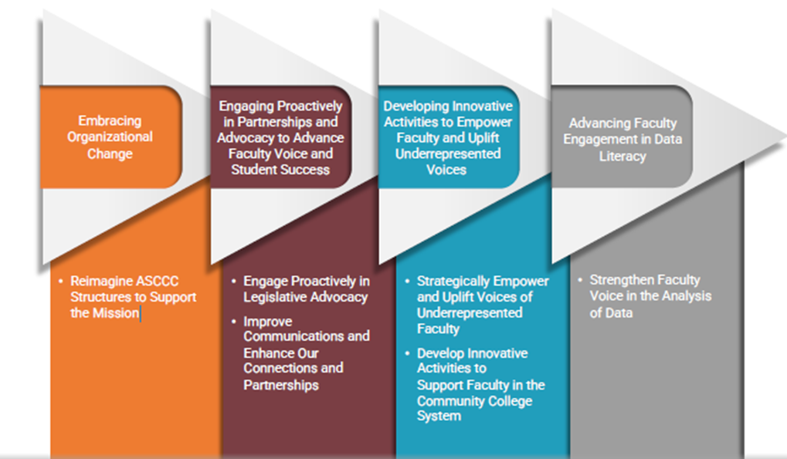
Turning Plans into Actions (ASCCC 2023-2026 Strategic Planning Document p.28)
Among the 4 strategic directions, six groups of strategic actions reflect the consensus of the Executive Committee about the direction ASCCC should move to attain its envisioned future.

Slide 11
Embracing Organization Change
Action:
Reimagine ASCCC Structures to Support the Mission

Slide 12
Engaging Proactively in Partnerships and Advocacy to Advance Faculty Voice and Student Success
Actions:
Engage Proactively in Legislative Advocacy
Improve Communications and Enhance Our Connections and Partnerships

Slide 13
Developing Innovative Activities to Empower Faculty and Uplift Underrepresented Voices
Actions:
Strategically Empower and Uplift Voices of Underrepresented Faculty
Develop Innovative Activities to Support Faculty in the Community College System

Slide 14
Advancing Faculty Engagement in Data Literacy
Actions:
Strengthen Faculty Voice in the Analysis of Data

Slide 15
Reimagining with Purpose 2023-2026 Strategic Planning & Previous ASCCC Strategic Plan Comprehensive Report
2023-2026 ASCCC Strategic Planning Document
ASCCC Strategic Plan Comprehensive Report 2018-2023

Slide 16
Q&A
Questions and Discussion

Slide 17
Any Other Questions?
We are here to help!
You can always reach out to ASCCC by e-mail with any questions you may still have.
Info@asccc.org

