Slide 1
Protecting our Most Vulnerable Students: How can we assure that students of color and low-income students are equitably served in online and remote learning?

Slide 2
The Presenters
Teresa Aldredge
ASCCC Educational Policies Committee, Cosumnes River College
Sam Foster
ASCCC South Representative
Silvester Henderson
ASCCC At-Large Representative
Darcie McClelland
ASCCC Educational Policies Committee, El Camino College

Slide 3
This Presentation Will Be Interactive
We will discuss some of the challenges our most vulnerable students face in online and remote learning and some strategies to address them
We hope to share ideas and learn from each other
Please use the chat to engage in the conversation
Notes:
Sam

Slide 4
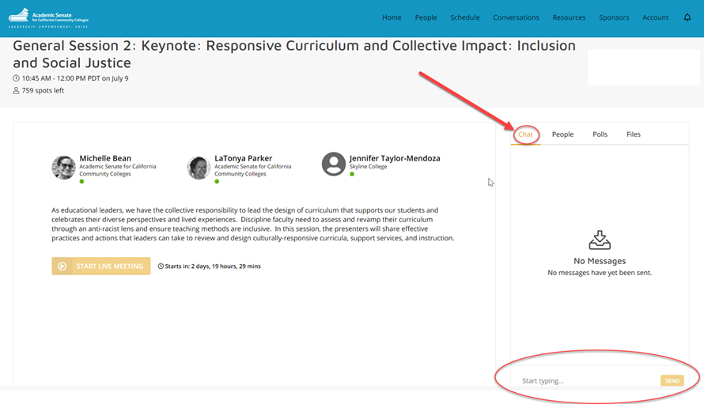
Use Pathable Chat to Engage in the Conversation
Notes:
Sam

Slide 5
Overview
We will group the challenges observed, including innovative ways to address them, in several categories:
Technology Barriers
Basic Needs
Effective Training and Orientation
Learning Environment
Loss of Community
Access to Learning Support Structures
Notes:
Sam

Slide 6
In each category listed on the slides are some of the challenges and innovative ideas we have observed. We know there are many more.
Please add to the conversation by including your experiences regarding
Challenges observed
Strategies to address challenges
Notes:
Sam

Slide 7
Technology Barriers
Laptop or other computer access
Wi-Fi
Multiple users with limited resources (slow or unstable)
Software access
Notes:
Silvester

Slide 8
Strategies to Address Technology Barriers
Loaner computers to students
Hot spots
Partnership with local cable providers
Synchronous vs asynchronous instruction (flexibility)
Notes:
Silvester

Slide 9
Basic Needs
Food insecurity
Housing insecurity
Limited transportation
Notes:
Silvester

Slide 10
Strategies to Address Basic Needs
Drive up food pantry
Delivery for students with limited transportation
Hotel vouchers (short term)
Extended stay hotel contracts (longer term)
Food and gas vouchers, bus passes
Notes:
Silvester

Slide 11
Effective Training and Orientation
How to access the virtual environment
Understanding terms (virtual, asynchronous, synchronous, hybrid)
Using the LMS (Canvas)
Notes:
Darcie

Slide 12
Strategies to Address Training and Orientation
Go through Canvas training with students (overview)
Canvas Coaches (live one-on one coaches)
Short targeted videos
Clear messaging on the website and in the class schedule about how classes will meet
Notes:
Darcie

Slide 13
Learning Environment
A quite place to study
Privacy
Notes:
Darcie

Slide 14
Strategies to Address Learning Environment
Open parking lots on campus with Wi-Fi access
Not requiring cameras for students unless essential
Notes:
Darcie

Slide 15
Loss of Sense of Community
Classroom Cohorts
Student Communities: EOPS, Umoja, Puente, DSPS, Athletes, Veterans, others
Notes:
Teresa

Slide 16
Strategies to Increase Sense of Community
Village hours
Peer check in
Optional group work
Notes:
Teresa

Slide 17
Access to Learning Support Structures
Tutoring
Learning labs
Access to physical textbooks
Library resources
Access to reserve textbooks
Notes:
Teresa

Slide 18
Strategies for Learning Support Structures
Online tutoring hub
Net Tutor
Notes:
Teresa

Slide 19
Reflections
What ideas can we take back to help our students?
Notes:
Sam + Others

Slide 20
Thank You
Additional questions?
Email: info@asccc.org
Notes:
Sam

