Slide 1
Representation Matters: Building Diverse Faculty Leadership
Silvester Henderson, At-Large Representative Mayra Cruz, At-Large Representative Conan Mckay, Area B Representative
,
[Date]

Slide 2
Presentation Highlights
What is the definition of “Representative Diversity”?
Why is “Diversity” important in regards to building new faculty leadership?
Is the concept of building “Diversity” and individual person or a way of thinking?
Can “Diverse Leaders/” inspire “Workplace Equity”?
Marketing Tools for building a diverse team of Senate Leaders.
Questions and Comments?

Slide 3
What is “Representative Diversity”
NEA – “Representative Diversity” can be defined as the sum of the ways that people are both alike and different. The dimensions of diversity include race, ethnicity, gender, sexual orientation, language, culture, religion, mental and physical ability, class, and immigration status”.

Slide 4
Why is “Diversity” important in regards to building new faculty leadership?
Supports cultural sensitivity, professional involvement and academic collaboration.
Cultivates student “Tolerance”.
Inspires “New” and “Active” Leadership – Create a space for growth.

Slide 5
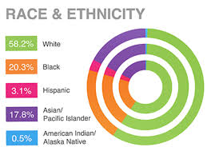
Is the concept of building “Diversity” and individual person or a way of thinking?
Various Ethnic Groups – Racial Identification
Diversity of thoughts?
Race & Ethnicity
Does racial identity matter at all?
Discussion?
Susan Wood (2008) “Diversity of thought—the idea of more-than-one-way— is key to understanding the potential of diversity and inclusion as an organizational resource”.
https://digitalcommons.ilr.cornell.edu/cgi/viewcontent.cgi?article=1573&context=articles

Slide 6
Ethnic Diversity: Our Challenge
Left Out: How Exclusion in California’s Colleges and Universities Hurts Our Values, Our Students and Our Economy. The Campaign for College Opportunity March 2018 http://collegecampaign.org/portfolio/left-out-report/

Slide 7
Can “Diverse Leaders/” inspire “Workplace Equity”?
Sophie Johnson (2018) – “Equity in a workplace means everyone receives fair treatment”
Discussion
http://work.chron.com/advantages-equity-workplace-2635.html

Slide 8
Inclusion Cultivates Excellence: Growing Diverse Faculty Senate Leaders
Professional Development Focus on Diversity
Form a Committee to assess and address the diversification of the Senate
The Department Chair as Transformative Diversity Leader

Slide 9
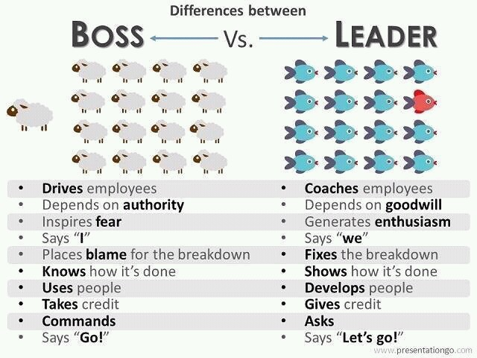
Marketing Tools for building a diverse team of Senate Leaders
Know your college.
Remember to be a “Leader” and not a “Boss”.
Create a “Diversity Leadership Team” – Promote Honesty!
Schedule “Diverse” educational presentations – non active faculty, campus leads, higher educational partners, business leaders, social justice advocates & other.
Promote Equity Mindedness and Race-Conscious conversations!
Promote “Inclusion” – Love!

Slide 10
Questions & Comments
Please feel free to contact each of us for more information.
Silvester Henderson Shenderson@losmedanos.edu
Mayra Cruz cruzmayra@fhda.edu
Conan McKay cmckay@mendocino.edu

