Slide 1
All Authentic Faculty Voices & Lived Experiences Belong in Academic Leadership

Slide 2
Session Presenters
Juan Arzola– ASCCC At-Large Representative
Karen Chow– ASCCC Area B Representative
Robert L Stewart Jr – ASCCC South Representative

Slide 3
Padlet Activity
How racially diverse is your senate? What are some challenges faced in including BIPOC faculty as academic senate leaders?
All Authentic Faculty Voices & Lived Experiences Belong in Academic Leadership Padlet

Slide 4
Why Have An Inclusive Workplace?
There have been many events through the years that have highlighted the need for creating a diverse and inclusive workplace. From a morale and business perspective, making sure that inclusion, diversity, equity, anti-racism and access are valued throughout the inner workings of the college is imperative. Why?
Increased innovation and creativity
Provides insight into the needs of diverse stakeholders
Improves decision-making
Insures that all employees are able to thrive
Makes sure that colleges and services are representative of the communities they serve

Slide 5
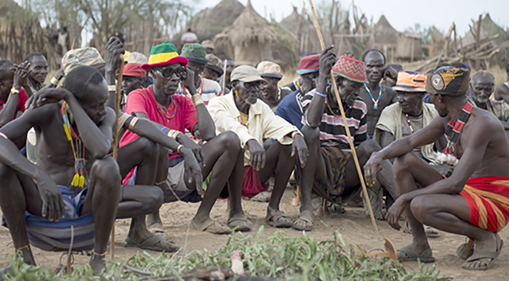
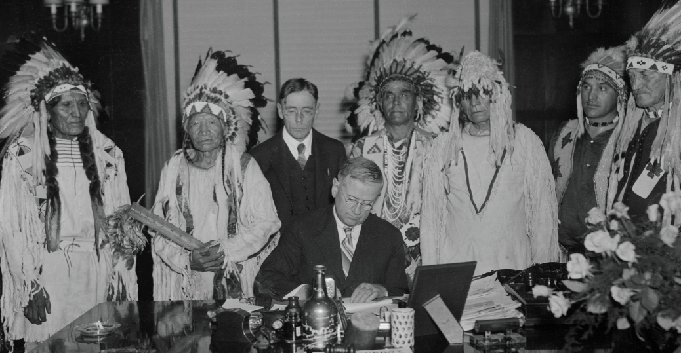
Effects of Colonization on Decision-Making
Pre-colonial governance and decision-making structures and practices
The effects of European colonialism
How did the decision-making model change?
Who was allowed to participate in decision-making?
Colorism and cultural genocide
Patriarchy and the devaluing of female perspective
Notes:
In Mesoamerica, The system of decision making was based on consensus, not majority rule. This form of decision making later baffled colonial agents who could not find Indigenous officials to bribe or manipulate. According to the value system that drove consensus building and decision making in these societies, the community's interest overrode individual interests.
In large parts of Africa, pre-colonial political systems were highly decentralized with lawmaking, social control, and allocation of resources carried out by local entities, such as lineage groupings, village communities, and age-sets. These systems were largely based on consensual decision-making arrangements that varied from one place to another. As Legesse (2000; 1973) notes, the fundamental principles that guide the consensus-based (decentralized authority) systems include curbing the concentration of power in an institution or a person and averting the emergence of a rigid hierarchy. The settlement of conflicts and disputes in such consensual systems involves narrowing of differences through negotiations rather than through adversarial procedures that produce winners and losers.

Slide 6
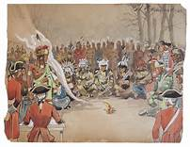
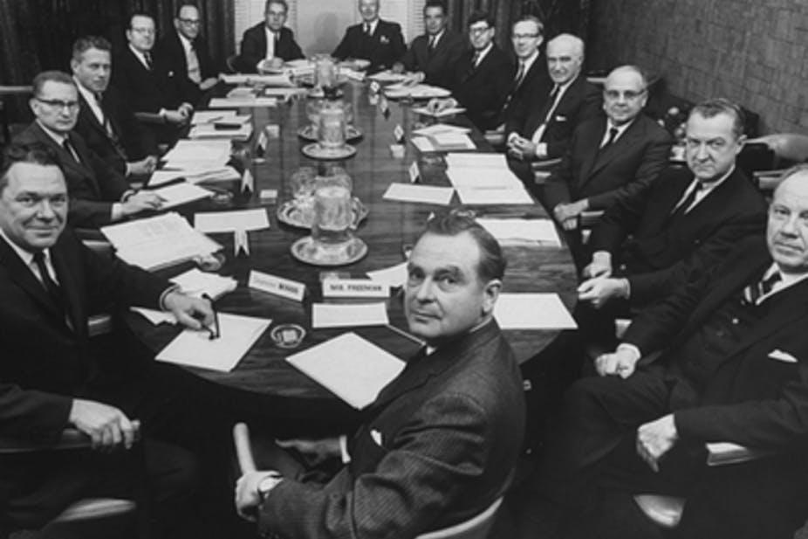
Post-Colonization Governance and Decision making structures
Top down, hierarchical
Dominated by white male
Individualistic versus consensus
Sustained through “divide and conquer” strategy

Slide 9
Academic Senate Roles In College Decision-Making
Academic senates serve a unique role on our California Community College campuses. Academic senates are the primary way by which the faculty engage in local, district and state participatory governance , and work closely with administrations on academic and professional matters.
Academic senates achieve this by offering the administration recommendations, guidance, perspective, and feedback as the college makes important decisions on how the college does its business.

Slide 10
College Committees
Decisions made at our colleges are driven through processes implemented via college decision-making committees. Some of the most common decisions a college makes are around areas such as: Curriculum, Degree and certificate requirements, Grading policies, Educational program development, Standards or policies regarding student preparation and success, District and college governance structures, Roles and involvement in accreditation processes, including self-study and annual reports, Policies for professional development activities, Processes for program review, Processes for institutional planning and budget development, among other academic and professional matters.
Sounds Familiar? If not, it certainly needs to sound familiar.

Slide 11
10 + 1: Academic and Professional Matters
The California Code of Regulations (Title 5) Section 53200 bestows the functional primacy of Academic Senates to make recommendations with respect to academic and professional matters. And in part (C) of Section 53200, it defines the areas in which the Academic Senate has this primacy.

Slide 12
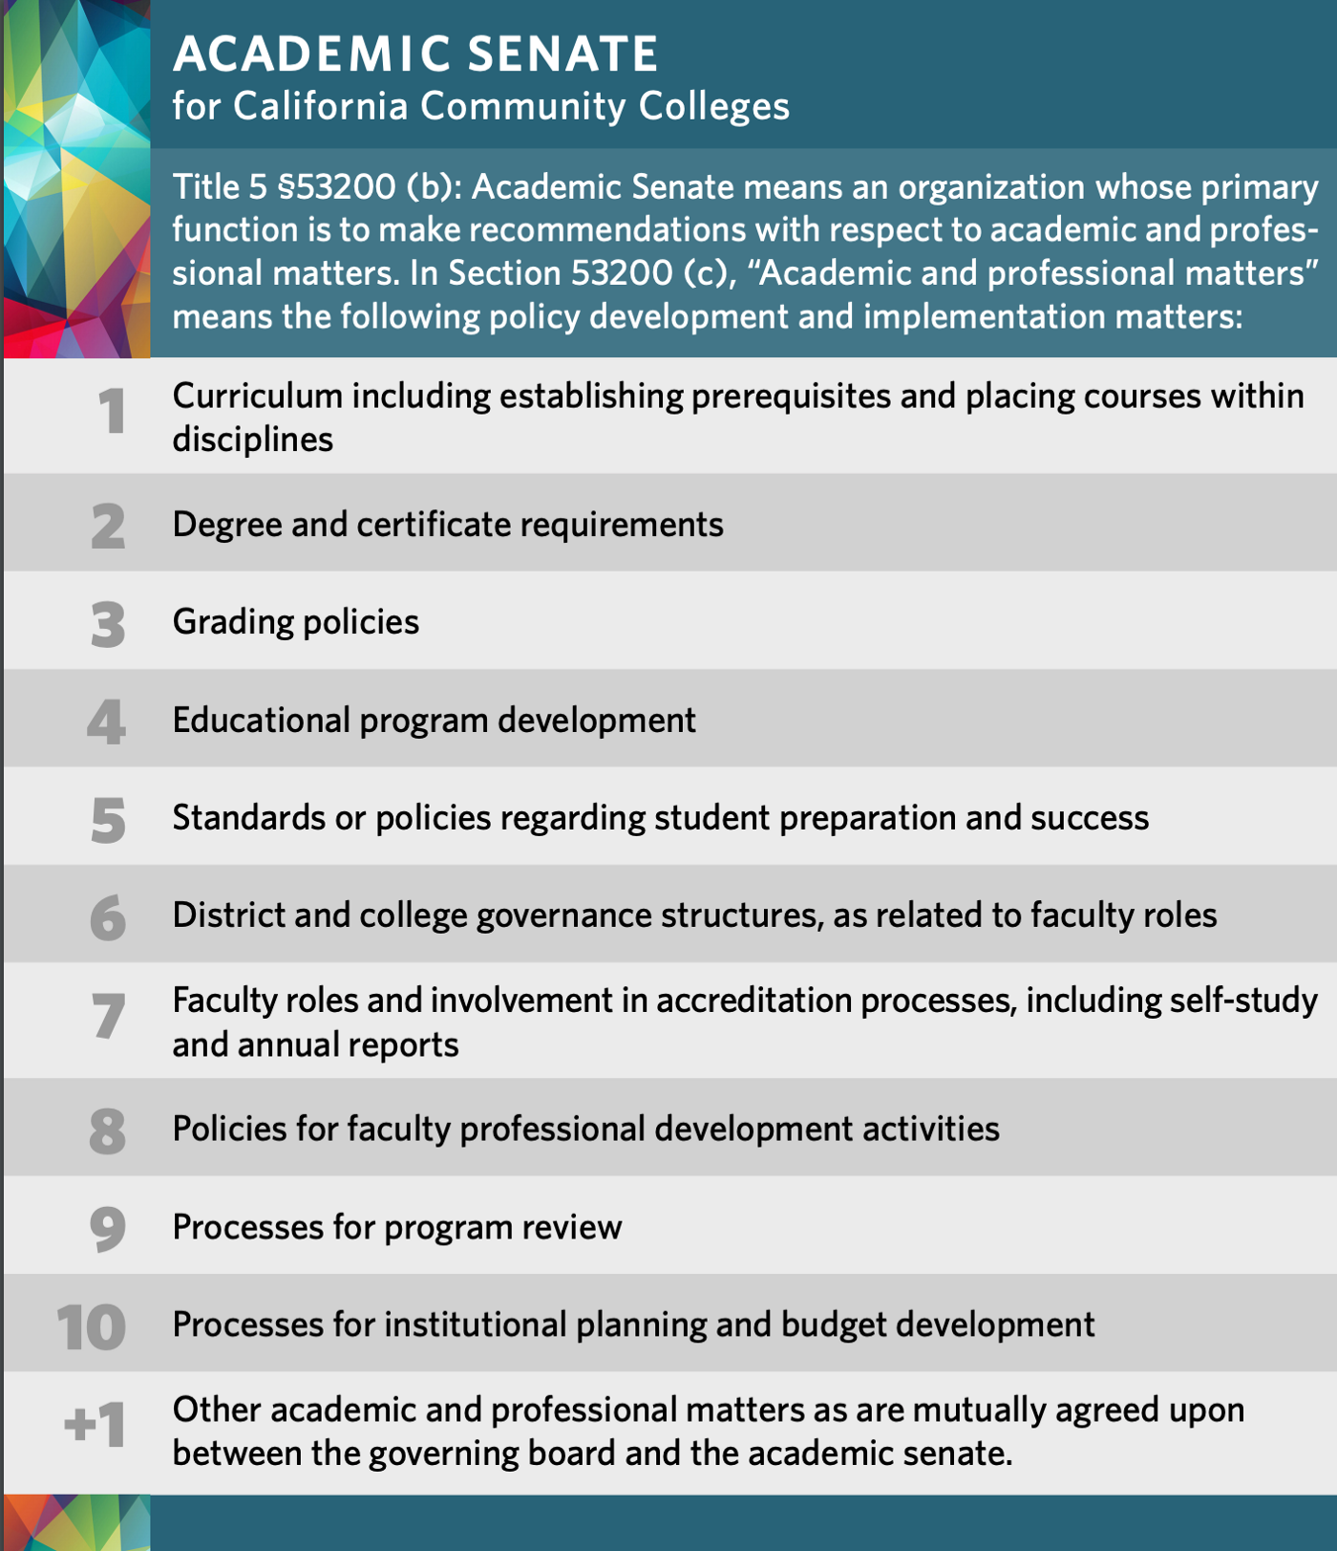
10 + 1: Academic and Professional Matters

Slide 13
Why Is This Important?
The types of decision-making committees that you typically find on college campuses align with the 10+1 topics of Academic Senate purview. Therefore:
Academic Senates get to play a significant role in the participation of faculty, faculty leadership, and faculty appointments of all college committees within the purview of the Academic Senate.

Slide 14
Inclusion, Diversity, Equity, Anti-racism and Access in Faculty Leadership
It is well established in educational leadership research that decision-making is at its best when diverse voices are amplified and when alternative perspectives are considered.
Decisions are often influenced by who sits at the head of the table, and underrepresented groups are not being equitably elevated to positions of leadership in our academic senates and decision-making committees
This means that as it relates to Academic and Professional Matters at a college, the Academic Senate has the influence to make sure that Black, Indigenous and People of Color (BIPOC) voices are not only represented at the table, but also are able to realize positions of leadership at those decision-making tables.

Slide 15
Inclusion, Diversity, Equity, Anti-racism and Access in Faculty Leadership
Does it matter who runs the committee meeting?
Would who chairs a committee have an effect on the work and ideas that are considered by the committee?
Who typically holds the committee leadership on the college committees and academic senate committees at your college?
What does your Academic Senate President typically look like?

Slide 16
Academic Senate Leadership Power
As an Academic Senate leader, you may have been empowered by your local academic senate to make faculty appointments to committees, or your local academic senate may have a process in place to place faculty onto committees and into leadership roles on committees.
This means that if we are faculty leaders, with appointment powers to faculty leadership roles on campus, we must be in tune with our own level of comfort with inclusion and our own biases.

Slide 17
Why is it important to have diversity in these leadership roles?
Representation that differs in race, gender, language, abilities, religion and other identities at decision-making tables, and more importantly, diverse representation at the table as a committee “leader”, provides amplification of marginalized voices, and allows for various perspectives (even if they are not your own) to emerge that allows one to challenge the status quo, to question ideas that may not be IDEAA, to uplift novel ideas, and to advocate for all.
Ensuring inclusion, diversity, equity, anti-racism and access in academic senate leadership allows exploration of the huge range of ideas and issues present on campus and in the surrounding community.

Slide 18
Questions to Ask
Do you feel there is a culture of exclusion at your college?
Are you confident in your understanding of specific behaviors that impact a person’s feeling of inclusion?
Are you aware of any implicit or explicit biases or racism that you may harbor in favor of others who are like you?
According to Zenger and Folkman, “Inclusivity is in the eye of the beholder. You might intend to be inclusive, and even think you are inclusive, but your impact on others might be very different."

Slide 19
Recommendations

Slide 23
Building Inclusive, Diverse, Equitable, Anti-racist Academic Senate Leadership Capacity
Holistic & Intentional Professional Development to address any biases and racism among the faculty and within the institution
Intentional Leadership Mentorship opportunities that are inclusive of BIPOC faculty, in which sufficient engagement and dialogue occurs on the benefits, challenges, and responsibilities of specific faculty leadership roles
Empower BIPOC faculty to speak their truth to power in order to expose any implicit or explicit bias that may be holding them back from faculty leadership roles

Slide 24
Be Courageous and Examine your Local Academic Senate systems and structures.
Senate and Committee “Colorblind” Charge/Mission
Limiting Access to Leadership Opportunities
Employment Qualification (full-time, tenured only?)
Effect on Part-time Colleagues
Effect on Non-tenured, Probationary Colleagues
On-boarding/Training Program for New Faculty Hires or Incoming Senators
Robert’s Rules: A Necessary Evil?
Lack of Intentional Inclusionary Recruitment Strategies
Dangers of Tokenism
Intentionality
Tapping folx to encourage leadership

Slide 25
Resources
https://www.asccc.org/10_1
California Code of Regulations (Title 5) Section 53200
Miller, F. & Katz, J (2002) Inclusion Breakthrough: Unleashing the Real Power of Diversity
Bourke, J. & B. Dillon, (2018), The diversity and inclusion revolution: Eight powerful truths, Deloitte Review, Issue 12.
Catalyst (2014)
Ferdman, Prime & Riggio, (2021) Inclusive Leadership - Transforming Diverse Lives, Workplaces, and Societies
Navigating Inclusion As a Leader - Intoducing the Inclusive Leadership Compass (2021)
https://rossier.usc.edu/news-insights/news/having-place-table-not-enough (2021)
https://rossier.usc.edu/usc-rossier-magazine-fallwinter-2021

Slide 26
Additional Resources
Alleman, N. F., Allen, C. C., & Haviland, D. (2017). Collegiality and the Collegium in an Era of Faculty Differentiation. ASHE Higher Education Report, 43(4), 1–131.
Anta Diop, C. (1987). Precolonial Black Africa: A comparative study of the political and social systems of Europe and Black Africa, from antiquity to the formation of modern states. Brooklyn, New York: Lawrence Hill & Company.
Dunbar Ortiz, R. (2014). An Indigenous Peoples’ History of the United States. Boston, Massachusetts: Beacon Press.
Goodman, Diane J. (2011). Promoting Diversity and Social Justice: Educating People from Privileged Groups. New York: Routledge.
Kendi, Ibram X. (2019). How to be an Antiracist. New York: One World.
Love, Barbara, Dejong, Keri, and Hughbanks, Christopher (2007). Critical Liberation Theory. Social Justice Education. Amherst: University of Massachusetts.
Protocols. School Reform Initiative. Accessed at https://www.schoolreforminitiative.org/protocols/.
Relevance of African Traditional Institutions of Governance (2006). United Nations Economic Commission for Africa. Accessed at https://repository.uneca.org/bitstream/handle/10855/3086/bib.%2025702_I.pdf?sequence=1.
Wood, Luke and Frank Harris, III. (2020). How to Respond to Microaggressions When They Occur. Diverse: Issues in Higher Education. CMA Publications. Accessed at https://diverseeducation.com/article/176397/.

Slide 27
What about Leadership Resources?
Bookmark ASCCC.org
Local Senates Handbook (2020) - Local Senates Handbook contains important resources all Local Academic Senate leaders should become familiar with.
https://www.asccc.org/communities/local-senates/leadership-resources
Please consider signing up for service on a statewide committee, ASCCC is looking to amplify diverse voices and ideas.
https://asccc.org/asccc-inclusion-diversity-equity-anti-racism-and-accessibility-ideaa-tools
ASCCC Effective Dialogue Tools
Tools for Building Professional Community
Notes:
Communities under the RESOURCES tab
Handbook under the COMMUNITIES tab
Technical Visits under SERVICES tab
Listservs under RESOURCES

