Slide 1
Common Course Numbering
Cheryl Aschenbach, ASCCC Vice President
Omar Torres, College of the Canyons
Tiffany Tran, Irvine Valley College

Slide 2
Description
Join presenters for an update on the work of the AB 1111 Common Course Numbering Task Force and to discuss ideas on how to implement common course numbering system-wide. Faculty have many perspectives about common course numbering; your concerns, experiences, and ideas are welcome and valued in this session as together we explore the benefits to students, challenges and unintended consequences, and opportunities to rethink how we look at course comparability and portability.

Slide 3
AB 1111 Task Force
Overview

Slide 4
AB 1111: The Bill
Education Code §66725.5:
(a)(1) To streamline transfer from two- to four-year postsecondary educational institutions and reduce excess credit accumulation, on or before July 1, 2024, both of the following shall occur:
The California Community Colleges shall adopt a common course numbering system for all general education requirement courses and transfer pathway courses
Each community college campus shall incorporate common course numbers from the adopted common course numbering system in its catalog.
(2) The common course numbering system shall be student facing…and ensure that comparable courses across all community colleges have the same course number.”
(3) …the workgroup…shall consider starting with courses in the Course Identification Numbering System (C-ID)

Slide 5
AB 1111: The Task Force
Public meetings: Bagley-Keene Open Meeting Act
Bimonthly meetings Sept. 2022 to Dec. 2023
ASCCC & CCCCIO Co-Chairs
Facilitated by Sova in collaboration with Chancellor’s Office
Representative stakeholders: students x2, faculty x4, CIOs x2, CEO, CSSO, A&R x2, IT x2, trustee, CSU x2 (faculty+admin), UC x2, AICCU, Chancellor’s Office x2
Visit AB 1111 Project Webpage for more info

Slide 6
AB 1111: The Task Force Focus
The CCN Task Force will consult with subject experts and engage in discussions to inform recommendations for the Board of Governors related to the following:
A definition of a student-facing common course numbering system for all general education requirement courses and transfer pathway courses
An implementation plan to guide efforts to establish and adopt a common course numbering system that meets the requirements of AB 1111; and
An overview of the process and timelines for how each community college campus incorporates common course numbers into its catalog using the adopted common course numbering system.
From Slide 24 of Sept. 29, 2022 Task Force Meeting Slide Deck
Related: Task Force Charter

Slide 7
AB 1111: The Timeline

Slide 8
AB 1111: Task Force Learning Phase
Three meetings so far
Discussed and defined “student-facing”
Learned from four districts doing common course numbering
Learned about articulation
Learned about C-ID
Began to shape potential workstreams for implementation plan
Future work
Determine principles, timelines, and recommendations for workstreams

Slide 9
The Importance of Articulation
C-ID.NET and ASSIST.ORG

Slide 10
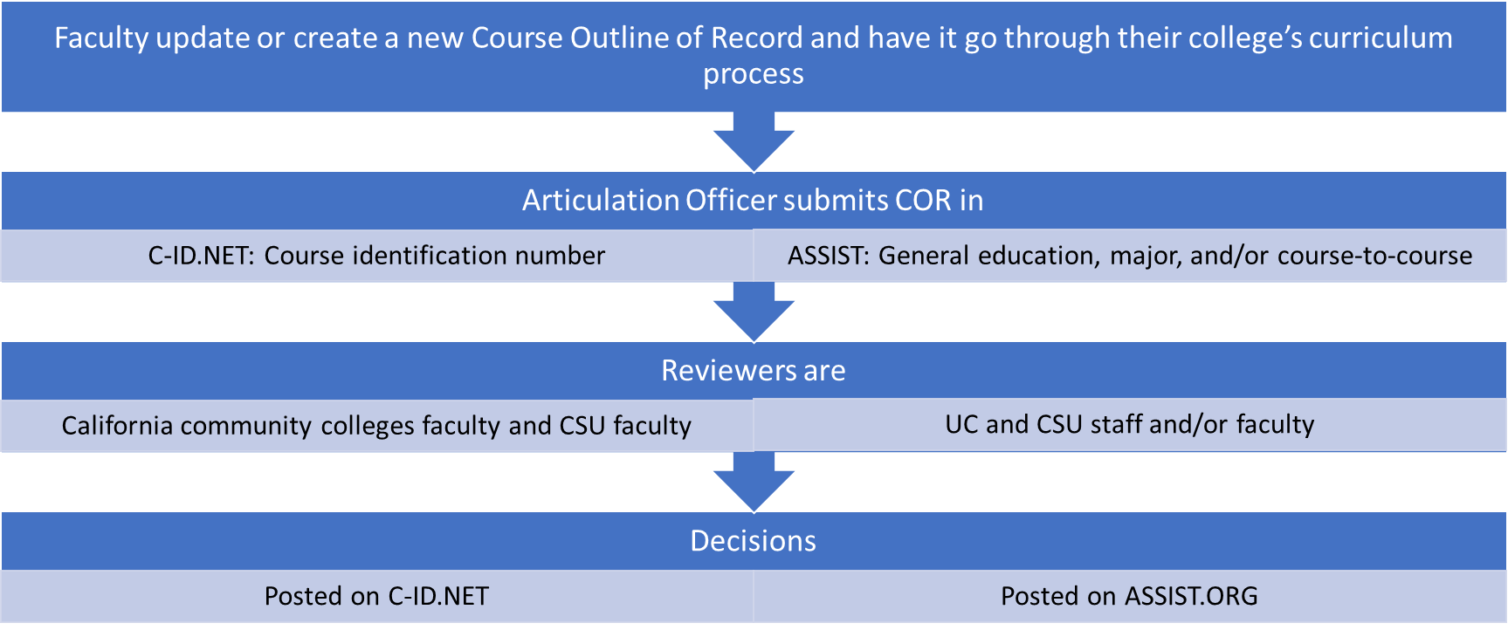
C-ID and ASSIST
Articulation Process
Reviewers are California community colleges faculty and CSU faculty
Approved courses are posted on C-ID.NET

Slide 11
Faculty-driven supra-numbering system started in 2007 to ease transfer and articulation
Served as the mechanism to identify comparable courses between California community colleges and also with the universities
Course Outlines of Record (COR) reviewed for determination of comparable, not identical
Descriptor designations (subject code and number) do not replace local course numbering but are included in the the course description
Vetted broadly via intersegmental discipline faculty
CORs are reviewed every 5 years by the Faculty Discipline Review Group (FDRG)
Predates Transfer Model Curricula (TMCs) and Associate Degrees for Transfer (ADTs)
After AB 1440 (Padilla, 2010) was passed, C-ID structure and processes were leveraged to facilitate development of TMCs, the template and structure for ADTs
Data
57 disciplines with descriptors
464 finalized descriptors

Slide 12
Components of a C-ID Course Descriptor
C-ID Number
Course description
Units
Prerequisites or co-requisites
Advisories on Recommended Preparation
Course-content, lecture and lab are separated where applicable
Course objectives
Evaluation methods
Sample textbooks

Slide 13
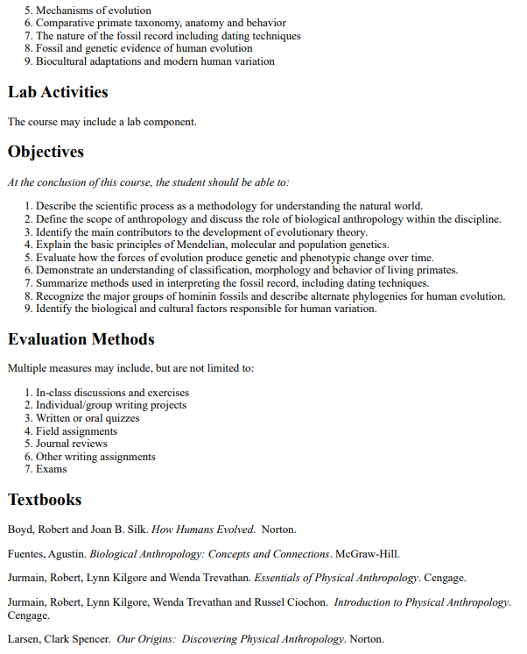
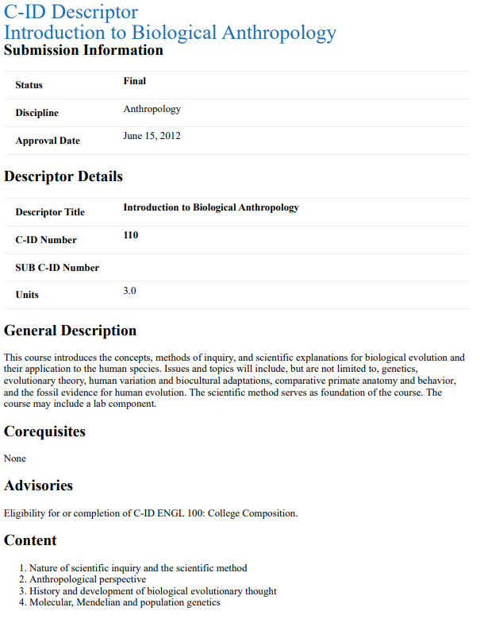
Example of C-ID Descriptor

Slide 14
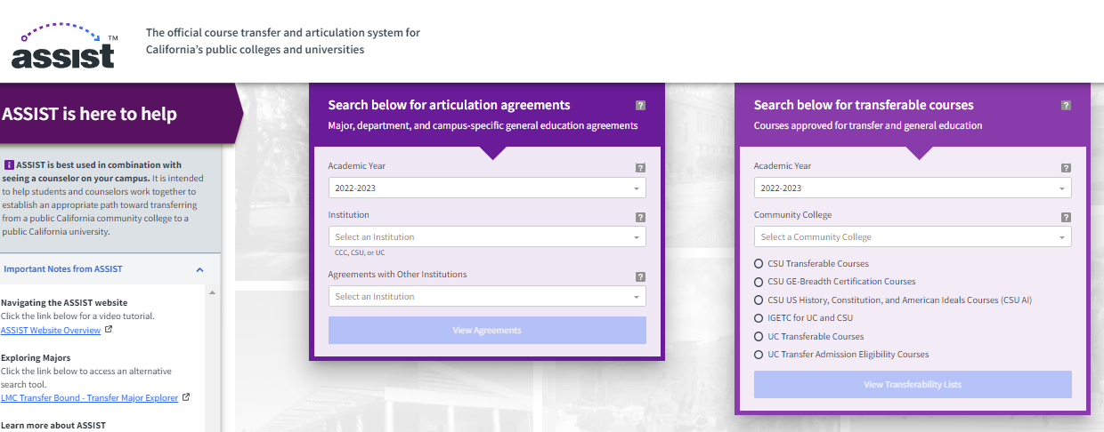
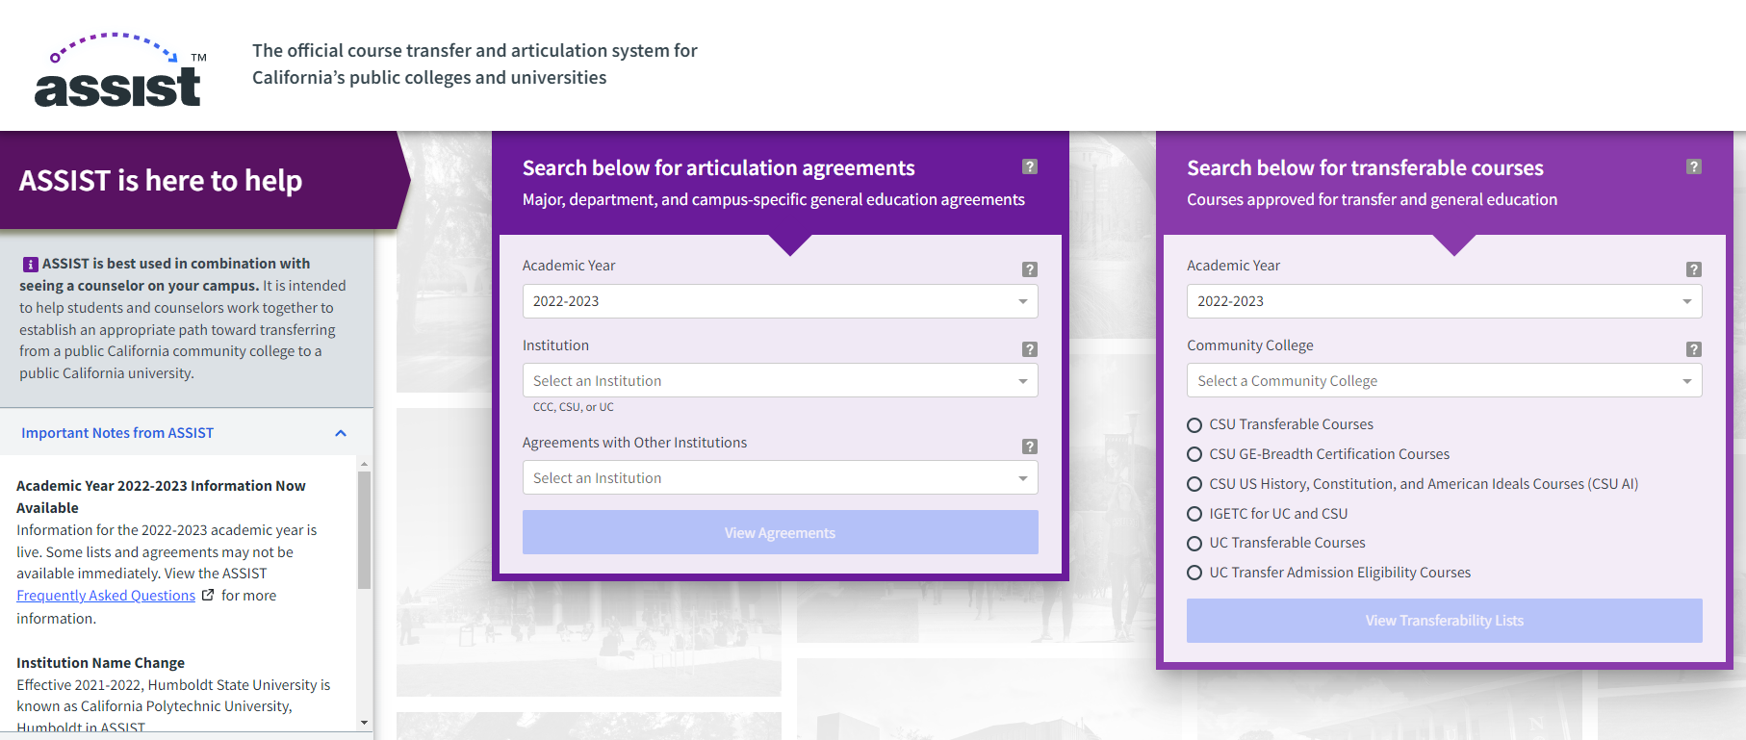
ASSIST.ORG
The official course transfer and articulation system for California’s public colleges and universities.
Started in 1985 with funding from the California State Legislature.
Coming soon: Association of Independent California Colleges and Universities (AICCU)
530, 165 agreements pulled per month
50,781 transfer lists pulled per month

Slide 15
Example of General Education

Slide 16
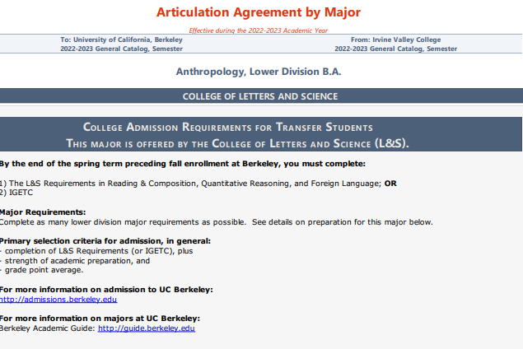
Example of Major Articulation

Slide 17
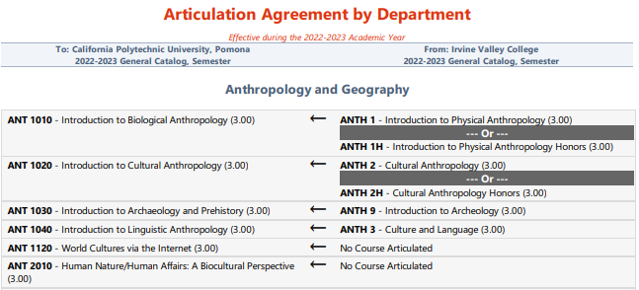
Example of Course-to-Course Agreement

Slide 18
Common Course Numbering
Using C-ID and ASSIST

Slide 19
Implementation Discussion

Slide 20
Curricular Alignment
What COR elements should be used to determine “common” ?
C-ID descriptors include title, number, units (minimum), general description, pre-reqs/co-reqs/advisories, content, lab activities, objectives, evaluation methods, textbooks
Minimum?
Comparable or Identical?
Principle: Common course numbering, not common curriculum. Agree? Disagree?

Slide 21
Curricular CCN Processes
Curriculum Adoption Processes
What should timeline for initial implementation look like?
How should implementation be phased in?
Curriculum Revision Processes
How should updates be proposed and processed as a system?
How do we ensure that colleges implement revisions?
Should college self-certify? Should it be part of annual curriculum certification?
Set amount of time for colleges to align w/ descriptors?
How often should CCN COR elements be reviewed?
Align with C-ID? Use a 5-year cycle similar to ADTs?

Slide 22
Tech System Needs & Requirements
What financial and technical support will colleges need?
Should there be a centralized common curriculum system & CCN descriptor repository? Or local systems + COCI?
What capabilities should the CCN repository have?

Slide 23
CCN System Governance & Oversight
What should system governance structure look like?
Faculty driven?
Subcommittee of 5C?
Similar to C-ID?
Other ideas?
How might system governance needs & structure differ from CCN curricular leadership & oversight?

Slide 24
Intersegmental Articulation
Should GE be articulated at system level?
Could CSU and UC GE approval/articulation be based on CCN descriptors w/ minimum amount of common content?
What additional elements would be needed in descriptors?

Slide 25
Communication
What communication will be needed
for system stakeholders?
for local faculty and staff?
for students?
How should communications occur?

Slide 26
What else?
Thoughts?
Questions?
Concerns?
Ideas?

Slide 27
Questions?
Thank you!
info@asccc.org

